Slide 1
📊 CREDIT CARD TRANSACTION DASHBOARD
(Power BI | SQL | DAX)

Slide 2
CREDIT CARD TRANSACTIONS
Power BI Financial Dashboard
📅 Weekly, Quarterly & YTD Analysis
📊 Real-Time Business Insights
  Prepared By:
  Lomada Siva Gangi Reddy
  B.Tech CSE (Data Science), RGMCET
  Aspiring Data Analyst

Slide 3
Agenda
Presentation Outline
  Project Overview & Objective
  Data Source & Database Design
  SQL Data Loading Process
  Data Modeling in Power BI
  DAX Measures & Calculations
  Dashboard Overview
  Weekly & YTD Insights
  Business Impact
  Export, Sharing & Future Scope

Slide 4
Project Overview
End-to-end Credit Card Transaction Analytics Project
Built using SQL, Power BI, and DAX
Designed to analyze:
  Revenue & transactions
  Customer behavior
  Card & regional performance
  Risk & activation metrics

Slide 5
🎯 Project Objective
Develop a comprehensive credit card dashboard
Provide real-time insights into key KPIs
Enable:
  Weekly performance tracking
  Quarterly & YTD analysis
  Data-driven decision making

Slide 6
🛠 Technology Stack
Power BI – Visualization & dashboards
SQL (MySQL) – Data storage & querying
DAX – KPIs & time intelligence
CSV Files – Raw data source
Power BI Service – Publishing & sharing

Slide 7
📂 Data Source
Data stored in SQL Database
Imported from CSV files
Two main tables:
  cc_details – Credit card transactions
  cust_details – Customer demographics
🔗 GitHub Repository:
https://github.com/shivareddy2002/Credit_Card_Transaction_Report

Slide 8
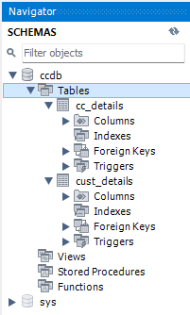
🧱 Database Schema
Database Schema Overview
Structured relational database design
Two primary tables:
  cust_details – Customer information
  cc_details – Credit card transaction data
One-to-Many relationship between customer and transactions.
Tables linked using Client_Num.
Optimized for analytical and time-based queries.

Slide 9
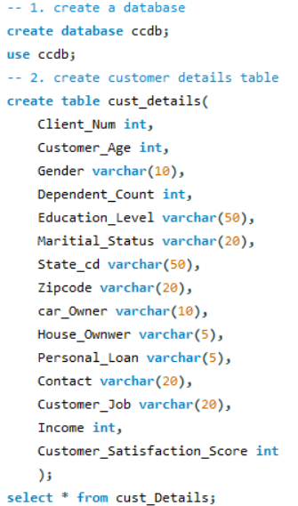
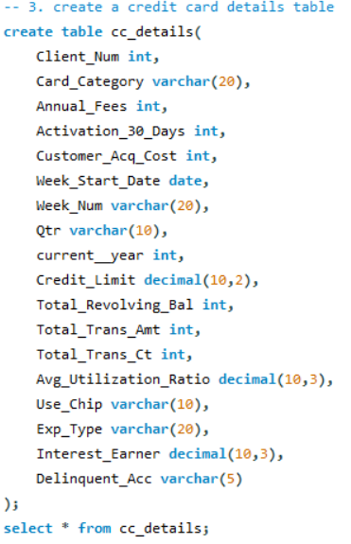
🔄 SQL – Data Loading Process
Import Data into SQL
Steps Followed:
  Prepared CSV files
  Created SQL tables
  Loaded data using LOAD DATA INFILE
  Validated row counts & data types

Slide 10
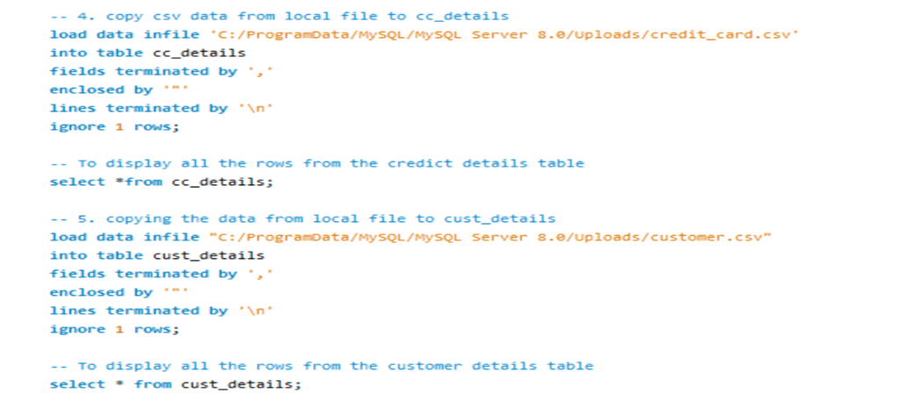
Copying CSV data into MySQL

Slide 11
🔗 Data Modeling in Power BI
Data Modeling
  Connected Power BI to SQL database
  Created relationships between tables
  Cleaned & transformed data
  Optimized model for performance

Slide 12
🧮 DAX – Customer Segmentation
Age Groups
  (20–30), (30–40), (40–50), (50–60), (60+)
Income Groups
  Low (< 35K)
  Medium (35K–70K)
  High (> 70K)
Helps analyze customer behavior & spending patterns

Slide 13
📈 DAX – Revenue & Time Intelligence
Revenue = Annual Fees + Transaction Amount + Interest Earned
Time Intelligence Measures
  Current Week Revenue
  Previous Week Revenue
  Week-over-Week (WoW) Comparison

Slide 14
📊 Power BI Dashboard Overview
Interactive & dynamic visuals
Slicers for :
  Week / Quarter
  Card Category
  Gender
  Income Group
  Transaction Type
Real-time KPI monitoring

Slide 15
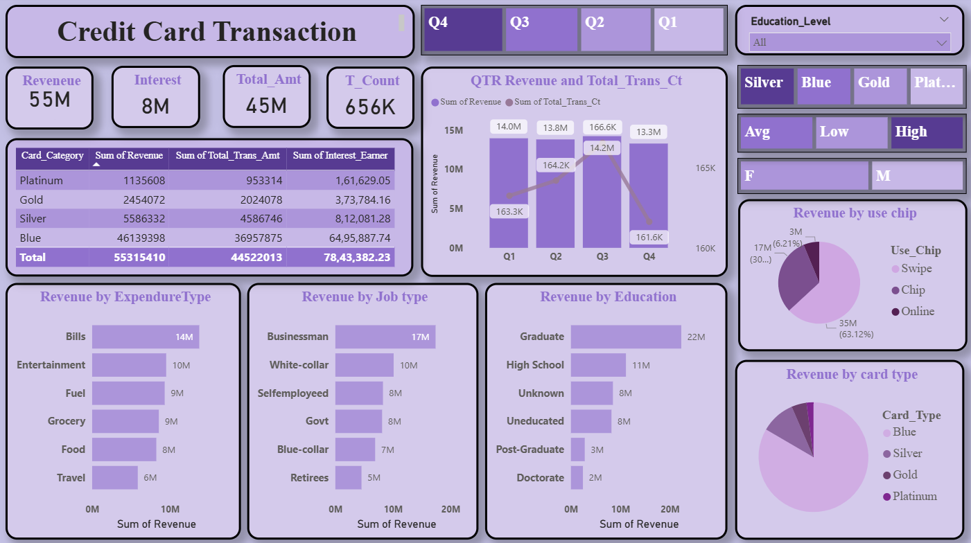
Credit Card Transaction Dashboard

Slide 16
📌 Key Performance Indicators
💰 Total Revenue: 55M
💳 Total Transaction Amount: 46M
🔢 Transaction Count: 656K
💸 Interest Earned: 8M
👥 Customer Count
⚠️ Delinquent Rate: 6.06%
✅ Activation Rate: 57.5%

Slide 17
📈 Year-to-Date (YTD) Insights
Overall Performance (YTD)
  💰 Total Revenue: 57M
  💳 Total Transaction Amount: 46M
  💸 Total Interest: 8M
  👨 Male Revenue: 31M
  👩 Female Revenue: 26M

Slide 18
Card & Regional Insights
🏦 Card Category Analysis
Blue & Silver cards → ~93% of transactions
🌍 Regional Contribution
TX, NY & CA → ~68% of total revenue

Slide 19
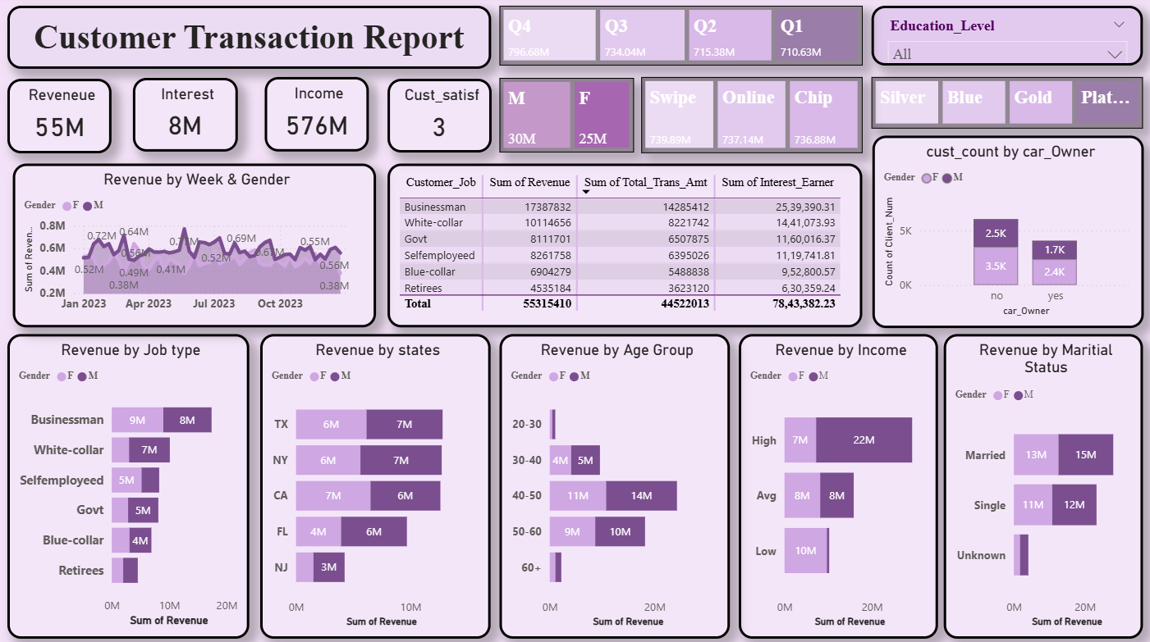
Customer Transaction Report

Slide 20
⚠️ Risk & Activation Metrics
Operational Metrics
  ✅ Activation Rate: 57.5%
  ❌ Delinquent Rate: 6.06%
  ➡ Useful for risk monitoring & customer engagement

Slide 21
💡 Business Value
Real-time KPI monitoring
Faster financial decision making
Identifies:
  High-performing cards
  High-value regions
  Risky customer segments
Supports strategic planning

Slide 22
📤 Export & Distribution
Exported as:
  PDF reports
  Power BI Service dashboards
Used for:
  Weekly review meetings
  Business & strategy discussions

Slide 23
🚀 Future Enhancements
Future Scope
  Revenue forecasting
  Delinquency prediction
  Automated refresh via Power BI Service
  Customer-level drill-through analysis
  Machine Learning integration

Slide 24
✅ Conclusion
Successfully built a Credit Card Transaction Dashboard
Delivered actionable insights using:
  SQL
  Power BI
  DAX
Demonstrates strong Data Analytics & BI skills

Slide 25
💻 GitHub Repository
Contains complete project source code
Includes:
  SQL table creation & data loading scripts
  DAX measures & calculations
  Project documentation & README
Useful for:
  Code review
  Technical validation
  Reusability & learning
🔗 GitHub Link:
https://github.com/shivareddy2002/Credit_Card_Transaction_Report

Slide 26
📁 Google Drive – Project Assets
Contains Power BI dashboard files
Includes:
  .pbix report
  Dashboard screenshots
  Exported PDF reports
Used for:
  Project demonstrations
  Stakeholder presentations
  Easy sharing & access
🔗 Google Drive Link:
https://drive.google.com/drive/folders/1YSSy2iV1EUN50Yyfj53jRacoqx3Kx3rV

Slide 27
👨‍💻 About the Author
Lomada Siva Gangi Reddy
  🎓 B.Tech CSE (Data Science), RGMCET (2021–2025)
  💡 Interests: Python | Machine Learning | Deep Learning | Data Science
  📍 Open to “Internships & Job Offers”
  📧 Email : lomadasivagangireddy3@gmail.com
  📞 Phone : 9346493592
  🔗 LinkedIn: https://www.linkedin.com/in/lomada-siva-gangi-reddy-a64197280/
  💻 GitHub: https://github.com/shivareddy2002
  🌐 Portfolio: https://lsgr-portfolio-pulse.lovable.app/

