Slide 1
Factory Method Design Pattern

Slide 2
Introduction
Factory Method pattern comes under “Creational Design Patterns”
A Factory Pattern or Factory Method Pattern defines an interface or abstract class for creating an object but subclasses will decide which class to instantiate

Slide 3
Introduction (contd..)
In Factory pattern, we create object without exposing the creation logic to the client and refer to newly created object using a common interface

Slide 4
Advantages
Factory Method Pattern allows the sub-classes to choose the type of objects to create
Factory pattern can also be used to hide information related to creation of object
It promotes the loose-coupling by eliminating the need to bind application-specific classes into the code

Slide 5
Usage
When a class doesn't know what sub-classes will be required to create
Where we have to create an object of any one of the sub-classes depending on the data provided

Slide 6
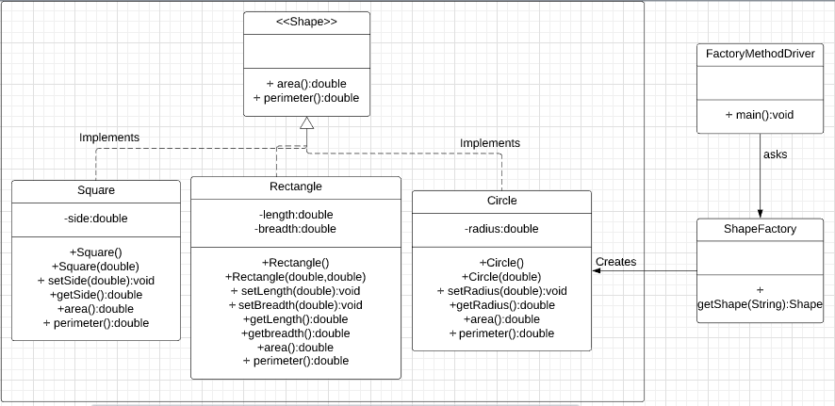
Implementation

Slide 7
References:
https://javarevisited.blogspot.com/2011/12/factory-design-pattern-java-example.html
https://www.tutorialspoint.com/design_pattern/factory_pattern.htm
https://www.javatpoint.com/factory-method-design-pattern

