Slide 2
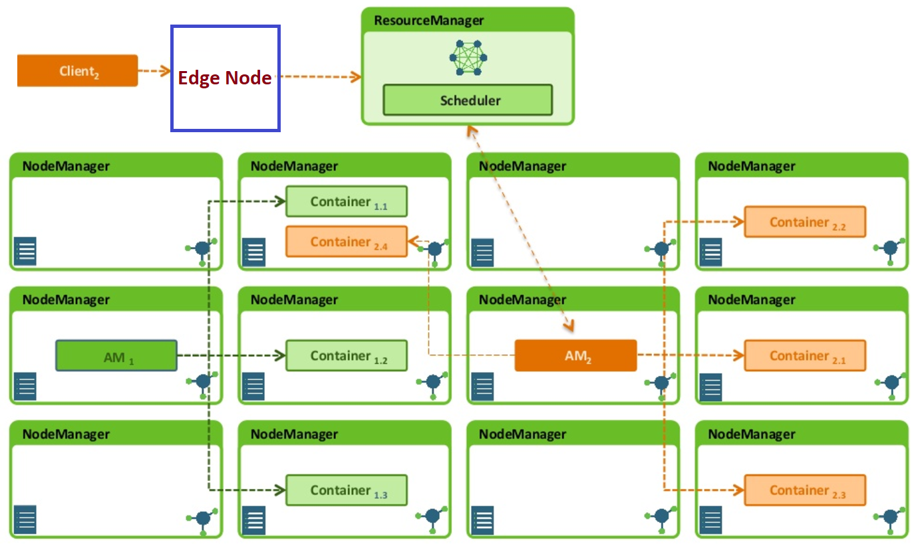
Masters -- HDFS NameNode, YARN ResourceManager, and HBase Master.
Slaves -- HDFS DataNodes, YARN NodeManagers, and HBase RegionServers. The DataNodes, NodeManagers, and HBase RegionServers are co-located or co-deployed for optimal data locality.

Slide 3
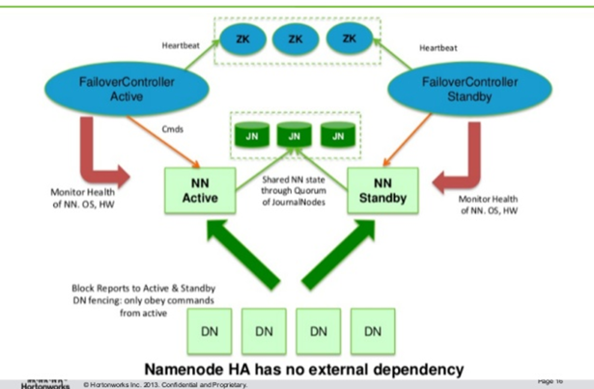

Slide 4
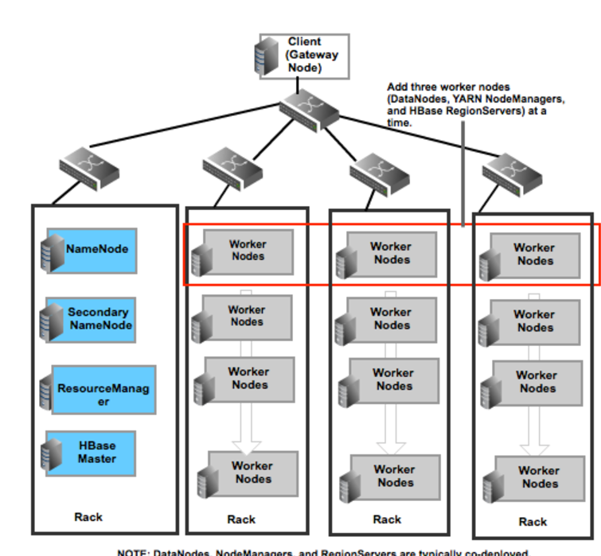

Slide 5
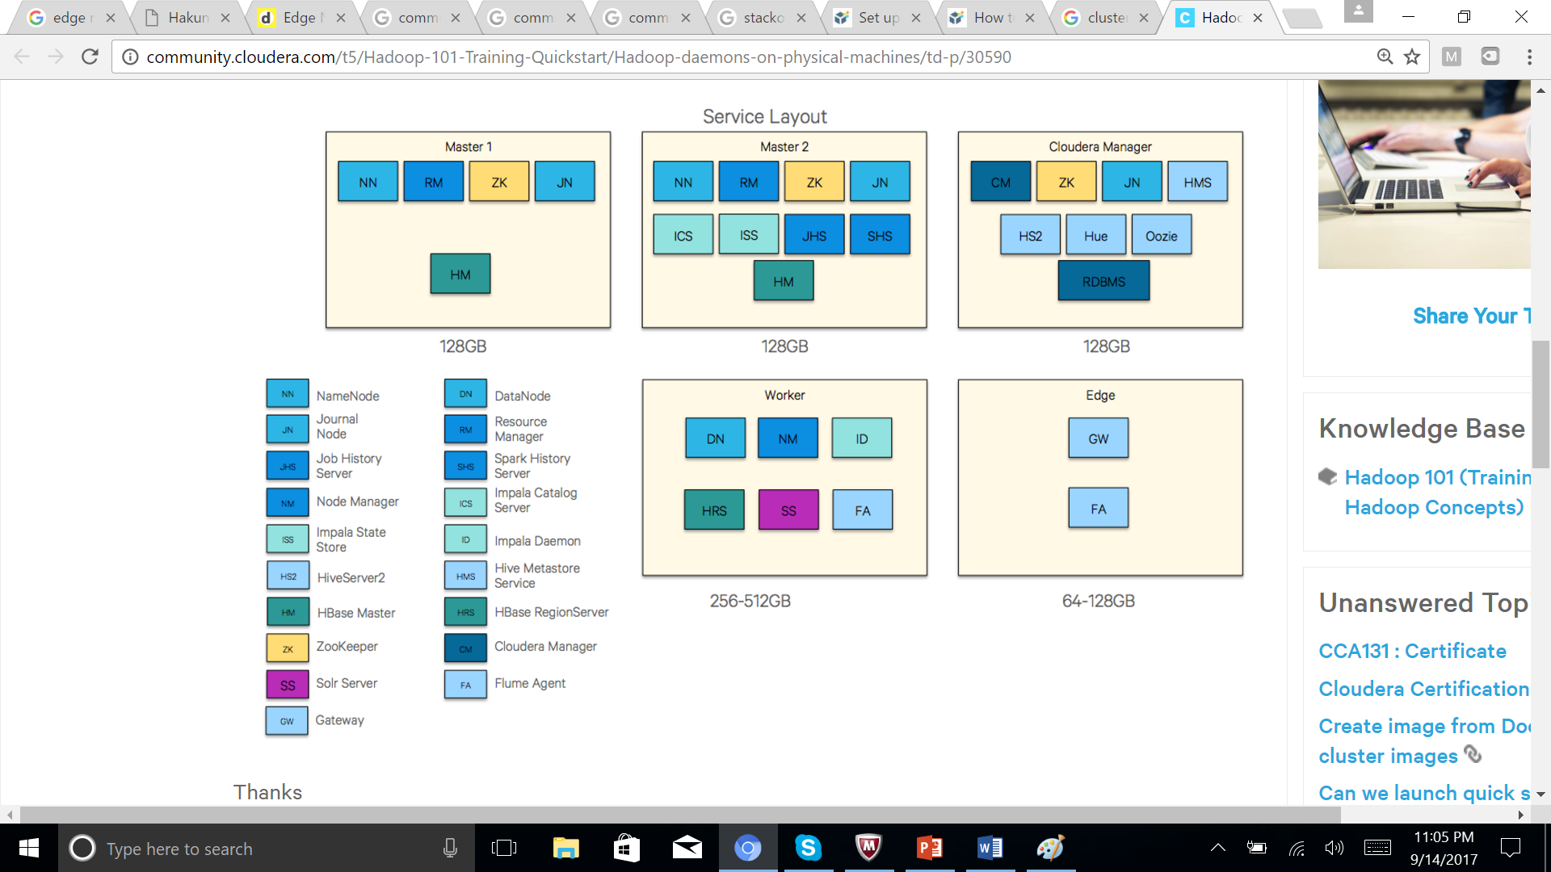

Slide 6
EdgeNode or a GatewayNode. Gateway nodes are the interface between the Hadoop cluster and the outside network. Edge nodes are used to run client applications and cluster administration tools.
The edge node does not have to be part of the cluster.

Slide 7
Does the edge node a part of the cluster (What advantages do we have if it is inside the cluster . Does it store any blocks of data in hdfs.
Should the edge node be outside the cluster .
--
Edge nodes in a Hadoop cluster are typically nodes that are responsible for running the client-side operations of a Hadoop cluster.
Typically edge-nodes are kept separate from the nodes that contain Hadoop services such as HDFS, MapReduce, etc, mainly to keep computing resources separate

Slide 8
Note that running master and slave Hadoop services on the same node is not an ideal setup, and can cause scaling and resource issues depending on what's at use. This kind of configuration is typically seen on a small-scale dev environment.
Does the edge node have to be part of the cluster The edge node does not have to be part of the cluster, however if it is outside of the cluster (meaning it doesn't have any specific Hadoop service roles running on it), it will need some basic pieces such as Hadoop binaries and current Hadoop cluster config files to submit jobs on the cluster.

Slide 9
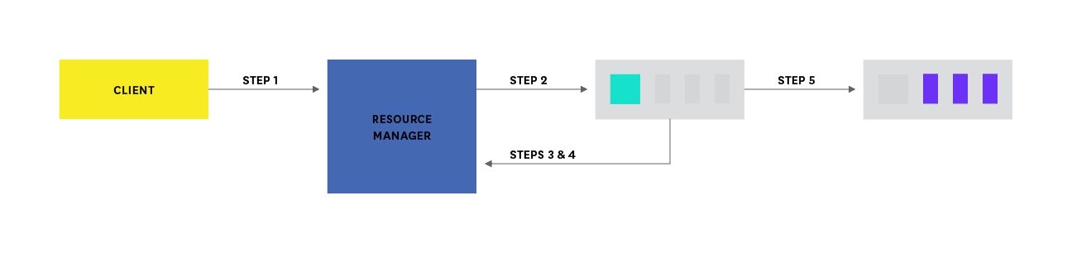

Slide 10
Client program submits the MapReduce application to the ResourceManager, along with information to launch the application-specific ApplicationMaster.
ResourceManager negotiates a container for the ApplicationMaster and launches the ApplicationMaster.
ApplicationMaster boots and registers with the ResourceManager, allowing the original calling client to interface directly with the ApplicationMaster.
ApplicationMaster negotiates resources (resource containers) for client application.
ApplicationMaster gives the container launch specification to the NodeManager, which launches a container for the application.
During execution, client polls ApplicationMaster for application status and progress.
Upon completion, ApplicationMaster deregisters with the ResourceManager and shuts down, returning its containers to the resource pool.

