Slide 1
Wikipedia Definitions
Predictive analytics is an area of statistical analysis that deals with extracting information from data and uses it to predict future trends and behavior patterns.
The core of predictive analytics relies on capturing relationships between explanatory variables and the predicted variables from past occurrences, and exploiting it to predict future outcomes.

Slide 2
Steps of Data Exploration and Preparation
Quality of your inputs decide the quality of your output.
Below are the steps involved to understand, clean and prepare your data for building your predictive model:
Variable Identification
Missing values treatment
Outlier treatment
Variable transformation
Variable creation
https://www.analyticsvidhya.com/blog/2016/01/guide-data-exploration/

Slide 3
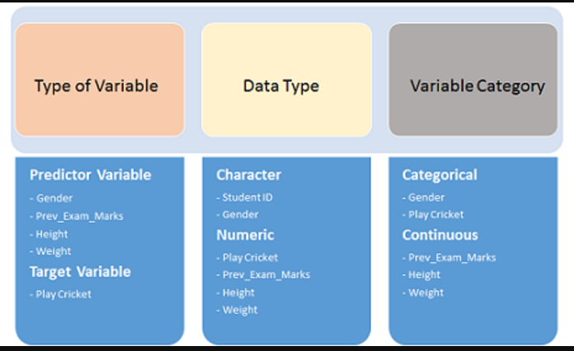

Slide 4
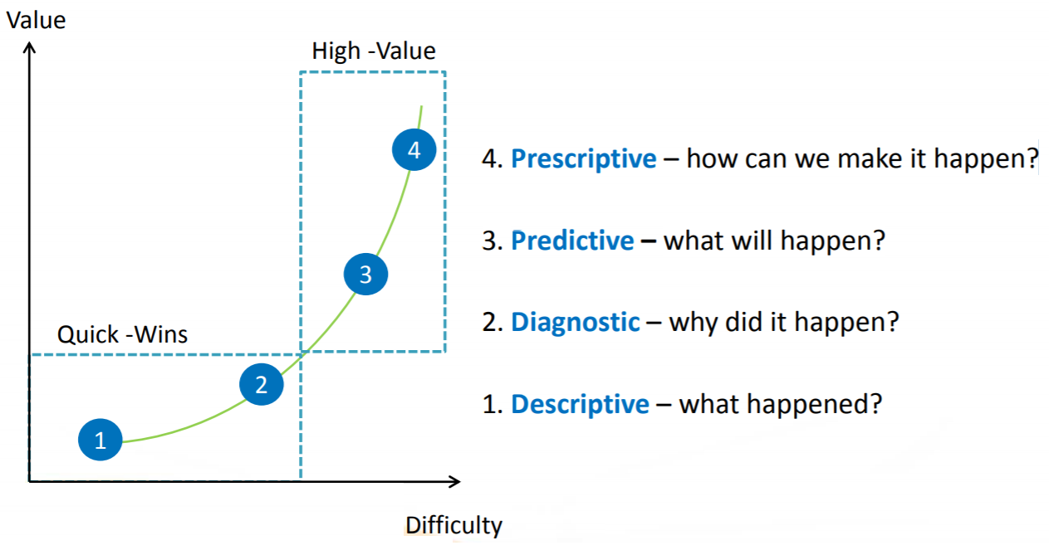

Slide 5
Common Predictive Analytics Methods
  Regression:
    Predicting output variable using its cause-effect relationship with input variables. OLS Regression, GLM, Random forests, ANN etc.
  Classification:
    Predicting the item class. Decision Tree, Logistic Regression, ANN, SVM, Naïve Bayes classifier etc.
  Time Series Forecasting:
    Predicting future time events given past history. AR, MA, ARIMA, Triple Exponential Smoothing, Holt-Winters etc.

Slide 6
  Association rule mining:
  Mining items occurring together. Apriori Algorithm.
  Clustering:
  Finding natural groups or clusters in the data. K-means, Hierarchical, Spectral, Density based EM algorithm Clustering etc.
  Text mining:
  Model and structure the information content of textual sources. Sentiment Analysis, NLP

Slide 7
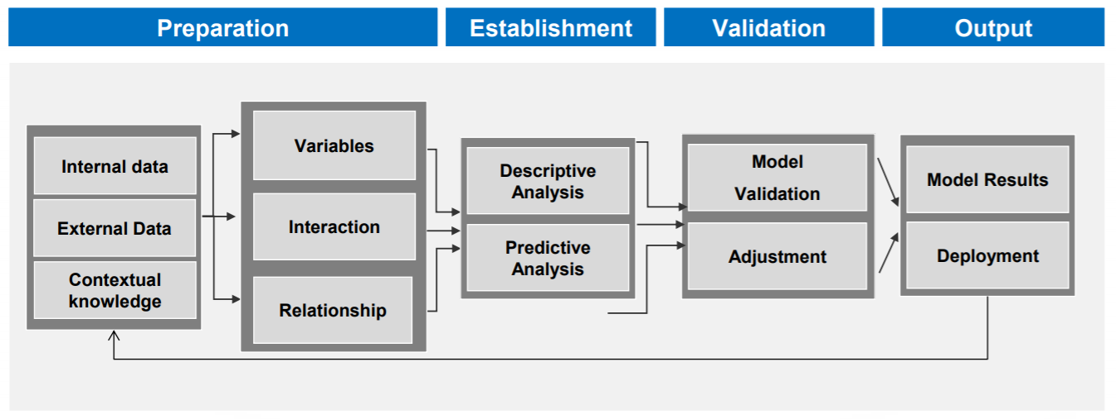

Slide 8
