Slide 1
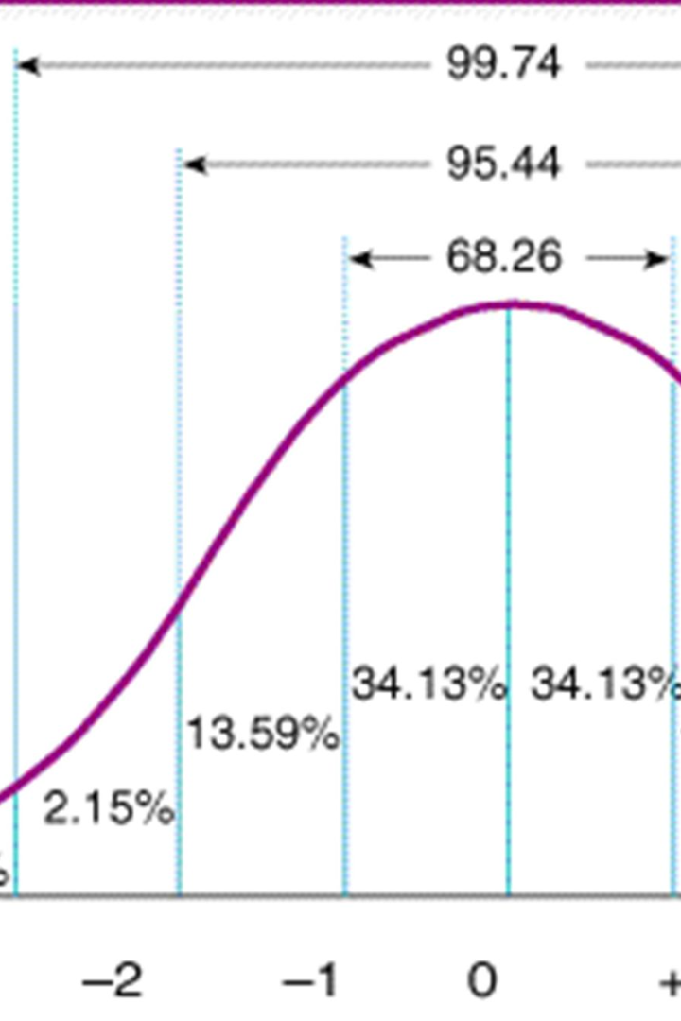
Normal Distribution
Explore the fascinating world of normal distribution and its applications in statistics, quality control, financial analysis, and more.

Slide 2
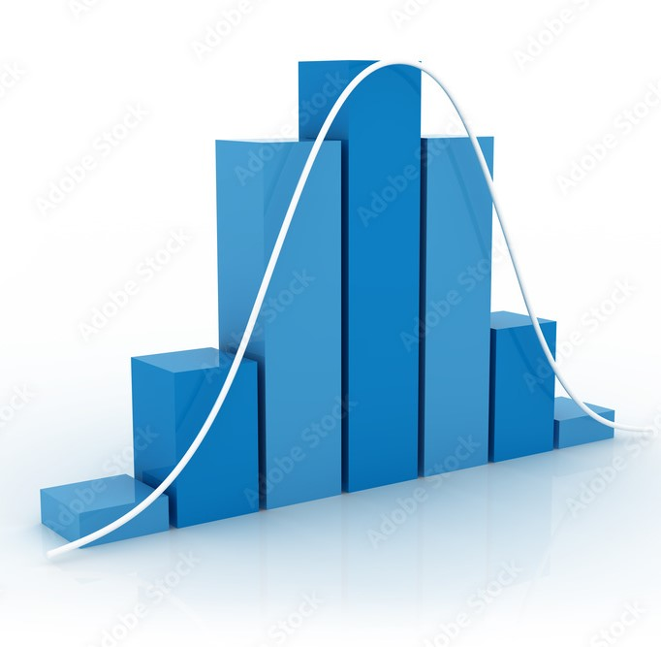
Definition and Explanation
A statistical model representing a symmetrical, bell-shaped curve that describes the probability distribution of a continuous random variable where most occurrences cluster around the mean, showcasing common natural phenomena and variability in a population.

Slide 3

Characteristics
Explore the symmetry and bell-shaped curve of normal distribution. Learn about the standard deviation and the 68-95-99.7 rule.

Slide 4

Applications
1. Finance/Economics: Normal distribution models stock prices and asset returns, crucial for options pricing like Black-Scholes.
2. Quality Control: Helps ensure product consistency by analyzing variations in dimensions like height or weight in manufactured items.
3. Biological Measurements: Applies to traits like height, weight, blood pressure, and IQ scores in populations, following a bell curve.
4. Psychology/Sociology: Describes human behaviors, test scores, and errors in measurements or perceptions through a normal distribution.
5. Natural Phenomena: Models errors in measurements, noise in signals, and physical measurements like star brightness.
6. Demographics/Social Sciences: Describes income, education, and population characteristics distribution patterns.
7. Health Sciences: Applies to medical parameters like cholesterol, blood sugar, and various measurements in populations.

Slide 5
Limitations
Dive into the assumptions and limitations of normal distribution. Identify scenarios where normal distribution may not be applicable.
Assumption of Symmetry: It assumes perfect symmetry around the mean, which might not hold true for many real-world datasets that exhibit skewness or asymmetry.
Finite Tails: The tails of the normal distribution extend infinitely, which might not accurately represent scenarios where extreme events occur more frequently than predicted by the normal distribution (fat-tailed distributions).
Not Universally Applicable: While it applies to many natural phenomena, some real-world data might not conform to a normal distribution, leading to inaccurate predictions if forced into a normal model.

Slide 6

Conclusion
Despite its widespread applicability in various fields, it's important to recognize that while the normal distribution serves as a valuable model for many natural phenomena, its assumptions and limitations remind us to exercise caution in assuming a 'one-size-fits-all' approach. Acknowledging its strengths and weaknesses allows for more informed and precise analyses when dealing with real-world data.

