Slide 1


Delving into AR and VR: A Look into the Future
This presentation will explore the world of augmented reality (AR) and virtual reality (VR), their key differences, their current applications, and their potential future impact on our lives.
by Shiva sai Jakkoju

Slide 2
Understanding the Difference: AR vs. VR
Augmented Reality (AR)
Virtual Reality (VR)
AR overlays digital elements onto the real world. Imagine seeing a virtual map superimposed on your view of a city street.
VR immerses users in a completely computer-generated environment. Think of putting on a headset and being transported to a virtual world.

Slide 3
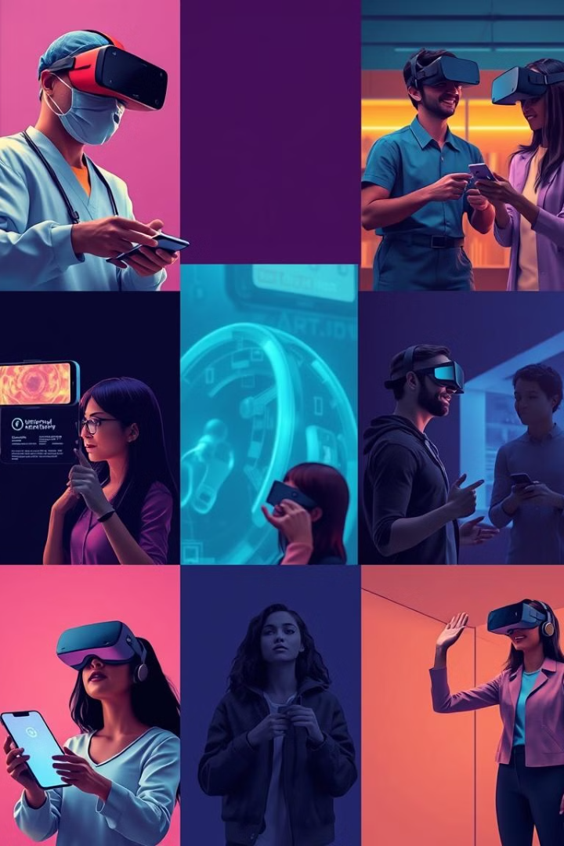
The Applications of AR and VR
Gaming
Education
AR and VR have revolutionized gaming, offering immersive experiences, interactive gameplay, and new possibilities.
AR and VR enhance learning through interactive simulations, virtual field trips, and personalized learning experiences.
Healthcare
Retail
AR and VR are used in medical training, surgical planning, and patient rehabilitation, improving medical outcomes.
AR allows customers to try on virtual clothes and accessories, while VR provides immersive shopping experiences.

Slide 4




The Future of AR and VR
1
Integration into Everyday Life
Enhanced Human Experiences
2
Imagine interacting with virtual assistants, receiving personalized information, and experiencing new forms of entertainment.
New Industries and Jobs
3
These technologies will lead to new industries and job opportunities in design, development, and application of AR and VR.
Technological Advancements
4
Expect advancements in hardware, software, and content creation to further enhance AR and VR experiences.

