Slide 1

Speech Coding at Low bit rates
Under the guidance of
Aparna P.
Assistant Professor
By
Shiva Sai Samboju(202SP023)

Slide 2
Contents
Introduction
Speech Production Model
Encoder
Decoder
Limitations
References

Slide 3
Introduction
Speech coding has been and still is a major issue in the area of digital speech processing.
It is a lossy type of coding.
Classifying based upon available techniques we get waveform coders and parametric coders.
One of the most successful parametric coders is Linear Predictive Coder.
There are many variants over the basic scheme: LPC-10, CELP, MELP, RELP, VSELP, ASELP, LD-CELP.

Slide 4
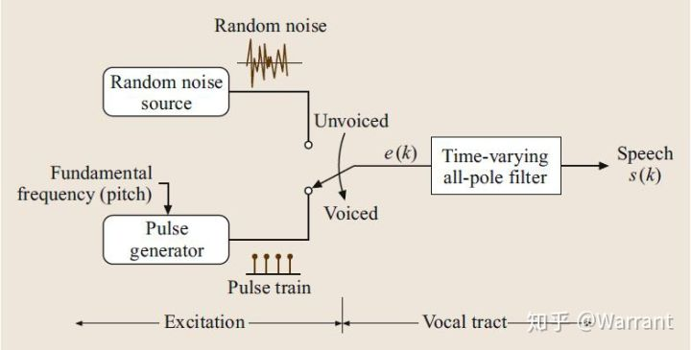
Speech Production Model
$\tilde{s}=\sum_{k=1}^{p}{a_{k}}s\left(n−k\right)$
$P\left(z\right)=\sum_{k=1}^{p}{a_{k}}z^{−k}$

Slide 5
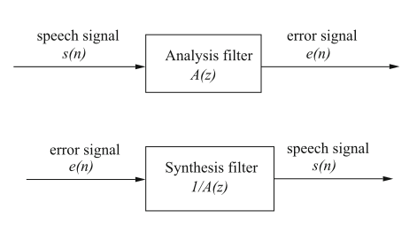
Prediction Error
$e\left(n\right)=s\left(n\right)−\tilde{s}\left(n\right)=s\left(n\right)−\sum_{k=1}^{p}{a_{k}}s\left(n−k\right)$
$A\left(z\right)=1+\sum_{k=1}^{p}{a_{k}}z^{−k}$
$\tilde{s}=\sum_{k=1}^{p}{a_{k}}s\left(n−k\right)$
$s_{w}\left(n\right)=s\left(n\right)w\left(n\right)$
$E_{p}=\sum_{n=−∞}^{∞}{e^{2}\left(n\right)}=\sum_{n=−∞}^{∞}{{\left(s_{w}\left(n\right)+\sum_{k=1}^{p}{a_{k}s_{w}\left(n−k\right)}\right)}^{2}}$
$\sum_{k=1}^{p}{a_{k}}\sum_{n=−∞}^{n=∞}{s_{w}}\left(n−i\right)s_{w}\left(n−k\right)=\sum_{n=−∞}^{n=∞}{s_{w}}\left(n−i\right)s_{w}\left(n\right)$
$\frac{∂E_{p}}{∂a_{k}}=0,1≤k≤p$

Slide 6
Autocorrelation Method
$R_{s}\left(i\right)=\sum_{n=−∞}^{∞}{s_{w}\left(n\right)s_{w}\left(n+i\right)},1≤i≤p$
$\sum_{k=1}^{p}{R_{s}\left(\left|i−k\right|\right)a_{k}}=−R_{s}\left(i\right),1≤i≤p$
$\left(\begin{matrix}R_{s}\left(0\right) & R_{s}\left(1\right) & ..R_{s}\left(p−1\right) \\ R_{s}\left(1\right) & R_{s}\left(0\right) & ..R_{s}\left(p−2\right) \\ . & . & . \\ . & . & . \\ R_{s}\left(p−1\right) & R_{s}\left(p−2\right) & R_{s}\left(0\right)\end{matrix}\right)\left(\begin{matrix}a_{1} \\ a_{2} \\ a_{3} \\ . \\ . \\ . \\ a_{p}\end{matrix}\right)=\left(\begin{matrix}R_{s}\left(1\right) \\ R_{s}\left(2\right) \\ R_{s}\left(3\right) \\ . \\ . \\ . \\ R_{s}\left(p\right)\end{matrix}\right)$

Slide 7
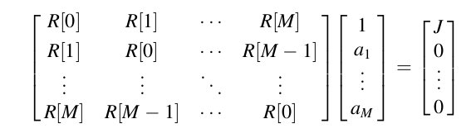






Levinsons Durbin Algorithm

Slide 8
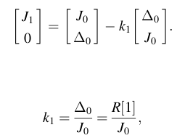



Slide 9
Speech Model Parameters
Estimating the parameters is the responsibility of the encoder.
The decoder takes the estimated parameters and uses the speech production model to synthesize speech.

Slide 10
Phase Information
The approach throws away all phase information of the original waveform, preserving only the magnitude of the frequency spectrum.
The synthetic waveform sounds like the original because, for a human listener, phase has a relatively lower rank than magnitude information.

Slide 11
Pitch Period Estimation
The time between successive vocal cord openings is called the fundamental period, or pitch period.

Slide 12
Pitch Estimation
The Autocorrelation Method
$R\left[l,m\right]=\sum_{n=m−N+1}^{m}{s}\left[n\right]s\left[n−l\right]$
By calculating the autocorrelation values for the entire range of lag, it is possible to find the value of lag associated with the highest autocorrelation representing the pitch period estimate.
Maximum pitch value range is 198,so we need atleast 8 bits for each frame.

Slide 13
Voicing Detector
Purpose: classify a given frame as voiced or unvoiced.
The boundary between V/UV is not always clear: this happens for transition frames, where the signal goes from voiced to unvoiced or vice versa.

Slide 14
Voicing Detector
The zero crossing rate of the frame ending at time instant m is defined by:
$ZCR=\frac{1}{2}\sum_{n=m−N+1}^{m}{\left|sgn\left(s\left[n\right]\right)−sgn\left(s\left[n−1\right]\right)\right|}$
For voiced speech, the zero crossing rate is relatively low due to the presence of the pitch frequency component (of low-frequency nature)
For unvoiced speech, the zero crossing rate is high due to the noise-like appearance of the signal with a large portion of energy in the high-frequency region.

Slide 15
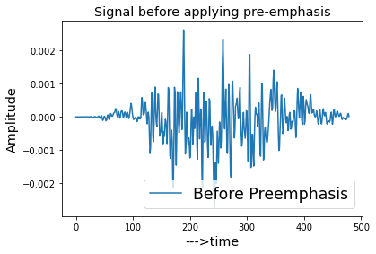
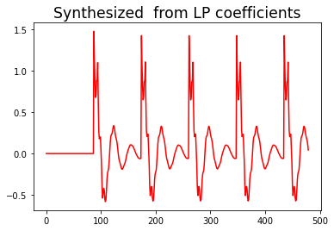
LPC Coding: Voiced Example
Voiced Frame:
480 samples

Slide 16
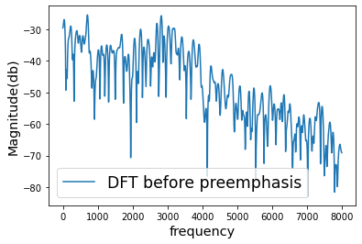
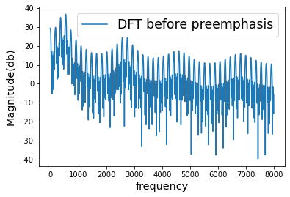
Voiced Example
For the original signal, the structure of the harmonics looks more irregular and randomized, while for the synthetic case, a more regular structure appears.
Original
Synthetic

Slide 17
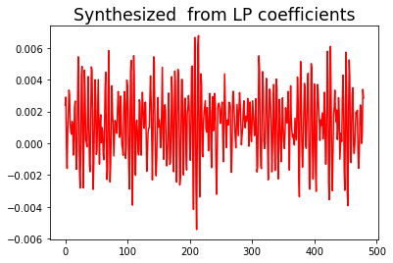
LPC Coding: Unvoiced Example
Unvoiced frame having 480 samples:

Slide 18
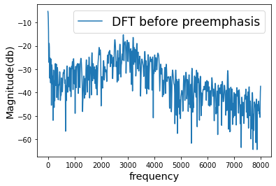
Unvoiced Example:
Power Spectrum Envelope
Left: Original Right: synthetic Plots of power spectrum for an unvoiced frame

Slide 19
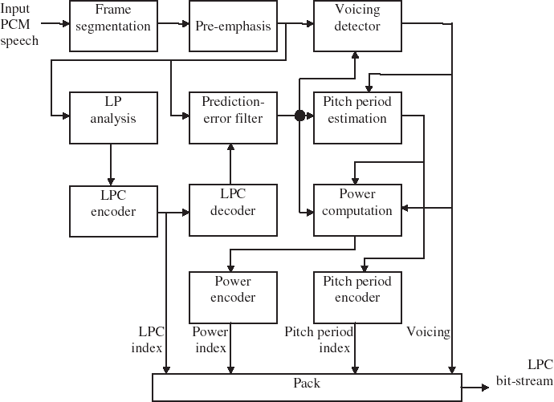
LPC Encoder

Slide 20
LPC Encoder Structure
The input speech is segmented into non-overlapping frames.
A pre-emphasis filter is used to adjust the spectrum of the signal.
The voicing detector classifies the current frame as voiced or unvoiced and outputs one bit indicating the voicing state.
The pre-emphasized signal is used for LP analysis, where ten LPC coefficients are derived.
These coefficients are quantized with the indices transmitted as information of the frame.
The quantized LPCs are used to build the prediction-error filter, which filters the pre-emphasized speech to obtain the prediction-error signal at its output.
Pitch period is estimated from the prediction-error signal if the frame is voiced.

Slide 21
Pre-Emphasis
Typical spectral envelope of speech signal has a high frequency attenuation due to radiation effects of the sound from the lips: high- frequency components have relatively low amplitude - this increases the dynamic range of the speech spectrum.
One simple solution is to process the speech signal using the filter which is high-pass in nature.The purpose is to increase the energy of the high-frequency spectrum. The effect of the filter can also be thought of as a flattening process, where the spectrum is ‘‘whitened.’’

Slide 22
Power Calculation
Power of the prediction-error sequence is different for voiced and unvoiced frames.
For the unvoiced case, denoting the prediction-error sequence as (with N being the length of the frame):
$P=\frac{1}{N}\sum_{n=0}^{N−1}{e^{2}\left[n\right]}$
$g=\sqrt{P}$
For the voiced case, power is calculated using:
$P=\frac{1}{⌊N/T⌋T}\sum_{n=0}^{⌊N/T⌋T−1}{e^{2}\left[n\right]}$
$g=\sqrt{Tp}$

Slide 23
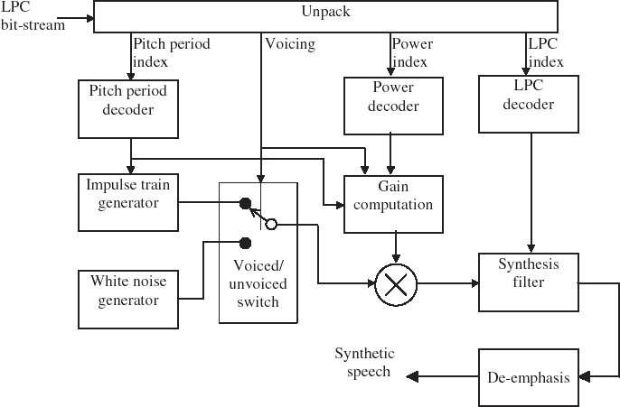
LPC Decoder

Slide 24
LPC Decoder Structure
The decoder is essentially the LPC model of speech production with parameters controlled by the bit-stream.
Gain computation is performed separately for Voiced and Unvoiced frames.
Finally, the output of the synthesis filter is de-emphasized to yield the synthetic speech.

Slide 25
Limitations
In many instances, a speech frame cannot be classified as strictly voiced or strictly unvoiced.
The use of strictly random noise or a strictly periodic impulse train as excitation does not match practical observations using real speech signals.
No phase information of the original signal is preserved.

Slide 26
References
[1] http://www.data-compression.com/speech.html
[2] M. H. Johnson and A. Alwan, "Speech Coding: Fundamentals and Applications", to appear as a chapter in the Encyclopedia of Telecommunications, Wiley, December 2002.
[3] http://www.ti.com/corp/docs
[4] http://www-mobile.ecs.soton.ac.uk
[5] L. R. Rabiner and B. H. Juang, Fundamentals of Speech Recognition. Englewood Cliffs, New Jersy: Prentice-Hall, 1993.
[6] L. R. Rabiner, Digital Signal Processing. IEEE Press, 1972.

