Slide 1
 |  | KA | Side Moving Deformable
Barrier 60 km/h (SUV Side Impact)
PT
fr
Crash PIC : | Some person
CAE Analyst : | Some other person
Simulation Path:
User input notes area

Slide 2
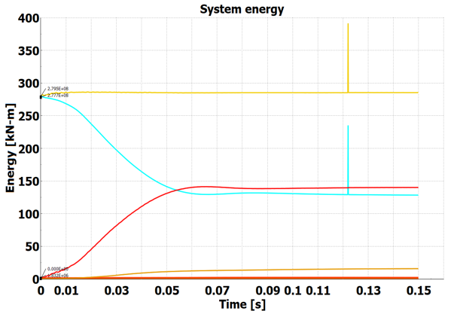
CAE quality check
Image 1
Energy | Max | Min
Property | Value
Image 2
Image 3

Slide 3
Executive Report
Image 1
Image 3
Image 2
Image 5
Image 6
SS 150ms | SS peak mm
 | SS peak time
Image 7
Image 8
Row 1 | Row 1
Area | 30ms | 40ms | 50ms | 60ms | 70ms | 80ms | Area | 30ms | 40ms | 50ms | 60ms | 70ms | 80ms
Image 4
Image 9
Image 10
Image 11
Image 12
Row 2 | Row 1
Area | 30ms | 40ms | 50ms | 60ms | 70ms | 80ms | Area | 30ms | 40ms | 50ms | 60ms | 70ms | 80ms
Some user note

Slide 4
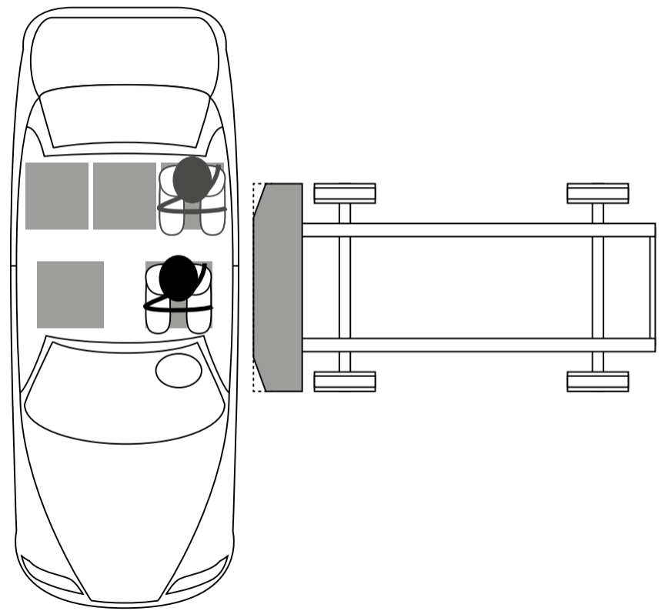
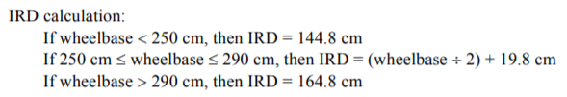
Set-up – CBU and barrier position
Impact Point
Image 3
Impact Location | Target
Wheelbase (mm) | 2890
Target Impact Pt (mm) | 793
CAE Impact PT (mm)
CAE delta (mm)
Impact Point from Front Wheel Axle
Image 3
 | Mass [kg]
TEST [Target]
Physical CAE mass
CAE-Added mass
MDB mass | 2006.4
Ground Planes | 216.0
Total CAE-CBU mass
Mass deviation
MDB to Suspension overlap
MDB Overlap (Struck Side Only)(Struck Side Only)
 | Target Overlap [mm] | CAE Overlap [mm] | CAE delta [mm]
Front | 103
Rear | 123
Impact Speed
Image 3
Target Speed [km/h] | CAE Speed [mm/s] / 277.77 = [km/h]
60
Some user input conclusion about impact point, mass, and initial speed

Slide 6
Set-up – Dummy position
Image 1
Row 1
Point | X | Y | Z
Row 2
Point | X | Y | Z
Some user input conclusion about dummy set

Slide 7
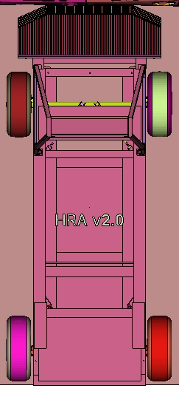
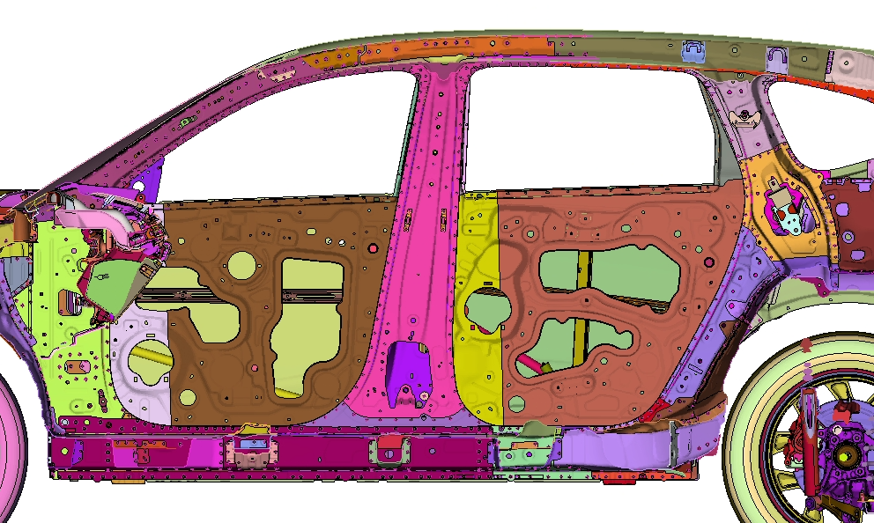
Body-In-White – Kinematics
Front view peak time step
Top view peak time step
Image 1
Image 2
A
F
C
B
D
E
Image 5
Image 6
A
B
Image 7
Image 8
C
D
Front view final time step
Top view final time step
Image 4
Image 3
Image 9
Image 10
F
E

Slide 8
Body-In-White – CBU deformation
CBU Outside Iso View [Peak Intrusion]
BIW Outside Iso View [Peak Intrusion-Plastic Strains]
Image 1
Image 2
Image 3

Slide 9
Bill of Materials - [F21 – UPB]
PID | Name | Material | Thickness
PID | Name | Material | Thickness
Image 1
Comp has X number of parts
PID | Name | Material | Thickness
Image 1
Comp has X number of parts

Slide 10
Body-In-White – Stiff ring deformation
Upper Body – Outer [Deformed-Peak Intrusion]
Upper Body – Outer [Un-Deformed-Peak Intrusion]
Image 2
Image 3
Image 6
Image 1
Upper Body – Inner [Deformed-Peak Intrusion]
Upper Body – Inner [Un-Deformed-Peak Intrusion]
Image 5
Image 4
Image 7

