Slide 1


Sri Krishna Arts and Science College
Coimbatore 641 008
Department of Software Systems
PROJECT PRESENTATION
TOPIC: TEXT SUMMARIZER AND CHATBOT USING LLM AND RAG
BY
Anupriya R
24MCS006
II – MSc Computer Science
Under the guidance :
Mrs . R. LALITHA MCA., M.Phil., SET.,
Assistant Professor

Slide 2
CONTENT
Abstract
Introduction
Objectives
Problem Identification and Methodology
Existing System- Limitations
Proposed system - Advantages
Flow Diagram
Result and Discussion
Conclusions
References

Slide 3
Problem: Digital content overload challenges efficient document processing and information retrieval
Solution: Developed RAG-powered system for multi-format document handling (PDF/DOCX/TXT)
Technology: Integrates FAISS, and LLM for intelligent processing
Features: Interactive chatbot with contextual document understanding
Interface: User-friendly Streamlit platform for document upload and queries
Impact: Enhanced document analysis efficiency for professional and academic use
ABSTRACT

Slide 4
INTRODUCTION
Document analysis and text summarization present growing challenges in the digital era
This project demonstrates an intelligent solution using RAG architecture and Mistral 7B LLM model
The system combines extractive and abstractive summarization for optimal results
Core features include natural query responses, multi-format document support, and contextual understanding
Built using cutting-edge technologies: FAISS for retrieval for embeddings
Streamlined implementation delivers efficient and accurate document processing

Slide 5
OBJECTIVES
Build a multi-format document analysis system (PDF, DOCX, TXT)
Provide automatic summarization (extractive + abstractive)
• Enable chatbot-style natural query answering
• Use RAG architecture (Sentence Transformer + FAISS + LLM) for accuracy

Slide 6
PROBLEM IDENTIFICATION AND METHODOLOGY
Problem Identification:
Information Overload
Growing volume of digital documents makes manual reading and analysis impractical
Difficulty in quickly finding specific information within large documents
Challenge of processing multiple document formats efficiently

Slide 7
Time Constraints:
Professionals need immediate access to document information
Reading entire documents to find specific answers is time-consuming
Traditional search methods are inefficient for modern needs
User Interaction:
Need for natural, conversational interaction with documents
Requirement for direct answers rather than document sections
Demand for intelligent summarization while maintaining accuracy

Slide 8
PROBLEM IDENTIFICATION AND METHODOLOGY
Methodology
Document Processing:
  Multi-format support (PDF, DOCX, TXT)
  Text extraction and preprocessing
  Document validation
RAG Architecture:
  Sentence Transformer for embeddings
  FAISS for similarity search
  Mistral 7B LLM for response generation
  Context-aware query handling

Slide 9
User Interface:
  Streamlit-based chat interface
  Document upload functionality
  Interactive Q&A system
  Summary display

Slide 10
EXISTING SYSTEM – LIMITATIONS
Traditional document analysis relies on keyword search and rule-based methods, often missing context and giving incomplete results. LLMs without retrieval grounding risk hallucinations and poor accuracy. Most systems also support only one file format and lack interactive, conversational interfaces.
Limitations:
• Keyword-based, misses semantic context
• Cannot handle natural language queries well
• LLM-only systems may give incorrect answers
• Limited document format support

Slide 11
PROPOSED SYSTEM – ADVANTAGES
Accurate, context-aware answers using RAG
Handles multiple document formats in one system
• Supports natural language queries
Combines summarization + Q&A features
Provides source transparency for verification
User-friendly interface for both technical & non-technical users

Slide 12
Document Processing Funnel
Cleaning, chunking,
and validating the
document
Preprocessing
Generating vector
representations using
Sentence Transformer
Embeddings
FAISS Index
Conducting
similarity searches
Retrieval + LLM
Using Mistral-7B model for
retrieval and processing

Slide 13
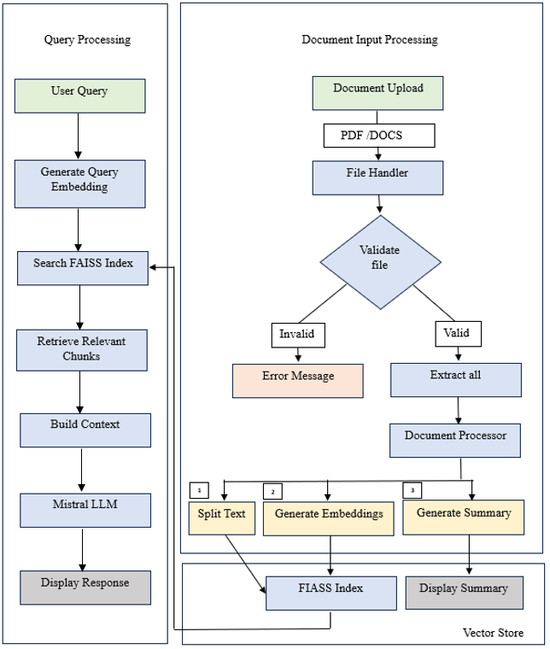
FLOW DIAGRAM
Notes:
Extractive: When the user wants to keep the original sentence structure for more accuracy or clarity. Abstractive: When the user wants a more human-like summary with rephrased or condensed content.

Slide 14
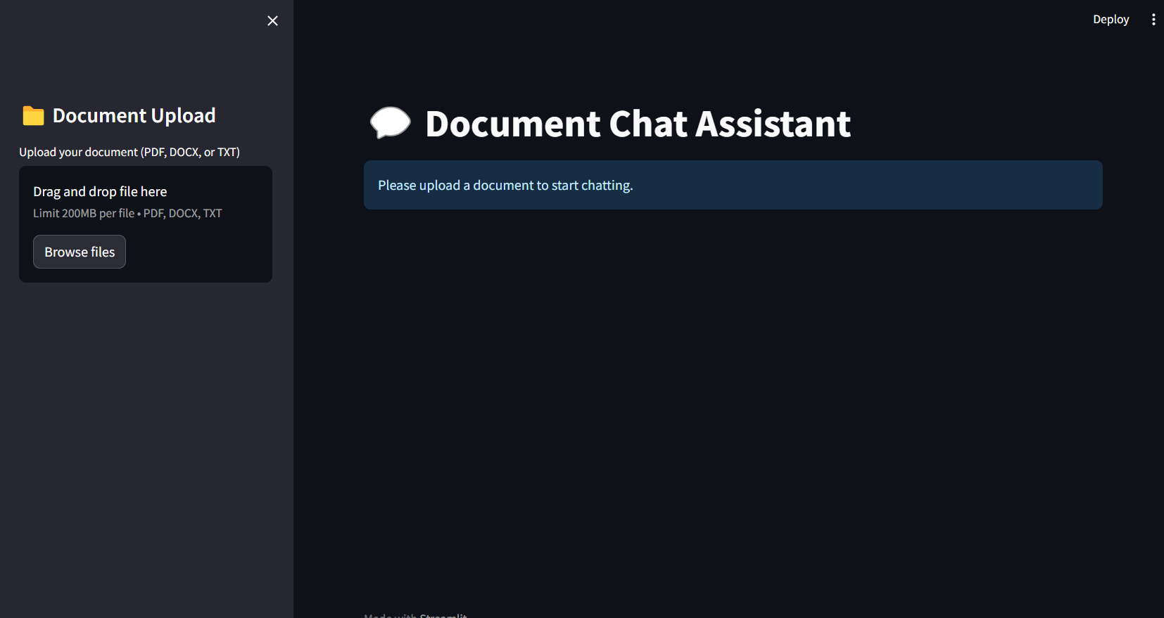
RESULTS AND DISCUSSION

Slide 15
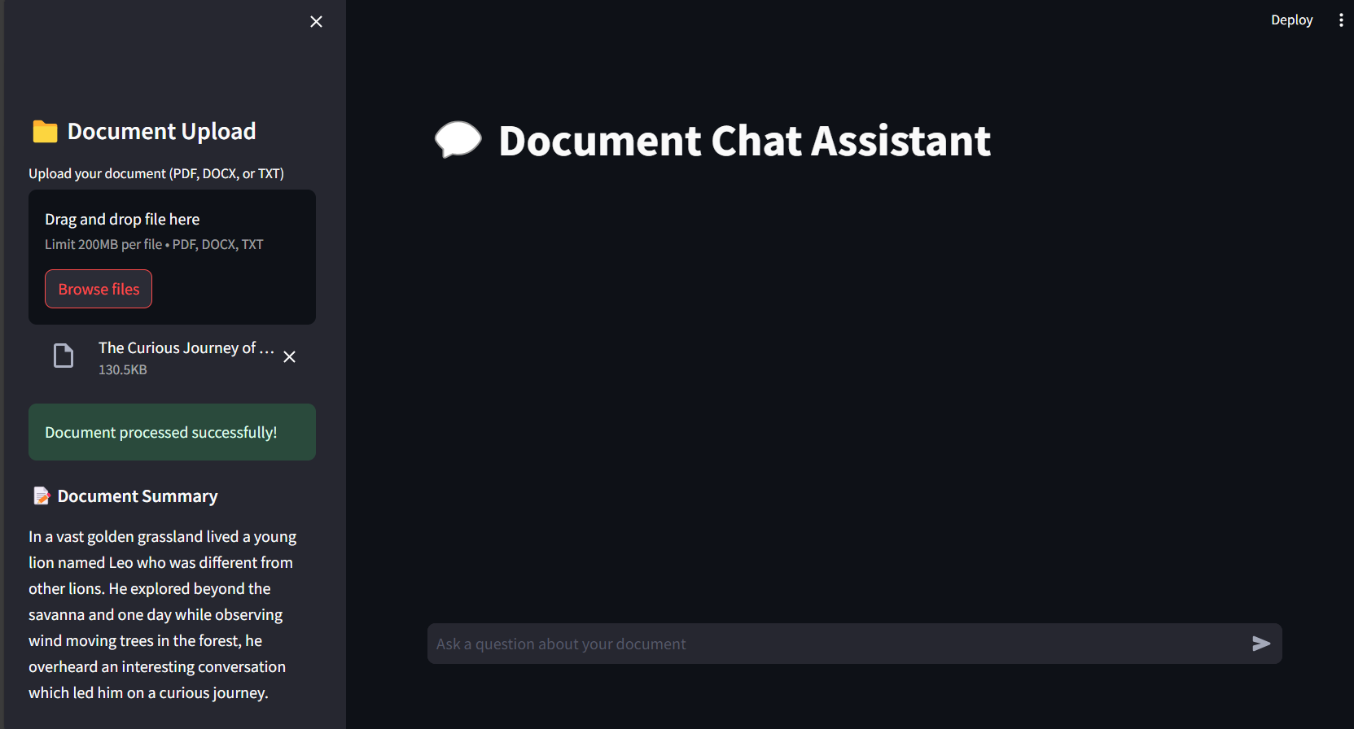

Slide 16
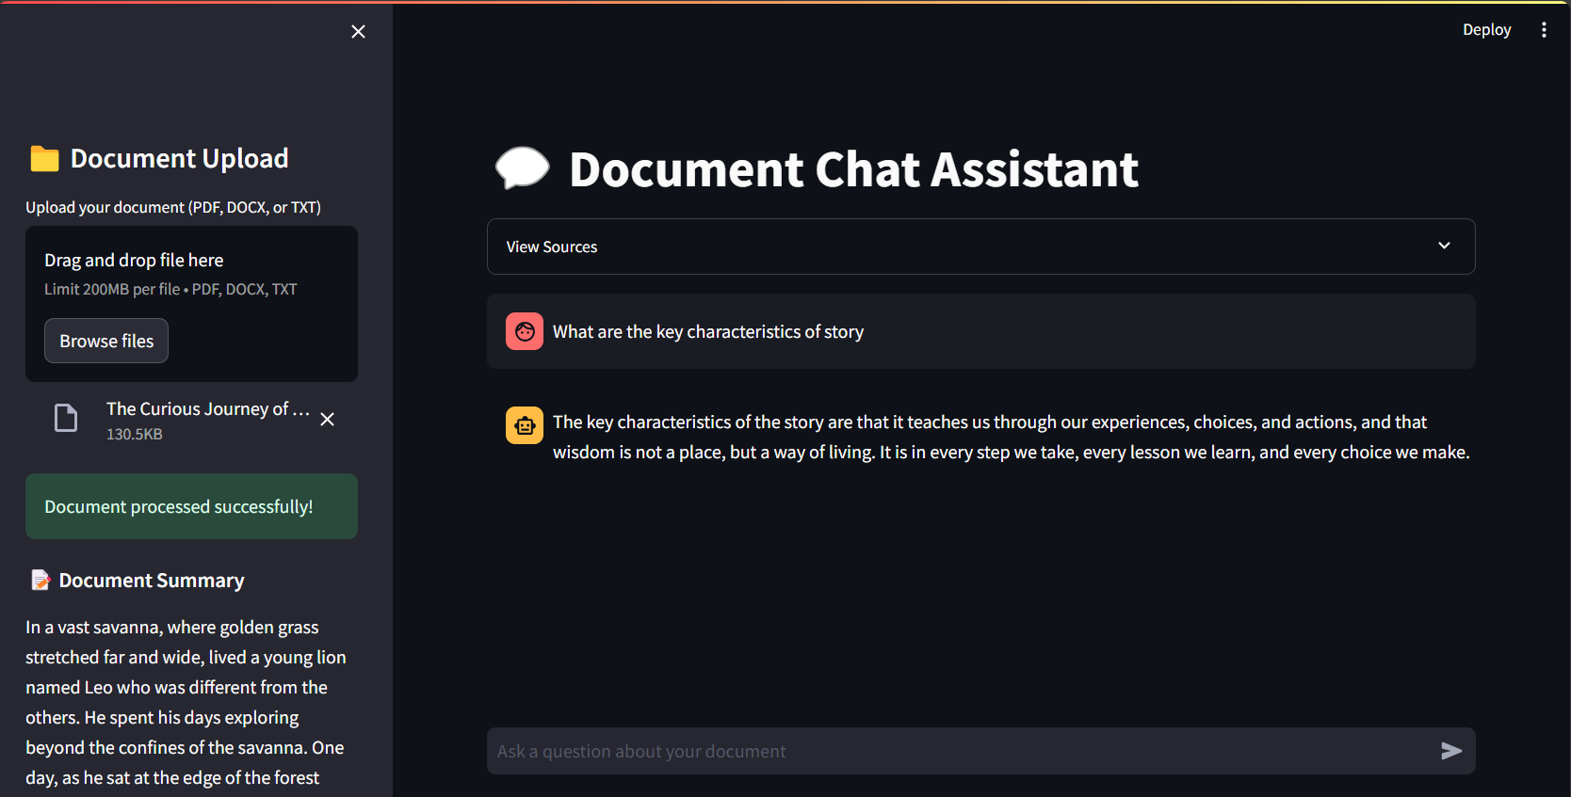

Slide 17
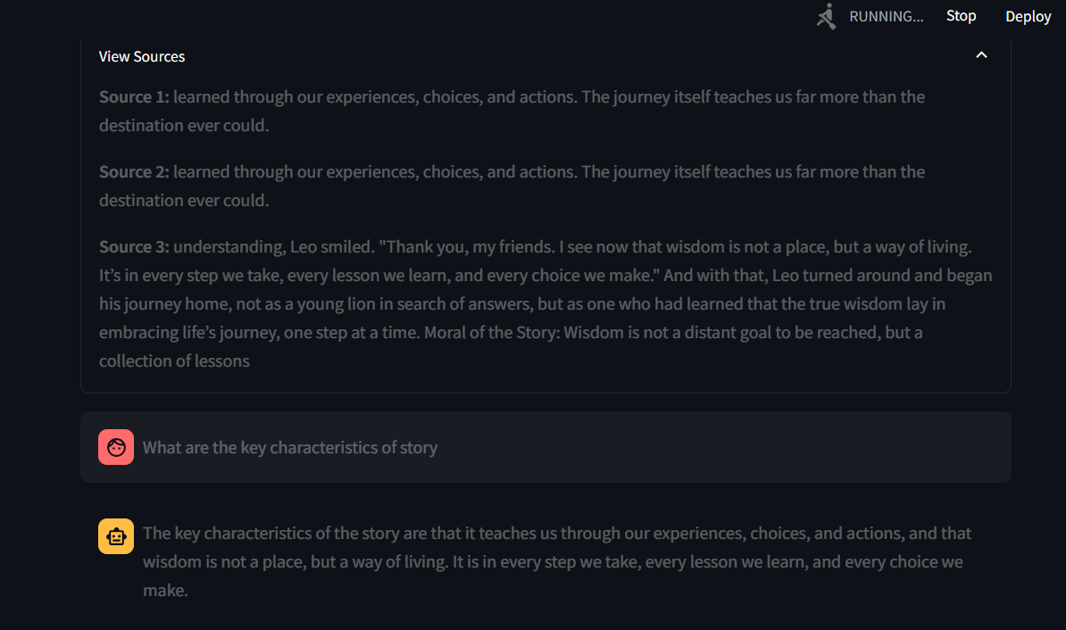

Slide 18
RESULTS AND DISCUSSION
Key Features:
  Efficient Processing: Handle PDFs, DOCX, and TXT files with accurate text extraction.
  Smart Summarization: Generate concise summaries using advanced Gemini model.
  Interactive Chatbot: Enable intuitive Q&A for document exploration.
  Real-Time Insights: Deliver instant responses with minimal delay.
  Customizable Output: Tailor summaries and responses to user needs.

Slide 19
Impact:
Faster Insights: Save time with quick document analysis.
Improved Accessibility: Simplify complex information retrieval.
Personalized Experience: Adapt outputs to varying user preferences.

Slide 20
CONCLUSION
Successfully developed a RAG-based summarizer & chatbot
• Provides fast, accurate insights from documents
• Helps in academic, business, and legal document analysis
  Enhances user experience with an easy-to-use Streamlit interface
  Reduces manual effort and time in document processing
  Provides a scalable framework for future improvements

Slide 21
REFERENCES
FAISS Documentation – Facebook AI Similarity Search
Sentence-Transformers: Pre-trained Models for Semantic Textual Similarity
Streamlit Documentation – Build Interactive Web Apps in Python
llama-cpp-python: Lightweight Python bindings for running LLMs locally
PyPDF2 and python-docx Libraries – For PDF/DOCX Text Extraction

Slide 22
REFERENCES
Zhang, Y. et al. Data-driven building load prediction and large language models: Comprehensive overview, Elsevier (2024).
Onan, A. et al. DeepExtract: Semantic-driven extractive text summarization framework using LLMs, Journal of King Saud University – Computer and Information Sciences (2024).
Luo, Z. et al. Factual consistency evaluation of summarization in the era of large language models, Journal of Artificial Intelligence and Text Evaluation (2024).

Slide 23
Thank You

