Slide 1
BIKE SHARING DATA ANALYSIS
Internship Project Presentation
Data Preprocessing • Statistical Analysis • Dashboard • Forecasting
Presented by: Shiva Saxena
Internship Organization:Nexthikes IT Solutions

Slide 2
Internship Overview
• Project focus: analyze bike-sharing rental data and communicate useful patterns.
• Internship learning areas: data cleaning, transformation, analysis, visualization and reporting.
• Primary tools: Microsoft Excel, Power Query, PivotTables, charts and forecasting tools.
• Outcome: a cleaned dataset, analytical findings, an interactive dashboard and a presentation-ready report.
2

Slide 3
Project Objectives
• Prepare a consistent dataset suitable for analysis.
• Check data quality, missing values, duplicates and valid ranges.
• Summarize rental activity using descriptive statistics and grouped analysis.
• Explore relationships between rentals and weather-related variables.
• Build dashboard views and explore forecasting and anomaly identification.
3

Slide 4
Key Findings & Learning Outcomes
• The sample contains 58,304 rentals across 1,000 records.
• Registered rentals (53,383) exceed casual rentals (4,921) in the analyzed sample.
• Registered rentals are strongly associated with total rentals (correlation ≈ 0.990).
• Temperature has a weak positive relationship with rentals (correlation ≈ 0.229).
• Internship skills practiced: data preparation, quality checks, PivotTables, dashboarding, correlation, forecasting and reporting.
4

Slide 5
Dataset Overview
1,000
Records
16
Columns
58,304
Total rentals (cnt)
2
Rental user groups
• Key identifier: instant; date field: dteday; target measure: cnt.
• Other fields include season, year, month, hour, weekday, weather, temperature, humidity and windspeed.
• Dataset used for this project contains 1,000 rows and 16 columns.
5

Slide 6
Data Preparation & Cleaning
• Used Power Query to transform and combine the provided dataset sections.
• Aligned column names and data types before appending records.
• Reviewed missing values, duplicate records and key-field consistency.
• Checked ranges for fields such as hour, weekday, weather situation and rental counts.
• Kept a repeatable preparation workflow to reduce manual copy-and-paste work.
6

Slide 7
Data Quality Checks
• Record count after combining: 1,000 rows; 16 columns.
• Identifier field: instant; expected sequence checked across the prepared data.
• Reviewed blank values and duplicate records during validation.
• Confirmed categorical fields use consistent values and numeric fields are suitable for analysis.
• Data-quality checks are important because errors can distort summaries and charts.
7

Slide 8
Key Performance Indicators
58,304
Total rentals
4,921
Casual rentals
53,383
Registered rentals
58.30
Average cnt / record
• Registered rentals make up the larger share of rentals in this sample.
• KPIs provide a quick summary before exploring trends and relationships.
8

Slide 9
Descriptive Statistical Analysis
• Calculated summary statistics such as mean, median, standard deviation, minimum and maximum.
• Total rental count (cnt): mean ≈ 58.304; median = 49; standard deviation ≈ 50.986.
• Temperature average ≈ 0.206; humidity average ≈ 0.582; windspeed average ≈ 0.195.
• Descriptive statistics help explain typical values and the amount of variation in the dataset.
• Note: temperature-related fields are normalized values, not degrees Celsius.
9

Slide 10
Correlation Analysis
0.990
Registered vs total rentals
0.229
Temperature vs rentals
−0.025
Humidity vs rentals
• Registered rentals have a very strong positive correlation with total rentals.
• Temperature shows a weak positive correlation with total rentals in this sample.
• Humidity has a correlation close to zero, indicating little linear association in this sample.
• Correlation describes association and does not prove causation.
10

Slide 11
Bike Rental Demand Forecast
Rental by Season
Season 1 has the largest rental total in this analyzed sample.
These totals describe the project sample; they should not be generalized to a full-year population without additional data.
BIKE SHARING DATA ANALYSIS • INTERNSHIP PROJECT
11

Slide 12
Interactive Dashboard
Weekdday & Holiday Analysis
HIGHEST IN SAMPLE
Friday = 9,095 rentals
HOLIDAY FIELD
holiday is represented as a binary indicator in the final analytical dataset.
USE
Calendar effects can be combined with hour and weather variables for more detailed demand analysis.
BIKE SHARING DATA ANALYSIS • INTERNSHIP PROJECT
12

Slide 13
Overall Rental Summary
58,304
53,383
4,921
Total rentals
Registered rentals
Casual rentals
CUSTOMER MIX
Registered riders contribute the large majority of recorded rentals in this sample.
BIKE SHARING DATA ANALYSIS • INTERNSHIP PROJECT
11
13

Slide 14
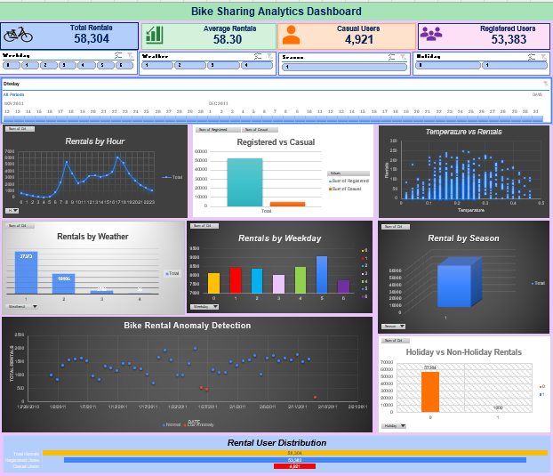
Interactive Dashboard
• Designed KPI Cards to display Total Rentals, Average Rentals, Casual Users and Registered Users.
• Used charts to analyze rentals by hour, weather, weekday, season, customer type and temperature.
• Added slicers and date filters to explore rental patterns across weekday, weather, season and holiday categories.
• Enabled interactive filtering and comparison of bike rental trends across different categories.
BIKE SHARING DATA ANALYSIS • INTERNSHIP PROJECT
14

Slide 15
Bike Rental Demand Forecast
• Used Excel’s forecasting workflow to explore future rental demand from the date series.
• Forecast visuals can show actual values, forecast values and confidence bounds.
• Interpret the forecast as an estimate, not a guarantee of future demand.
• Before presenting, verify that the forecast chart uses the intended date range and correct rental-count field.
BIKE SHARING DATA ANALYSIS • INTERNSHIP PROJECT
15

Slide 16
Anomaly Detection
• Created an anomaly review sheet with Date, Total Rentals, category and explanatory comment.
• Used a scatter chart to distinguish Normal records from Low anomaly records.
• Added comments to explain the classification and the relevant bounds to a reviewer.
• An anomaly flag is a prompt for investigation; it should not automatically be treated as an error.
• Confirm the final thresholds and counts against the latest version of the workbook before presenting.
BIKE SHARING DATA ANALYSIS • INTERNSHIP PROJECT
16

Slide 17
Limitations & Recommendations
• The analyzed dataset is a 1,000-record sample, so findings may not represent every season or location.
• Some chart interpretations depend on category-level PivotTable values; verify exact figures before external presentation.
• Use more historical data and validate forecasts against later observations.
• Document cleaning rules and anomaly thresholds so the workflow can be repeated.
• Recommended next step: refresh the dashboard with new data and compare trends over time.
BIKE SHARING DATA ANALYSIS • INTERNSHIP PROJECT
17

Slide 18
CONCLUSION
This internship project demonstrates an end-to-end analytics workflow—from data preparation and validation to statistical analysis, dashboard visualization, forecasting and anomaly review.
Thank You

