Slide 1
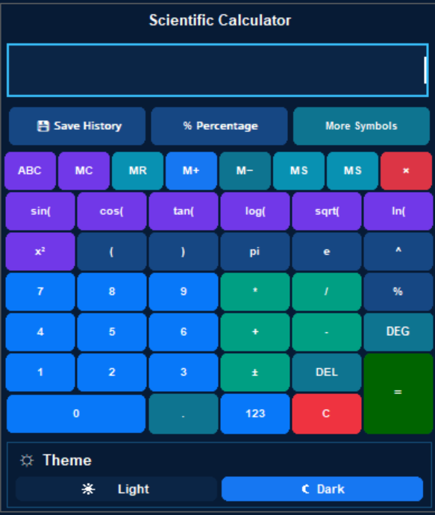
Advanced Calculator
A Multi-Purpose desktop tool built with Python , Tkinter and Customtkinter
NEXTHIKES IT SOLUTIONS
Presented By: Shiva Saxena
Built with Python • Tkinter • CustomTkinter

Slide 2
01 / INTRODUCTION
Project overview
One desktop application that brings everyday calculations and advanced tools together.
What it is
What it solves
How it works
A multi-tool calculator application built in Python with a graphical user interface.
Reduces the need to switch between separate tools for calculations, conversions and graphing.
Users interact with tabs, buttons and input fields; Python processes the operations and displays results.
PROJECT GOAL
Deliver a practical, easy-to-use calculator experience with a clear interface and a broad set of built-in capabilities.
ADVANCED CALCULATOR • PYTHON DESKTOP APPLICATION
02

Slide 3
02 / CAPABILITIES
A complete set of calculation tools
The application is organized into dedicated sections for different tasks.
Scientific
Percentage
Age
Advanced mathematical operations and functions
Quick percentage calculations
Age calculation from date of birth
Unit Converter
Graph Plotter
History
Convert common measurement units
Plot equations and X–Y data
Review and manage previous calculations
The tab-based layout keeps each tool focused while making the overall application easy to navigate.
ADVANCED CALCULATOR • PYTHON DESKTOP APPLICATION
03

Slide 4
03 / TECHNOLOGY
Technology stack
Python libraries selected for interface development, numerical work and visualisation.
Python
Core programming language
Tkinter / ttk
Windowing, widgets and tab navigation
CustomTkinter
Modern styled interface components
NumPy
Numerical array and data operations
Matplotlib
Charts and graph visualisation
The GUI and calculation logic are connected through Python event handlers and callback functions.
ADVANCED CALCULATOR • PYTHON DESKTOP APPLICATION
04

Slide 5
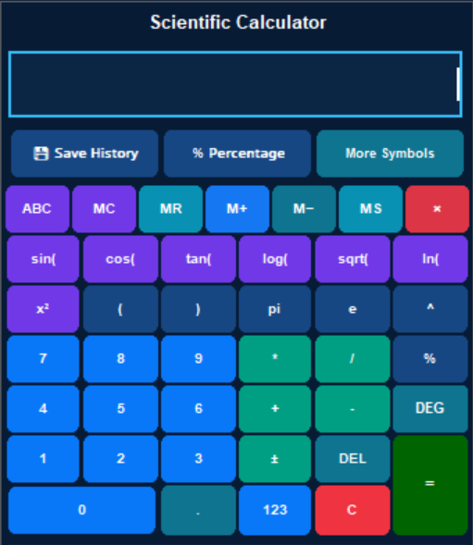
04 / CORE MODULE
Scientific calculator
Designed for common arithmetic as well as scientific-style calculations.
Core operations
Addition, subtraction, multiplication, division and brackets.
Scientific Functions
Trigonometric functions and additional mathematical symbols.
Input experience
Dedicated keypad, display field and quick-access controls.
DEMO EXAMPLE
sin(30°) → 0.5
Example result based on the calculator's demonstrated trigonometric behaviour.
ADVANCED CALCULATOR • PYTHON DESKTOP APPLICATION
05

Slide 6
05 / PRODUCTIVITY
Memory controls & smart keypad
Memory buttons make it easier to reuse values during a calculation session.
MC
MR
M+
M−
MS
Memory Clear
Memory Recall
Add to Memory
Subtract from Memory
Memory Store
Additional keypad controls
• ABC / symbol access for alternate input options
• Backspace and clear controls for editing entries
• Dedicated operator and numeric keys for faster input
ADVANCED CALCULATOR • PYTHON DESKTOP APPLICATION
06

Slide 7
06 / UTILITY TOOLS
Percentage & age calculator
Two focused tools for common everyday calculations.
Percentage calculator
Age calculator
Calculate a percentage of a value quickly.
Example: 10% of 500 = 50
Calculate the elapsed age from a date of birth, expressed in years, months and days.
These dedicated screens keep utility calculations separate from the scientific keypad.
ADVANCED CALCULATOR • PYTHON DESKTOP APPLICATION
07

Slide 8
07 / UTILITY TOOLS
Unit converter
Convert values between supported units without manual formula work.
INPUT
RESULT
250 cm
2.5 m
SOURCE UNIT
TARGET UNIT
Example conversion: centimetres to metres. The converter also supports temperature conversion such as 25°C → 77°F.
ADVANCED CALCULATOR • PYTHON DESKTOP APPLICATION
08

Slide 9
08 / GUIDED TOOLS
Guided calculator
A separate workspace provides a guided path for supported calculation tasks.
Step 1 · Enter
Step 2 · Follow
Step 3 · Review
Provide the values requested by the selected calculation.
Use the on-screen prompts and controls to proceed through the workflow.
Read the calculated output in the application interface.
The Guided Calculator is presented as a dedicated application tab alongside the other tools.
ADVANCED CALCULATOR • PYTHON DESKTOP APPLICATION
09

Slide 10
09 / VISUAL ANALYTICS
Chart variety
The graphing area includes multiple visualisation styles for exploring data.
Line Chart
Area Chart
Pie
Bar Chart
Waterfall
Pie Chart
Bubble Chart
Combo Chart
Waterfall Chart
Waterfall Chart
The available chart type depends on the selected graphing workflow and the data supplied.
ADVANCED CALCULATOR • PYTHON DESKTOP APPLICATION
10

Slide 11
08 / VISUAL ANALYTICS
Graph plotter
Turn mathematical expressions or coordinate data into visual output.
Equation mode
X–Y values mode
Chart options
Enter a mathematical expression and plot its curve.
Provide paired data values and visualise their relationship.
Supports a range of chart styles for different visual tasks.
ILLUSTRATIVE GRAPH PREVIEW
ADVANCED CALCULATOR • PYTHON DESKTOP APPLICATION
11

Slide 12
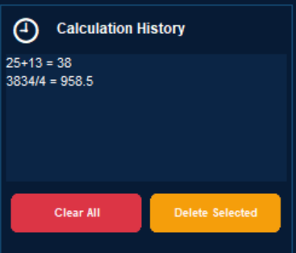
10 / WORKFLOW
Calculation history
A convenient way to review recent work and keep track of calculations.
CALCULATION HISTORY
8 + 2 = 10
10% of 500 = 50
sin(30) = 0.5
250 cm = 2.5 m
Review
Manage
See previous expressions and results.
Clear all history or delete selected entries.
History is stored locally in a text file by the application.
ADVANCED CALCULATOR • PYTHON DESKTOP APPLICATION
12

Slide 13
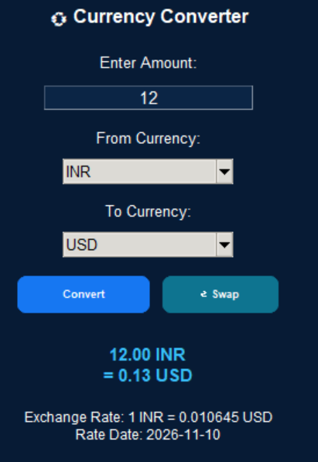
12 / NEW FEATURE
Currency converter
Convert between supported currencies using the latest available exchange-rate reference data.
Flexible currency pair
Choose a source and target currency from the dropdown lists.
Rate and date
Displays the exchange rate and the rate’s publication date.
History integration
Successful conversions can be recorded in Calculation History.
Data note: Frankfurter provides daily reference rates, not a tick-by-tick live trading feed.
ADVANCED CALCULATOR • PYTHON DESKTOP APPLICATION
13

Slide 14
13 / USER EXPERIENCE
Interface & navigation
A dark, high-contrast theme with a right-side navigation panel and quick-access controls.
ADVANCED CALCULATOR
Quick navigation
Switch between tools from the Calculator Tabs panel.
123 × 45
Scientific
123 456 789
Graph Plotter
Consistent design
Age Calculator
Shared colours, buttons and panels provide a cohesive interface.
THEME • LIGHT / DARK MODE
Guided Calculator
Unit Converter
Currency Converter
UI sketch — illustrative, not a live screenshot.
ADVANCED CALCULATOR • PYTHON DESKTOP APPLICATION
14

Slide 15
12 / UNDER THE HOOD
Application structure & working
A simplified view of how a user action becomes a displayed result.
USER INPUT
EVENT HANDLER
CALCULATION LOGIC
OUTPUT
→
→
→
Button, keypad or tab action
Tkinter / CustomTkinter callback
Python functions and numerical operations
Display, history entry or graph
The interface is organised into separate tabs and helper functions, keeping each feature focused and easier to maintain.
ADVANCED CALCULATOR • PYTHON DESKTOP APPLICATION
15

Slide 16
13 / VALIDATION
Testing & demonstrated results
Representative checks performed while developing the calculator.
History
8 + 2 = 10
Percentage
10% of 500 = 50
Result appears in history
Correct percentage result
Age
15-08-2000
Length
250 cm → 2.5 m
Years, months and days displayed
Unit conversion result
Temperature
25°C → 77°F
Trigonometry
sin(30) → 0.5
Temperature conversion result
Scientific calculation result
These examples reflect the development checks reported during project testing.
ADVANCED CALCULATOR • PYTHON DESKTOP APPLICATION
16

Slide 17
14 / ROADMAP
Future enhancements
Potential directions for expanding the application beyond its current feature set.
More conversions
Expand the range of supported measurement categories.
Export options
Allow users to export calculation history and graph results.
Improved validation
Add clearer feedback for invalid or incomplete inputs.
Packaging
Create a standalone desktop installer for easier distribution.
These are proposed improvements, not claims about features already implemented.
ADVANCED CALCULATOR • PYTHON DESKTOP APPLICATION
17

Slide 18
THANK YOU
Questions & Discussion
Advanced Calculator | Python Desktop Application
PROJECT DEMO
Built with Python

