Slide 1
WebRTC based social video broadcasting
Team Name: Shiva’s Group
Aman Sardana
Krishnan Narayanan
Shiva Ramaseshan

Slide 2
Group Project Description
1) Survey
2) Environment Setup
3) Requirement Analysis
4) System Design
5) Implementation
5.1) Responsive Web application.
5.2) Setting up user management on the website
5.3) Setting up signalling server
5.4) Setting up TURN sever
6) Testing and Re-engineering

Slide 3
Project Description (cont.)
Task Aman Krishnan Shiva
Task-1 30% 30% 40%
Task-2 33% 33% 33%
Task-3 33% 33% 33%
Task-4 40% 30% 30%
Task-5 33% 33% 33%
Task-6 30% 40% 30%

Slide 4
Individual Contribution
Team Members | Tasks | % Workload
Aman, Krishnan, Shiva | Requirements Gathering and complete design | 15
Aman | Dashboard, Events creation, Home page, Pre recorded – videos Files: broadcast.php, dashboard.php, logout.php, index.php | 25
Krishnan | Login Page, Sign up page, Facebook Login, AWS Hosting, Files: broadcast.php, dashboard.php, login.php, login.js, facebook.js, process.php | 25
 | Audio/Video combining using FFMPEG, Dashboard
Shiva | Implemented Signaling server using socket.io, Chat Files: broadcast.php, main.js (built on from html5 rocks), combineaudiovideo.php, facebook.js, process.php, dashboard.php, server.js | 25
 | Facebook login, Video Recording, Setting up node server.
Aman, Krishnan, Shiva | Testing and Integration | 15

Slide 5
Technical Details
Softwares and Languages:
webRTC API
HTML5/CSS3
Twitter Bootstrap
JavaScript
PHP
Node.js / node packages express.js. socket.io
MySQL database
Chrome with ripple emulator extension

Slide 6
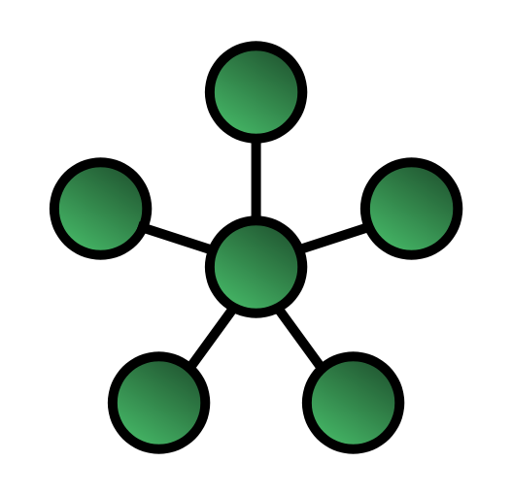
Technical Details
Star Topology
Reduces the bandwidth overload since the broadcaster sends
the video signal to other nodes but not every node
is connected to each other.
This is in contrast to mesh topology where every
node is connected to each other which causes an exponential strain on
the network bandwidth.

Slide 7
Technical Details
Expected Outcome:
A customized web site for users to sign in (can sign in through facebook or google plus)
The users after signing in should be able to watch any video being broadcasted as well as broadcast the videos
The users before signing in has the privilege of watching pre recorded videos.
The chatroom can be interactive where the user can chat or raise a question and the broadcaster can respond to the user.
The signed in user has the option of sending out invites to his/her friends from either facebook or google plus.
The signed in user will have his/her own dashboard and profile page where the interests of the user will be listed and they would get notifications depending on those interests.

Slide 8
Tasks Completed

Slide 9
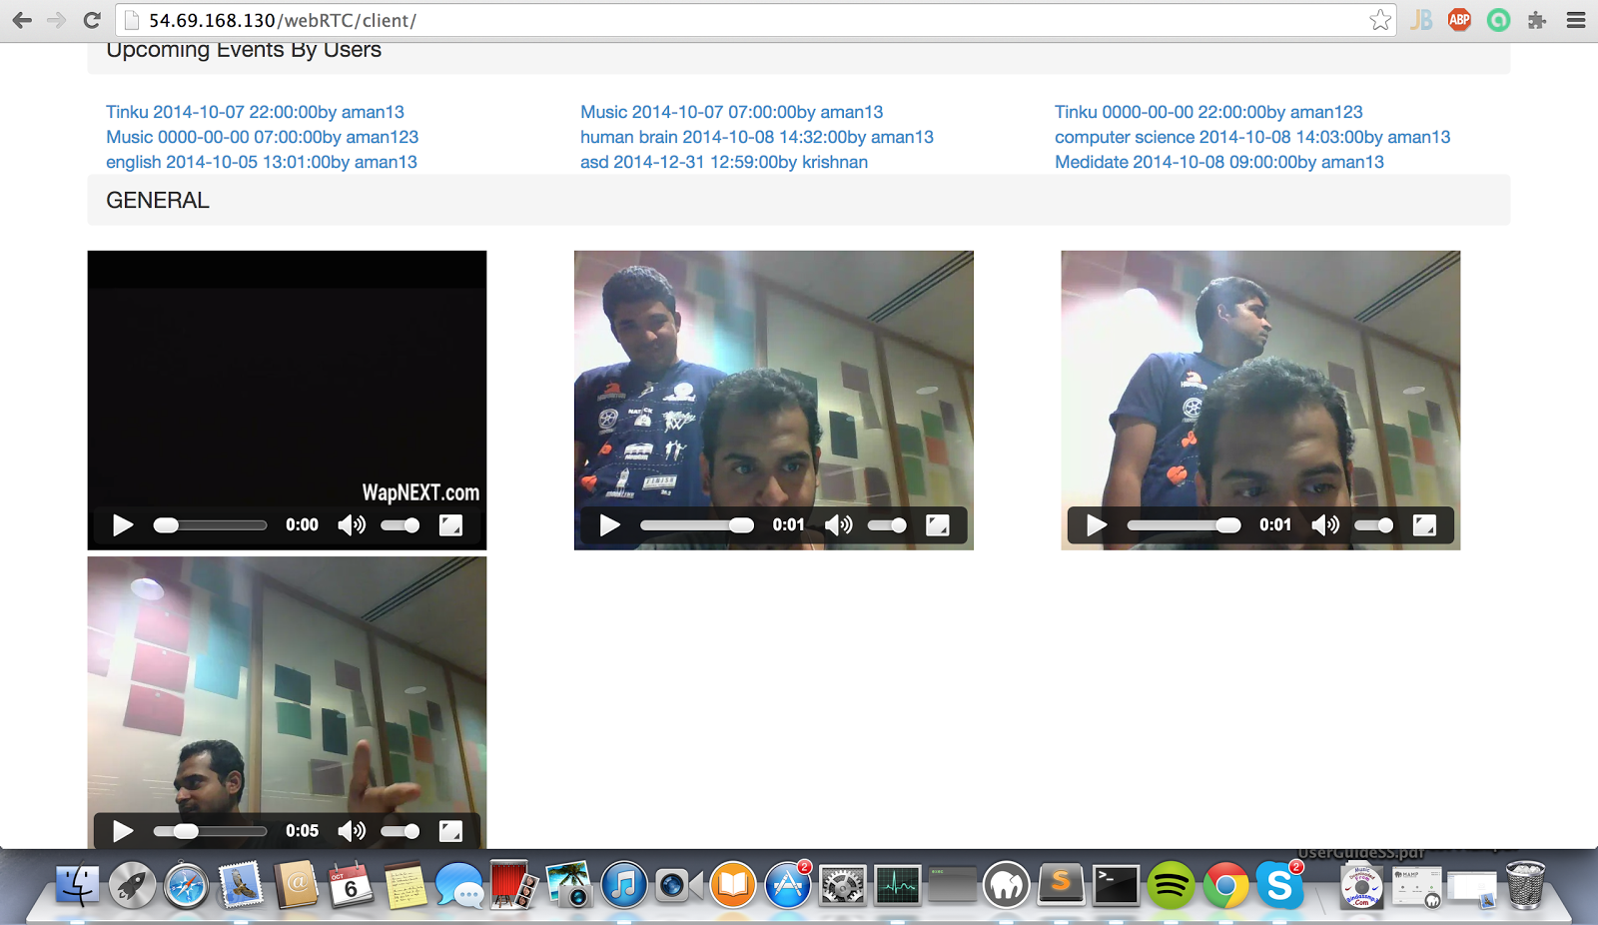
Home Screen
Home Screen where the user is able to watch pre recorded videos and is given an option to login to the web application where he can join any chat room by clicking on the link of events shown.

Slide 10
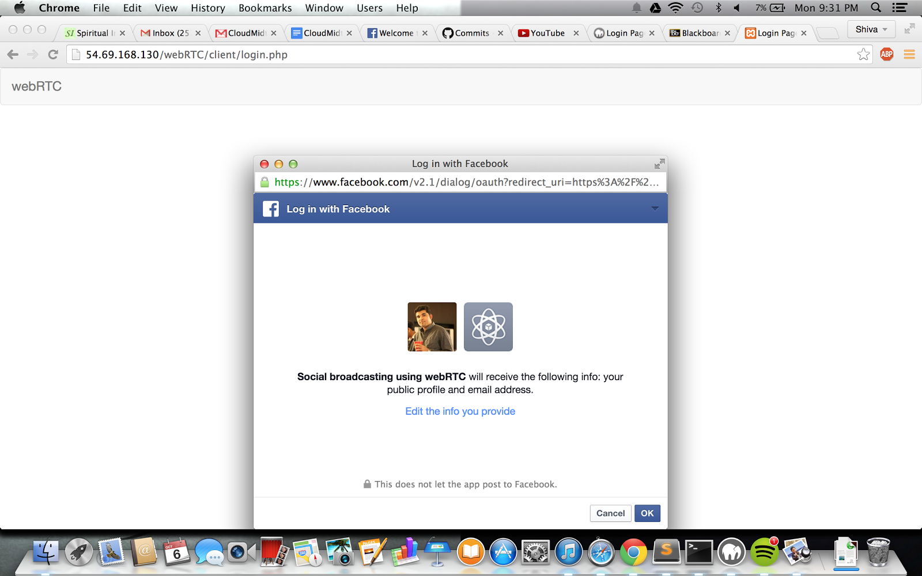
Login with facebook

Slide 11
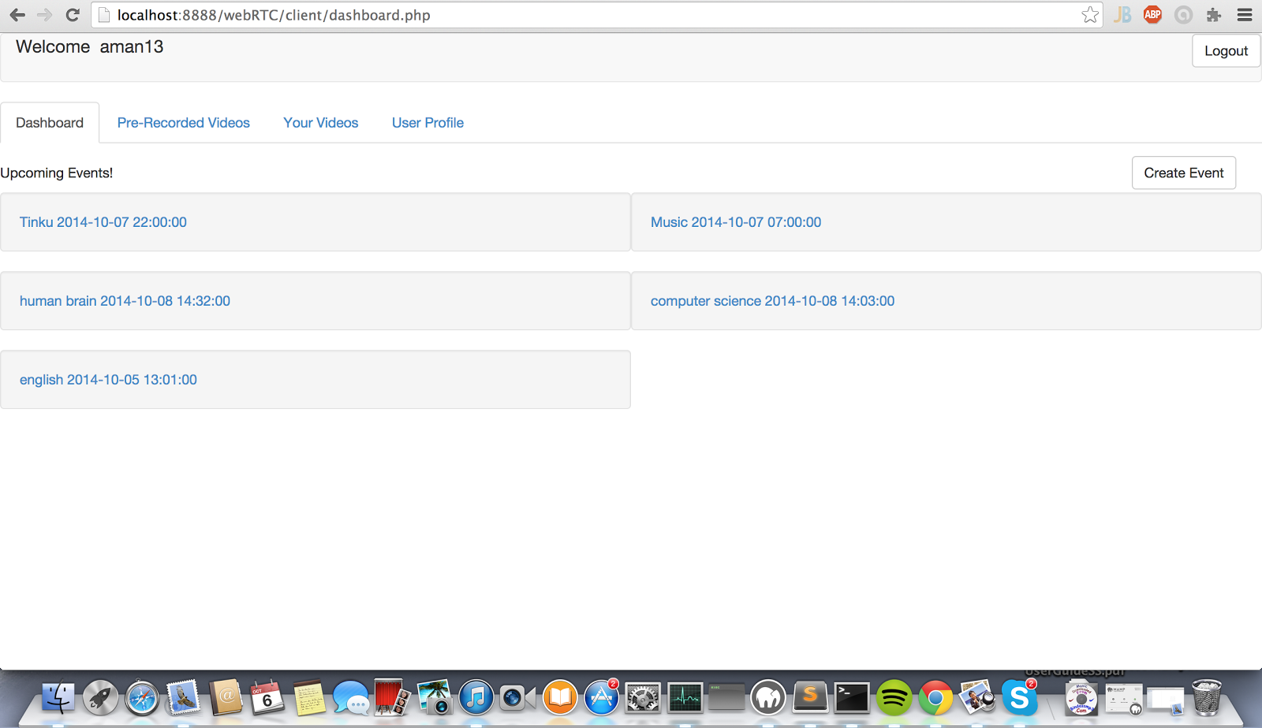
User Dashboard

Slide 12
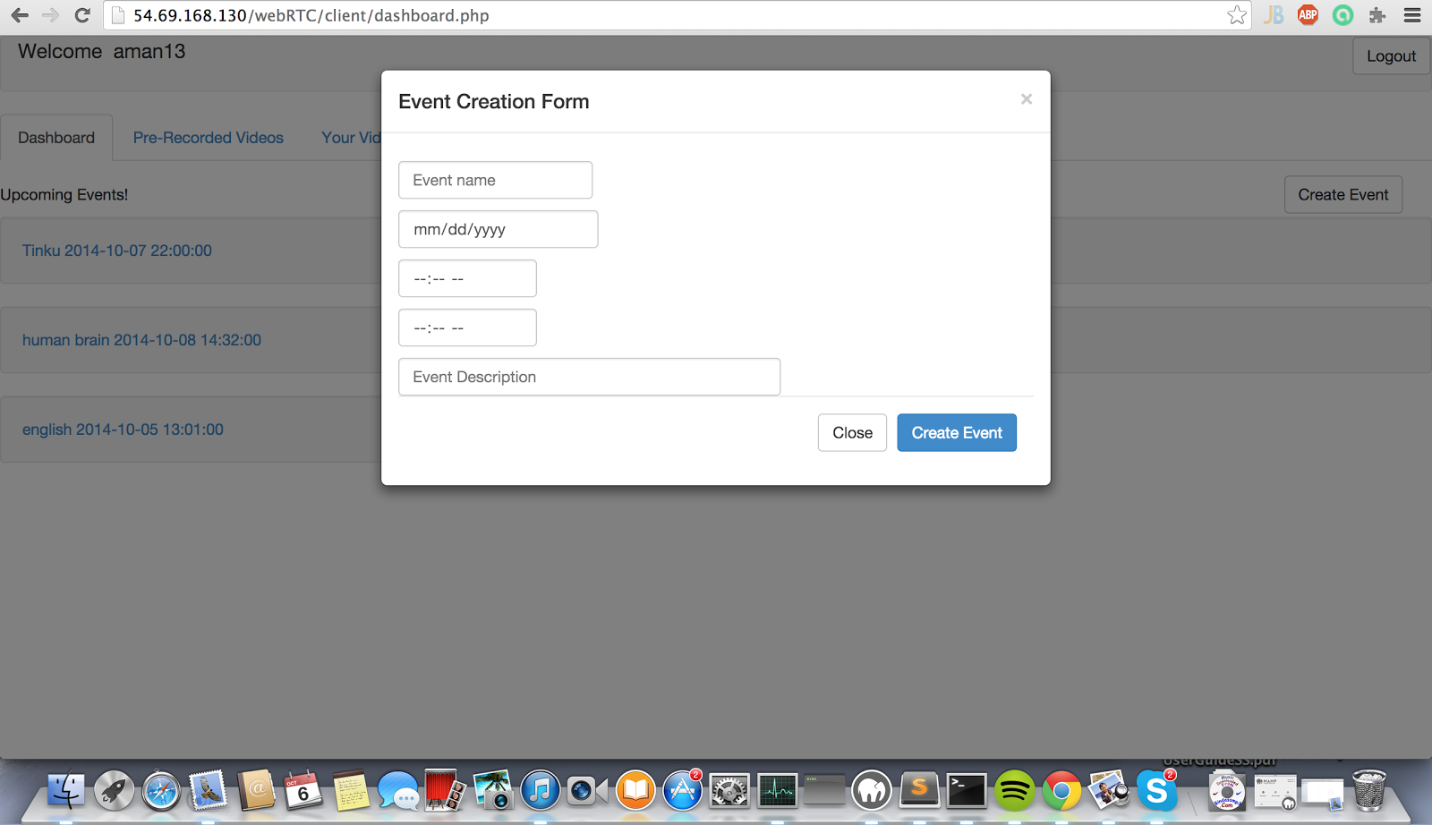
Event Creation

Slide 13
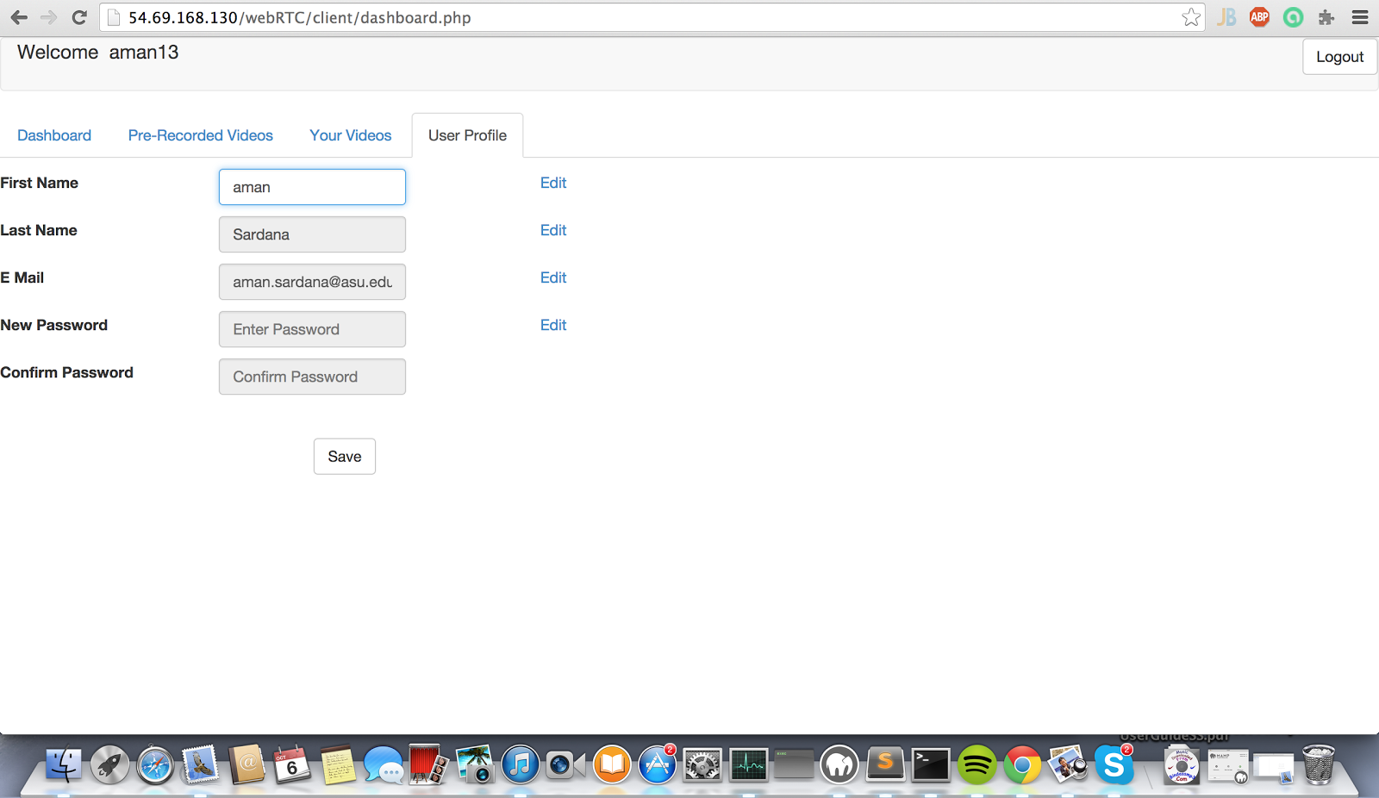
User Profile

Slide 14
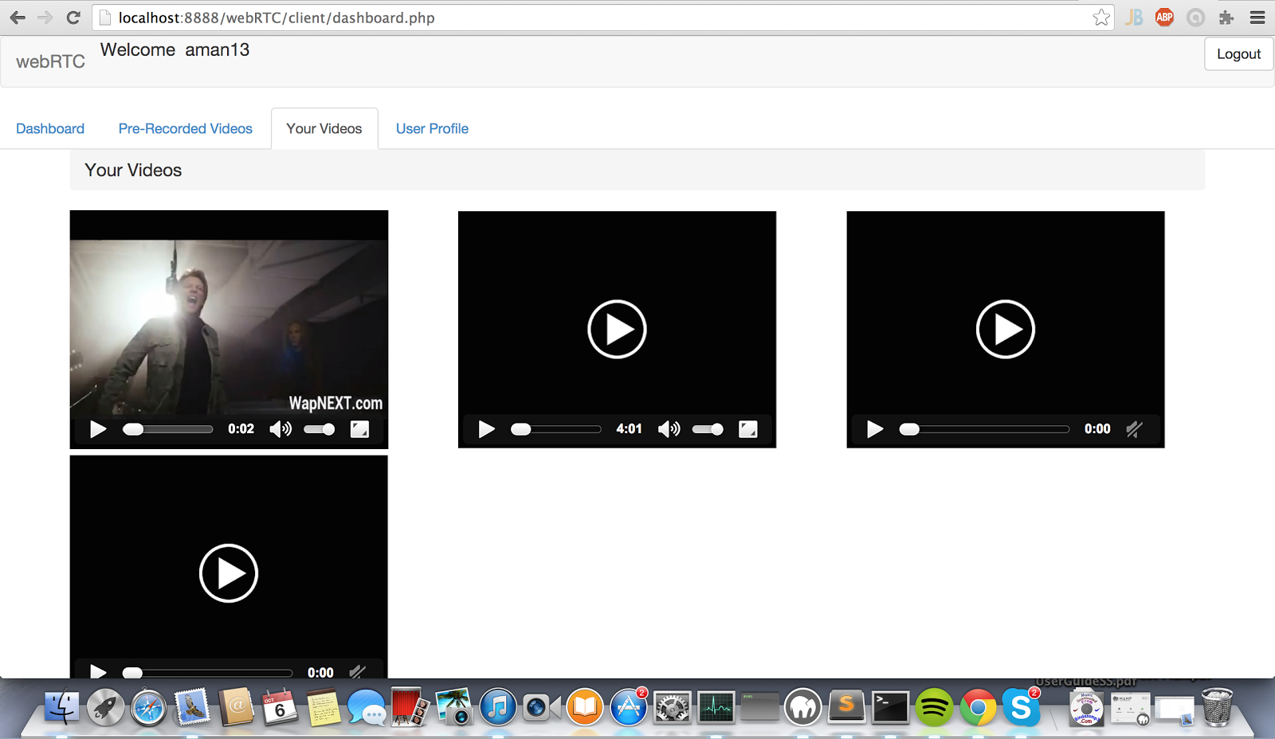
User’s Videos

Slide 15
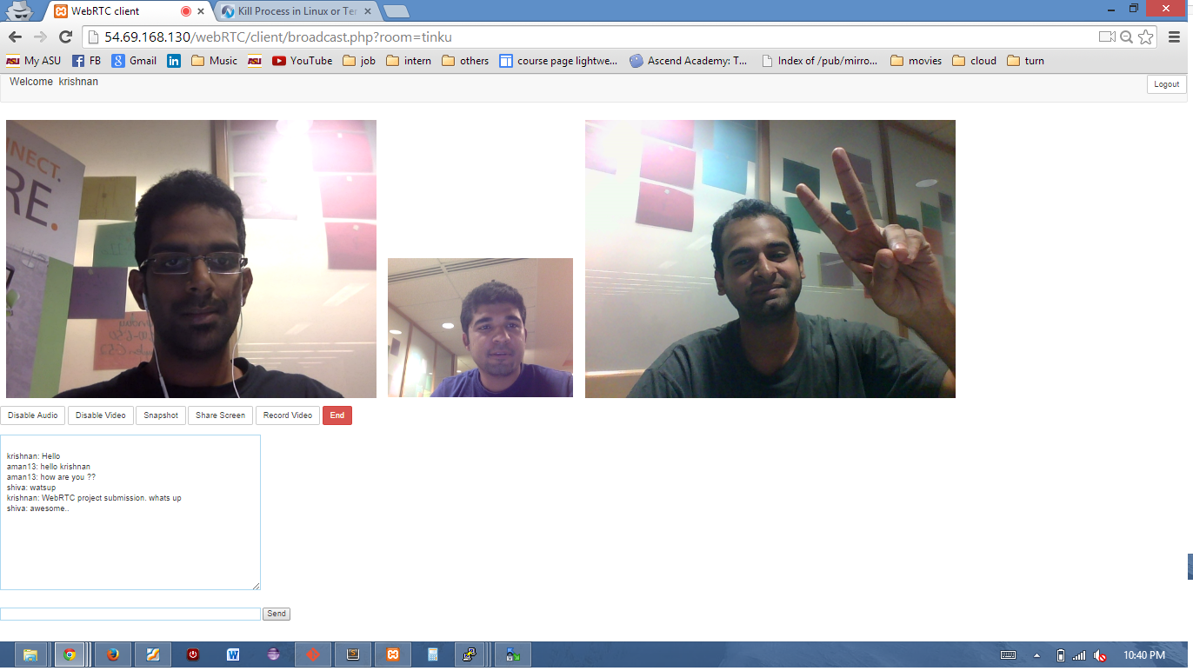
Broadcasting Room with Chat Feature

Slide 16
Amazon Aws Hosting
The virtual machines that we got was not being reached by our local machines. We tried to enable all traffic through all ports using ip tables in the vm and yet we couldn’t ping the vm from our local. Hence, we decided to host our application on amazon’s EC2. We were able to successfully deploy our application on ec2 and now it can be accessed from any local machine. The url to our application is http://54.69.168.130/webRTC/client/.

Slide 17
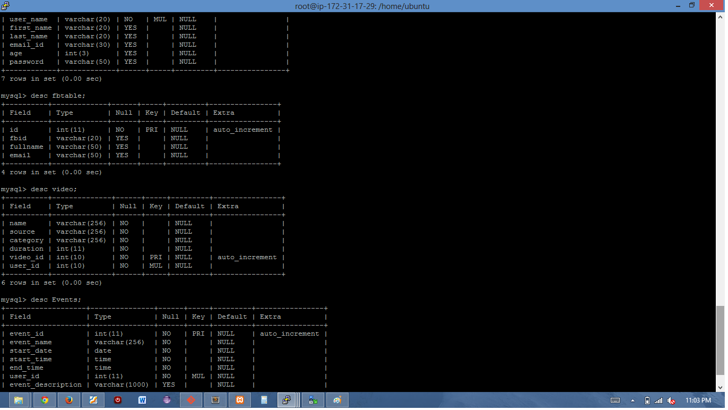
Database Design

Slide 18
Potential Future Enhancements
More login options :-
We can have more login options amongst the social networks sites. Like facebook login, we can have a Google+ login button as well for the users to login using their Google Plus account.
App posting to user’s feed :-
Provisions for the app to post content on the user’s feed. In case of facebook, we need to go through the process of app review to get the permissions to post content on behalf of user through oAuth. After getting the permission we can provide features like creating facebook events for him, post about a new broadcasting event he has created and likes on the webRTC app so that his friends circle gets to know about the app.
Phone Gap :-
We have created the app with HTML5 and responsive design in mind using bootstrap. So, we can use phonegap to convert our HTML5 app to mobile os platforms.

Slide 19
Individual Contribution
Team Members | Tasks | % Workload
Aman, Krishnan, Shiva | Requirements Gathering and complete design | 15
Aman | Dashboard, Events creation, Home page, Pre recorded - videos | 25
Krishnan | Login Page, Sign up page, Facebook Login, AWS Hosting, | 25
 | Audio/Video combining using FFMPEG, Dashboard
Shiva | Implemented Signaling server using socket.io, Chat | 25
 | Facebook login, Video Recording, Setting up node server.
Aman, Krishnan, Shiva | Testing and Integration | 15

Slide 20
Risks Involved
Nodes which are behind a NAT server will find it difficult to establish the connection. To avoid this, we would configure TURN server. If lot of traffic starts going to the TURN server then that might crash (Load Balancing is out of scope of the project). It would be a third party server that we would be using, so not having much control over that.
WebRTC doesn’t enforce a maximum limit on the number of connections which we can establish. So as a result we cannot accurately predict the number of connections before which the system might start to hang. It totally depends on the bandwidth of the users in that session.
WebRTC is a new technology and as it is with any new technology it is not that widely supported as of August 2014. It is supported on Chrome 23, Firefox 22 and Opera 18 browsers for desktop but not Safari and IE.
As of August 2014, it is not yet fully supported across all mobile devices. The mobile browsers Chrome 28, Firefox 24 and Opera Mobile 12 supports webRTC for all android. There isn’t much support for other mobile platforms.
As of August 2014, it is not yet a complete nor stable, and as such is not yet suitable for commercial implementation.[3]

Slide 21
Benefits
Users can watch recorded video in case they miss the live broadcast.
Users get notifications for videos being broadcasted based on their interests.
Users can send out invites to facebook or google plus friends to join this broadcasting site.
Users can subscribe to the videos and can get notifications from the uploader whenever he/she is about to broadcast.

Slide 22
Conclusion
This project is about user being able to do interactive video conferencing and being able to broadcast it to the public.
The recordings will be available of the session.So, that the users can view it again later.
Only the signed-in users will have the authority to broadcast videos and can attend the on-going events but any users can view the recorded videos.
The video conferencing would be achieved using webRTC and the web app hosted on ASU MobiCloud environment.
The project would be simpler in complexity than Google Hangouts but the main advantage of this project is that it would be plugin free. WebRTC is built right into the browser natively.

