Slide 1
WebRTC based social video broadcasting
Team Name: Shiva’s Group
Aman Sardana
Krishnan Narayanan
Shiva Ramaseshan

Slide 2
What is WebRTC?
WebRTC is a free, open project that enables web browsers with Real-Time communications (RTC) capabilities via simple JavaScript APIs.[1]
Major components of WebRTC
getUserMedia, which allows a web browser to access the camera and microphone and to capture media
RTCPeerConnection, which sets up audio/video calls
RTCDataChannels, which allow browsers to share data via peer-to-peer
Supports video communication between browser without use of any plugins.
References
[1] http://www.webrtc.org/

Slide 3
Individual Contribution
Team Members | Tasks | % Workload
Aman, Krishnan, Shiva | Requirements Gathering and complete design | 15
Aman | Dashboard, Events creation, Home page, Pre recorded – videos Files: broadcast.php, dashboard.php, logout.php, index.php | 25
Krishnan | Login Page, Sign up page, Facebook Login, AWS Hosting, Files: broadcast.php, dashboard.php, login.php, login.js, facebook.js, process.php | 25
 | Audio/Video combining using FFMPEG, Dashboard
Shiva | Implemented Signaling server using socket.io, Chat Files: broadcast.php, main.js (built on from html5 rocks), combineaudiovideo.php, facebook.js, process.php, dashboard.php, server.js | 25
 | Facebook login, Video Recording, Setting up node server.
Aman, Krishnan, Shiva | Testing and Integration | 15

Slide 4
Project Description
Social Collaboration platform
Video Recording
Facebook Login
Hosted on AWS (Amazon EC2)

Slide 5
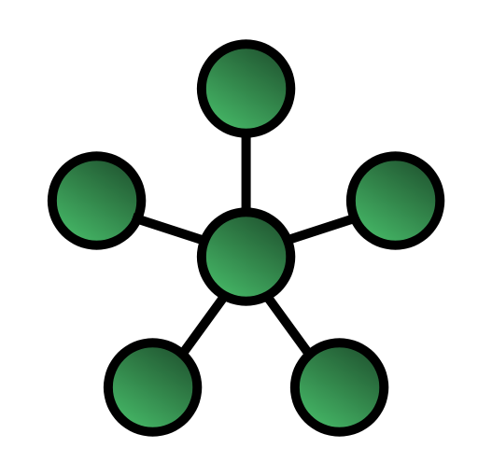
Project Design Details
Star Topology
Signaling using node js and socket.io
WebRTC doesn’t enforce any signaling mechanisms.
Peers
Initiator

Slide 6
Terminology
NAT (Network Address Translation)
Gives your device a public IP address.
STUN (Session Traversal Utilities for NAT)
Protocol to discover your public address.
TURN (Traversal using Relays around NAT)
Relaying all information through that server.
SDP (Session Description Protocol)
Standard for describing multimedia content so that both peers understand each other once data is transferring.
ICE (Interactive Connectivity Establishment)
Framework to allow web browsers to connect with peers.

Slide 7
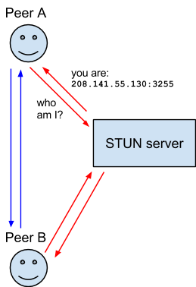
STUN

Slide 8
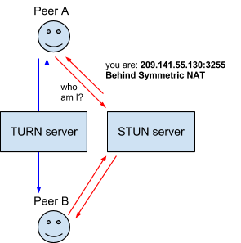
TURN

Slide 9
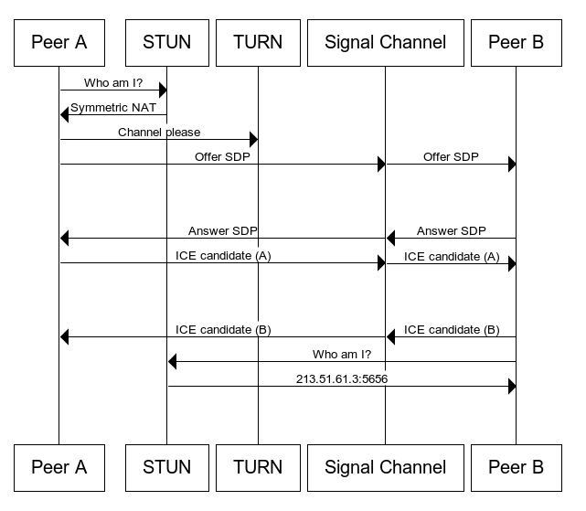
Entire Exchange

Slide 10
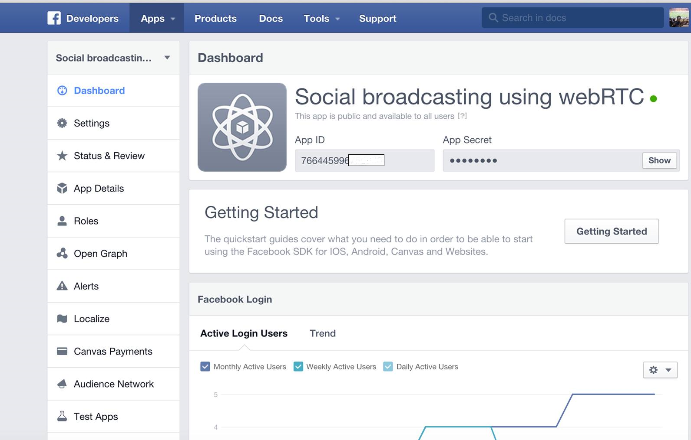
Facebook App

Slide 11
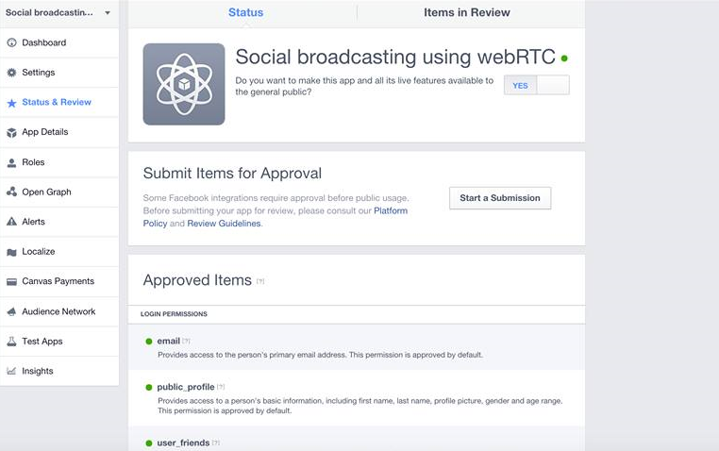
Permissions

Slide 12
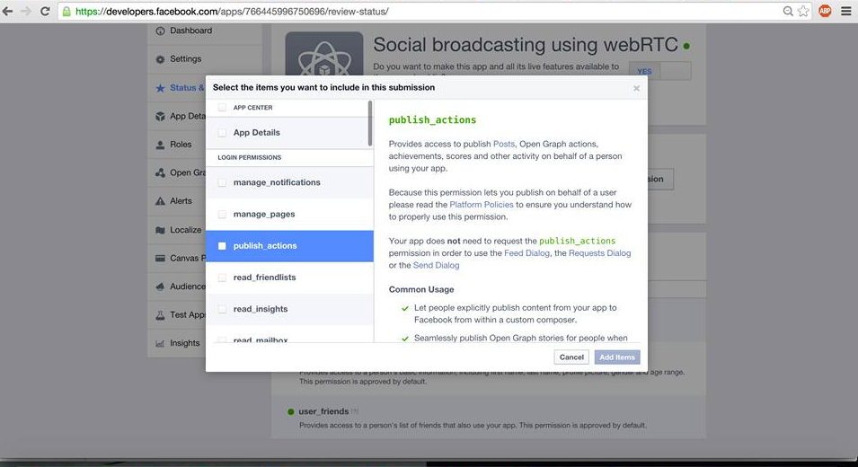
App Review

Slide 13
Challenges/ Constraints
WebRTC only supported on Chrome, Firefox and Opera
Browser’s doesn’t support MediaStreamRecorder API as it still a W3C draft.
Chrome doesn’t support recording video into a single WEBM file
As a workaround, we used FFMPEG.
WebRTC doesn’t enforce a maximum limit on the number of connections which we can establish. It totally depends on the bandwidth of the users in that session.

Slide 14
Potential Future Enhancements
More login options :-
We can have more login options among the social networks sites. Such as Google +
App posting to user’s feed :-
Provisions for the app to post content on the user’s feed. In case of facebook, we need to go through the process of app review to get the permissions to post content on behalf of user through oAuth. After getting the permission we can provide features like creating facebook events for him, post about a new broadcasting event he has created and likes on the webRTC app so that his friends circle gets to know about the app.
Phone Gap :-
We have created the app with HTML5 and responsive design in mind using bootstrap. So, we can use phonegap to convert our HTML5 app to mobile os platforms.

Slide 15
Refinements
Record video button is visible to every user
Cross browser ( Chrome to Firefox) testing.
Video thumbnails does not contain snapshot of the video.
Time validation of the Events.
Screen sharing fails to work in chrome as “usermedia-screen-capturing” flag is not set.

Slide 16
DEMO

