Slide 1
WebRTC based social video broadcasting
Team Name: Shiva’s Group
Aman Sardana
Krishnan Narayanan
Shiva Ramaseshan

Slide 2
Group Project Description
1) Survey
2) Environment Setup
3) Requirement Analysis
4) System Design
5) Implementation
5.1) Responsive Web application.
5.2) Setting up user management on the website
5.3) Setting up signalling server
5.4) Setting up TURN sever
6) Testing and Re-engineering

Slide 3
Project Description (cont.)
Task Aman Krishnan Shiva
Task-1 30% 30% 40%
Task-2 33% 33% 33%
Task-3 33% 33% 33%
Task-4 40% 30% 30%
Task-5 33% 33% 33%
Task-6 30% 40% 30%

Slide 4
Technical Details
Softwares and Languages:
webRTC API
HTML5/CSS3
Twitter Bootstrap
JavaScript
PHP
Node.js / node packages express.js. socket.io
MySQL database
Chrome with ripple emulator extension

Slide 5
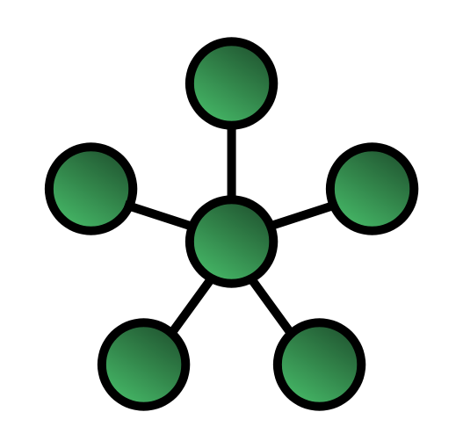
Technical Details
Star Topology
Reduces the bandwidth overload since the broadcaster sends
the video signal to other nodes but not every node
is connected to each other.
This is in contrast to mesh topology where every
node is connected to each other which causes an exponential strain on
the network bandwidth.

Slide 6
Technical Details
Expected Outcome:
A customized web site for users to sign in (can sign in through facebook or google plus)
{It requires approval from facebook for which we need to submit the app first. Now, we’ll submit the app and embed facebook login }
The users after signing in should be able to watch any video being broadcasted as well as broadcast the videos {Completed}
The users before signing in has the privilege of watching pre recorded videos.{Completed}
The chatroom can be interactive where the user can chat or raise a question and the broadcaster can respond to the user. {Chat is implemented but no button provided “Raise Hand”}
The signed in user has the option of sending out invites to his/her friends from either facebook or google plus.{not done}
The signed in user will have his/her own dashboard and profile page where the interests of the user will be listed and they would get notifications depending on those interests.{Not done}

Slide 7
Tasks Completed
•Home Screen where the user is able to watch pre recorded videos and is given an option to login to the web application where he can join any chat room.
•Sign up screen where user is able to login or register to our web application.
•webRTC video conferencing where the initiator would be able to see all the participants.
•Disable Audio/Disable Video button works by setting the audio stream/video stream to false. Disable video won’t switch off the webcam.
•Snapshot will capture the current frame in the person’s video tag and give the user an option to download the image.
•Record video button provided records audio and video simultaneously but separately. As MediaStreamRecorder API has not been implemented in chrome natively we are using RecordRTC.js which is free open source implementation based on w3c MediaRecorder API (which is still in draft).

Slide 8
Tasks to be Completed
Dashboard home page: This page would enable the user to create an event by providing a description of the video and the time/date the event would start. Along with this the user would be given the provision to view pre-recorded videos, and make changes to his profile settings such as email, first name last name etc.
The video tag’s need to be styled. Every participant should see the initiator in a big window whereas themselves in small window much like skype. As for the initiator, he should see every participant in an equally big window and himself in a small window.
The pre-recorded will have a poster image from the videos frames instead of common poster image for all the videos.
Since the app is in progress, we could give the user the provision to login through facebook or google.
Record video button provided records audio and video simultaneously but separately. As MediaRecorder API has not been implemented in chrome natively we are using RecordRTC.

Slide 9
Risks Involved
Nodes which are behind a NAT server will find it difficult to establish the connection. To avoid this, we would configure TURN server. If lot of traffic starts going to the TURN server then that might crash (Load Balancing is out of scope of the project). It would be a third party server that we would be using, so not having much control over that.
WebRTC doesn’t enforce a maximum limit on the number of connections which we can establish. So as a result we cannot accurately predict the number of connections before which the system might start to hang. It totally depends on the bandwidth of the users in that session.
WebRTC is a new technology and as it is with any new technology it is not that widely supported as of August 2014. It is supported on Chrome 23, Firefox 22 and Opera 18 browsers for desktop but not Safari and IE.
As of August 2014, it is not yet fully supported across all mobile devices. The mobile browsers Chrome 28, Firefox 24 and Opera Mobile 12 supports webRTC for all android. There isn’t much support for other mobile platforms.
As of August 2014, it is not yet a complete nor stable, and as such is not yet suitable for commercial implementation.[3]

Slide 10
Benefits
Users can watch recorded video in case they miss the live broadcast.
Users get notifications for videos being broadcasted based on their interests.
Users can send out invites to facebook or google plus friends to join this broadcasting site.
Users can subscribe to the videos and can get notifications from the uploader whenever he/she is about to broadcast.

Slide 11
Conclusion
This project is about user being able to do interactive video conferencing and being able to broadcast it to the public.
The recordings will be available of the session.So, that the users can view it again later.
Only the signed-in users will have the authority to broadcast videos and can attend the on-going events but any users can view the recorded videos.
The video conferencing would be achieved using webRTC and the web app hosted on ASU MobiCloud environment.
The project would be simpler in complexity than Google Hangouts but the main advantage of this project is that it would be plugin free. WebRTC is built right into the browser natively.

