Slide 1
Secure file storage on cloud using hybrid cryptography

Slide 2
Under the Guidance of : Dr. G. Lokeshwari
Batch No. – A17
B. Anirudh (20r11a0508)
M. Chandana(20r11a0535)
K. Lohit(20r11a0525)

Slide 3
contents
Abstract
Existing System and its disadvantages
Proposed system
Benefits of the proposed system
System Configuration
Modules
Literature Survey
System Architecture
UML Diagrams

Slide 4
1. abstract
Cloud is used in various fields like industry, military, college, etc. for various services and storage of huge amount of data. Data stored in this cloud can be accessed or retrieved on the user’s request without direct access to the server computer. But sometimes a single technique or algorithm alone cannot provide high-level security. So, we have introduced a new security mechanism that uses a combination of multiple cryptographic algorithms of symmetric key and steganography.
All the algorithms use 128-bit keys. LSB steganography technique is used to securely store the key information. Key information will contain the information regarding the encrypted part of the file, the algorithm, and the key for the algorithm. File during encryption is split into three parts. These individual parts of the file will be encrypted using different encryption algorithms simultaneously with the help of a multithreading technique. The key information is inserted into an image using the LSB technique. Our methodology guarantees better security and protection of customer data by storing encrypted data on a single cloud server, using AES, DES, and RC6 algorithms.

Slide 5
2. Existing system
User selects the file from the local storage.
The file will be uploaded to the cloud after getting encrypted.
It uses only AES algorithms.
It needs some more time for encryption and decryption process.2

Slide 6
3. Proposed system
The major concern regarding storage of data online that is on the cloud is the Security. This Security concern can be solved using various ways, the most used techniques are cryptography and steganography
In this proposed system 3DES (Triple Data Encryption Standard), RC6 (Rivest Cipher 6) and AES (Advanced Encryption Standard) algorithms are used to provide security to data.
Advanced Encryption Standard (AES)
In present day cryptography, AES is widely adopted and supported in both hardware and software. AES uses symmetric key encryption. It takes plaintext in blocks of 128,192, and 256 bits. Stronger and faster than Triple-DES
Triple Data Encryption Standard (3DES)
Triple DES is used to increase the complexity and reduce the weakness of DES. 3DES is based on the DES algorithm. It works by taking three 64-bit keys. It has two-key and three-key versions. In the two-key version, the same algorithm runs three times, but uses k1 for the first and last step.

Slide 7

4. Benefits of the proposed system
The proposed software product is liable to meet the required security needs of the data center of the cloud. Blowfish used for the encryption of file slices takes minimum time and has maximum throughput for encryption and decryption from other symmetric algorithms.
The idea of splitting and merging adds on to meet the principle of data security. The hybrid approach when deployed in a cloud environment makes the remote server more secure and thus, helps the cloud providers to fetch more trust of their users.
For data security and privacy protection issues, the fundamental challenge of separation of sensitive data and access control is fulfilled. Cryptography technique translates original data into unreadable form. Cryptography technique is divided into symmetric key cryptography and public key cryptography.
This technique uses keys for translate data into unreadable form. So only authorized persons can access data from cloud server. Cipher text data is visible to all people.

Slide 8
5. System configuration
Hardware Requirements
System : intel core i3
Hard disk: 40 Gb
RAM: 4 GB
Processor: i3 7th generation
Software Requirements
Coding Language : J2EE (JSP,Servlet,Java Bean,python)
Front end: HTML, CSS and java script
Back end: SQLite Server
Operating system : Windows Family.
Data Base : MS Access.
Web Server : Tomcat 6.0

Slide 9
6.Modules
6.1 Data Owner
In this module, the data provider uploads their encrypted data to the Cloud
server. For security purpose, the data owner encrypts the data file and
then store it on the server. The Data owner can be capable of manipulating
the encrypted data file and performing the following operations
Browse
Encryption
upload files
grant Permission to the cloud consumer / End user.

Slide 10
6.2 Cloud Server
The Cloud server manages which is to provides data storage service for the
Data Owners. Data owners encrypt their data files and store them in the
Server for sharing with data consumers. To access the shared data files, data
Consumers download encrypted data files of their interest from the Server
and then the Server will decrypt them. The server will generate the aggregate
key if the end-user requests for file authorization to access and performs the
following operations such as View all User Files, Give privileges to user
, View Search Transaction, View all attackers, View all End Users, View all
Data Owners, Create an Index on searched data and provide all related data
related to the corresponding keyword, View all Android users.

Slide 11
6.3 END User
In this module, the user can only access the data file with the secret key. The
user can search the file for a specified keyword. The data that matches a
particular keyword will be indexed in the cloud server and then respond to the
end user.
6.4 Android User
We can easily use this application. This application user has to install on a
mobile. Before using this application user should register, after registration,
he should log by using an authorized user name and password. After login
successful he will do some operations such as searching keywords in the
cloud server to find KNN data and viewing cloud attackers in the android
mobiles.

Slide 12
7. Literature Survey
Secure erasure cloud storage system using advanced encryption standard algorithm and proxy re-encryption.
https://ieeexplore.ieee.org/
Abstract: Cloud storage is an improved way out for those who wish to pay consideration to the security issues of their data. Cloud storage provides enhanced security from the occurrence of viruses. It is difficult for the information to be retrieved by any unauthenticated user since the data is encrypted when it is stored on the server. The entire server is very much secured with an innovative encryption system. The central focus of this paper is creating a protected storage system that provisions multiple tasks and this is thought-provoking when the storage system is dispersed and has no central power. Here, a proxy re-encryption scheme is suggested and combined with a distributed erasure code such that secure and strong data storage and retrieval, but also lets a user share his information on the cloud with a different user in the encrypted format itself. This paper facilitates the use of encoding the encrypted files and sharing files in the encrypted format itself. This paper uses the techniques of both encrypting and sharing the data.

Slide 13
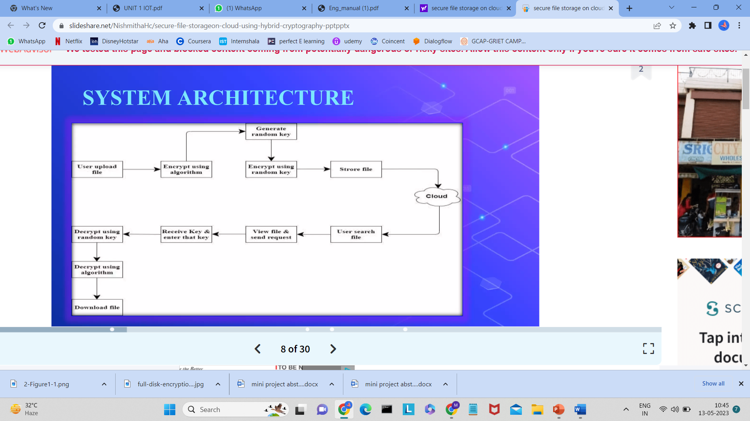
8. System Architecture

Slide 14
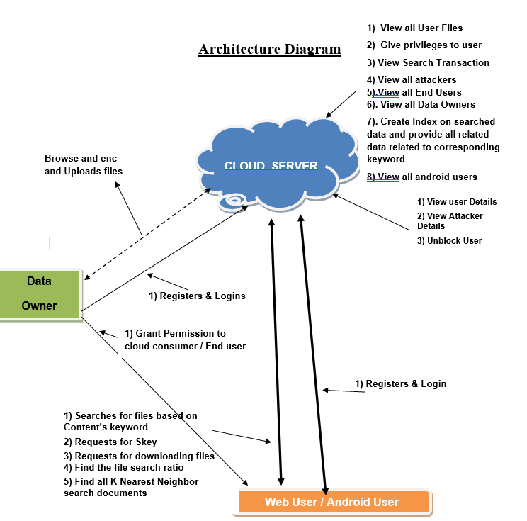

Slide 15
9. UmL Diagrams

Slide 16
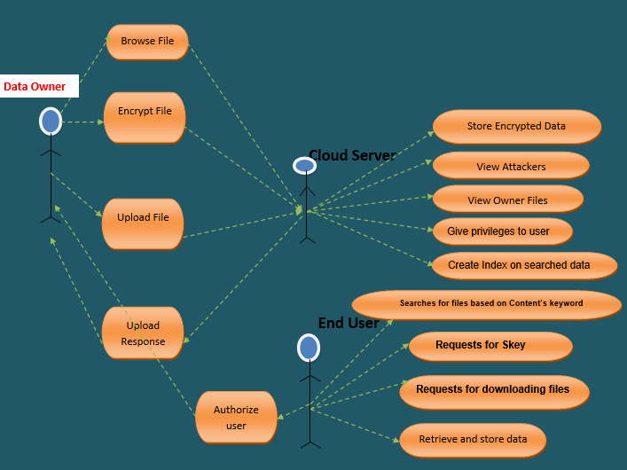
9.1 Use case

Slide 17
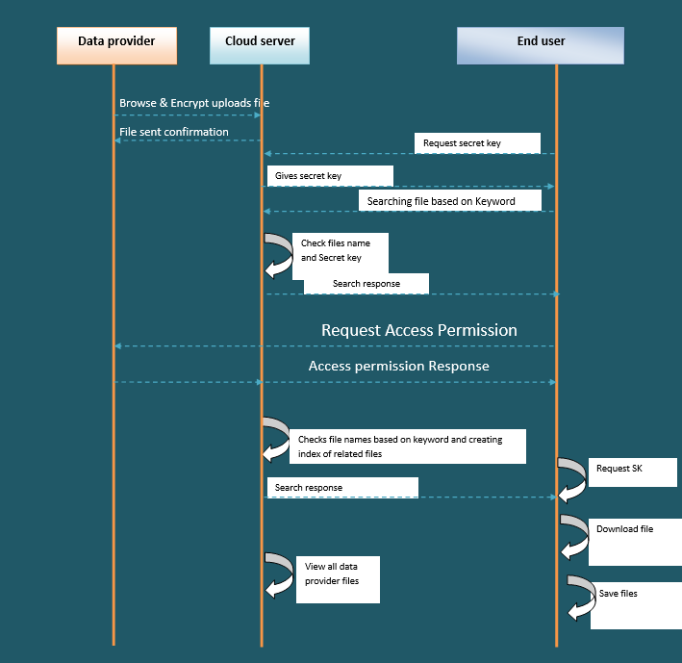
9.2 Sequence diagram

Slide 18
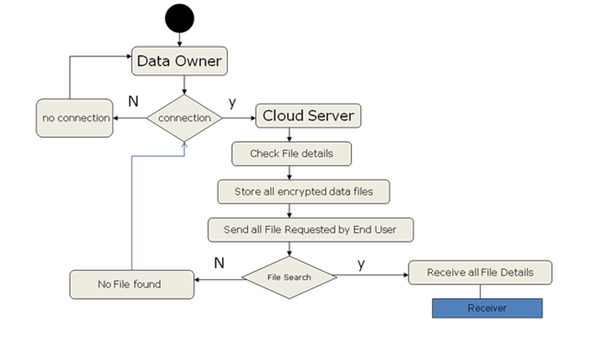
9.3 Activity Diagram

Slide 19
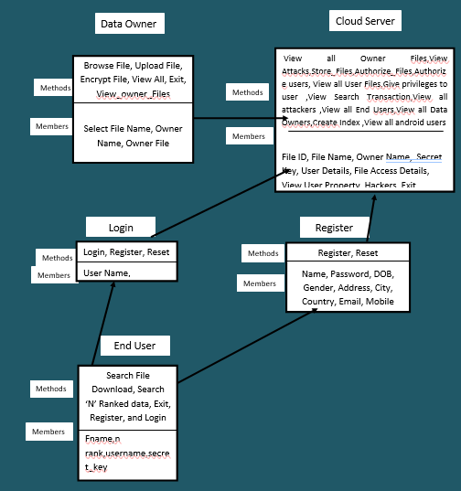
9.4 Class Diagram

Slide 20
Thank you

