Slide 1

DEPARTMENT OF CSE-DS
 | MALLA REDDY COLLEGE OF ENGINEERING (Approved by AICTE, Permanently Affiliated to JNTUH) Recognised under Section 2(f) & 12(B) of the UGC Act 1956, An ISO 9001:2015 Certified Institution. Maisammaguda, Dhulapally, post via Kompally, Secunderabad - 500100
MINI PROJECT REVIEW -0/1/2
ACADEMIC YEAR: 2023-2024
YEAR: II SEM:I
DATE :27-06-2024

Slide 2
Cyber threat detection based on artificial neural network using event profiles.
TEAM MEMBERS
1. G . Siri (22Q91A6719)
2. L . Karthik (22Q91A6724)
3. E . Shivashankar (22Q91A6717)
4. K . Naveen (22Q91A6729)
Under the Guidance of
Mr/Ms/Mrs.
Assistant Professor-CSE-DS

Slide 3
ABSTRACT
One of the major challenges in cybersecurity is the provision of an automated and effective cyber-threats detection technique. In this paper, we present an AI technique for cyber-threats detection, based on artificial neural networks
Introduces AI-driven cyber-threat detection using neural networks.
Employs FCNN, CNN, and LSTM for deep learning-based detection.
Develops an AI-SIEM system integrating event profiling and ANN methods.
Compares performance with SVM, k-NN, RF, NB, and DT using diverse datasets.
Shows ANN methods outperform conventional techniques in detecting network intrusions.

Slide 4
INTRODUCTION
Cyber threat detection using artificial neural networks (ANNs) involves using advanced software that learns from patterns in data to spot potential cyber threats. It works by analyzing logs of activities on computers and networks, looking for abnormal behavior that might indicate a hacker or a security breach. By training these neural networks with examples of both normal and suspicious activities, they can become better at identifying and alerting us to potential threats in real-time. This helps organizations stay ahead of cyber attacks and protect their systems and data more effectively

Slide 5
LITERATURE SURVEY

Slide 6
HARDWARE REQUIREMENTS
System : Pentium IV 2.4 GHz.
Hard Disk : 40 GB.
Floppy Drive : 1.44 Mb.
Monitor : 14’ Colour Monitor.
Mouse : Optical Mouse.
Ram : 512 Mb.
HARDWARE REQUIREMENTS
Operating system : Windows 7 Ultimate.
Coding Language : Python.
Front-End : Python.
Designing : Html,css,javascript.
Data Base : MySQL.

Slide 7


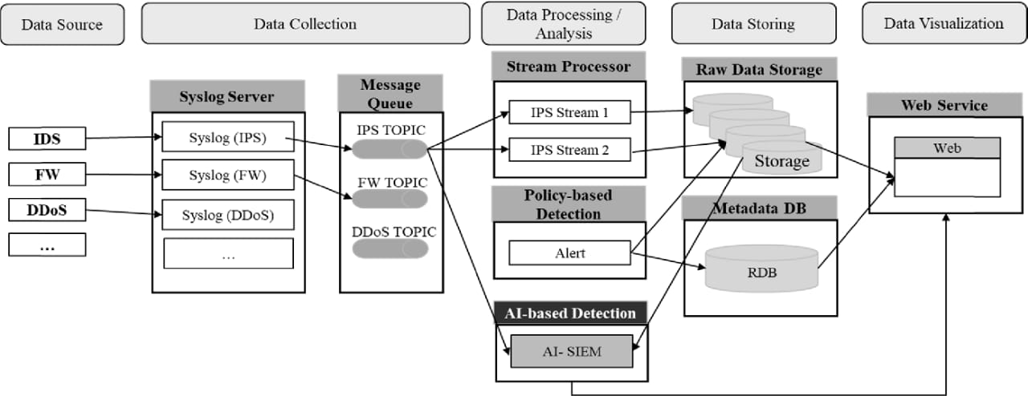
ARCHITECTURE

Slide 8
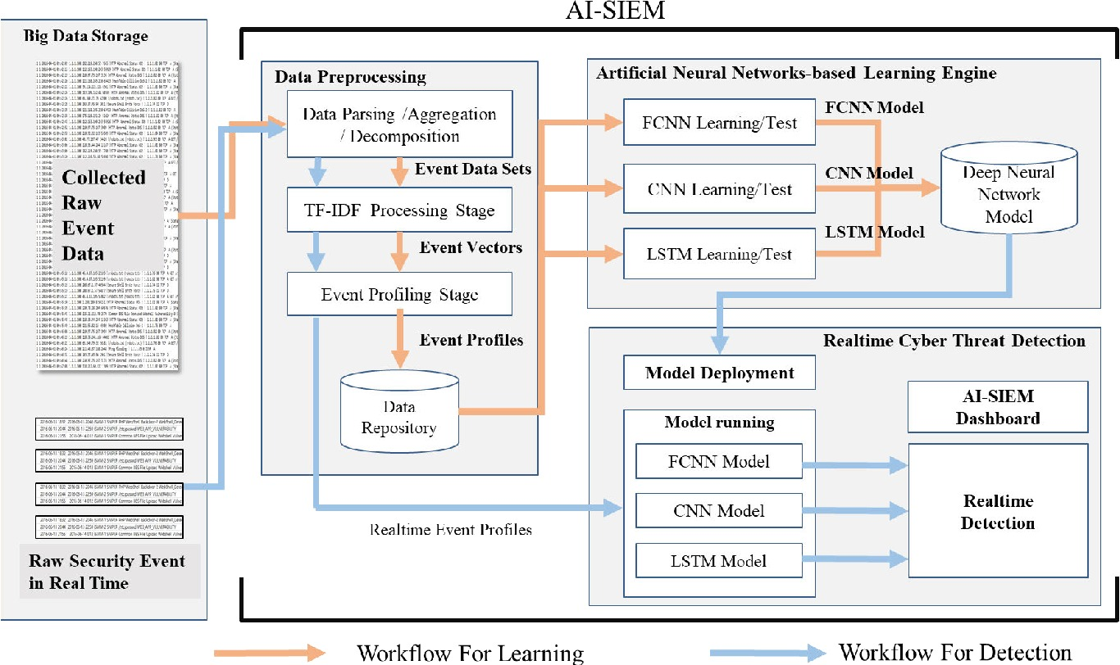
WORKFLOW

Slide 9
MODULES
Load Dataset:
Load data set using pandas read csv() method.
Split Data Set:
Split the data set to two types. One is train data test and another one is test data set.
Train data set:
Train data set will train our data set using fit method.
Test data set:
Test data set will test the data set using algorithm.
Predict data set:
Predict() method will predict the results.

Slide 10
ALGORITHMS
LSTM (Long Short-Term Memory)
A type of neural network good for understanding sequences, like sentences. It helps in learning patterns over long pieces of text.
CNN (Convolutional Neural Network)
Often used for images but can also analyze text by treating it like a signal. It helps in picking out important features from the text.
SVM (Support Vector Machine)
A classifier that finds the best line or boundary to separate different classes (like positive or negative texts).
KNN (K-Nearest Neighbors)
Classifies data points based on the closest points to them. It's like saying "you are similar to your neighbors."
Naive Bayes
A simple probabilistic classifier that assumes all features are independent. It's fast and works well for text classification.
Decision Tree
A tree-like model of decisions. Each node represents a decision point based on a feature, leading to a final classification.
Random Forest
An ensemble method that builds multiple decision trees and averages their results. It improves accuracy and reduces overfitting.

Slide 11
Methodologies
Data Preprocessing
Converting text data into numerical data that models can understand using ‘CountVectorizer’.
Train-Test Split
Splitting the dataset into two parts: one for training the models and one for testing their performance.
Performance Metrics
Evaluating models using:
Accuracy: How often the model is correct.
Precision: How many of the positive predictions are actually correct.
Recall: How many of the actual positives the model correctly identified.
F1-Score: A balance between precision and recall.
Graphical Comparison
Using bar graphs to compare how well each model performs in terms of accuracy, precision, recall, and F1-score.

Slide 12
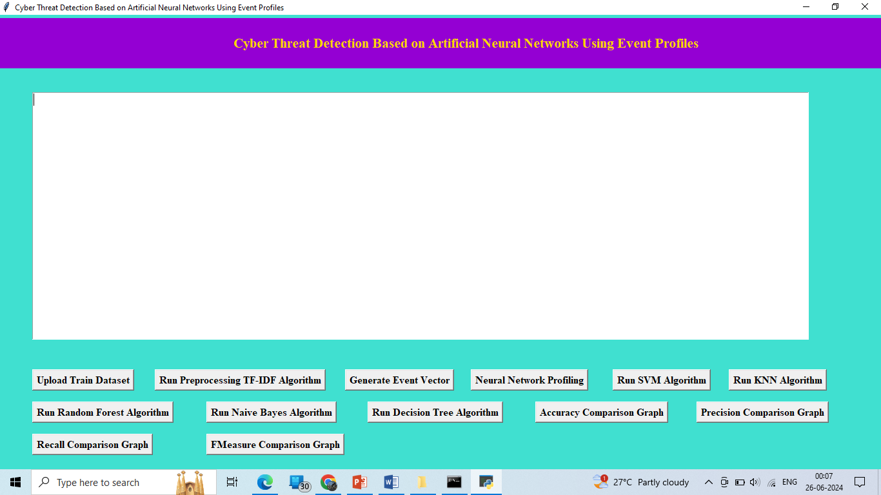
SAMPLE OUTPUT

Slide 13
CONCLUSION
In this paper, we proposed the AI-SIEM system, which uses event profiles and artificial neural networks to enhance cyber-threat detection. The novelty of our approach lies in condensing large-scale data into event profiles and applying deep learning methods. This system helps security analysts manage significant security alerts efficiently and respond quickly to threats by reducing false positives. We evaluated our system using two benchmark datasets (NSLKDD, CICIDS2017) and two real-world datasets. Our experiments showed that our methods could be used as effective learning-based models for network intrusion detection, outperforming conventional machine learning methods in accurate classifications.

Slide 14
REFERENCES
[1] S. Naseer, Y. Saleem, S. Khalid, M. K. Bashir, J. Han, M. M. Iqbal, K. Han, "Enhanced Network Anomaly Detection Based on Deep Neural Networks," IEEE Access, vol. 6, pp. 48231-48246, 2018.
[2] B. Zhang, G. Hu, Z. Zhou, Y. Zhang, P. Qiao, L. Chang, "Network Intrusion Detection Based on Directed Acyclic Graph and Belief Rule Base", ETRI Journal, vol. 39, no. 4, pp. 592-604, Aug. 2017
[3] W. Wang, Y. Sheng and J. Wang, "HAST-IDS: Learning hierarchical spatial-temporal features using deep neural networks to improve intrusion detection," IEEE Access, vol. 6, no. 99, pp. 1792-1806, 2018.
[4] M. K. Hussein, N. Bin Zainal and A. N. Jaber, "Data security analysis for DDoS defense of cloud based networks," 2015 IEEE Student Conference on Research and Development (SCOReD), Kuala Lumpur, 2015, pp. 305-310.

Slide 15


