Slide 1

DEPARTMENT OF CSE-DS
 | MALLA REDDY COLLEGE OF ENGINEERING (Approved by AICTE, Permanently Affiliated to JNTUH) Recognised under Section 2(f) & 12(B) of the UGC Act 1956, An ISO 9001:2015 Certified Institution. Maisammaguda, Dhulapally, post via Kompally, Secunderabad - 500100
MINI PROJECT REVIEW -1
ACADEMIC YEAR: 2023-2024
YEAR: II SEM:I
DATE :27-06-2024

Slide 2
Cyber threat detection based on artificial neural network using event profiles.
TEAM MEMBERS
1. G . Siri (22Q91A6719)
2. L . Karthik (22Q91A6734)
3. E . Shivashankar (22Q91A6717)
4. K . Naveen (22Q91A6729)
Under the Guidance of
Mrs.PV. HARIKA
ASSISTANT PROFESSOR

Slide 3
CONTENTS
INTRODUCTION
METHODOLOGY-ALGORITHM
MODULES
ARCHITECTURE
WORKFLOW
LITERATURE SURVEY
HARDWARE AND SOFTWARE REQUIREMENTS
SAMPLE OUTPUT
CONCLUSION
REFERENCES

Slide 4
INTRODUCTION
One of the major challenges in cybersecurity is the provision of an automated and effective cyber-threats detection technique. In this, we present an AI technique for cyber-threats detection, based on artificial neural networks
Introduces AI-driven cyber-threat detection using neural networks.
Employs FCNN, CNN, and LSTM for deep learning-based detection.
Develops an AI-SIEM system integrating event profiling and ANN methods.
Compares performance with SVM, k-NN, RF, NB, and DT using diverse datasets.
Shows ANN methods out perform conventional techniques in detecting network intrusions.

Slide 5
Cyber threat detection using artificial neural networks (ANNs) involves using advanced software that learns from patterns in data to spot potential cyber threats.
It works by analyzing logs of activities on computers and networks, looking for abnormal behavior that might indicate a hacker or a security breach.
By training these neural networks with examples of both normal and suspicious activities, they can become better at identifying and alerting us to potential threats in real-time.
This helps organizations stay ahead of cyber attacks and protect their systems and data more effectively

Slide 6
METHODOLOGIES
Data Preprocessing
Converting text data into numerical data that models can understand using ‘CountVectorizer’.
Train-Test Split
Splitting the dataset into two parts: one for training the models and one for testing their performance.
Performance Metrics
Evaluating models using:
Accuracy: How often the model is correct.
Precision: How many of the positive predictions are actually correct.
Recall: How many of the actual positives the model correctly identified.
F1-Score: A balance between precision and recall.
Graphical Comparison
Using bar graphs to compare how well each model performs in terms of accuracy, precision, recall, and F1-score.

Slide 7
ALGORITHMS
LSTM (Long Short-Term Memory)
A type of neural network good for understanding sequences, like sentences. It helps in learning patterns over long pieces of text.
CNN (Convolutional Neural Network)
Often used for images but can also analyze text by treating it like a signal. It helps in picking out important features from the text.
SVM (Support Vector Machine)
A classifier that finds the best line or boundary to separate different classes (like positive or negative texts).
KNN (K-Nearest Neighbors)
Classifies data points based on the closest points to them. It's like saying "you are similar to your neighbors."
Naive Bayes
A simple probabilistic classifier that assumes all features are independent. It's fast and works well for text classification.
Decision Tree
A tree-like model of decisions. Each node represents a decision point based on a feature, leading to a final classification.
Random Forest
An ensemble method that builds multiple decision trees and averages their results. It improves accuracy and reduces overfitting.

Slide 8
MODULES
Load Dataset:
Load data set using pandas read csv() method.
Split Data Set:
Split the data set to two types. One is train data test and another one is test data set.
Train data set:
Train data set will train our data set.
Test data set:
Test data set will test the data set using algorithm.
Predict data set:
Predict() method will predict the results.

Slide 9


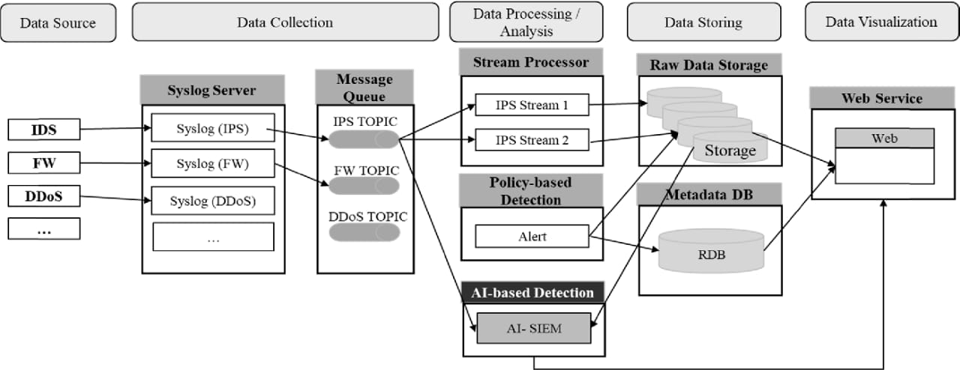
ARCHITECTURE

Slide 10
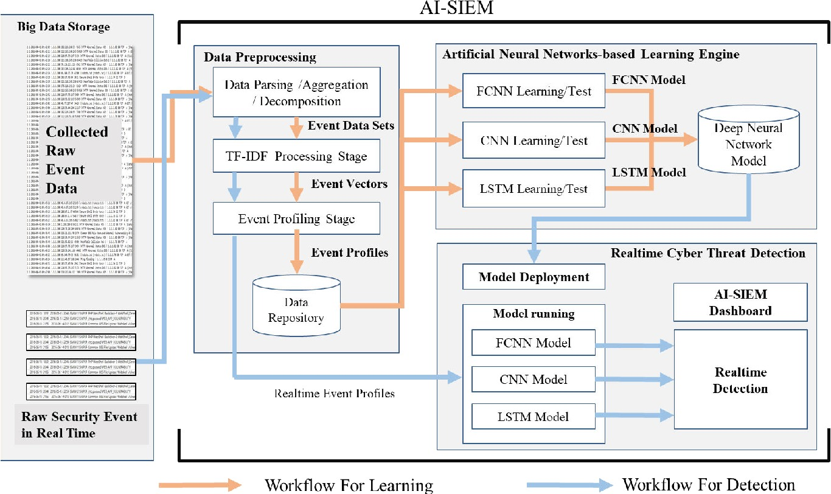
WORKFLOW

Slide 11
LITERATURE SURVEY
A.DEEP LEARNING-BASED INTRUSION DETECTION
AUTHOR: Naseer et al
[1]proposed, implemented and trained intrusion detection models using different deep neural network architectures including CNNs, Autoencoders, and RNNs. These models were trained on the NSLKDD training dataset and evaluated on both test datasets provided by NSLKDD. DCNN and LSTM models showed a performance of 85% and 89% accuracy, respectively, on test dataset.
AUTHOR: Wang et al
[2] proposed a hierarchical spatial and temporal features-based intrusion detection system (HAST-IDS) that automatically learns network traffic features. The main idea is that the spatial features of network traffic are first learned using deep CNNs and then learns the temporal features are learned LSTM networks. The experiments were conducted by DARPA and ISCX datasets.

Slide 12
AUTHOR: Du et al
[3] proposed a new algorithm based on the k-NN classifier method using TF-IDF for modeling program behavior in intrusion detection regarding system calls. In [29], with the k-NN classifier, the frequencies of system calls are used to describe the program behavior. For this, text categorization techniques, such as TF-IDF, are adopted to transform each system call data to a vector and measure the similarity between two program system call activities.
B. REAL SECURITY EVENT ANALYSIS
AUTHOR:Shen et al
[4] developed the system for predicting security events through deep learning, which is called Tiresias. Authors presented a system that leverages RNNs to predict future events on a machine, based on previous observations. It tested on a dataset of 3.4 billion security events collected from a commercial IPS, and showed that its approach is effective in predicting the next event that will occur on a machine with a precision of up to 0.93.
AUTHOR:Liao and Vemuri
[5] proposed DeepLog, a deep neural network model employing LSTM to train a system’s log patterns (e.g., log key patterns and corresponding parameter value patterns) from normal execution. This work uses the term frequency inverse document frequency (TF-IDF) vector to the log key.

Slide 13
HARDWARE REQUIREMENTS
System : Pentium IV 2.4 GHz.
Hard Disk : 40 GB.
Floppy Drive : 1.44 Mb.
Monitor : 14’ Colour Monitor.
Mouse : Optical Mouse.
Ram : 512 Mb.
SOFTWARE REQUIREMENTS
Operating system : Windows 7 Ultimate.
Coding Language : Python.
Front-End : Python
Data Base : MySQL.

Slide 14
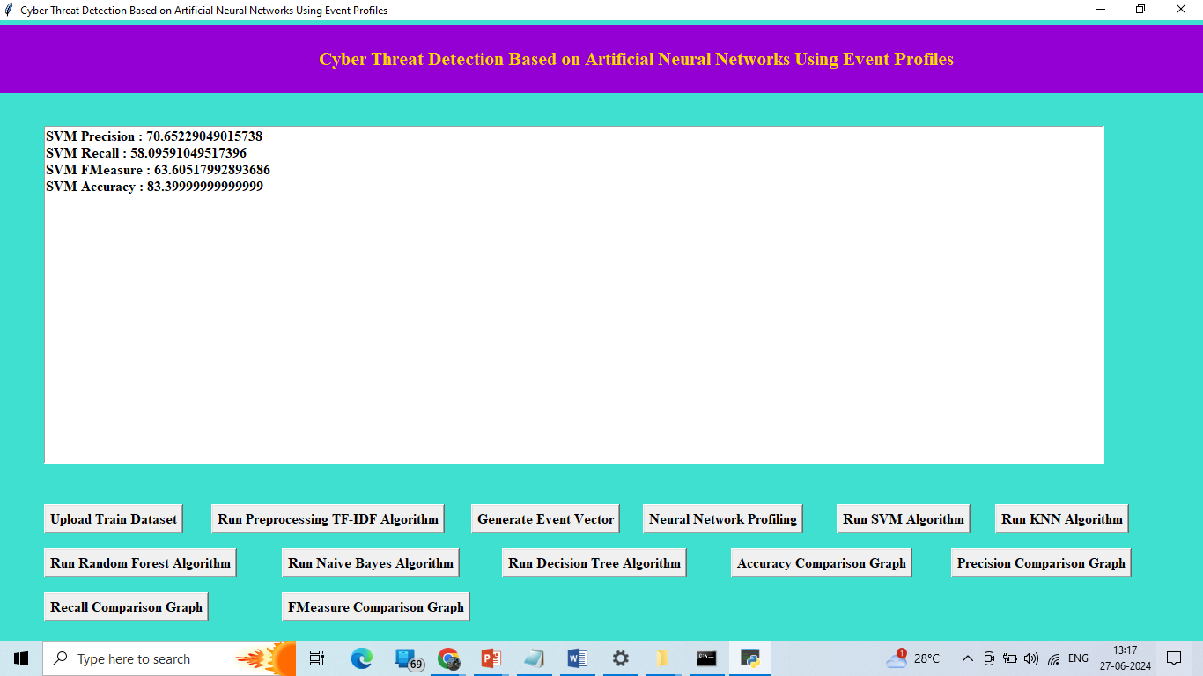
SAMPLE OUTPUT

Slide 15
CONCLUSION
In this paper, we proposed the AI-SIEM system, which uses event profiles and artificial neural networks to enhance cyber-threat detection. The novelty of our approach lies in condensing large-scale data into event profiles and applying deep learning methods. This system helps security analysts manage significant security alerts efficiently and respond quickly to threats by reducing false positives. We evaluated our system using two benchmark datasets (NSLKDD, CICIDS2017) and two real-world datasets. Our experiments showed that our methods could be used as effective learning-based models for network intrusion detection, outperforming conventional machine learning methods in accurate classifications.

Slide 16
REFERENCES
[1] S. Naseer, Y. Saleem, S. Khalid, M. K. Bashir, J. Han, M. M. Iqbal, and K. Han, ‘‘Enhanced network anomaly detection based on deep neural networks,’’ IEEE Access, vol. 6, pp. 48231–48246, 2018.
[2] W. Wang, Y. Sheng, and J. Wang, ‘‘HAST-IDS: Learning hierarchical spatial-temporal features using deep neural networks to improve intrusion detection,’’ IEEE Access, vol. 6, pp. 1792–1806, 2018.
[3] M. Du, F. Li, G. Zheng, and V. Srikumar, ‘‘DeepLog: Anomaly detection and diagnosis from system logs through deep learning,’’ in Proc. ACM CCS, Dallas, TX, USA, vol. 17, Nov. 2017, pp. 1285–1298.
[4] Y. Shen, E. Mariconti, P. A. Vervier, and G. Stringhini, ‘‘Tiresias: Predicting security events through deep learning,’’ in Proc. ACM CCS, Toronto, ON, Canada, Oct. 2018, pp. 592–605.
[5] Y. Liao and V. Vemuri, ‘‘Use of K-nearest neighbor classifier for intrusion detection,’’ Comput. Secur., vol. 21, no. 5, pp. 439–448, Oct. 2002.

Slide 17


