Slide 1
WSTA Workshop
9-March-2018
Shivashankar Subramanian
shivashankar@student.unimelb.edu.au

Slide 2
Discussion I
Give some examples of text processing applications that you use on a daily basis.

Slide 3
Text processing applications
There are lots!
Web search engines: Google, Bing
Speech-to-text: Siri, Cortana
Other commonly used applications: predictive messaging, spelling correction, machine translation, and so on.

Slide 4
Discussion II
What is tokenisation and why is it important?

Slide 5
Discussion II
What is tokenisation and why is it important?
Segmenting text into linguistic units, such as words, punctuations and numbers
How many tokens are there
The wolf said: "Little pig, little pig, let me come in.“
You’re -> you + ‘ + re
Important to normalize text. Also can give better features, say for classification.
Depends on the language (Language identification)

Slide 6
Discussion II
What are stemming and lemmatisation, and how are they different?

Slide 7
Discussion II
What are stemming and lemmatisation, and how are they different?
Both stemming and lemmatisation are mechanisms for transforming a token into a canonical (base, normalised) form. For example, turning the token walking into its base form walk.
Both operate by applying a series of rewrite operations to remove or replace (parts of) affixes (primarily suffixes) (In English).
However, lemmatisation works in conjunction with a lexicon : a list of valid words in the language. The goal is to turn the input token into an element of this list (a valid word) using the rewrite rules. If the re-write rules can’t be used to transform the token into a valid word, then the token is left alone.
Stemming simply applies the rewrite rules, even if the output is a garbage token.

Slide 8
Inflectional Vs Derivational Morphology
Inflectional morphology is the systematic process by which tokens are altered to conform to certain grammatical constraints:
E.g., English noun teacher --- plural form is teachers.
The idea is that these changes don’t really alter the meaning of the term.
Consequently, both stemming and lemmatisation attempt to remove this kind of morphology.

Slide 9
Inflectional Vs Derivational Morphology
Derivational morphology is the process by which we transform terms of one class into a different class.
E.g., if we would like to make the English verb teach into a noun (someone who performs the action of Teaching), then it must be represented as teacher.
This kind of morphology tends to produce terms that differ (perhaps subtly) in meaning, and the two separate forms are usually both listed in the lexicon.
Consequently, lemmatisation doesn’t usually remove derivational morphology in its normalisation process, but stemming usually does.

Slide 10
Discussion III
What is text-classification? Give some examples
Classifying a piece of text into pre-defined set of categories (in general)
Sentiment analysis, author identification, fake news detection, etc

Slide 11
Discussion III
Why is text classification generally a difficult problem? What are some hurdles that need to be overcome?
Representation --- bag-of-words, bag-of-ngrams
Sparsity (feature selection, transformation)

Slide 12
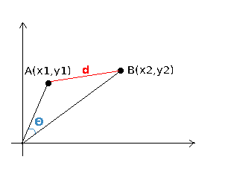
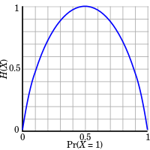
Discussion III
Supervised text classification problem:
k-Nearest Neighbour using Euclidean distance
k-Nearest Neighbour using Cosine similarity
Curse of dimensionality
Hyper parameters – k, distance metric
Decision Trees using Information Gain
Interpretable
Information gain = entropy(parent) – [average entropy(children)]
Not suitable for large dimensions (spurious correlations)
Information Gain is a poor choice because it tends to prefer rare features; in this case, this would correspond to features that appear only in a handful of documents

Slide 13
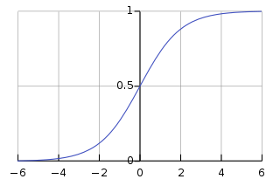
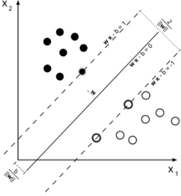
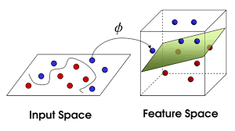
Discussion III
Naive Bayes
Simple and fast
Independence assumption
Not suitable for large dimensions
Logistic Regression
linear
Support Vector Machines
Linear/non-linear kernel
Multi-class

