Slide 1
WSTA 3

Slide 2
Synonym, hypernym, hyponym
Two words are synonyms when they share (mostly) the same meaning:
Snake and serpent are synonyms.
One word is a hypernym of a second word when it is a more general instance (“higher up” in the hierarchy) of the latter, for example, reptile Is the hypernym of snake. (in its animal sense)
Reverse – hyponym
diamond, emerald, and ruby are hyponyms of the word gemstone
poker, roulette, and craps are hyponyms of game
cyan, navy, and ultramarine are hyponyms of blue (which, in turn, is a hyponym of the word color)
fork, knife, and spoon are hyponyms of utensil

Slide 3
Meronym
Part of (Meronym)
Scales is a meronym of reptile
Wheel is a meronym of cycle
What is the opposite?

Slide 4
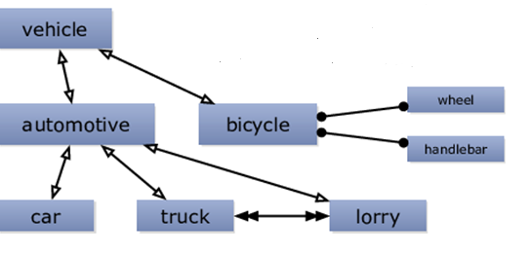
Example

Slide 5
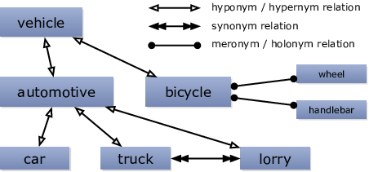
Example

Slide 6
Information - hierarchy

Slide 7
Retrieval

Slide 8

Max similarity
Information & Retrieval – sense 2 for both words
(2 * 4)/(5+8) = 0.615
Overall

