Slide 1
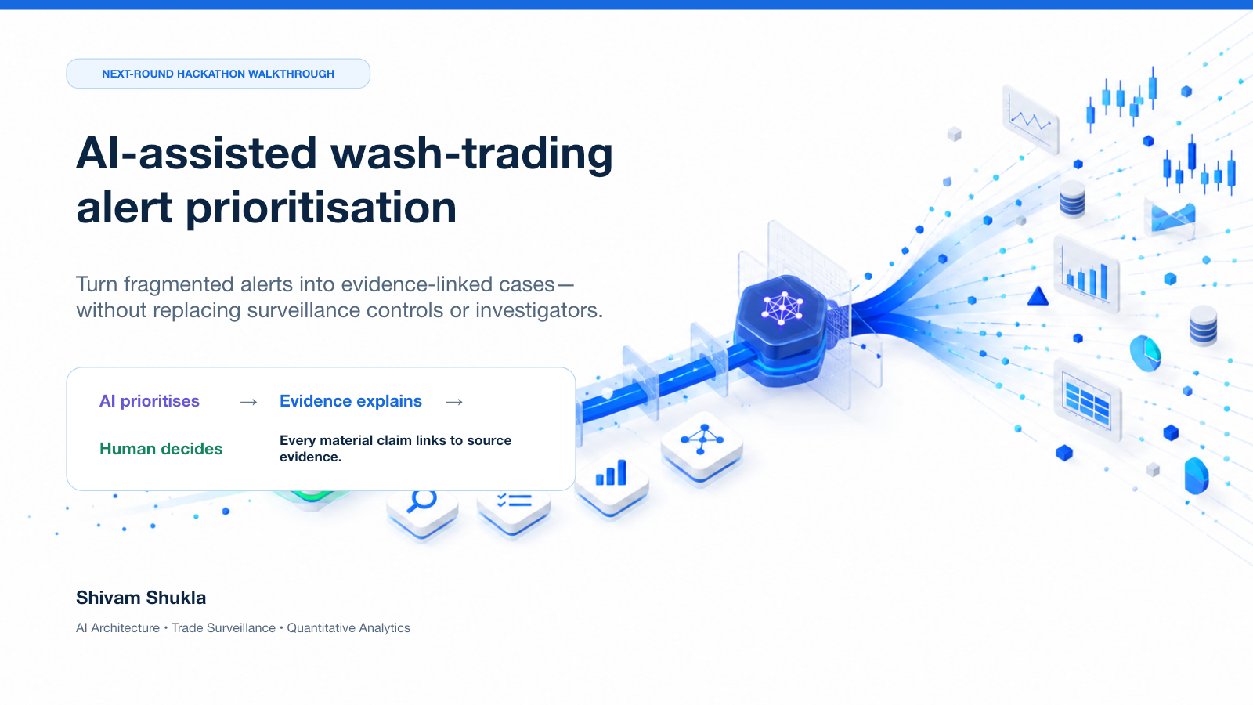
Notes:
Opening cover taken exactly from the attached Next Round Deck.
Introduce the use case as AI-assisted wash-trading alert prioritisation and emphasise that investigators retain decision authority.
[Sources]
- /Users/shivamshukla/Downloads/Trade_Surveillance_Navigator_Next_Round_Deck.pptx, slide 1
- Rendered source image: /Users/shivamshukla/Documents/Codex/2026-08-25/i-x20/attached-next-round-rendered/slide-1.png

Slide 2
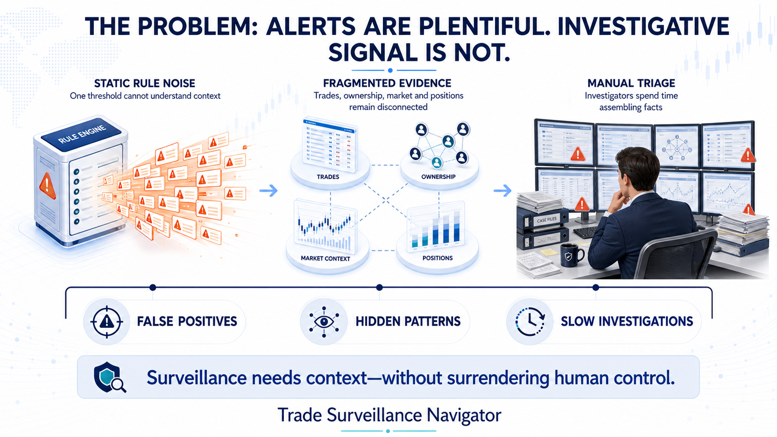
Notes:
Open with the business problem: alert volume is not the same as investigative signal.
Static rules lack context, evidence remains fragmented and investigators spend time assembling facts before they can assess risk.
The slide intentionally uses no numerical claim; it frames the documented prototype objective.
[Sources]
- /Users/shivamshukla/.codex/attachments/9a9f726b-71a2-4f7e-aa84-20169b6c7d19/pasted-text.txt
- OpenAI ImageGen asset: /Users/shivamshukla/Documents/HACKTHON/presentation-assets/00-problem-statement-alerts-vs-signal.png

Slide 3
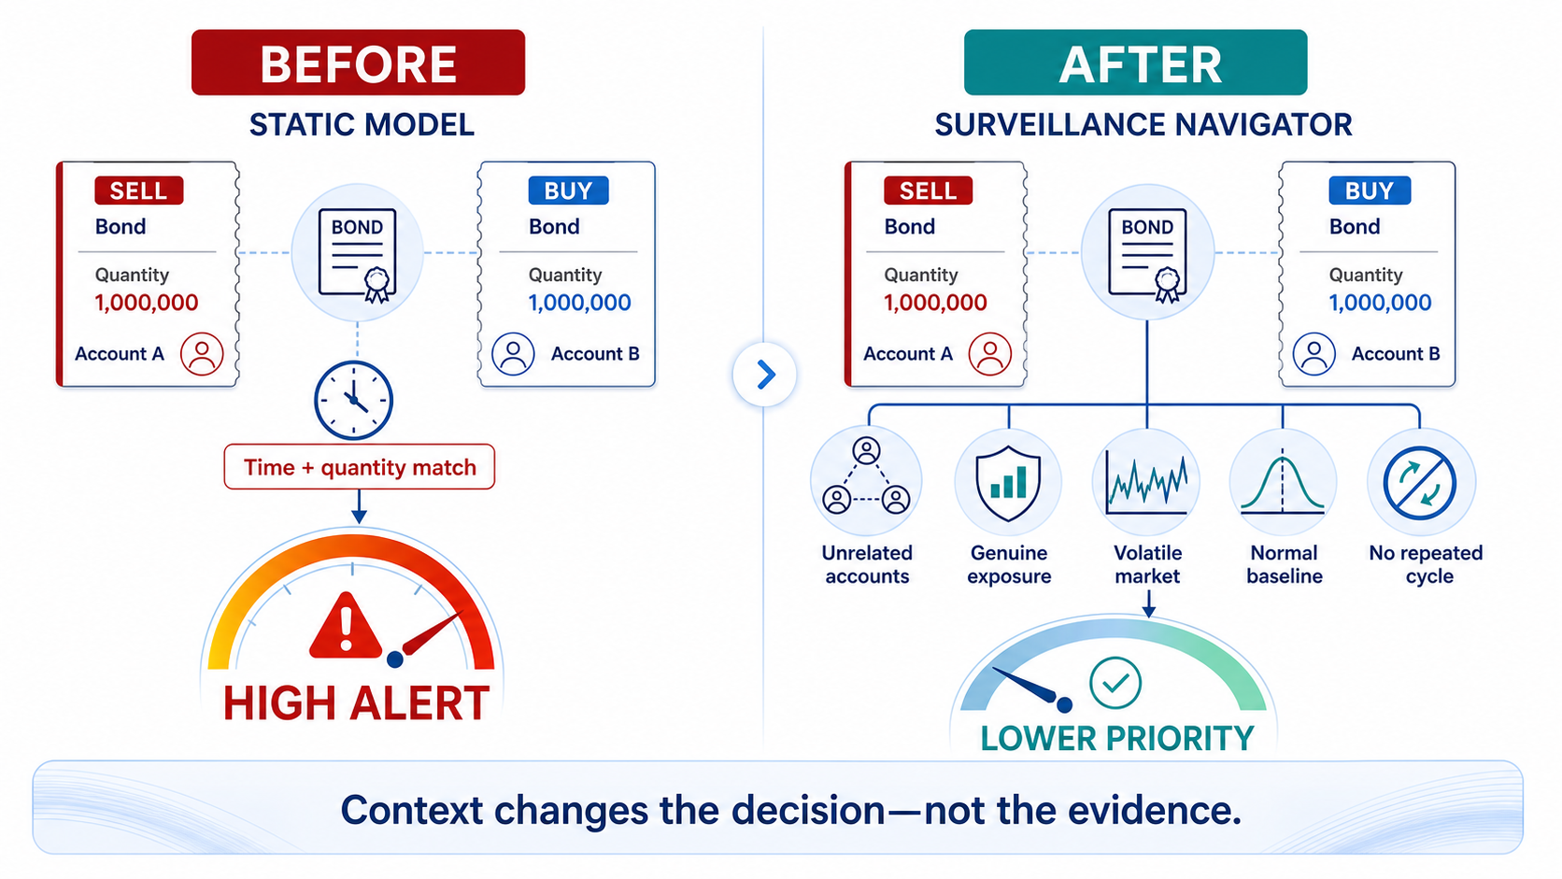
Notes:
Use this scenario to show how legitimate context lowers priority without deleting the original alert.
[Sources]
- OpenAI ImageGen asset: /Users/shivamshukla/Documents/HACKTHON/presentation-assets/02-static-model-vs-surveillance-navigator.png

Slide 4
SURVEILLANCE NAVIGATOR
The current queue sees alerts; Trade Surveillance Navigator sees the case
BEFORE
AFTER
31 isolated rule alerts
1 prioritised case
Repeated review of trades, accounts and context
with weak prioritisation and manual evidence gathering.
67 trades · 4 accounts · 1 common UBO
7 round trips · 2 venues · full evidence lineage
The product does not create more alerts. It compresses, contextualises and prioritises the alerts already generated.
02

Slide 5
SURVEILLANCE NAVIGATOR
A controlled hybrid architecture keeps AI in the right lane
DETERMINISTIC
Timing · price · size · exposure · liquidity
ML / STATS
EBM ranking · anomaly · peer deviation · clustering
GRAPH
Common control · repeated edges · circular motifs
LLM
Evidence synthesis · timeline · rationale
No evidence → no factual claim
No autonomous disposition
03

Slide 6
SURVEILLANCE NAVIGATOR
The strongest MVP model is explainable by construction
CHAMPION
Calibrated Explainable
Boosting Machine
Isolation Forest
Min-cost flow
Behaviour anomaly
Fragment matching
Learns non-linear feature shapes and governed interactions while exposing each local contribution. Isotonic calibration converts ranking outputs into stable prioritisation bands.
Probabilistic linkage
Constrained clustering
Entity resolution
Case compression
The score is priority—not the probability that abuse occurred.
04

Slide 7
SURVEILLANCE NAVIGATOR
Hybrid ML detects known patterns and novel anomalies
SUPERVISED MODEL
Calibrated Histogram
Gradient Boosting
Isolation Forest
Sigmoid calibration
Flags behavioural outliers
Stabilises probability
Learns non-linear combinations of timing, quantity, recurrence, exposure and ownership signals. Sigmoid calibration makes its probabilities more reliable for prioritisation.
Transparent rules
Weighted fusion
Shows risk drivers
45% rules · 55% ML
Graph context enriches features. OpenAI explains cited evidence. Human review remains mandatory.
11
Notes:
The supervised model recognises known combinations; Isolation Forest contributes novel-behaviour detection.
The final score blends transparent rules with the trained ML result. OpenAI is an explanation layer only.
[Sources]
- /Users/shivamshukla/Documents/HACKTHON/ml-service-python/scripts/train_model.py
- /Users/shivamshukla/Documents/HACKTHON/ml-service-python/app/ml_model.py
- /Users/shivamshukla/Documents/HACKTHON/ml-service-python/app/main.py

Slide 8
SURVEILLANCE NAVIGATOR
Implemented ML produces an explainable priority score
COMPONENT | ALGORITHM | PURPOSE
Supervised detection | HistGradientBoostingClassifier | Learns suspicious behavioural combinations from labelled records
Probability calibration | CalibratedClassifierCV + sigmoid | Makes classifier probabilities more meaningful for prioritisation
Anomaly detection | IsolationForest | Flags unusual behaviour, including patterns weakly represented in training
Transparent scoring | Weighted rules + logistic transformation | Shows explainable risk drivers and risk reducers
Hybrid ensemble | Rules + supervised ML + anomaly score | Produces the final prioritisation score
Entity / graph intelligence | Common-control and relationship features | Raises risk when accounts or entities appear connected
OpenAI LLM | Responses API | Turns verified evidence into an investigator-readable summary only
12
Notes:
This slide lists only the algorithms and services currently implemented in the prototype.
Emphasise that the OpenAI layer summarizes verified evidence; it does not classify misconduct or make the final decision.
[Sources]
- Algorithm inventory supplied directly by Shivam Shukla on 2026-09-03.

Slide 9
SURVEILLANCE NAVIGATOR
Context can push the same rule pattern in opposite directions
ILLQUID + LINKED
LIQUID + VOLATILE
94
22
8 seconds · 99.8% size match · 7 cycles
Common UBO · 0.3% net exposure
High-volume event · normal strategy
No resolved link · genuine position change
RULE ALERT ≠ HIGH-RISK CASE
05

Slide 10
SURVEILLANCE NAVIGATOR
The score journey makes every intelligence gain visible
51
→
67
→
71
→
83
→
94
Rule
Pattern
Market
Exposure
Entity
Every stage stores feature values, contributions, versions and evidence references.
06

Slide 11
SURVEILLANCE NAVIGATOR
Every claim resolves to a metric and its source records
CLAIM
METRIC
EVIDENCE
Rapid position
round trip
Net exposure ratio
= 0.30%
[Trade:T183]
[Position:P905]
→
→
“Seven repeated opposing cycles between linked accounts generated high turnover while returning close to the opening position.”
[Trade:T183] [Trade:T187] [Position:P901] [Position:P905] [Ownership:O29]
07

Slide 12
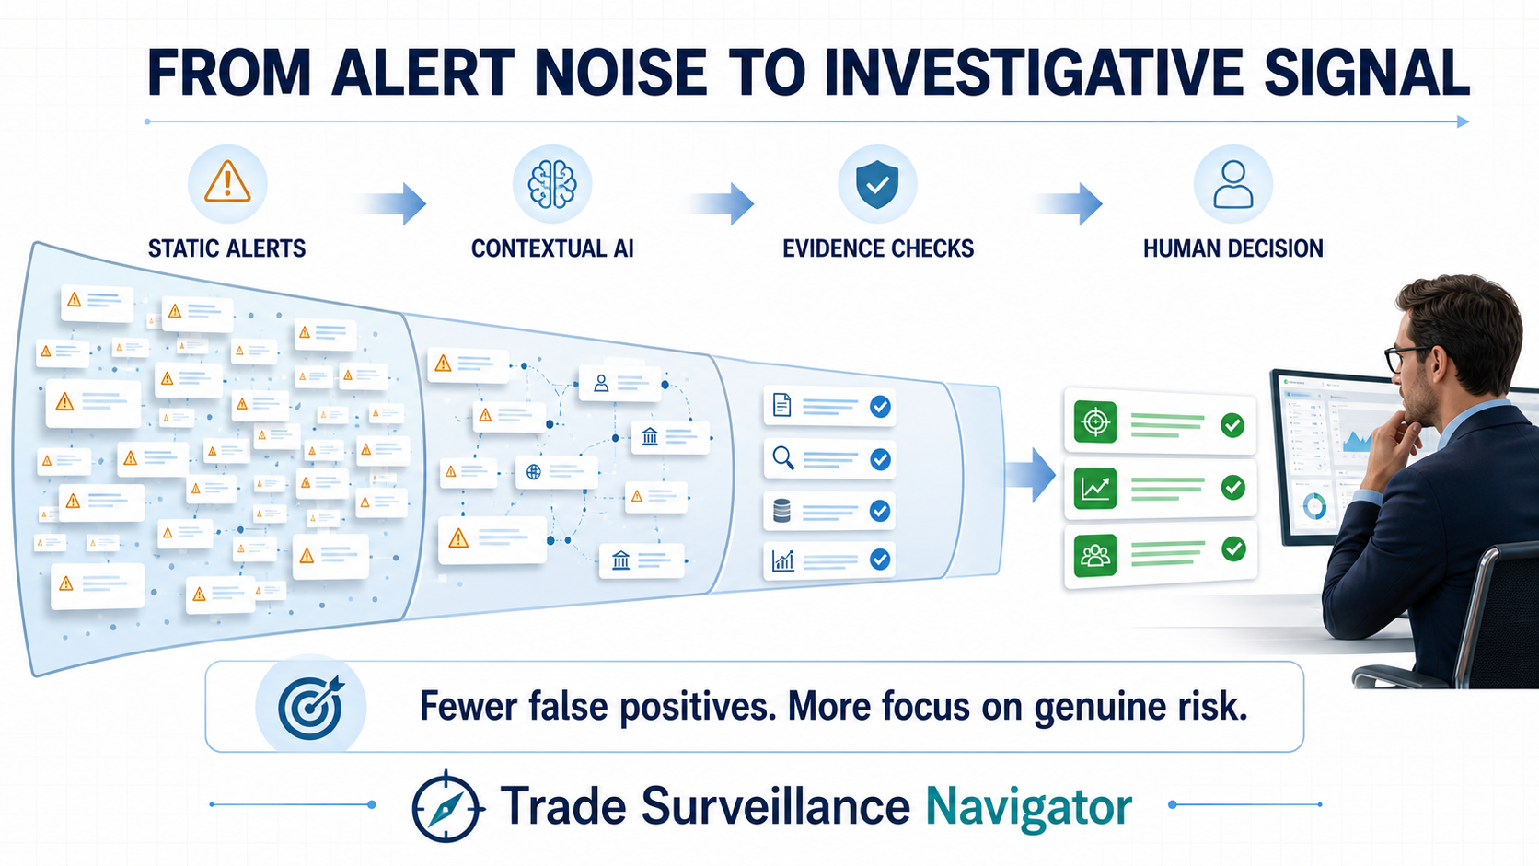
Notes:
Use this visual to explain the false-positive reduction funnel and the role of machine learning in prioritization.
The investigator remains responsible for the final disposition.
[Sources]
- OpenAI ImageGen asset: /Users/shivamshukla/Documents/HACKTHON/presentation-assets/01-alert-noise-to-investigative-signal.png

Slide 13
SURVEILLANCE NAVIGATOR
The prototype demonstrates four judge-ready moments
01
Obvious high risk
94 HIGH
02
False-positive reduction
22 LOW
03
AI connects the dots
46 → 87
04
Coordinated network
Weak trades → strong case
08

Slide 14
SURVEILLANCE NAVIGATOR
One month is enough when sophistication is sequenced
WEEK 1
WEEK 2
WEEK 3
WEEK 4
Trade → alert → risk score
Alert → context → prioritised case
Case → evidence → investigator
Reliability, calibration and story
Matching · recurrence · exposure
Market · baseline · entity · cluster
Citations · confidence · workflow
QA · KPIs · rehearsal
Stop chasing experimental graph ML. Win with a fully working, explainable flow.
09

Slide 15
SURVEILLANCE NAVIGATOR
Success is measured in evidence, priority and time saved
100%
0
67%
4 / 4
citation coverage
unsupported claims
synthetic case compression
golden scenarios
Decision requested
Approve a four-week MVP focused on evidence-backed case prioritisation.
AI prioritises. Evidence explains. Human decides.
10

Slide 16
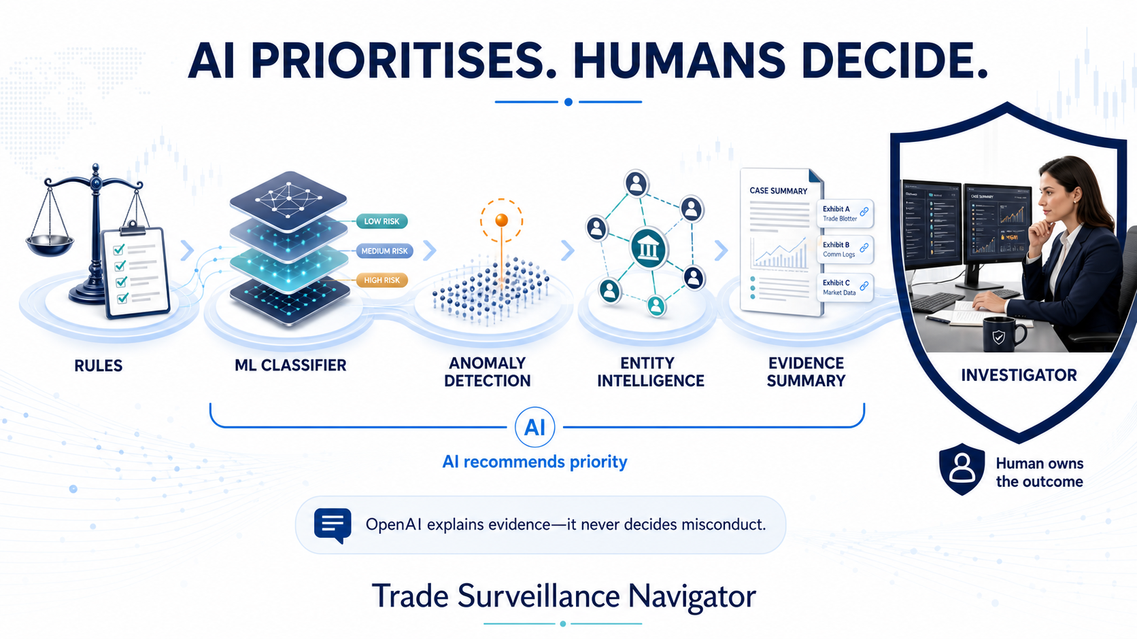
Notes:
Use this visual to reinforce that AI prioritises and explains while the investigator owns the outcome.
[Sources]
- OpenAI ImageGen asset: /Users/shivamshukla/Documents/HACKTHON/presentation-assets/03-ai-prioritises-humans-decide.png

