Slide 1
Crop Production Analysis in India
Unified Mentor Data analytics Internship Project
T.Shiva Kumar Yadav

Slide 2
Overview:
This project focuses on analyzing crop production data to gain insights into agricultural productivity, trends, and factors influencing crop yields. By applying data analytics techniques, the project aims to provide valuable insights for farmers, agricultural policymakers, and stakeholders in the agribusiness sector.
Tools and Technologies:
Language: Python
Libraries: Pandas, NumPy, Matplotlib, Seaborn
Environment: Jupyter Notebook
Deliverables:
Jupyter Notebook with code and explanations.
Visualizations showcasing segmentation and insights.
Concise report summarizing analysis and recommendations

Slide 3
Details of Data
Columns:
State_Name', 'District_Name', 'Crop_Year', 'Season', 'Crop', 'Area', 'Production’
RangeIndex: 246091 entries, 0 to 246090

Slide 4
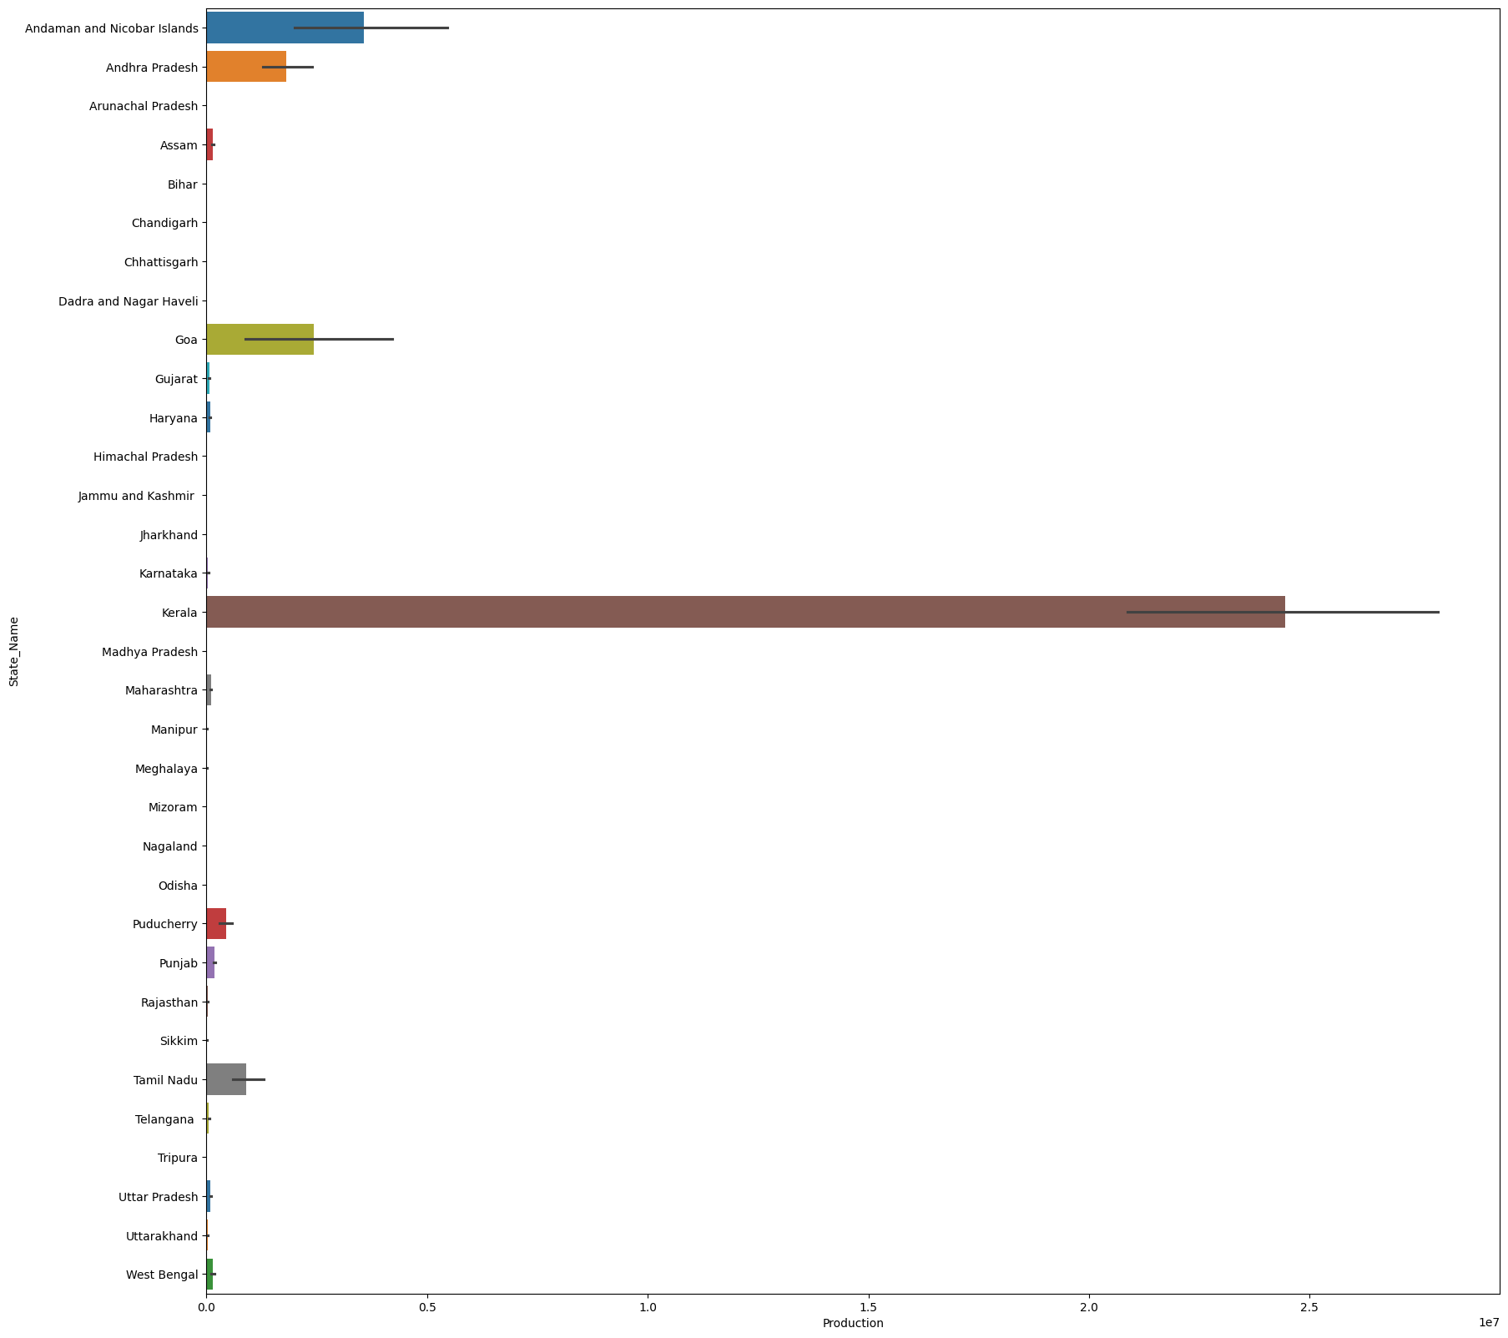
Production vs State Name Graph

Slide 5
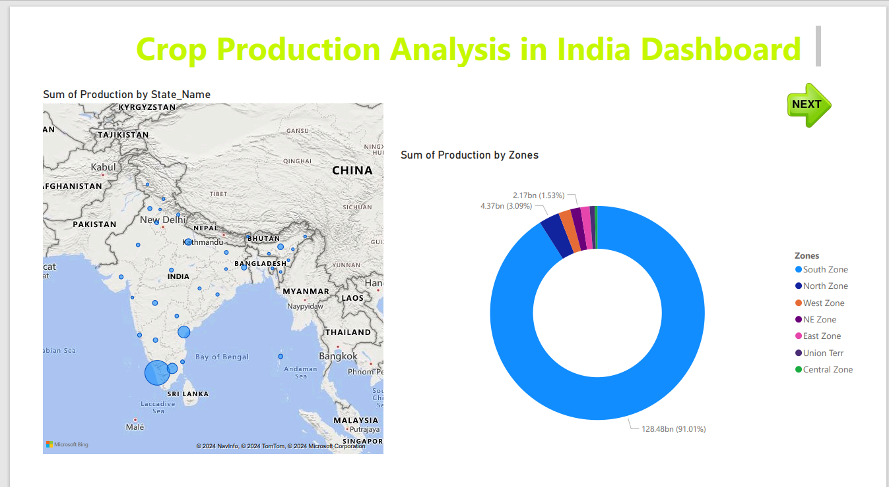
My Dashboards Using Power Bi Tool:

Slide 6
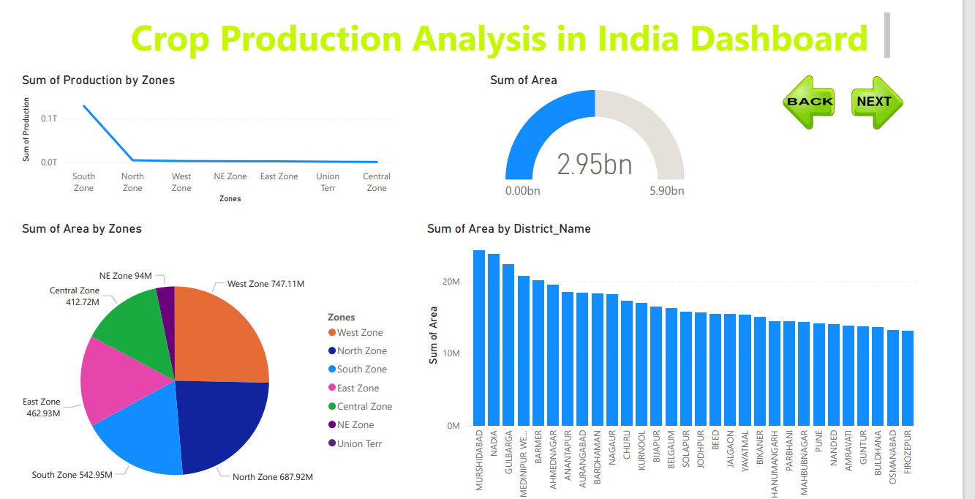

Slide 7
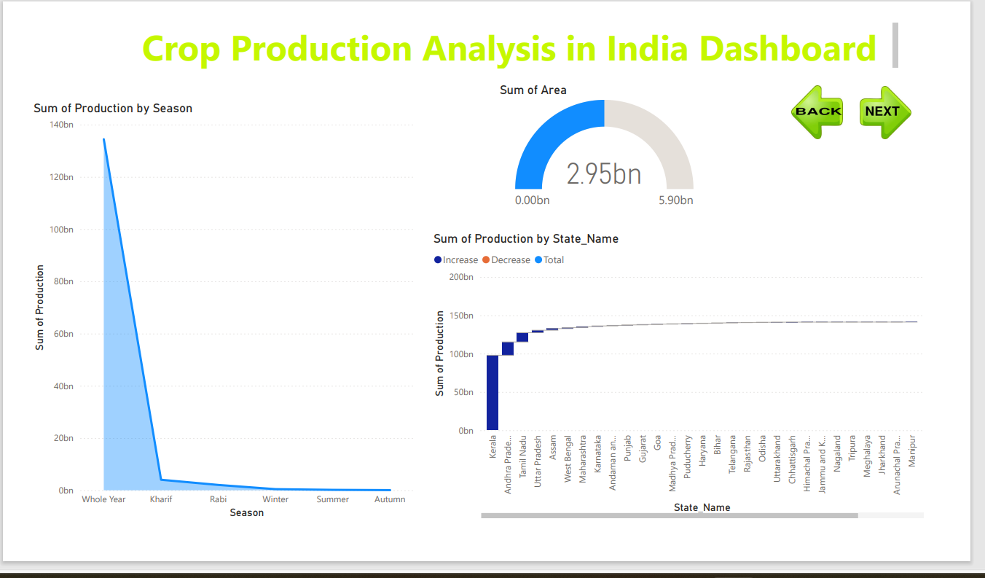

Slide 8
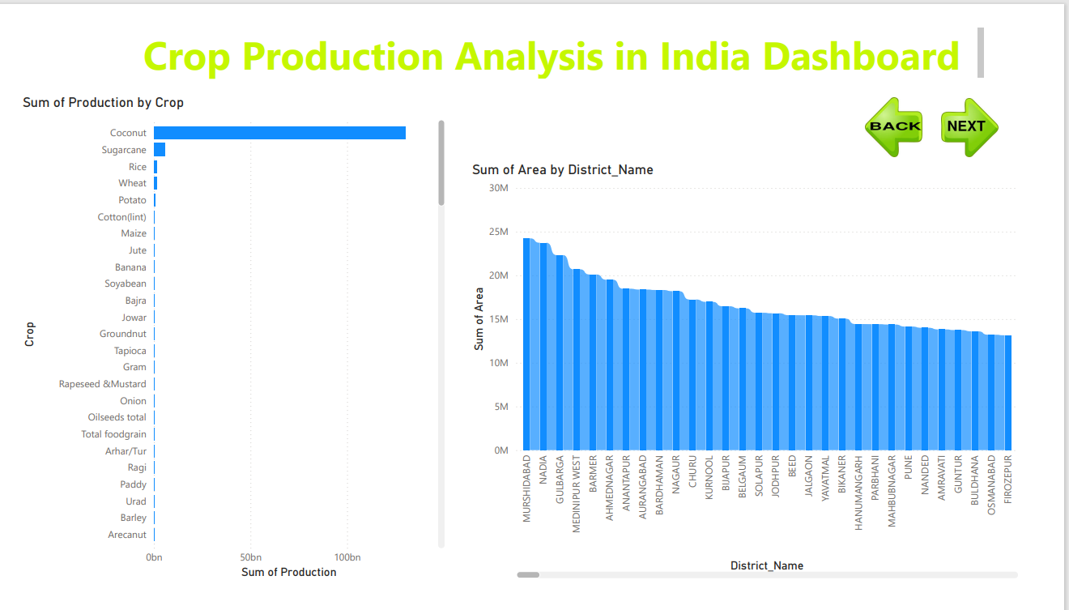

Slide 9
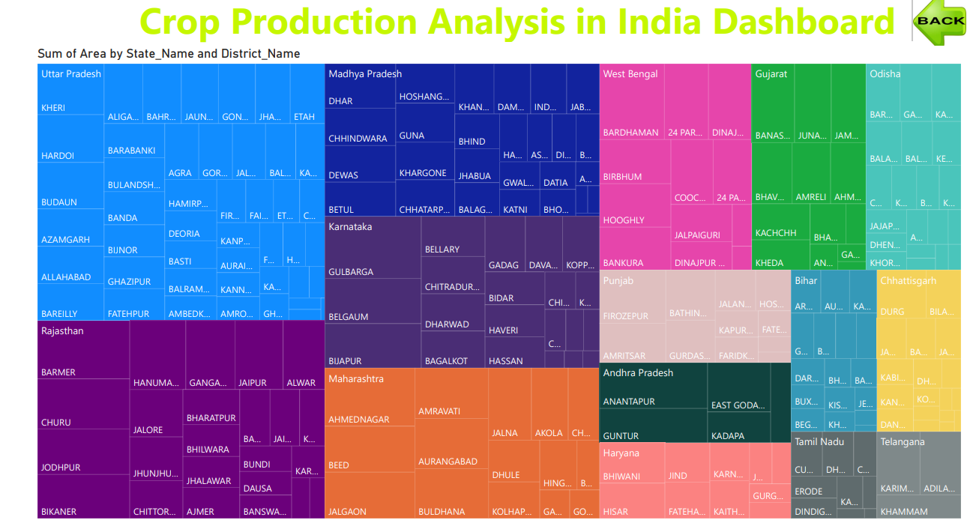

Slide 10
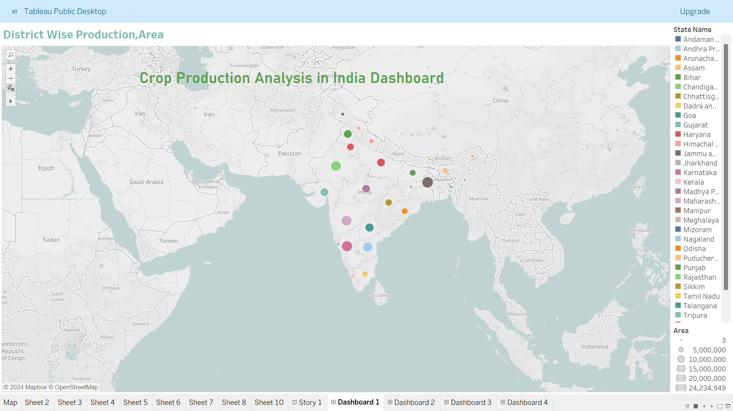
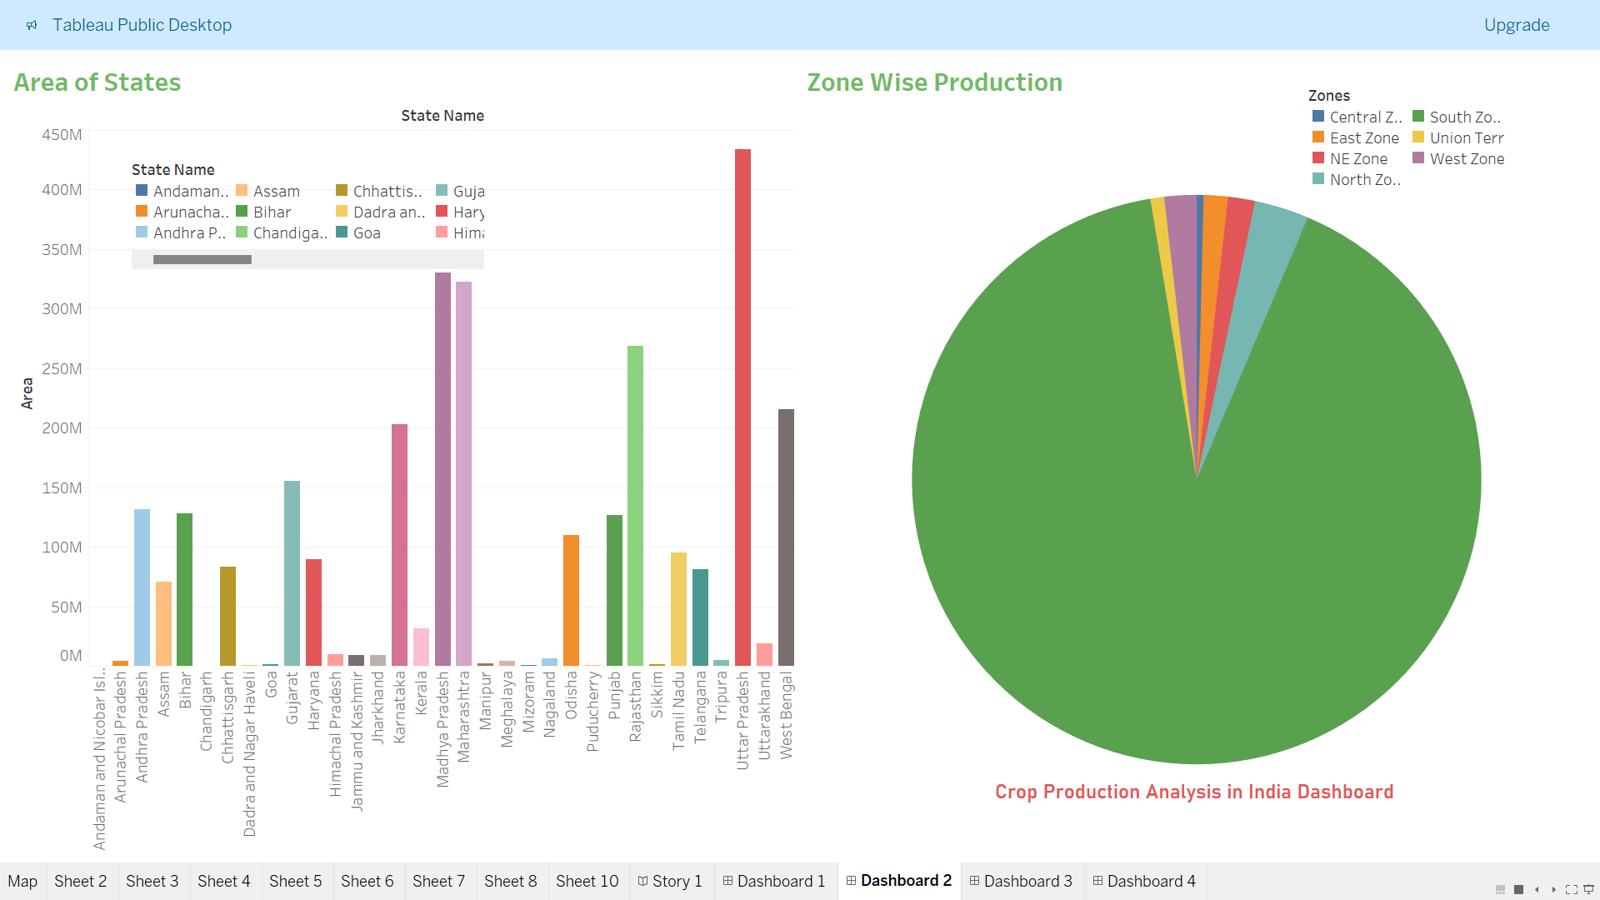
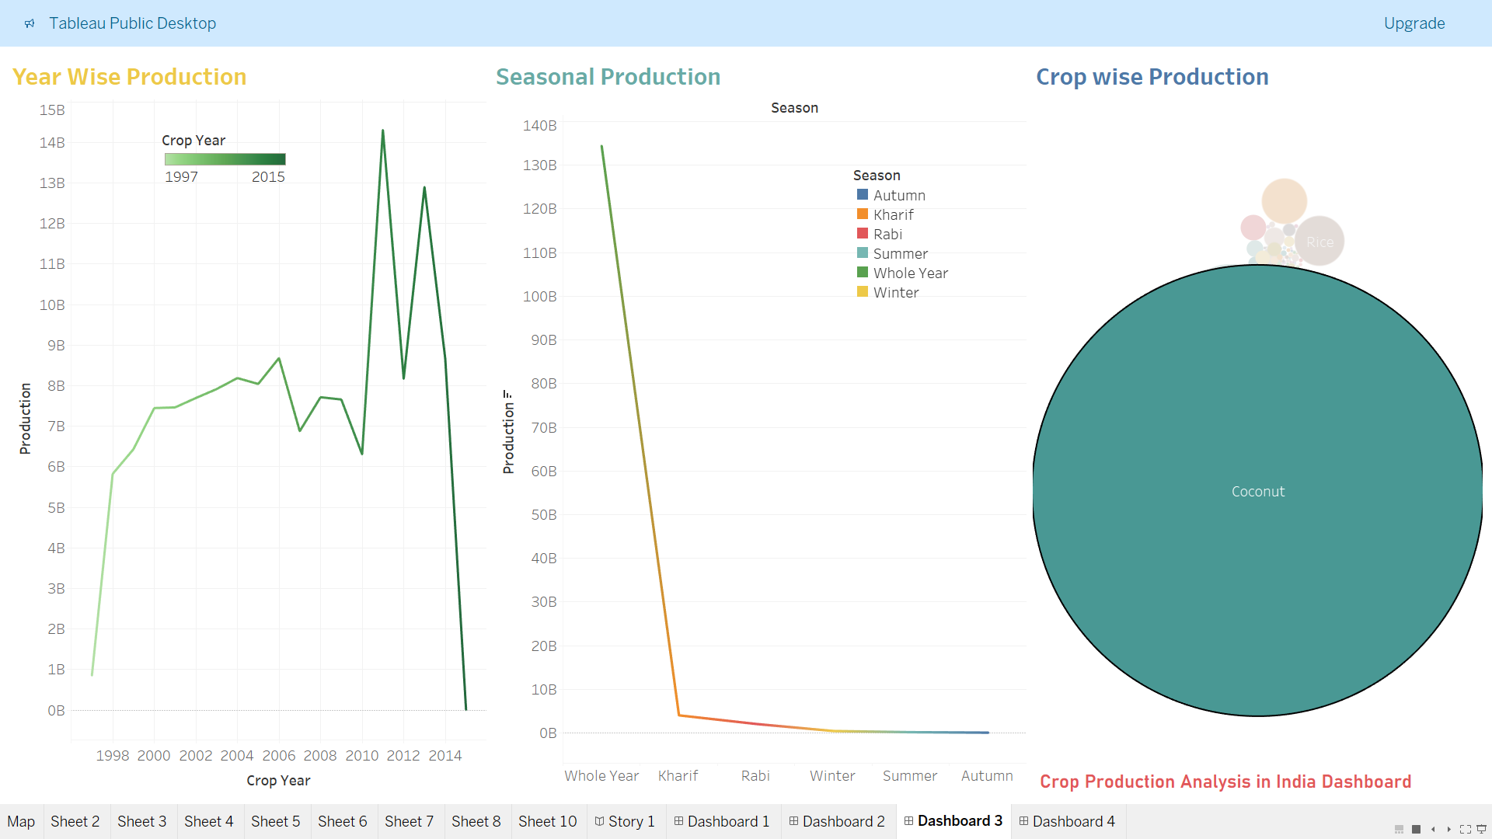
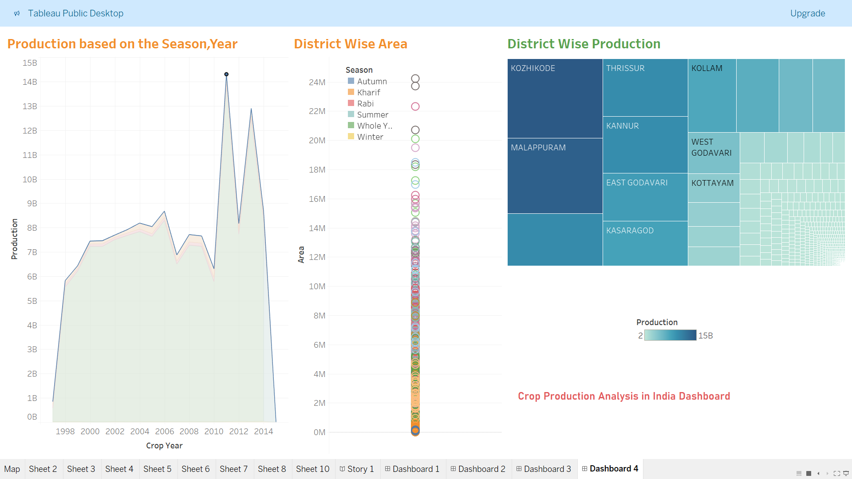
My Dashboards Using Tableau:

