Slide 1
Title: The Role of Information Technology in Modern Transportation
Subtitle: Transforming Automobiles, Metro Rail, and Avionics
Sri Venkateshwara college of Engineering and Technology –Task-08-Extempore Activity

Slide 2
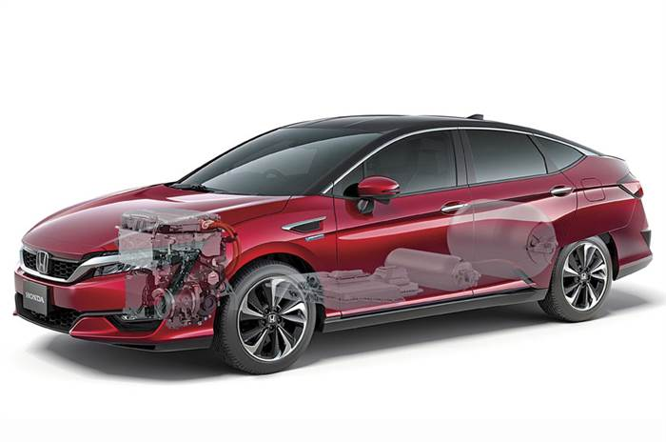
IT in Automobiles:
Smart Vehicles & AI Integration: Autonomous and semi-autonomous vehicles.
Advanced Driver Assistance Systems (ADAS): Collision avoidance, lane assist, and adaptive cruise control.
Connected Cars & IoT: Real-time traffic updates, predictive maintenance, and infotainment systems.
Electric Vehicles (EVs): Battery management and charging station connectivity.

Slide 3
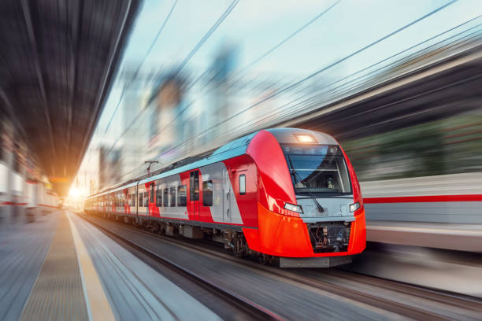
IT in Metro Rail:
Automated Fare Collection: Digital payments and smart ticketing.
Intelligent Transport Systems: AI and GPS-based tracking for better train scheduling.
Smart Surveillance & Security: AI-driven cameras and monitoring systems for passenger safety.
Remote Monitoring & Predictive Analytics: Maintenance alerts to prevent technical failures.

Slide 4
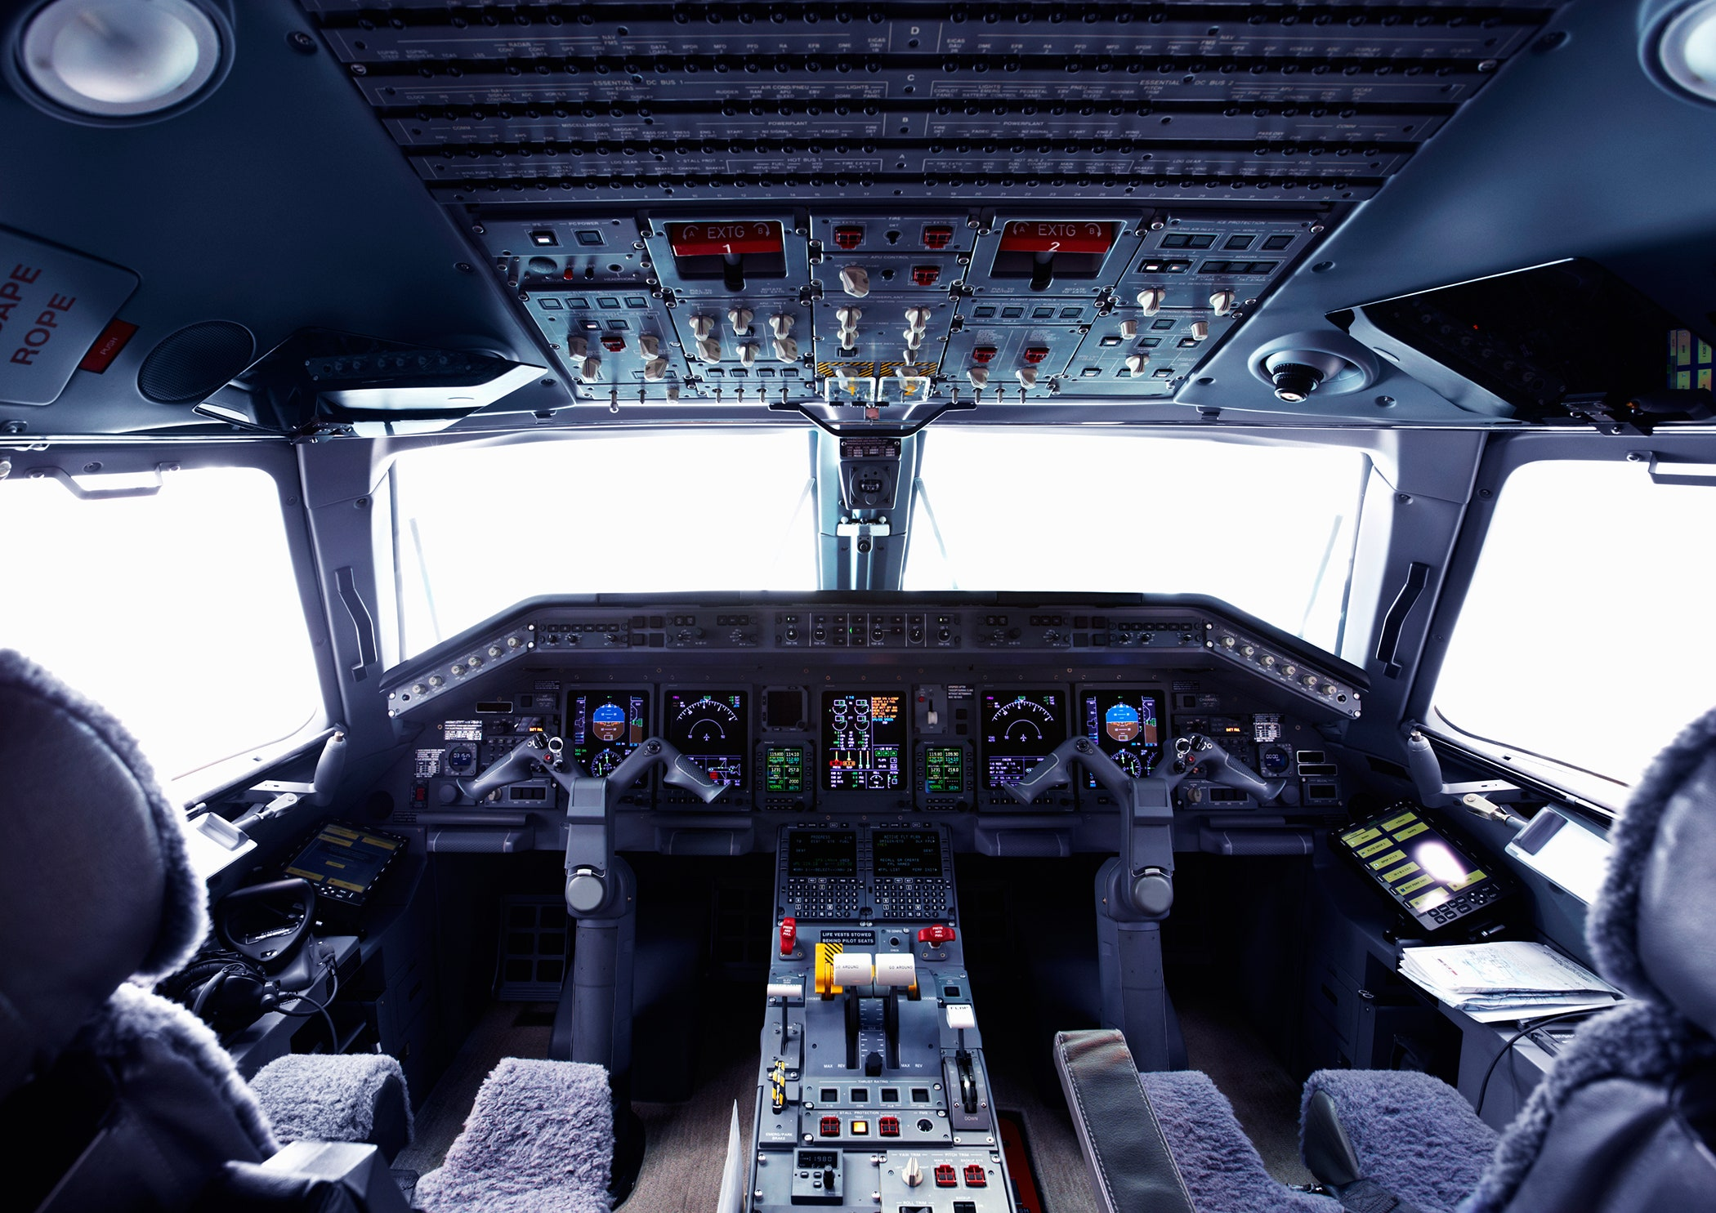
IT in Avionics:
Flight Management Systems (FMS): Digitalized cockpit operations for improved navigation.
Air Traffic Control Automation: Enhancing safety and reducing flight delays.
Big Data & Predictive Maintenance: AI-based maintenance solutions for aircraft longevity.
In-Flight Connectivity: Wi-Fi services and entertainment systems for passengers.

Slide 5
Benefits of IT in Transportation
Increased Safety: AI reduces human error in driving, rail operations, and aviation.
Operational Efficiency: IT-driven analytics improve scheduling and reduce congestion.
Cost Reduction: Automation leads to lower operational and maintenance costs.
Sustainability: IT helps optimize fuel usage and supports electric vehicle adoption.
Future of IT in Transportation
Hyperloop & High-Speed Rail: AI-driven advancements for ultra-fast transport.
Smart Cities & Traffic Management: IoT-enabled smart roads and traffic solutions.
AI Co-Pilots in Aviation: Automated support systems for pilots.
Connected & Green Vehicles: Advancements in electric and hybrid vehicle technology.
IT is shaping the future of transportation by making it safer, smarter, and more efficient.
Continued innovation in IT will lead to more sustainable and intelligent transport systems.
Embracing these technologies is essential for the future of mobility.

