Slide 1
STACKHOLDER MAPPING
Sri Venkateshwara college of Engineering and technology-Task-09-Stakeholder Mapping

Slide 2
Stakeholder Mapping for Cold Storage Facility Establishment
1. Introduction
Stakeholder mapping is a crucial step in the establishment of a cold storage facility, as it helps identify key players involved in the project and their level of influence and interest. This document provides a structured stakeholder map, categorizing stakeholders based on their roles and engagement levels.
2. Stakeholder Categories
A. Primary Stakeholders (Directly Impacted)
Investors & Business Owners – Provide financial backing and strategic direction.
Farmers & Food Suppliers – Rely on cold storage for preserving perishable goods.
Cold Storage Operators – Manage the day-to-day functioning of the facility.
Distributors & Retailers – Depend on cold storage for inventory management and logistics.
B. Secondary Stakeholders (Indirectly Impacted)
Government & Regulatory Authorities – Enforce compliance with food safety and environmental laws.
Logistics & Transportation Providers – Facilitate the movement of stored goods.
Technology & Equipment Suppliers – Provide necessary refrigeration and monitoring systems.
C. Tertiary Stakeholders (Supportive Roles)
Customers & End Consumers – Benefit from fresher products and reduced food waste.
Local Communities – May be affected by infrastructure development and job opportunities.
Environmental Agencies – Ensure sustainable practices and energy-efficient operations.

Slide 3
3. Stakeholder Mapping Matrix:
Stakeholder | Power | Interest | Engagement Strategy
Investors & Business Owners | High | High | Continuous engagement & reporting
Government & Regulatory Authorities | High | High | Compliance & regular communication
Cold Storage Operators | High | High | Training & operational updates
Farmers & Food Suppliers | Low | High | Awareness programs & partnerships
Logistics & Transportation Providers | Medium | High | Coordination & contract management
Technology & Equipment Suppliers | Medium | Medium | Vendor collaboration & procurement
Distributors & Retailers | High | High | Business negotiations & updates
Customers & End Consumers | Low | Medium | Marketing & feedback collection
Local Communities | Low | Low | Community engagement initiatives
Environmental Agencies | Medium | High | Sustainability reporting & compliance

Slide 4
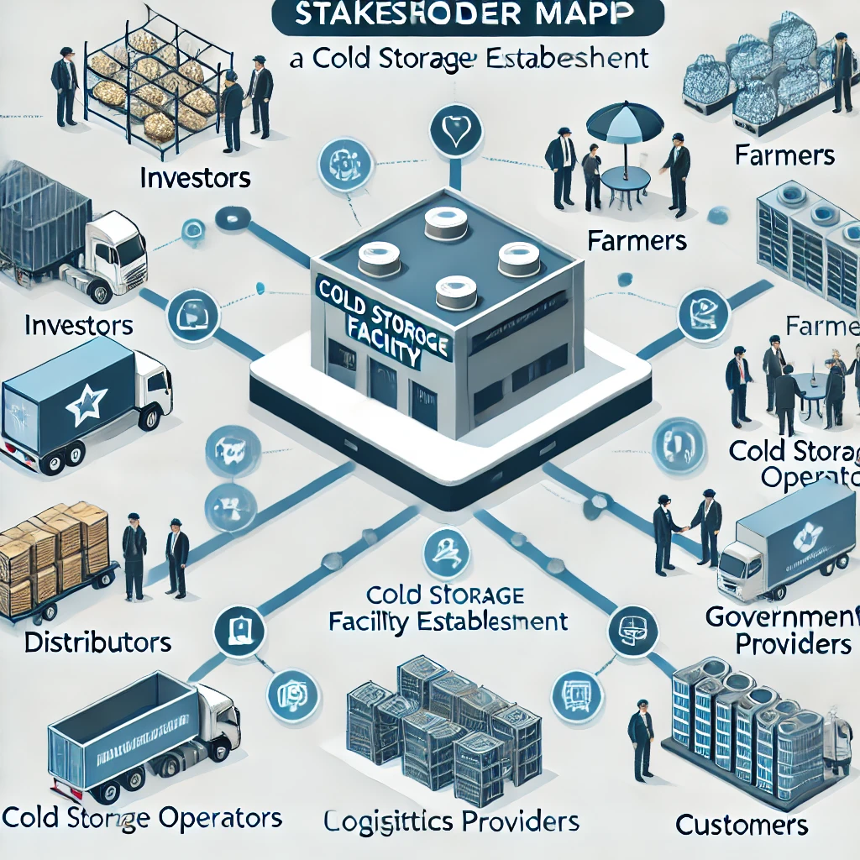
4. Conclusion
Understanding the roles and impact of each stakeholder in a cold storage facility project ensures smoother operations, regulatory compliance, and long-term sustainability. Effective engagement with key stakeholders will lead to better decision-making, risk mitigation, and project success.

