Slide 1
Product Selection: Food Delivery App (Example: "Quick Eats")
Sri Venkateshwara college of Engineering and Technology-Task-12-Journey Mapping

Slide 2
1. User Research – Conducting User Research
Surveys & Interviews – Gather feedback from frequent food delivery users.
Competitor Analysis – Study existing apps (Swiggy, Uber Eats) to find pain points.
User Reviews & Feedback – Analyze App Store & Play Store reviews.
Key Findings:
Users are frustrated with high delivery fees and long wait times.
Many users want healthier meal options and customized recommendations.
Users prefer quick refunds & customer support when issues occur.

Slide 3
2. Personal Creation
User Personal: "Amit Sharma" (Frequent Food Delivery User)
📌 Demographic Information:
Name: Amit Sharma
Age: 28
Location: Bangalore, India
Occupation: IT Professional
Income: ₹80,000/month

Slide 4
Goals and Objectives:
Order affordable, quality food with fast delivery.
Get real-time tracking and accurate delivery estimates.
Explore healthy meal options without extra effort.
Psychographic Information:
Interest: Tech-savvy, values convenience, prefers cashless transactions.
Choices: Likes discounts & cashback offers.
Personality Traits: Impatient, prefers quick solutions, loyal to good service.
Behavior and Preferences:
Orders 4-5 times per week.
Prefers express delivery (under 30 min).
Uses food delivery apps mostly at lunch & dinner times.
Often checks ratings & reviews before ordering.
⚠️ Challenges and Pain Points:
High delivery charges make small orders expensive.
Late deliveries cause frustration.
Lack of healthy meal choices in most restaurants.
Difficult refund process for wrong/cold food.

Slide 5
Journey Mapping (Lucid chart)
User Journey for Amit Sharma Using Quick Eats App
Stage | User Action | Pain Points | Improvement Opportunities
Awareness | Sees an ad for Quick Eats | Might be hesitant to switch | Offer a discount for first-time users
Consideration | Checks app reviews, browses restaurants | Unsure about food quality | Verified user reviews & ratings
Purchase | Orders food, chooses payment method | High delivery fee | Membership for free delivery
Delivery | Tracks order in-app | Late delivery or wrong order | Live tracking & AI-based ETA
Post-Delivery | Rates order, gives feedback | Refund process is slow | Instant refund & chatbot support

Slide 6
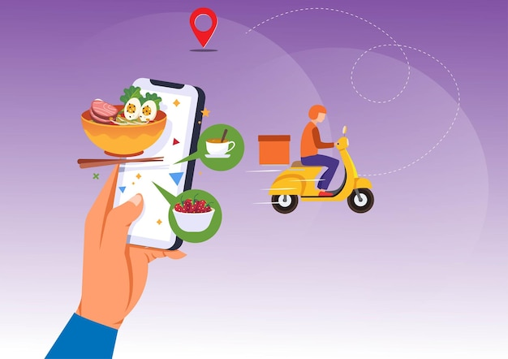
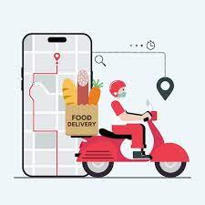
Final Deliverable:
Empathy Map: Create a Lucid chart Empathy Map covering user emotions, thoughts, and behaviors.
User Journey Map: Use Lucid chart templates to visualize Amit Sharma’s experience from discovering the app to post-delivery feedback.

