Slide 1
A Day with the Smart Water Bottle
Story board concept
Sri Venkateshwara college of Engineering and Technology- Task-5-Story Boarding

Slide 2
Storyboard: "A Day with the Smart Water Bottle"
1. Morning Wake-Up
Scene: A person wakes up feeling sluggish, rubbing their eyes while sitting on the bed.
Smart Bottle Action: The bottle glows softly as a hydration reminder.
User Reaction: The person picks up the bottle, drinks water, and feels refreshed.
Emotion: Tired → Energized.
2. On the Go
Scene: The user is commuting—either walking, driving, or on public transport—carrying the bottle.
Smart Bottle Action: Tracks their water intake and gently vibrates to remind them if they haven't sipped in a while.
User Reaction: They take a sip while continuing their commute.
Emotion: Busy → Mindful.
3. Workout Boost
Scene: The user is at the gym, lifting weights or running on a treadmill, sweating.
Smart Bottle Action: A hydration reminder appears on the bottle’s small display, suggesting how much water to drink based on activity level.
User Reaction: They pause to drink and feel re-energized.
Emotion: Tired → Refreshed.
4. Afternoon Slump
Scene: The user is at their work desk, staring at a screen, feeling sluggish and losing focus.
Smart Bottle Action: The bottle flashes a reminder: "Dehydration causes fatigue—drink up!"
User Reaction: The user drinks water and starts feeling more focused.
Emotion: Fatigued → Recharged.
5. Evening Wind Down
Scene: The user is in bed, scrolling through their phone, getting ready to sleep.
Smart Bottle Action: A final reminder appears: "Last sip for better sleep!"
User Reaction: They take a final sip, place the bottle on their nightstand, and turn off the lights.
Emotion: Restless → Relaxed.

Slide 3
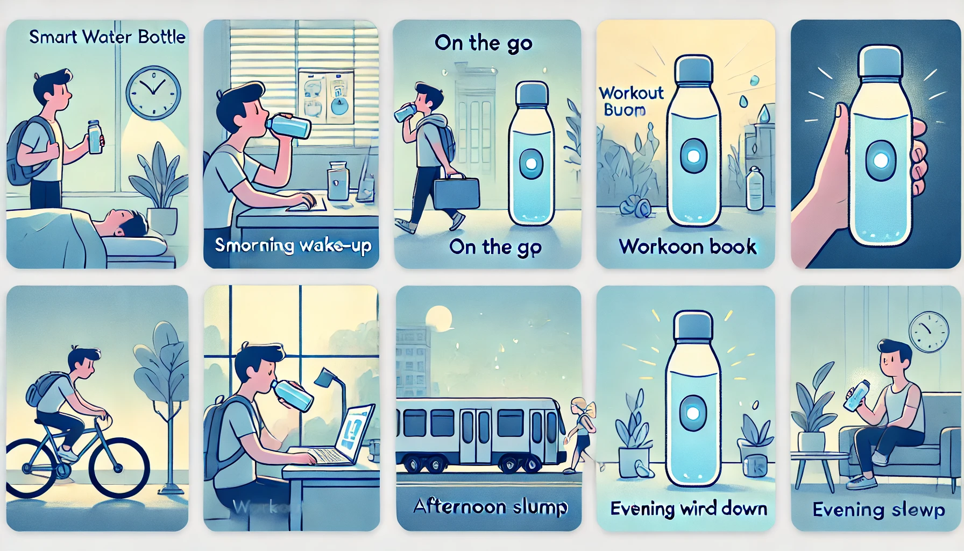
Vision Board of Smart Water Bottle

