Slide 1
GOOGLE GEN AI HACKATHON 2024
Statement Title - Optimizing Patient-Doctor Connectivity through a Personalized Online Healthcare Platform
Theme – Healthcare
Team Name: Rockers

Slide 2
MediConnect: Personalized Online Healthcare Platform
ROCKERS
Proposed Solution (Describe your Idea/Solution/Prototype)
Proposed Solution:
MediConnect is an online platform that connects patients with healthcare professionals based on symptoms and medical needs. It features secure registration, AI-powered symptom checkers, real-time video consultations, and electronic medical records management.
How It Addresses the Problem:
MediConnect overcomes barriers like limited access to specialized doctors, geographical constraints, and long waiting times by offering personalized doctor recommendations and streamlined healthcare access.
Innovation & Uniqueness:
- AI-Powered Symptom Checker for precise doctor matching.
- Real-Time Communication with WebRTC and Socket.io.
- Integrated Platform for registration, consultation, and payments.
- User-Centric Design with a secure, scalable infrastructure.

Slide 3
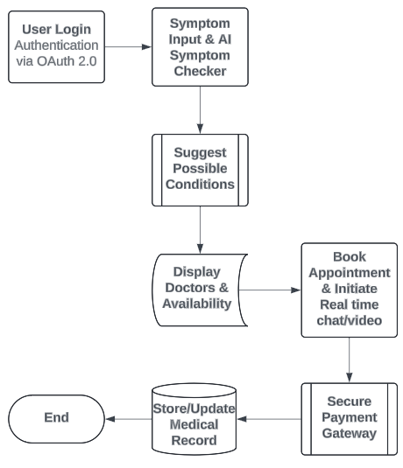
TECHNICAL APPROACH
ROCKERS
Technologies to Be Used:
Front-End:
React.js (UI Development)
Redux (State Management)
Material-UI/Bootstrap (Responsive Design)
HTML5, CSS3, JavaScript (ES6+) (Core Web Development)
Back-End:
Node.js with Express.js (Server-Side Application)
Python (Django/Flask) (AI Integration)
JWT, OAuth 2.0 (Authentication/Authorization)
WebRTC, Socket.io (Real-Time Communication)
Database:
MongoDB (User Data, Medical Records)
PostgreSQL/MySQL (Structured Data)
Redis (Caching)
Amazon S3/Azure Blob Storage (File Storage)
Process Flowchart

Slide 4
FEASIBILITY AND VIABILITY
ROCKERS
Feasibility Analysis:
Technical: Utilizes scalable, modern technologies like React.js, Node.js, and AI-powered tools, ensuring secure, real-time communication and seamless integration.
Financial: Moderate initial investment with revenue potential through subscriptions, consultation fees, and partnerships.
Market: High demand for telemedicine post-pandemic, with unique positioning in symptom-based doctor matching.
Challenges & Risks:
Data Security: Handling sensitive patient information securely.
AI Accuracy: Ensuring reliable AI-driven symptom checks.
User Adoption: Encouraging adoption among both patients and healthcare providers.
Strategies to Overcome:
Robust Security: Implement end-to-end encryption and regular audits.
AI Enhancement: Continuously train and update AI models.
User Support: Offer tutorials and support for easy adoption.
Phased Rollout: Start with an MVP, gather feedback, and iterate.

Slide 5
IMPACT AND BENEFITS
ROCKERS
Potential Impact:
Enhanced Access: Connects patients to specialists quickly, improving healthcare availability in remote and underserved areas.
Better Experience: Offers a personalized, seamless journey from symptom logging to real-time consultations, enhancing patient outcomes.
Reduced Wait Times: Speeds up access to healthcare services, minimizing delays and improving overall efficiency.
Benefits:
Social:
Increased Access: Bridges gaps in healthcare availability and reduces disparities.
Empowerment: Allows patients to make informed decisions and manage their health better.
Improved Health Outcomes: Facilitates timely care and follow-ups, leading to better health results.
Environmental:
Lower Carbon Footprint: Reduces travel needs through virtual consultations, supporting sustainability.
Efficient Use: Optimizes healthcare resource utilization and reduces physical infrastructure strain.
Economic:
Cost Savings: Offers affordable care options, reducing patient and system costs.
Provider Support: Expands doctor reach and improves practice efficiency, potentially increasing revenue.
Revenue Generation: Creates opportunities for additional revenue through subscription fees and partnerships.

Slide 6
RESEARCH AND REFERENCES
ROCKERS
"Telemedicine: A Review of the Current State of Telemedicine and Its Impact on Healthcare Delivery" S. Sheikh and K. P. Ghanem, "Telemedicine: A Review of the Current State of Telemedicine and Its Impact on Healthcare Delivery," Journal of Telemedicine and Telecare, vol. 23, no. 2, pp. 91-96, 2017.
"The Future of Telemedicine: A Comprehensive Review of Current Developments" A. Kumar and V. Kumar, "The Future of Telemedicine: A Comprehensive Review of Current Developments," Frontiers in Medicine, vol. 7, p. 134, 2020.
"Artificial Intelligence in Healthcare: Review, Opportunities, and Threats" F. Jiang and J. Z. Xu, "Artificial Intelligence in Healthcare: Review, Opportunities, and Threats," IEEE Access, vol. 7, pp. 300-316, 2019.
"Impact of Telemedicine on Healthcare Utilization and Outcomes: A Systematic Review" F. Q. Kruse and K. K. Miles, "Impact of Telemedicine on Healthcare Utilization and Outcomes: A Systematic Review," JAMA Network Open, vol. 2, no. 1, p. e187488, 2019.
"Health IT and Digital Health Innovations for Healthcare Delivery: A Scoping Review" L. Yang, M. R. Bourgeois, and N. J. McMahon, "Health IT and Digital Health Innovations for Healthcare Delivery: A Scoping Review," Journal of Biomedical Informatics, vol. 104, p. 103406, 2020.

