Slide 1
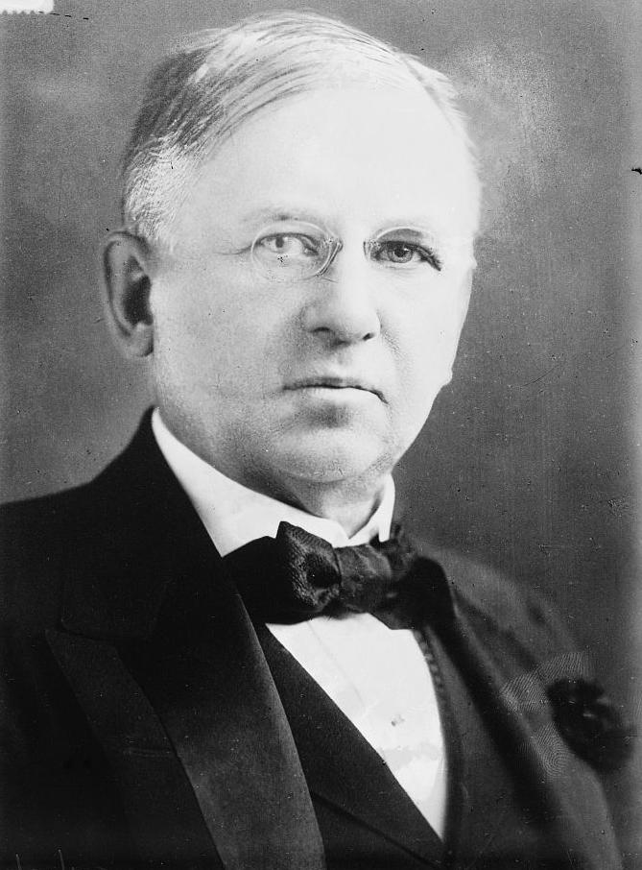
Problem
Half of the money I spend on advertising is wasted;
The trouble is I don’t know which half !
‘John Wanamaker’,
Marketing Pioneer
Sales Data
Media Channels Data
Fixed Budget for 2020
How to Allocate it?

Slide 2

Solution
1. Prior Knowledge
2. Data Sparsity
3. Model Uncertainty
Bayesian Modelling
Marketing Mix Modelling

Slide 3
Methodology
Pre-Processing
Bayesian
MMM
Channel Contribution
and
Budget Allocation Optimisation
Up Sampling
Outlier Detection
Missing Values
Correlation Analysis
Granger Causality Analysis
Feature Engineering

Slide 4
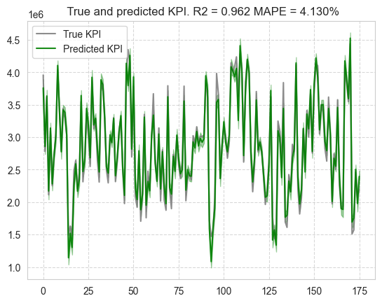
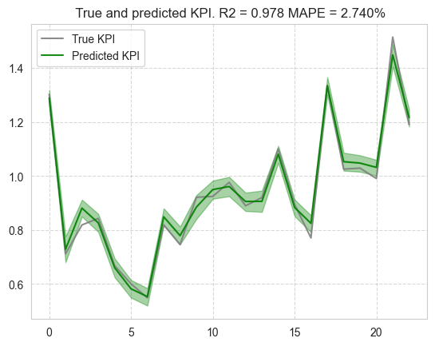
Model Accuracy
Great predictive accuracy
Better performance on unseen data

Slide 5
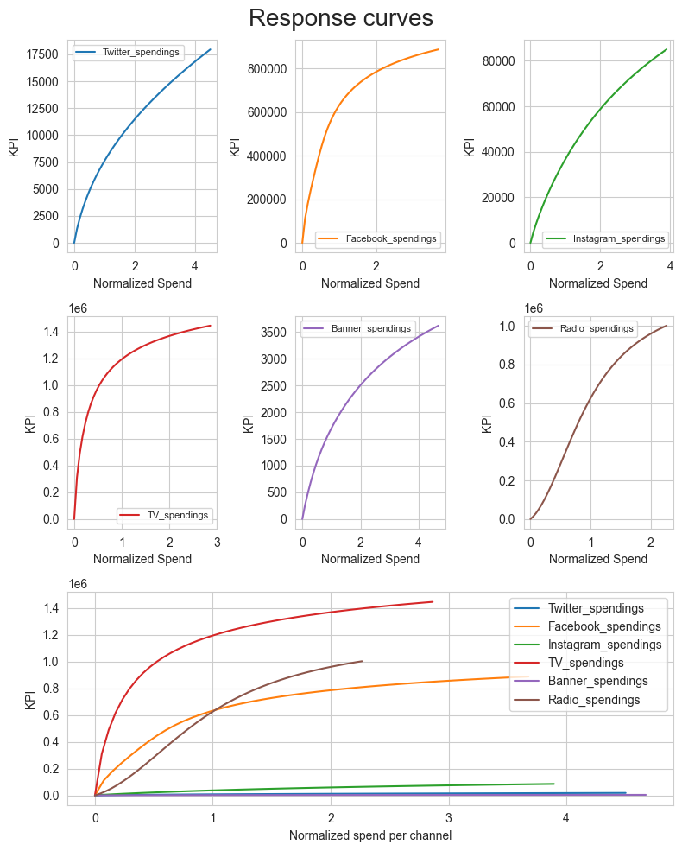
Response Curves
Demonstrate cause effect relationships
Show what-if scenarios
Tv ads lead to highest sales
Diminishing returns

Slide 6
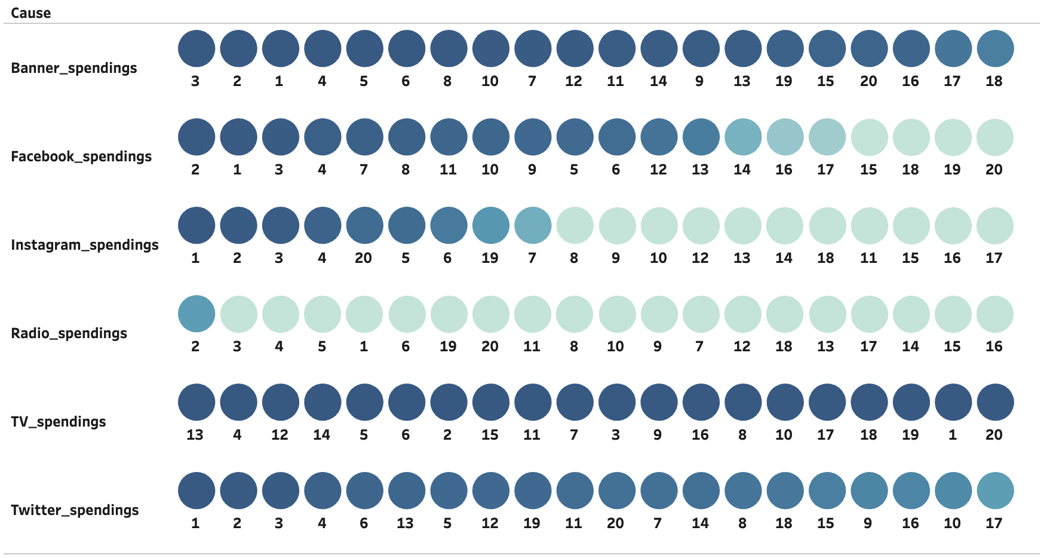
Granger Causality

Slide 7
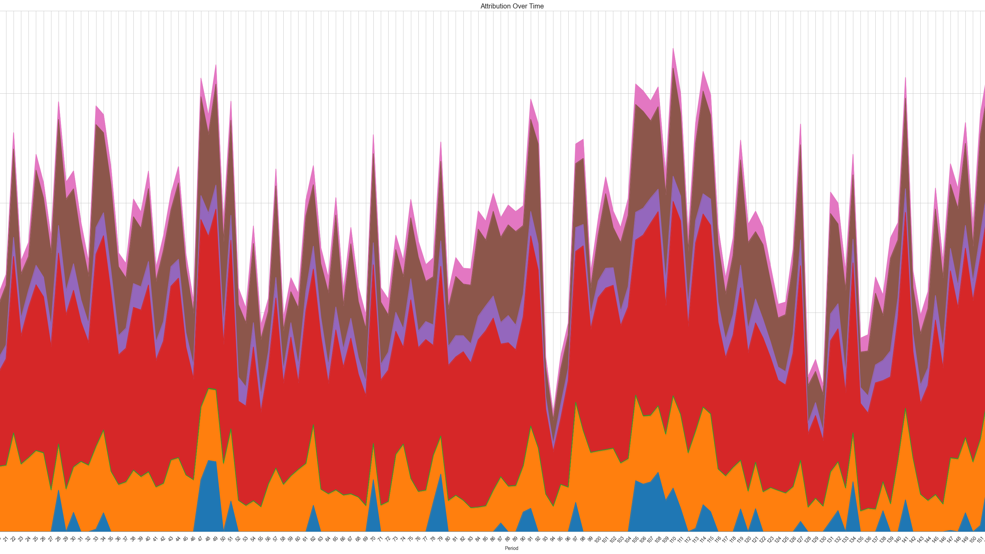
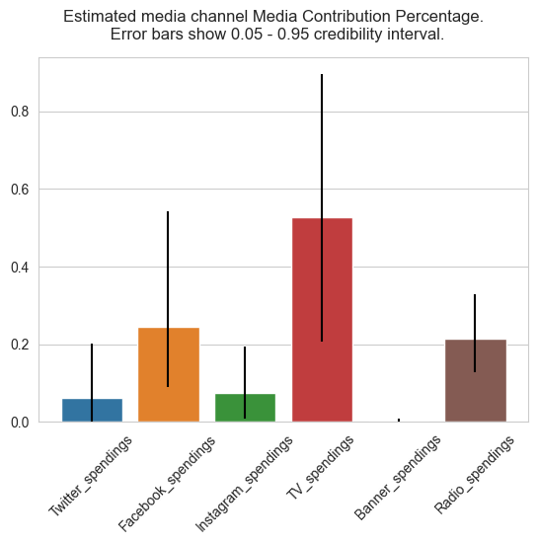
Channel Contribution
TV spendings has the highest contribution and highest uncertainty
Radio spendings is the most reliable

Slide 8
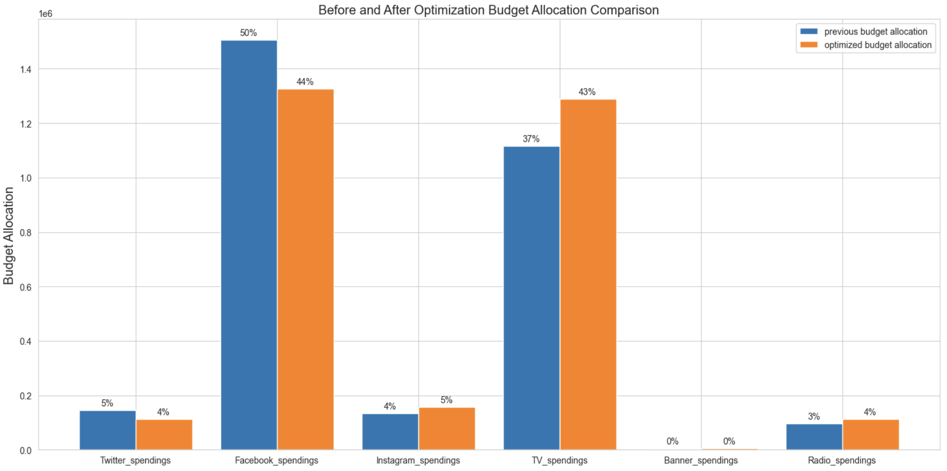
Budget Optimization
TV, Instagram, Radio
Facebook, Twitter

Slide 9
Budget Allocation Suggestion
Spending Feature | Change in Budget | Suggested Allocation
Twitter Spending | - 1% | 113, 211.6 ￡
Facebook Spending | - 6% | 1, 325, 687.6 ￡
Instagram Spendings | + 1% | 156, 219.6 ￡
TV Spending | + 6% | 1, 288, 438.1 ￡
Banner Spending | … | 4, 452 ￡
Radio Spending | + 1% | 111, 990.9 ￡
2.46 % Higher Sales
225, 618, 140 ￡

Slide 10

How to Make it More Accurate?
Non media marketing metrics (price, promotion, product distribution)
Seasonality, holiday, weather, macro economy
Radio data on a weekly basis

