Slide 1
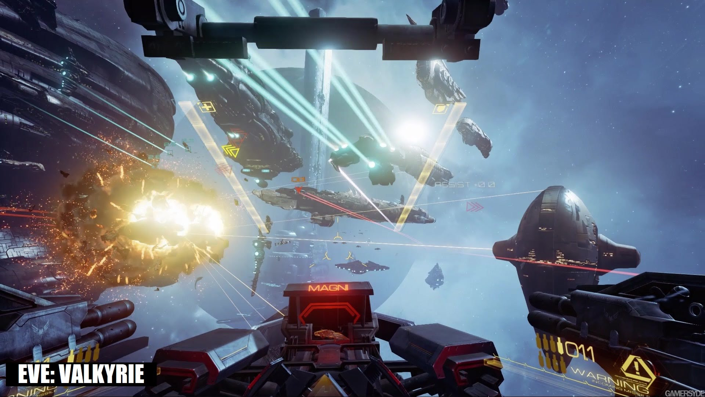

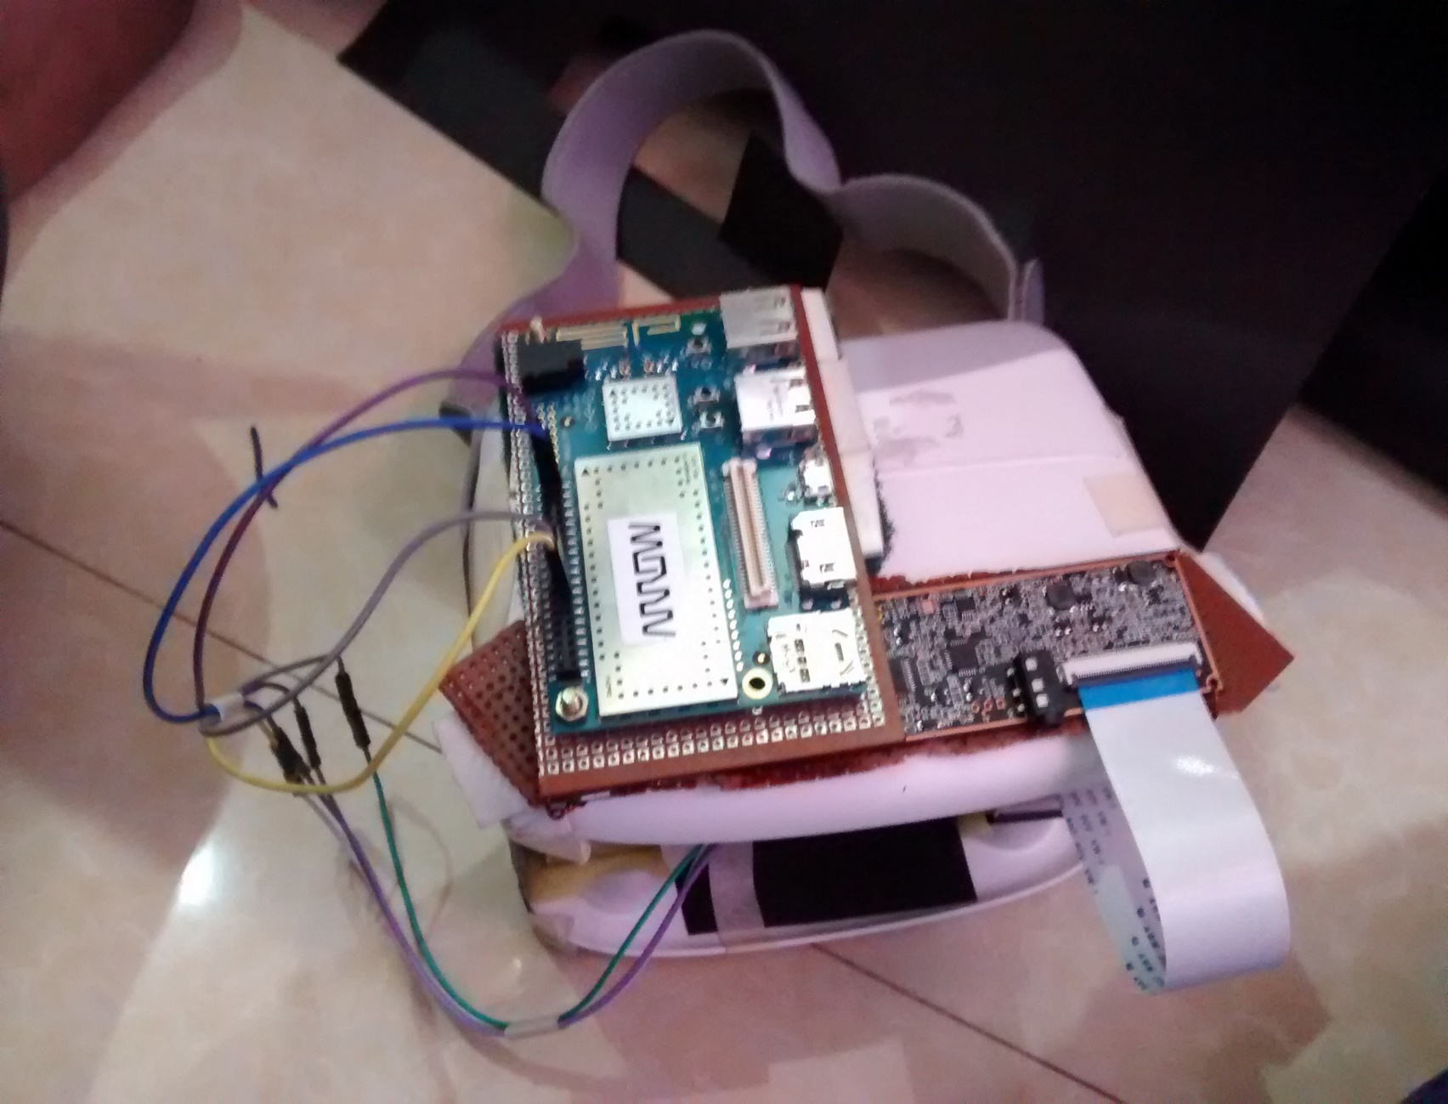
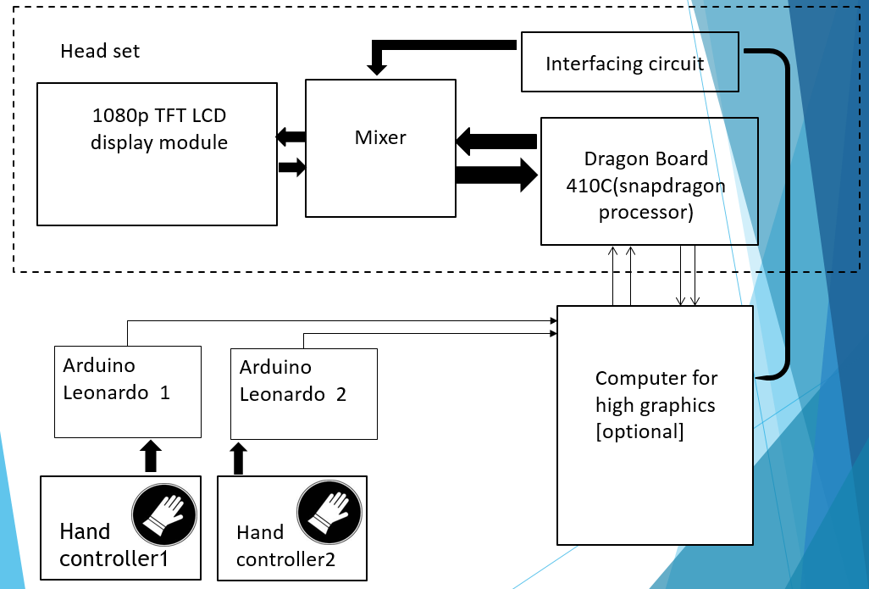
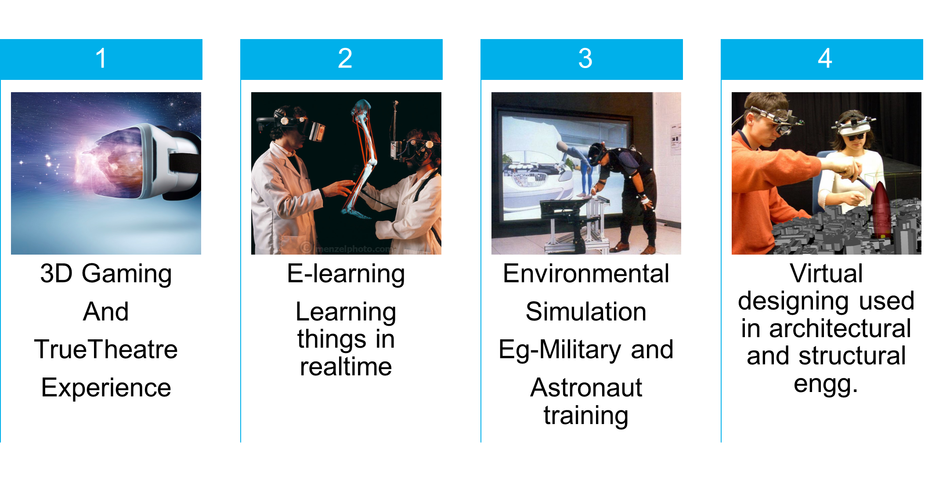
Gesture Based Virtual Reality System
1.S.SHYAM /SADDIQUE MOHAMMED /GEETHA.R | 2. MR.M.MARIA DOMINIC SAVIO | 1.Students and 2.Assisstant professor of Dept. of ECE in SRM UNIVERSITY ,Chennai , India.
ABSTRACT
MATERIALS
RESULTS
Virtual Reality (VR) is a computer simulated environment that has the inherent potential of manipulating people’s mind with a 3D experience using human image perception and optical illusions. Our Aim is to build a cost effective VR for the masses with further room for development by open source community.
Materials (detailed list)
S.NO | Item / Parts | Supplier/ Manufacturer | Model No./ Description | Quantity | Unit Price | Total (Rs.)
1 | DragonBoard410c | Qualcomm | 410C | 1 | Rs4,000 | Rs4,000
2 | Display | Topfoison shenzden displays | TF60006A | 1 | Rs3,800 | Rs3,800
3 | Gyroscope GY-521 | roborium | GY-521 | 2 | Rs199 | Rs199
4 | LVL shifter Breakout | NIL | 3-5v variant | 1 | Rs200 | Rs200
5 | Google cardboard | Aura | Cardboard | 1 | Rs659 | Rs659
6 | PC with HDMI | NIL | NIL | 1 | NIL | NIL
7 | Arduino Leonardo | Genuino | Leonardo | 1 | Rs700 | Rs700
8 | Glove | Nil | Nil | 2 | Rs300 | Rs600
9 | Flex Sensor | Roborium | 2” | 4 | Rs540 | Rs2160
 | Total (Rs.) |  |  |  |  | Rs12,319
INTRODUCTION
Virtual reality (VR) is process of completely knocking off user from the real environment and immerses them in a computer generated virtual environment . It gives the user strong feeling of being present in that environment .Virtual Reality is not new to us , It has been a dream for us for many years .Different scientist had different approach to virtual reality starting from Canaletto painting 250 years ago then to Thomas Alva Edison invention of camera in 1890 to Morton Heilig first head mounted 3-D display which gives artificial sensory experience which is called as Sensoram . Now Oculus Rift developed a compact head mount VR head set which uses computer – graphics based system to provide 3-D interactive environment to the user .Virtual reality has a wide range of applications not only gaming and movies it can be used for educational , tourism , engineering and training for driving and shooting etc.
The windows and Android VR application has been integrated into single platform
Face worn HUD has been made with 1080p display and sophisticated onboard processor.
Glove with various sensor for interaction with virtual world has been designed and programmed.
SYSTEM OVERVIEW
APPLICATIONS
SOFTWARES
TRIDEF 3D
TRINUS GYRE
ARDUINO INTERFACE
CARDBOARD APPS ON ANDROIF
CONSTRAINTS
COMPARISONS
HIGH COST
Most materials involved in making high quality VR is quite costly.
HUGE COMPUTING RESOURCE
For a good realistic experiences , GPU of the host machine must be very powerful GTX960 is recommended.
OPTICAL ENGINEERING
Current generation VR has highly restricted field of view . Further research on Aspherical lens and image filters like barrel distortion is needed.
Specifications | Gear VR | Our System
Processor | Octa-core processor (Exynos 7420 ) | Quad-core processor (Snapdragon 410C)
Graphical Processing Unit (GPU) | Two GPUs (Mali-T760 MP8) | One GPU (Qualcomm Adreno 306)
Sensors | 9-axis Gyro sensor , Accelerometer and Magneto meter | 6-axis Gyro sensor and Accelerometer
Controller | Touch pad , Joystick controller , Data gloves | Hand gesture recognition using Flex sensors and Gyro sensors
Auxiliary Interface Compatibility | Can’t interface with PC Can interface with android | Can Interface with PC And android
Display | 2k Resolution with upscaler | 1080P-490PPI
Cost | High cost RS.21000 | Low cost (Rs 12000 to Rs 15,000)
REFERENCE
RiftSteven and M. LaValle and Anna Yershova and Max Katsev and Michael Antonov, Head Tracking for the Oculus,2014 IEEE International Conference on Robotics & Automation (ICRA),Hong Kong Convention and Exhibition Center, May 31 - June 7, 2014
S. A. Zekavat and R. M. Buehrer, Handbook of Position Location. IEEE Press and Wiley, 2012.
G. Welch and E. Foxlin, “Motion tracking: no silver bullet, but a respectable arsenal,” IEEE Computer Graphics and Applications, vol. 22, no. 6, pp. 24–38, 2002.

