Slide 1
CODE IMPACT TOOL

Slide 2

Agenda
1
High-level Workflow
Data Preparation
CIT: Reporting
Technical Implementation
Steps in data preparation
CIT tool usage
2
2

Slide 3
High-level Workflow

Slide 4



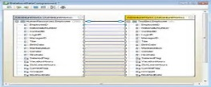
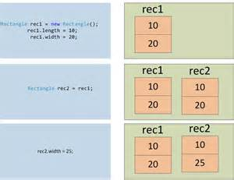



Data Preparation for CIT
Data dictionaries
version1
version2
Compare Versions
Compared results
script
column changes
value changes
param file
pearl script
report

Slide 5



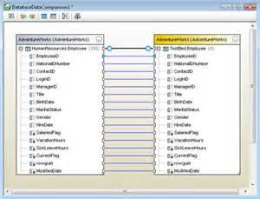






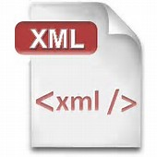
CIT: Reporting
Input Files
Report
script
value changes
value changes
CIT
column changes
column changes
param file
analysis report
MS Access
report

Slide 6
Technical Implementation

Slide 7
Steps in Data Preparation
Data dictionaries
MS Access
Mapping (Link Manager)
Tables
Queries
Main Table
Main1 Table
Value Table
Value1 Table
Current Version
Data Dictionary Table
Data Dictionary Value
Compare DB
Upgraded Version
Data Dictionary Table
Data Dictionary Value
Export
SQL Queries
CITParam Text
tzg_Upgrade Analysis.plx
Combined_table_changes
Added_columns
Remove_columns
Combined Table Changes
Combined Value Changes
2 Text Files
Combined_value_changes
Added_values
Remove_values
Run.Bat
Report text file
7

Slide 8
CIT tool usage
Feed to CIT
Code Results
Export DB Changes
Export Value Changes
CIT Tool
Import
Export
Analysis
Report
CIT DB
FACET Table Changes
FACET Value Changes
Perl Report File
Param File
XML
Structural Change Report
Value Change Report
Detail Change Report
3 Crystal Reports
8

Slide 9


