Slide 1
COURSE TITLE: Data Communications and Networks

Slide 2
Noise
How do you calculate the signal-to-noise ratio?
The signal-to-noise ratio is typically measured in decibels and can be calculated by using a base 10 logarithm. The exact formula depends on how the signal and noise levels are measured, though.
For example, if they're measured in microvolts, the following formula can be used:
S/N = 20 log10(Ps/Pn)
Ps is the signal in microvolts, and Pn is the noise in microvolts.
However, if the signal and noise are measured in watts, the formula is slightly different:
S/N = 10 log10(Ps/Pn)

Slide 3
Noise
When Ps is greater than Pn, S/N will be positive. Ideally, Ps should be much greater than Pn to minimize noise interference. As an example, suppose that Ps equals 10 microvolts and Pn equals 1 microvolt. Because 10 divided by 1 equals 10, the following formula can be used to calculate S/N:
S/N = 20 log10(10) = 20 dB
A ratio of 20 dB means that the signal is clearly readable. If the signal is much weaker but still above the noise level -- say, 1.3 microvolts -- S/N is much lower, in this case, only 2.28 dB:
S/N = 20 log10(1.3) = 2.28 dB

Slide 4
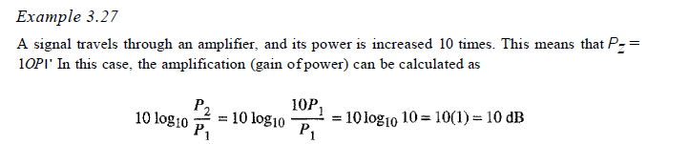
Noise

Slide 5
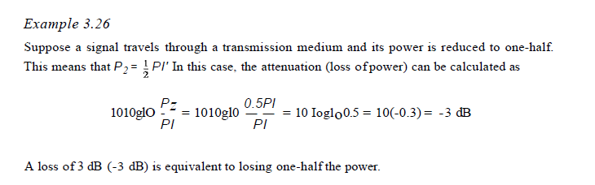
Noise

Slide 6
Channel Capacity
Noiseless Channel: Nyquist Bit Rate –
For a noiseless channel, the Nyquist bit rate formula defines the theoretical maximum bit rate
Nyquist proved that if an arbitrary signal has been run through a low-pass filter of bandwidth, the filtered signal can be completely reconstructed by making only 2*Bandwidth (exact) samples per second. Sampling the line faster than 2*Bandwidth times per second is pointless because the higher-frequency components that such sampling could recover have already been filtered out. If the signal consists of L discrete levels, Nyquist’s theorem states:

Slide 7
Channel Capacity
BitRate = 2 * Bandwidth * log2(L) bits/sec
In the above equation, bandwidth is the bandwidth of the channel, L is the number of signal levels used to represent data, and BitRate is the bit rate in bits per second.
Bandwidth is a fixed quantity, so it cannot be changed. Hence, the data rate is directly proportional to the number of signal levels.

Slide 8
Channel Capacity
Examples:
Input1 : Consider a noiseless channel with a bandwidth of 3000 Hz transmitting a signal with two signal levels. What can be the maximum bit rate?
Output1 : BitRate = 2 * 3000 * log2(2) = 6000bps
Input2 : We need to send 265 kbps over a noiseless channel with a bandwidth of 20 kHz. How many signal levels do we need?
Output2 : 265000 = 2 * 20000 * log2(L)
log2(L) = 6.625
L = 26.625 = 98.7 levels

Slide 9
Channel Capacity
2. Noisy Channel : Shannon Capacity –
In reality, we cannot have a noiseless channel; the channel is always noisy. Shannon capacity is used, to determine the theoretical highest data rate for a noisy channel:
Capacity = bandwidth * log2(1 + SNR) bits/sec
In the above equation, bandwidth is the bandwidth of the channel, SNR is the signal-to-noise ratio, and capacity is the capacity of the channel in bits per second.
Bandwidth is a fixed quantity, so it cannot be changed. Hence, the channel capacity is directly proportional to the power of the signal, as SNR = (Power of signal) / (power of noise).
The signal-to-noise ratio (S/N) is usually expressed in decibels (dB) given by the formula:

Slide 10
Channel Capacity
10 * log10(S/N)
So for example a signal-to-noise ratio of 1000 is commonly expressed as:
10 * log10(1000) = 30 dB.

Slide 11
Channel Capacity
Examples:
Input1 : A telephone line normally has a bandwidth of 3000 Hz (300 to 3300 Hz) assigned for data communication. The SNR is usually 3162. What will be the capacity for this channel?
Output1 : C = 3000 * log₂(1 + SNR) = 3000 * 11.62 = 34860 bps
Input2 : The SNR is often given in decibels. Assume that SNR(dB) is 36 and the channel bandwidth is 2 MHz. Calculate the theoretical channel capacity.
Output2 : SNR(dB) = 10 * log₁₀(SNR) SNR = 10^{(SNR(dB)/10)} SNR = 10^{3.6} = 3981
Hence, C = 2 * 10⁶ * log₂(3982) = 24 MHz

Slide 12
Flow Control
Transmission Delay:
The time taken to transmit a packet from the host to the transmission medium is called Transmission delay.
Let B bps is the bandwidth and L bit is the size of the data then transmission delay is,
Tt = L/B

Slide 13
Flow Control
Propagation delay:
After the packet is transmitted to the transmission medium, it has to go through the medium to reach the destination. Hence the time taken by the last bit of the packet to reach the destination is called propagation delay.
Tp = Distance / Velocity
Note:
Velocity =3 X 10^8 m/s (for air)
Velocity= 2.1 X 10^8 m/s (for optical fibre)

Slide 14
Flow Control
Problem-01:
A 20 Kbps satellite link has a propagation delay of 400 ms. The transmitter employs the “go back n ARQ” scheme with n set to 10.
Assuming that each frame is 100 bytes long, what is the maximum data rate possible?

Slide 15
Flow Control
Solution-
Given-
Bandwidth = 20 Kbps
Propagation delay (Tp) = 400 ms
Frame size = 100 bytes
Go back N is used where N = 10
Calculating Transmission Delay-
Transmission delay (Tt)
= Frame size / Bandwidth
= 100 bytes / 20 Kbps

Slide 16
Flow Control
= (100 x 8 bits) / (20 x 103 bits per sec)
= 0.04 sec
= 40 msec

Slide 17
Flow Control
Calculating Value Of ‘a’- a = Tp / Tt a = 400 msec / 40 msec a = 10 | Calculating Efficiency- Efficiency (η) = N / (1+2a) = 10 / (1 + 2 x 10) = 10 / 21 = 0.476 = 47.6 %

Slide 18
Flow Control
Calculating Maximum Data Rate Possible-
Maximum data rate possible or Throughput
= Efficiency x Bandwidth
= 0.476 x 20 Kbps
= 9.52 Kbps
≅ 10 Kbps

Slide 19
Numerical

Slide 20
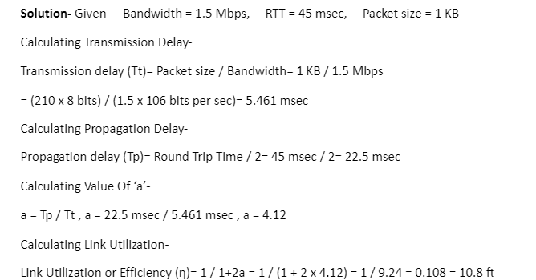
Numerical

Slide 21

Numerical

Slide 22
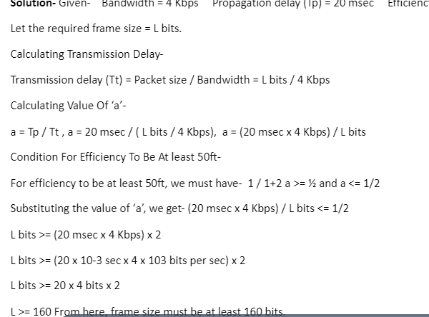
Numerical

Slide 23
ALOHA
Problem-
A group of N stations share 100 Kbps slotted ALOHA channel. Each station output a 500 bits frame on an average of 5000 ms even if previous one has not been sent. What is the required value of N?
Solution-

Slide 24
ALOHA
Throughput Of One Station-
Throughput of each station= Number of bits sent per second
= 500 bits / 5000 ms
= 500 bits / (5000 x 10-3 sec)
= 100 bits/sec
Throughput Of Slotted Aloha-
Throughput of slotted aloha= Efficiency x Bandwidth
= 0.368 x 100 Kbps
= 36.8 Kbps

Slide 25
ALOHA
Total Number Of Stations-
Throughput of slotted aloha = Total number of stations x Throughput of each station
Substituting the values, we get-
36.8 Kbps = N x 100 bits/sec
∴ N = 368

Slide 26
ALOHA
Let N station share 60 kbps of slotted aloha channel. Frame size is 1024 bits which are send at every 40 seconds. The value of N is ?
Solution:
Given Bandwidth (B) = 60 Kbps = 60*10^3
Bitrate for each host (b) = 1024/40 = 25.6 b/s
In slotted ALOHA, Number of stations N = (0.368 * Bandwidth) / Bitrate of each station.
= (0.368 * 60*103) / 25.6
= 862.5 stations

Slide 27
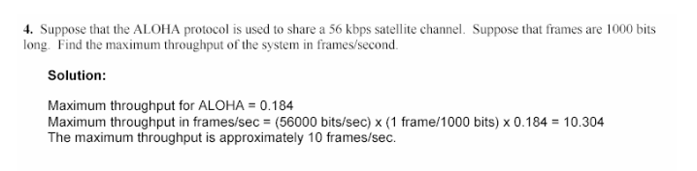
ALOHA

Slide 28
CSMA/ CD
Problem:
In a CSMA / CD network running at 1 Gbps over 1 km cable with no repeaters, the signal speed in the cable is 200000 km/sec. What is minimum frame size?
Solution-
Given-
Bandwidth = 1 Gbps
Distance = 1 km
Speed = 200000 km/sec

Slide 29
CSMA/ CD
Calculating Propagation Delay-
Propagation delay (Tp) = Distance / Propagation speed
= 1 km / (200000 km/sec)
= 0.5 x 10-5 sec
= 5 x 10-6 sec
Calculating Minimum Frame Size-
Minimum frame size= 2 x Propagation delay x Bandwidth
= 2 x 5 x 10-6 sec x 109 bits per sec
= 10000 bits

Slide 30
CSMA/ CD
Problem:
A 2 km long broadcast LAN has 10^7 bps bandwidth and uses CSMA / CD. The signal travels along the wire at 2 x 10^8 m/sec. What is the minimum packet size that can be used on this network?

Slide 31
CSMA/ CD
Solution:
Given- Distance = 2 km Bandwidth = 107 bps Speed = 2 x 10^8 m/sec 1. Calculating Propagation Delay- Propagation delay (Tp) = Distance / Propagation speed = 2 km / (2 x 108 m/sec) = 2 x 103 m / (2 x 108 m/sec) = 10-5 sec | 2. Calculating Minimum Frame Size- Minimum frame size = 2 x Propagation delay x Bandwidth = 2 x 10-5 sec x 107 bits per sec = 200 bits or 25 bytes

