Slide 1

PDPM INDIAN INSTITUTE OF INFORMATION TECHNOLOGY DESIGN AND MANUFACTURING JABALPUR
Image Processing
TEAM MEMBERS:-
1. PRAGYA CHAURASIA
2. APOORVA VIKLRAM SINGH
3. SHIVAM YADAV
4. MUKUL MISHRA

Slide 2
INTRODUCTION
We worked in the field of image processing.
Now, What is image processing?
Image processing is a method to convert image into digital form and to perform some operations on an image, in order to get an enhanced image or to extract some useful information from it.

Slide 3
Purpose of Image processing
1. Visualization
2. Image sharpening and restoration
3. Image retrieval
4. Measurement of pattern
5. Image Recognition
Image Processing includes many domains , the field in which we worked is:-
IMAGE WATERMARKING

Slide 4
TECHNIQUE USED
In our whole project we used:-
Matlab2016
Windows 10
RAM :- 4.00 GB
Processor : INTEL(R) Core(TM) i3-6006U CPU @ 2.00GHz 1.99GHz
64 bit operating system, x64 based processor
MS-Paint

Slide 5
INTRODUTION TO IMAGE WATERMARKING
IMAGE WATERMARKING
It is a process in which we embed a message or image in a host image so that the watermark(an image) is hidden in the host image. By this process we can check the ownership of our host image in case if there is any change in our watermarked image .

Slide 6
IMAGE
Image is stored in the form of matrix which contains pixels.
Images are broadly classified into four types :-
Binary Image(Black and White)
Grayscale Image
Coloured Image(RGB)
Index Color

Slide 7
IMAGE WATERMARKING
In this field we basically worked in two domains namely:-
Ownership :-
We basically check the one who owns the image or to whom the image belongs remains same or not while travelling of image from one place to other.
Tampering :-
Here, in this method we check that whether image which we got is original one or not.

Slide 8
OWNERSHIP
Image watermarking are of two types :
Invisible
Visible
For ownership check we use invisible watermarking.
METHODOLOGY
We take an image which we will be using as a hidden image technically it will be our watermark. Now the idea is to embed this watermark to our host image , now whenever someone will guarantee that this image is owned by him we will now check the watermark embedded and will assure that he is the right owner.

Slide 9
LSB Based Image Watermarking
Here , LSB stands for least significant bit.
In LSB Based Image Watermarking , we will change the last bit of binary form of each pixel of the host image by the pixel values of our watermark image.
After that we will get a new image called watermarked image in which we will have our watermark hidden in the host image.
We compared the watermarked image with our host image using the following command.
1. Peak signal to noise ratio(psnr)
2. Structural similarity index(ssim)
3. Mean squared error(immse)

Slide 10
After doing so , we attacked our watermarked image. There are two types of attacks:
1.Geometrical Processing
2.Signal Processing
After attacking , we extracted our watermark from the attacked watermarked image and compared it with our original watermark using BER commands:
BER = Number of wrong bits/total bits

Slide 11
TAMPERING
Whenever image is distorted or changed in anyway then it is called tampering of an image.
METHODOLOGY
We took an image and replaced its last four bits to first four bits in this way we got an image which is almost similar to original one.
Now if someone tampered it then we will check those last bits again with the previous one and will report that image is tampered.

Slide 12
RESULTS
RESULT 1:-
Comparison of original image with the watermarked image
We got the following result:
Watermark 1
 | ssimval | peaksnr | Mse
Image1.jpg | 0.9982 | 50.088 | 0.6371
Image2.jpg | 0.9981 | 49.9081 | 0.6642
Image3.jpg | 0.9982 | 49.7368 | 0.6909
Image4.png | 0.9982 | 49.6911 | 0.6982
Image5.png | 0.9983 | 49.6621 | 0.7029

Slide 13

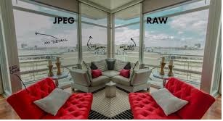



Image1.jpg
Image2.jpg
Image3.jpg
Image4.png
Image5.png

Slide 14
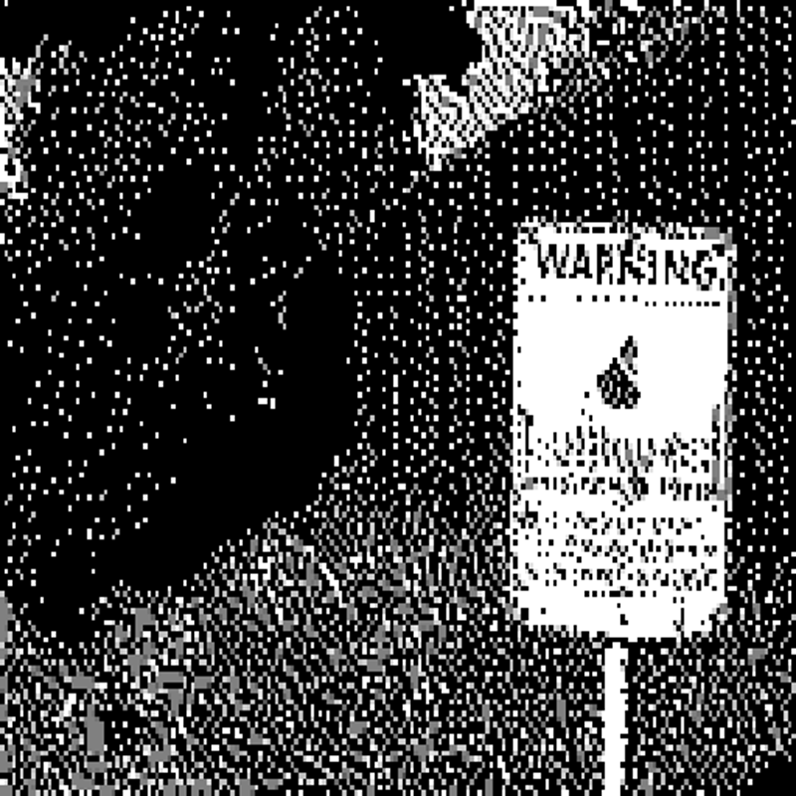
Watermark1

Slide 15
RESULT 2:-
After watermarking we attacked the watermarked image using different attack and after that we extracted the watermark from attacked image and compared it with the original watermark and got the following result.
HOST | WATRMRK | medfilt | Resize | Adjust | Noise(g) | translate
Lena | Watermark1 | 1320,0.005 | 129476,0.4939 | 153376,0.5851 | 128890,0.4917 | 18608,0.071
Lena | Watermark2 | 25436,0.097 | 129463,0.4939 | 15793,0.5867 | 129165,0.4927 | 79189,0.3.21
Baboon | Watermark1 | 1357,0.0052 | 130936,0.4995 | 145014,0.5532 | 131303,0.5009 | 18608,0.071
Baboon | Watermark2 | 27265,0.104 | 130955,0.4996 | 145004,0.5531 | 130928,0.4995 | 79189,0.3.21

Slide 16
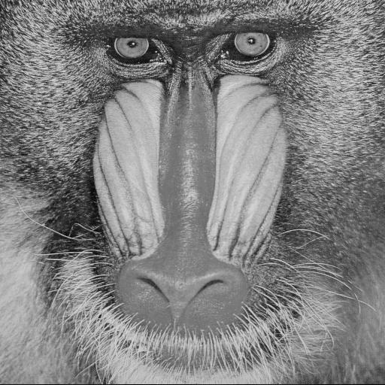
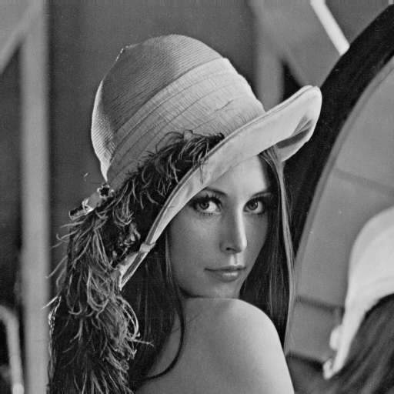
Baboon
Lena

Slide 17


Watermark
Watermark1

Slide 18
Watermark2
Watermark1
Lena.png

Slide 19
RESULT 3:-
Comparison when watermarking is done by changing at every bit one by one and we got the following result .
Bit Position | psnr | ber
8(LSB) | 49.7436 | 0.5063
7 | 43.7321 | 0.5059
6 | 37.7037 | 0.5082
5 | 31.6985 | 0.5055
4 | 25.6657 | 0.5081
3 | 19.6316 | 0.5115
2 | 13.6279 | 0.5093
1(MSB) | 7.5728 | 0.0970

Slide 20


RESULT 4:-
We took an image and changed the last 4 bits of its each pixel with the first 4 bits of the same pixel. After doing so, we tampered the image using MS – paint and then we compared the first 4 bits of each pixel with the last 4 bits of the same pixel . if the values matched , we left the it as it is . And if the values does not matched , we changed the bits of that pixel with 0 which result in the change of that portion into black . And this gave us the idea that at what position the image was tampered.
watermark 2 tampered detected

Slide 21
CONCLUSION
Conclusion 1. We have seen that after changing LSB of each pixel to that of pixel of watermark , we are not getting much differences means there is similarity , images are almost similar and watermark is also inserted , so we can conclude that we are getting psnr values somewhat greater than 35db which showing similarity in the two images.
Conclusion 2. After attacking on images we distorted it and when we extracted watermark from attacked watermarked image we have seem ber values are not as much we need as this ratio should be nearly zero but it is not coming so we can say that LSB based watermarking is not useful as extracted watermark is not much similar to original one.
Conclusion 3. So as concluded above LSB is not correct position to embed watermark so now we checked psnr and ber values for all position and for MSB ber is very nearly zero but psnr is very low than 35db so , the best position which we got where ber is nearly zero and psnr is greater than 35dbis the middle position.

Slide 22
REFERENCES
Mathworks
YouTube
www.tutorialspoint.com
Watermarks Attacks by S. Voloshynovskiy CSE Department, University of Geneva, Switzerland
Wikipedia
Quora
Unacademy
ieeexplore.ieee.org
www.udemi.com

Slide 23
THANK YOU

