Slide 1
Introduction to Machine Learning
Shivay Lamba

Slide 2
Part 1: AI Introduction and applications
➔Introduction
How this talk is divided
➔New and Old news about AI Part 2: ML Introduction and workflow
➔Introduction
Part 3: High Level Learning framework
➔Code (and some Math) walkthrough of linear classifier

Slide 3
What is AI ?
Demonstration of human like intelligence by machines.
A machine performing any task that needs human level intelligence can be said to be “Artificially
Intelligent”

Slide 4
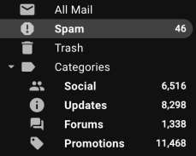


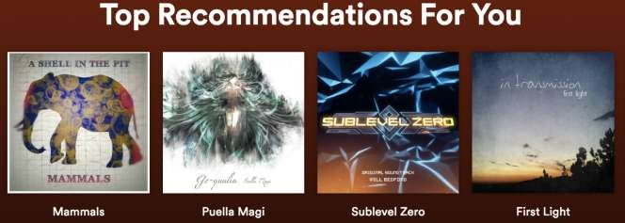
AI In everyday life today
Email Categorization
Web search
Targeted (annoying) Ads

Slide 5
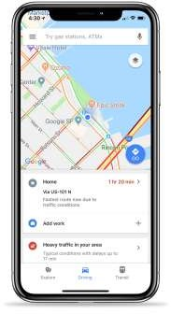
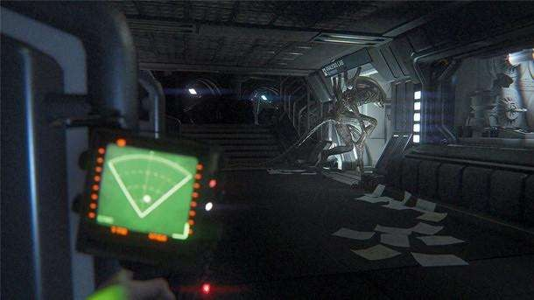

AI In everyday life today
Maps & Navigation
Computer Games
Digital Assistants

Slide 6
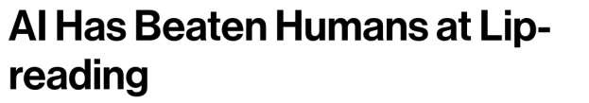
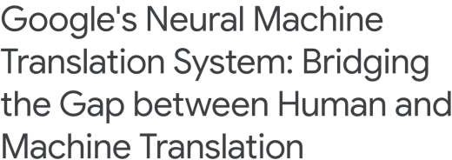
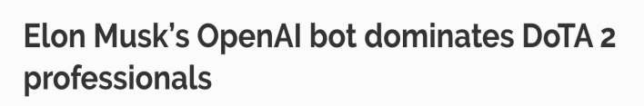

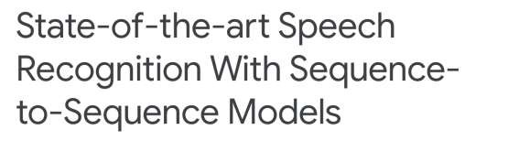
Few ML success stories in the past 3 years

Slide 7
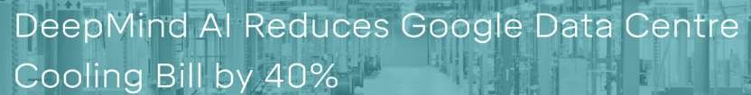

Few ML success stories in the past 3 years

Slide 8
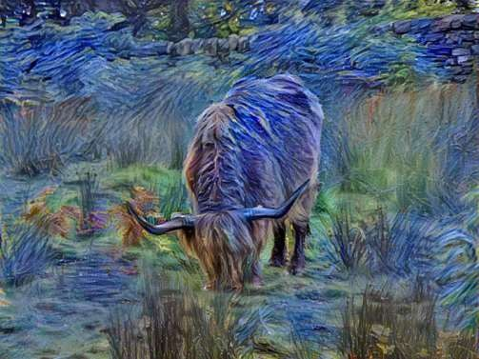
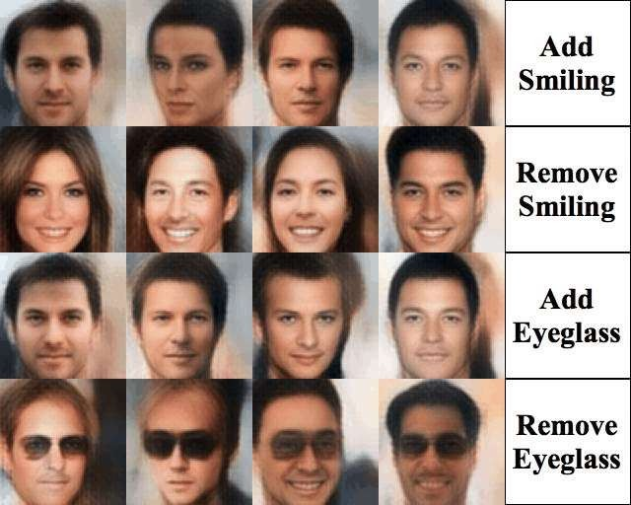
Few ML success stories in the past 3 years
Neural Style Transfer
Controllable Image Generation (Xianxu Hou et. al.)

Slide 9
Major Goals of AI
➔Reasoning and Problem Solving
➔Knowledge Representation
➔Autonomy and Planning
➔Self Learning via Experiences ← Machine Learning is a part of this
➔Natural language processing
➔Sensory Perception

Slide 10
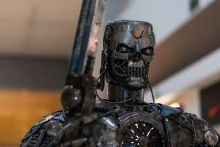
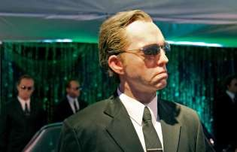

Major Goals of AI
➔Motion and Manipulation
➔Social Intelligence
➔General/Super Intelligence ← Media tries to sell you this

Slide 11
Sciences involved in AI research
➔Computer Science
➔Mathematics
➔Psychology
➔Linguistics
➔Philosophy
➔Many Others

Slide 12
Philosophy around AI
➔Is general/super intelligence possible ?
➔Do they have to be similar to human systems to be intelligent as us ?
➔Can intelligent machines be dangerous ?
➔Should we prefer more accurate systems over transparent systems ?

Slide 13
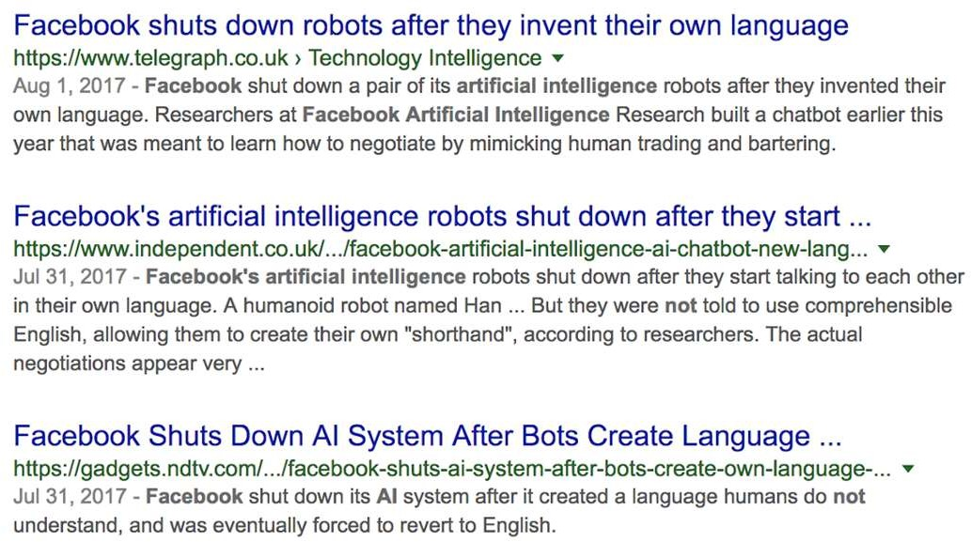
The vagueness and the hype
Real Story: Task was to learn negotiation in natural language, not some efficient cryptic language. Researchers only reported a failed experiment trail.

Slide 14
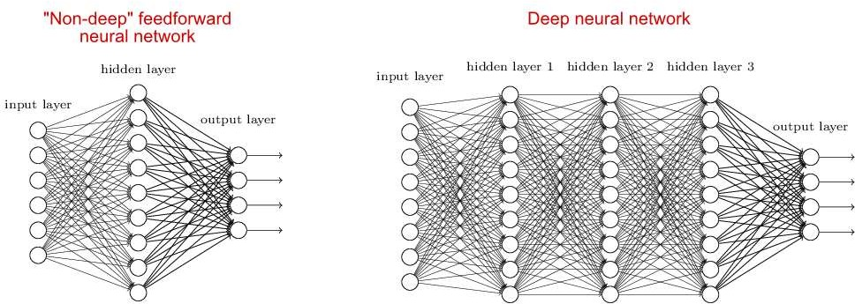
Few words on “Deep learning”
Image Credits: http://neuralnetworksanddeeplearning.com/chap5.html

Slide 15
AI, ML, NN, DL are not new!
➔ First Programmable Computer ≈ 1936
➔ AI research began ≈ 1956
➔ Neural Networks - base ideas as early as 1943, polished idea ≈ 1958, research active since 1990s
➔ Deep learning - first idea proposed in 1965, early implementations ≈ 1965 - 1971, research active since 1990s
➔ Large NNs were computationally infeasible to train back then
➔ NNs and DL went into “hibernation” for more than a decade

Slide 16
Training complex models has become feasible now
➔Large datasets are available for some tasks
Resurgence of “AI” because of Deep Learning
➔Compute power has increased exponentially - we now have very powerful GPUs/TPUs
➔Theoretical ideas in research have been polished over time
➔Much better tools to work with!
Theano,Tensorflow (Google), Keras (now Google), Torch/PyTorch(Facebook), CNTK (Microsoft), Caffe (UCB), MXNet(Apache, Amazon), sklearn, gensim, nltk

Slide 17
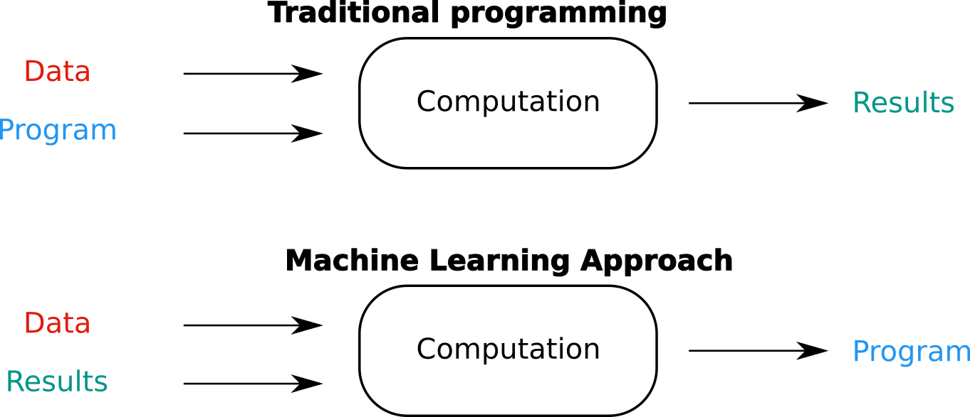
Machine Learning
Image credits: https://recast.ai/blog/machine-learning-algorithms/

Slide 18
Machine Learning
Blends ideas from statistics, computer science, operations research, pattern recognition, information theory, control theory and many other disciplines to design algorithms that find low-level patterns in data, make predictions and help make decisions (at scale).

Slide 19
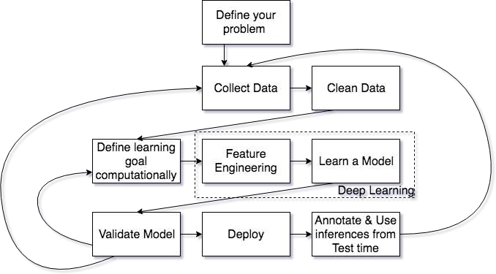
Typical Machine Learning Pipeline

Slide 20
➔Supervised Learning - some feedback is available
Common Taxonomy of ML methods
Completely Supervised Learning
Semi-Supervised Learning
Active learning
➔Reinforcement Learning
➔Unsupervised Learning - no explicit ground truths
➔Meta learning
➔...

Slide 21
Let’s dig deep into it…
What do you mean by
Apple

Slide 22
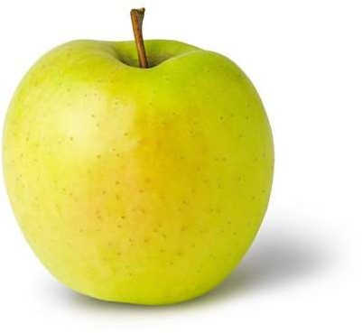
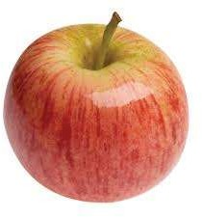

Learning (Training)
Features:
Color: Radish/Red
Type : Fruit
Shape
etc…
Features:
Sky Blue
Logo
Shape
etc…
Features:
Yellow
Fruit
Shape
etc…

Slide 23
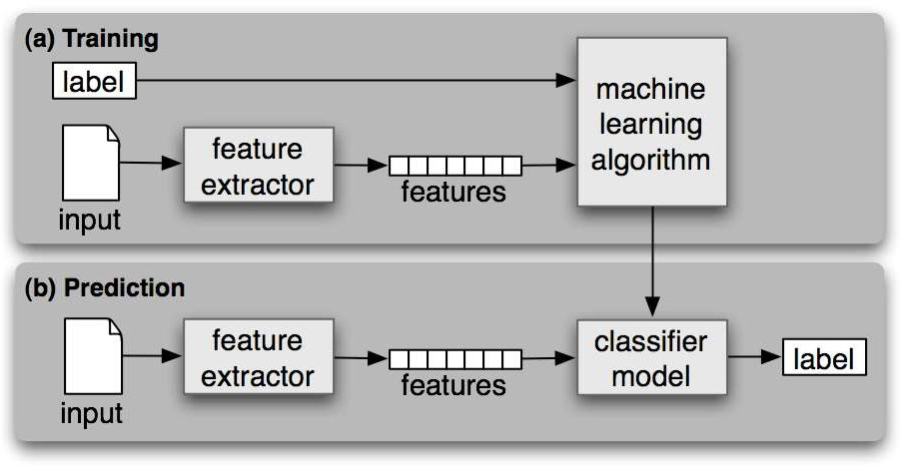
Workflow

Slide 24
Categories
Supervised Learning
Unsupervised Learning
Semi-Supervised Learning
Reinforcement Learning

Slide 25
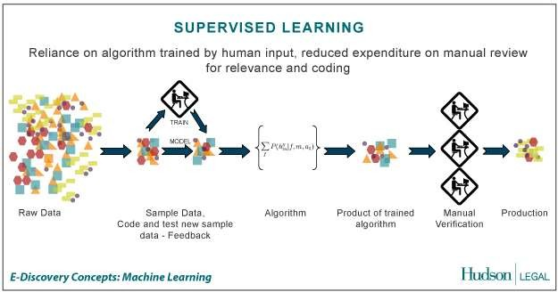
Supervised Learning
the correct classes of the training data are known
Credit: http://us.hudson.com/legal/blog/postid/513/predictive-analytics-artificial-intelligence-science-fiction-e-discovery-truth

Slide 26
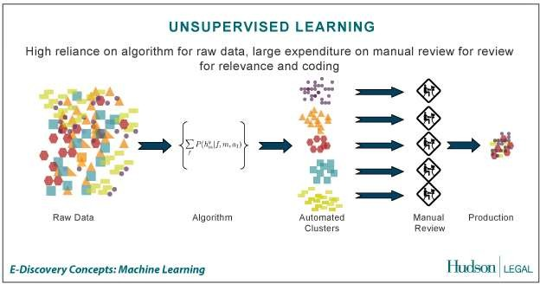
Unsupervised Learning
the correct classes of the training data are not known
Credit: http://us.hudson.com/legal/blog/postid/513/predictive-analytics-artificial-intelligence-science-fiction-e-discovery-truth

Slide 27
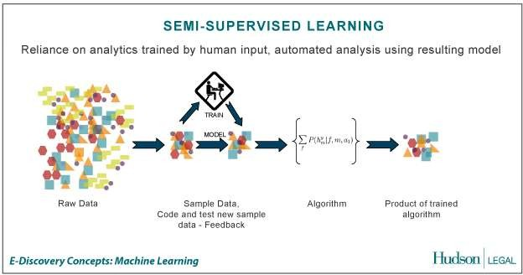
Semi-Supervised Learning
A Mix of Supervised and Unsupervised learning
Credit: http://us.hudson.com/legal/blog/postid/513/predictive-analytics-artificial-intelligence-science-fiction-e-discovery-truth

Slide 28
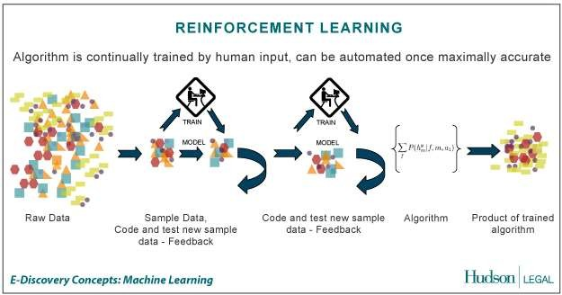
Reinforcement Learning
allows the machine or software agent to learn its behavior based on feedback from the environment.
This behavior can be learnt once and for all, or keep on adapting as time goes by.
Credit: http://us.hudson.com/legal/blog/postid/513/predictive-analytics-artificial-intelligence-science-fiction-e-discovery-truth

Slide 29
Common Tasks for ML
➔Classification (usually supervised)
➔Regression (usually supervised)
➔Clustering (unsupervised)
➔Dimensionality Reduction
➔...

Slide 30
➔Task is to learn to categorize input into discrete classes
Classification
E.g. Input: Image
Output: probabilities of image containing
{dog, cat, horse, zebra}
➔Supervised task, we have true labels for each input
➔Metrics: To keep things simple, we will use accuracy - how many things the classifier can classify correctly.
Selecting a metric depends on the data + problem

Slide 31
Classification
classify a document into a predefined category.
documents can be text, images
Popular one is Naive Bayes Classifier.
Steps:
Step1 : Train the program (Building a Model) using a training set with a category for e.g. sports, cricket, news,
Classifier will compute probability for each word, the probability that it makes a document belong to each of considered categories
Step2 : Test with a test data set against this Model
http://en.wikipedia.org/wiki/Naive_Bayes_classifier

Slide 32
Clustering
clustering is the task of grouping a set of objects in such a way that objects in the same group (called a cluster) are more similar to each other
objects are not predefined
For e.g. these keywords
“man’s shoe”
“women’s shoe”
“women’s t-shirt”
“man’s t-shirt”
can be cluster into 2 categories “shoe” and “t-shirt” or “man” and “women”
Popular ones are K-means clustering and Hierarchical clustering

Slide 33
Other things that we don’t have time for
➔Non-Linear classifiers
➔Learning Methods that don’t use Gradient Descent
➔Other Metrics: Precision, Recall, F1
➔Overfitting and underfitting
➔And many more tricks of the trade

Slide 34
Recommended materials:
https://www.coursera.org/learn/machine-learning
http://martin.zinkevich.org/rules_of_ml/rules_of_ml.pdf
http://neuralnetworksanddeeplearning.com/
https://www.coursera.org/learn/neural-networks
https://web.stanford.edu/~hastie/ElemStatLearn/
News and discussion on latest stuff - http://reddit.com/r/MachineLearning

Slide 35
Thank You!
Shivay Lamba
Google Summer of Code Mentor at Jenkins, CNCF for Machine Learning and Cloud Computing
Google Code In Mentor at Tensorflow
Ex Intern at EY, Genpact, Tech Mahindra

