Slide 1
DOB Violations Data Analysis
Capstone Project Presentation
Prepared by Shivangi

Slide 2
Introduction
Analyze NYC DOB Violations data to identify patterns and trends
Investigate borough-level violation activity and penalties
Understand common violation types and enforcement patterns
Used Python and data visualization techniques to support findings

Slide 3
Data Source
Source: DOB Violations CSV dataset
Rows: 131,213(Total 1.81M)
Columns: 46
Dataset updated : 05/14/2026
Dataset contains violation details, boroughs, penalties, dates, and violation types

Slide 4
Methodologies
Downloaded dataset from NYC opendata
Analyzed information using Python through Google Collab.
Utilized Python libraries: Pandas, Matplotlib, Seaborn
Cleaned Data and Handled missing values
Converted data types for numerical analysis
Grouped and aggregated data by borough, Penalty amounts and violation type
Created statistical summaries and visualizations

Slide 5
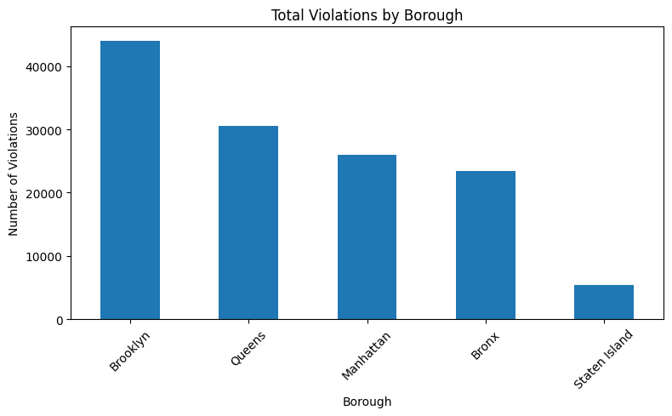
Total Violation & Penalty Amt
This graph Shows which borough has the most violations
Brooklyn has the most violations and Staten Island has the least violations

Slide 6
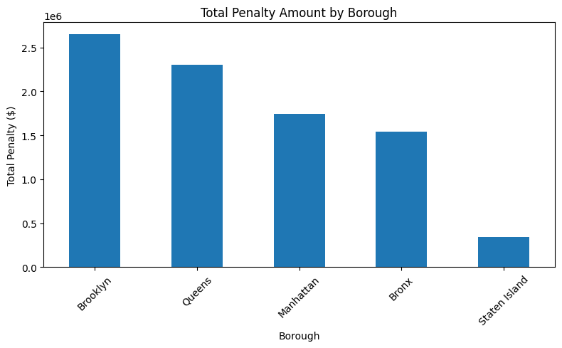
Total Violation & Penalty Amt
This graph shows the total penalty amount issued in each borough.
By aggregating penalty values, it highlights which boroughs contribute the most to overall fines.
This can indicate areas with higher severity violations or stronger enforcement activity.

Slide 7
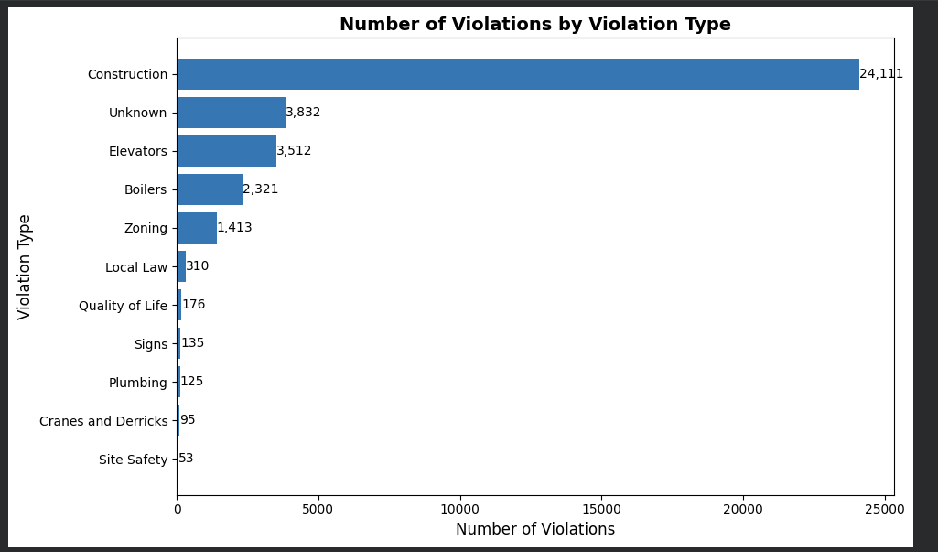
This graph displays the distribution of violations by violation type.
It shows which types of violations occur most frequently, helping identify the most common compliance issues.

Slide 8
Thank you!!!

