Slide 1
Market Basket Analysis
# BY- SHIV DATT MISHRA

Slide 2
Introduction
Market Basket Analysis (MBA) is a widely-used data mining technique that helps businesses understand customer purchasing behavior by identifying associations between different items within a transaction. The goal is to discover patterns or rules that explain the co-occurrence of products, which can inform decisions about product placement, promotions, and inventory management.
In this project, we perform Market Basket Analysis on the Groceries Dataset using association rule mining techniques. The insights derived from this analysis can be utilized to optimize various aspects of retail operations, including product placement strategies, personalized marketing, and inventory management. The ultimate aim is to enhance customer satisfaction and increase profitability by better understanding customer preferences and buying habits.

Slide 3
Objective
Identify key product associations that frequently co-occur in transactions.
Optimize inventory management by understanding product demand and associations.
Develop targeted marketing strategies based on product associations.
Develop targeted marketing strategies based on product associations.

Slide 4
Market Basket Analysis (MBA) is a data mining technique used to identify associations between items in a transaction database.
01
It is commonly applied in the retail industry to analyze customer purchasing behavior and discover frequent itemsets.
02
03
MBA uses algorithms like Apriori or FP-Growth to generate association rules that highlight relationships between products.
Understanding Market
Basket Analysis
04
The insights gained from MBA can be used to optimize product placement, develop marketing strategies, and improve inventory management.

Slide 5
Key Metrics in Market Basket Analysis
Support
Lift
Frequency of an item set's occurrence in the dataset.
Measures the strength of the association, comparing observed frequency with expected frequency if independent.
Confidence
Support Example
Likelihood of a consequent item being purchased when the antecedent item is bought.
If bread appears in 20% of transactions, its support is 0.2.

Slide 6
Algorithms and Dataset
Apriori Algorithm
A popular method in MBA that uses a bottom-up approach to identify frequent item sets.
Grocery Dataset
Contains anonymized transaction data, ideal for applying MBA to discover product relationships.
FP-Growth Algorithm
An efficient alternative to Apriori, particularly effective for large datasets by avoiding repeated scans.
Dataset Structure
Composed of transactions with items purchased together, enabling the discovery of association rules.

Slide 7
Data Preprocessing and Implementation
Data Cleaning
Data Transformation
Involves removing inconsistencies or irrelevant data from the dataset to ensure accuracy.
Converts the raw transaction data into a suitable format for analysis, such as creating item sets.
Implementation Tools
Analysis Steps
Utilized Python libraries like pandas for data manipulation and mlxtend for applying the Apriori algorithm.
Load and preprocess the dataset.
Apply the Apriori algorithm to identify frequent item sets.
Generate and interpret association rules for actionable insights.

Slide 8
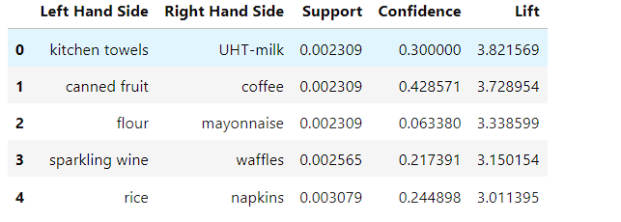
Output

Slide 9
Future Scope
Real-Time Analysis
Future Scope
Implement real-time market basket analysis for dynamic product recommendations.
Explore more efficient algorithms like FP-Growth or Eclat for deeper analysis.
Business Integration
Larger Datasets
Integrate findings with CRM systems to enhance targeted marketing and personalized promotions.
Apply MBA to larger and more diverse datasets to gain comprehensive insights.

Slide 10
Conclusion
Summary of Analysis
Market Basket Analysis revealed valuable insights into purchasing patterns using the Grocery Dataset.
Actionable Insights
The generated association rules provide a foundation for data-driven decision-making.
Impact on Business
Identified associations can optimize product placement, bundling strategies, and marketing efforts.
Final Thoughts
MBA is a powerful tool for retail analytics, offering a significant competitive advantage.

Slide 11
References and Bibliography
"Agrawal, R., Imieliński, T., & Swami, A. (1993). Mining association rules between sets of items in large databases."
"Han, J., Kamber, M., & Pei, J. (2012). Data Mining: Concepts and Techniques. Morgan Kaufmann."
"mlxtend: Machine Learning Extensions. Available at: https://github.com/rasbt/mlxtend"
"pandas: Data Analysis and Manipulation Library. Available at: https://pandas.pydata.org/"

