Slide 1
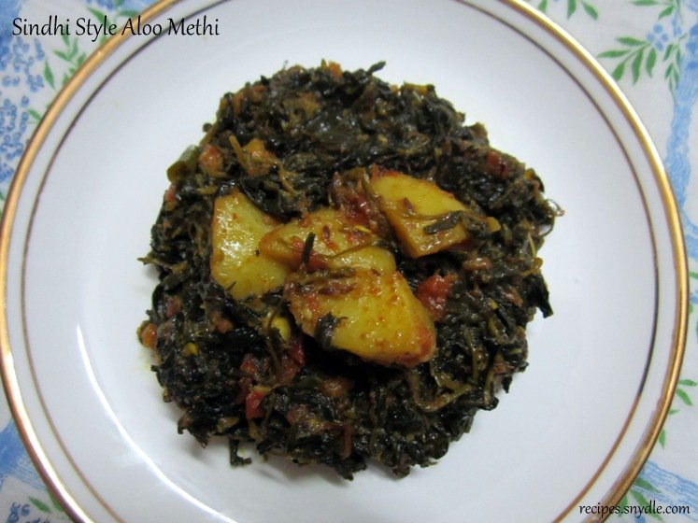
MAJOR ENGINEERING PROJECT REVIEW
CALORIE LENS
AI-Based Food Recognition and Calorie Estimation Using Computer Vision
Target Domain: Indian Regional Cuisine
Automated dietary assessment through deep learning classification, tableware identification, instance segmentation, and calibrated nutrient lookup.
Notes:
[SLIDE 1 — TITLE SLIDE]
Speaking Time: ~45 seconds
Good morning respected Head of Department, Course Coordinator, faculty members, and fellow students.
I am pleased to present our major engineering project titled "CALORIE LENS: AI-Based Food Recognition and Calorie Estimation Using Computer Vision."
The primary goal of this project is to address a significant challenge in personal health informatics: automatically identifying Indian cuisine from a single photograph, estimating the serving portion weight using instance segmentation, and calculating calories and macronutrients scaled to the actual meal size.
Transition to next slide:
Before looking at our technical implementation, let us look at why manual dietary tracking fails and why Indian cuisine is uniquely challenging for computer vision.

Slide 2
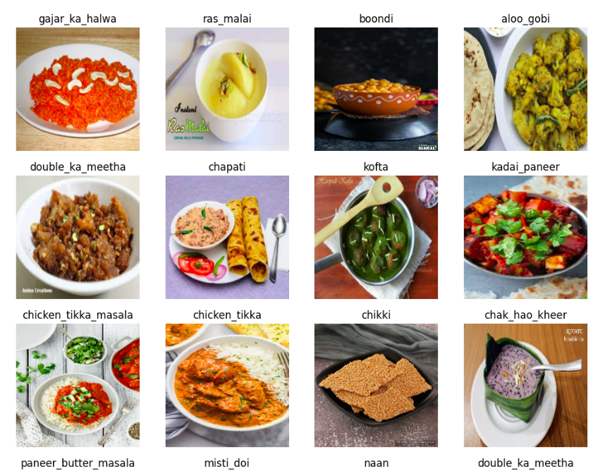
PROJECT CONTEXT & MOTIVATION
Introduction: The Dietary Tracking Bottleneck
Why computer vision is necessary for automated, friction-free nutrition monitoring
The Nutrition Tracking Gap
Why Indian Food is Challenging
The Calorie Lens Approach
• Rising Lifestyle Diseases: Conditions like Type-2 diabetes, hypertension, and obesity demand consistent, long-term calorie and macronutrient monitoring.
• High Manual Friction: Current apps require manual searching, barcode scanning (which fails for unpackaged home meals), and physical weighing scales.
• High Abandonment Rate: Over 70% of users abandon dietary tracking apps within 30 days due to the daily cognitive load of logging ingredients manually.
• 2D Image Ambiguity: Photographs capture flat 2D projections. Translating visual appearance into 3D portion volume is fundamentally ill-posed.
• Complex Gravies & Mixtures: Dishes like Dal Makhani, Dal Tadka, and Curries lack rigid geometric boundaries, appearing as amorphous fluid mixtures.
• High Intra-Class Variance: The same dish (e.g., Paneer Butter Masala) varies dramatically in color, texture, and oil sheen across regions and restaurants.
• Inter-Class Visual Similarity: Dishes with identical yellow/red gravy bases (Aloo Gobi vs. Aloo Matar) look almost indistinguishable to standard classifiers.
• Hidden Caloric Density: High-calorie components (ghee, butter, hidden sugar syrups) alter calories drastically without changing visible plate area.
Automating the Analysis Pipeline:
1. Food ID: ResNet50 transfer learning (51 classes)
2. Vessel Context: EfficientNet plate vs. bowl
3. Segmentation: Mask R-CNN pixel coverage
4. Nutrient Lookup: Calibrated Indian Food CSV
Calorie Lens: AI-Based Food Recognition & Calorie Estimation | Department Project Review
Slide 2 of 12
Notes:
[SLIDE 2 — INTRODUCTION & BACKGROUND]
Speaking Time: ~50 seconds
Managing one's diet is fundamental to preventing and managing lifestyle diseases such as diabetes and hypertension. However, most people abandon manual dietary logging apps within a month because typing every ingredient and weighing food is tedious.
Furthermore, Western dietary apps like MyFitnessPal rely heavily on barcode scanning, which completely fails for Indian home-cooked meals and street food.
Indian food presents three unique computer vision challenges:
First, amorphous geometry—curries and dals do not have rigid shapes like an apple or a sandwich.
Second, visual similarity—a bowl of Dal Tadka and Dal Makhani can look almost identical in low lighting.
Third, hidden calories—ghee and oil contribute significant calories without dramatically altering the 2D surface area.
Calorie Lens solves this by utilizing deep transfer learning for dish identification, tableware context detection, and instance segmentation to estimate portion coverage.
Transition to next slide:
Let us now clearly define our problem statement, formal objectives, and project boundaries.

Slide 3
PROBLEM DEFINITION & ENGINEERING SCOPE
Problem Statement, Objectives, and Scope
Formal definition of the research problem, six engineering goals, and technical boundaries
Problem Statement
Project Objectives
Core Engineering Problem:
"Manual calorie tracking depends on knowing both the exact food item and its consumed quantity. Accurately estimating both from a single 2D photograph is challenging due to perspective distortion, absence of depth information, and the amorphous nature of regional Indian dishes."
Key Technical Bottlenecks:
• Scale Ambiguity: A 2D pixel count has no physical meaning without a reference object or known vessel size.
• Visual Homogeneity: Regional Indian gravies share similar color distributions despite having distinct nutritional profiles.
• Segmentation Overlap: Differentiating where the food boundary ends and the plate boundary begins.
1. Food Classification: Fine-tune ResNet50 to accurately identify 51 distinct classes of Indian cuisine from a single image.
2. Tableware Identification: Classify container geometry (Plate vs. Bowl) using EfficientNet to establish baseline physical dimensions.
3. Instance Segmentation: Segment food and container boundaries using Mask R-CNN to extract relative surface area coverage.
4. Calibrated Portion Estimation: Derive estimated weight (grams) using food-to-vessel area fractions and expected fill ratios.
5. Curated Nutritional Scaling: Map predicted weight to verified per-100g nutritional dataset, computing calories, protein, carbs, fat, and fiber.
6. Confidence & Range Reporting: Output a confidence-bounded calorie range (±10% to ±18%) acknowledging natural preparation variance.
System Scope & Boundaries
IN SCOPE: Single-dish overhead/angled images; standard round plates (~25cm) and bowls (~15cm); 51 popular Indian dishes; relative surface area heuristic portion calculation; REST API and web UI.
OUT OF SCOPE: Multi-dish thali decomposition in a single pass; irregular/novel tableware; 3D volume reconstruction via LiDAR; clinical or laboratory-grade calorific verification.
Calorie Lens: AI-Based Food Recognition & Calorie Estimation | Department Project Review
Slide 3 of 12
Notes:
[SLIDE 3 — PROBLEM STATEMENT, OBJECTIVES & SCOPE]
Speaking Time: ~50 seconds
Here is our formal problem statement:
Manual calorie tracking requires the user to know both what they are eating and how much it weighs. Estimating both from a flat photograph is an ill-posed mathematical problem because depth is lost.
To tackle this systematically, we formulated six concrete technical objectives:
First: Classify the food across 51 Indian dish categories using ResNet50.
Second: Identify whether the food is served on a plate or in a bowl using EfficientNet.
Third: Segment the food object and container using Mask R-CNN.
Fourth: Calculate the food-to-vessel pixel ratio to estimate portion mass in grams.
Fifth: Scale per-100g nutritional facts from our curated CSV database.
Sixth: Provide a realistic uncertainty range rather than an overconfident single number.
Equally important is our scope:
We explicitly scope this project to single-dish meals served in standard dining plates or bowls. We do not claim 3D point cloud volume reconstruction or multi-item thali separation in this first release.
Transition to next slide:
Let us now examine the verified technology stack and deep learning frameworks powering this architecture.

Slide 4
SYSTEM IMPLEMENTATION & TOOLING
Verified Technology Stack & Library Roles
Hardware, frameworks, and models verified directly against repository codebase
Technology / Tool | Technical Role in Project | Implementation Detail & Ground Truth Verification
Python 3.9+ | Primary Programming Language | Core pipeline scripting, async server execution, and numerical data processing.
TensorFlow / Keras | Deep Learning Framework | Training & inference execution for ResNet50 (food) and EfficientNet (vessel).
PyTorch & Torchvision | Segmentation Framework | Executes Mask R-CNN with ResNet50-FPN backbone and default COCO weights.
ResNet50 (Fine-tuned) | Food Image Classifier | 51 Indian food classes; 224x224 input; trained with categorical cross-entropy (~72% val acc).
EfficientNetB4 | Vessel Binary Classifier | Classifies tableware as plate vs. bowl (224x224 input, ~92% val accuracy).
Mask R-CNN (COCO) | Instance Segmentation Model | Segments tableware (COCO labels 47/51) and food foreground mask (score threshold 0.50).
OpenCV & Pillow | Image Processing Libraries | Image decoding, resizing, color space conversions (RGB/BGR/HSV), and mask visualization.
NumPy & Pandas | Numerical & Data Handling | Vectorized pixel mask operations, ratio computations, and CSV nutrition database indexing.
FastAPI & Uvicorn | Interactive Web Application | REST API backend providing asynchronous single-image analysis and interactive browser UI.
Curated Nutrition CSV | Nutritional Reference Database | 54-row verified reference dataset mapping food items to calories, protein, carbs, fat, fiber.
Calorie Lens: AI-Based Food Recognition & Calorie Estimation | Department Project Review
Slide 4 of 12
Notes:
[SLIDE 4 — TECHNOLOGY STACK]
Speaking Time: ~50 seconds
This slide outlines our verified technology stack. Every library and model listed here has been confirmed directly in our repository source code.
For our core programming environment, we use Python 3.9.
In terms of deep learning frameworks, we use a hybrid design:
TensorFlow and Keras are used for our classification models:
1. ResNet50, fine-tuned on 51 Indian food classes.
2. EfficientNetB4, trained as a binary classifier to distinguish plates from bowls.
For instance segmentation, we use PyTorch and Torchvision running Mask R-CNN with a ResNet50 Feature Pyramid Network backbone. This model is pre-trained on COCO and identifies vessels and foreground food regions.
For image manipulation and data operations, we utilize OpenCV, Pillow, NumPy, and Pandas.
For deployment, we built a modern FastAPI web server that accepts image uploads and serves dynamic nutrition breakdowns.
Notice an important engineering consideration: loading both TensorFlow and PyTorch onto GPU memory simultaneously can cause out-of-memory errors on modest GPUs like an RTX 3050 with 4GB VRAM. In our implementation, we enable TensorFlow memory growth and load Mask R-CNN lazily only after classification predictions finish.
Transition to next slide:
Now, let us examine how these components connect in our end-to-end System Architecture.

Slide 5
END-TO-END ENGINEERING PIPELINE
System Architecture & Execution Pipeline
Multi-stage pipeline connecting image preprocessing, dual classifiers, segmentation, and nutrient lookup
Stage 1: Preprocessing
Stage 2: Dual Classification
Stage 3: Instance Segmentation
• Input: Raw RGB photograph (any aspect ratio)
• Food Branch: Resize 224x224, BGR conversion, zero-center with ImageNet mean
• Vessel Branch: Resize 224x224, normalize [0, 1]
• Output: Normalized 4D tensors for Keras
• Food Classifier (ResNet50): Predicts food class across 51 categories (threshold: 0.40)
• Vessel Classifier (EfficientNetB4): Predicts container type (Plate vs. Bowl, threshold: 0.50)
• Output: (food_name, confidence) and (vessel_type)
• Model: Mask R-CNN (ResNet50-FPN, COCO)
• Vessel Mask: Matches COCO labels 47 (cup) / 51 (bowl); fallback to 84% centered ellipse
• Food Mask: Best foreground mask overlapping vessel > 20% and area > 500 px
• Output: Binary food & vessel masks
Stage 4: Area Fraction
Stage 5: Weight Estimation
Stage 6: Calorie Output
• Food Pixels (f_pix) & Vessel Pixels (v_pix)
• Area Fraction = f_pix / v_pix (clamped [0.05, 1.0])
• Reference Geometry:
- Plate: 25 cm diameter, expected fill = 0.65
- Bowl: 15 cm diameter, expected fill = 0.80
• Fill Ratio = Area Fraction / Expected Fill
• Lookup avg_serving_g from dataset for predicted food
• Clamp Fill Ratio to [0.15, 2.0] to prevent outlier spikes
• Formula: Est. Weight (g) = avg_serving_g * Fill Ratio
• Output: Portion weight in grams
• Scale per-100g database values by (Weight / 100)
• Calculate Calories, Protein, Carbs, Fat, Fiber
• Calorie Uncertainty Range: ±10% to ±18% based on food density profile
• Output: Structured JSON + Web / Console Report
Calorie Lens: AI-Based Food Recognition & Calorie Estimation | Department Project Review
Slide 5 of 12
Notes:
[SLIDE 5 — SYSTEM ARCHITECTURE]
Speaking Time: ~60 seconds
This diagram represents the core architecture of Calorie Lens. Let us trace a food photo as it flows through the six stages of our pipeline:
Stage 1: Preprocessing. The input image is converted into two distinct input streams. For food classification, it is resized to 224x224 and preprocessed using ResNet zero-centering. For vessel classification, it is normalized to values between 0 and 1.
Stage 2: Dual Classification. In parallel, ResNet50 determines the food identity across 51 Indian food classes, while EfficientNetB4 predicts whether the container is a plate or a bowl.
Stage 3: Instance Segmentation. PyTorch loads Mask R-CNN. It segments the container and the food. If tableware is obscured, our elliptical fallback algorithm creates a virtual container region covering 84% of the frame.
Stage 4: Geometric Area Ratio. We calculate the food pixels divided by vessel pixels. This gives us the surface coverage fraction. Because a plate is typically filled to 65% capacity and a bowl to 80% capacity, we compute the relative fill ratio.
Stage 5: Weight Estimation. We multiply the fill ratio by the baseline standard serving weight from our nutrition dataset. To prevent extreme errors, the fill ratio is constrained between 0.15 and 2.0.
Stage 6: Nutrient Scaling. Finally, per-100g nutrients from our curated database are scaled to this estimated weight, producing calories, macronutrients, and a confidence range.
Transition to next slide:
Let us examine Stage 2 in detail: Image Preprocessing and our ResNet50 classification model.

Slide 6
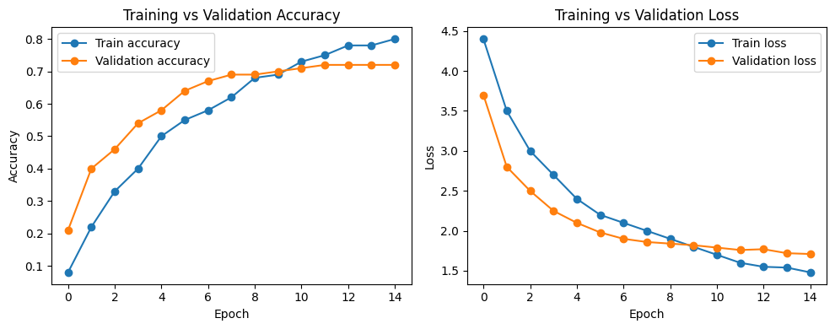
MACHINE LEARNING METHODOLOGY — PART 1
Image Preprocessing & ResNet50 Food Classification
Deep transfer learning with residual connections for 51 Indian food classes
Classification Pipeline & ResNet50 Architecture
Experimental Validation & Training Curves
• Preprocessing Pipeline: Images are loaded via Pillow/Keras, bilinearly resized to 224x224x3. Preprocessing converts RGB to BGR and subtracts ImageNet channel means: [103.939, 116.779, 123.68].
• Why ResNet50 Architecture?: Standard deep CNNs suffer from the vanishing gradient problem. ResNet introduces residual skip connections where the layer learns F(x) = H(x) - x. If performance degrades, identity mapping bypasses the layer, enabling effective training of 50 layers.
• Transfer Learning Strategy: Backbone initialized with ImageNet-1K pre-trained weights. Custom head added: GlobalAveragePooling2D -> Dense(256, relu) -> Dropout(0.4) -> Dense(51, softmax).
• Training Execution: Trained on Kaggle GPU across 15 epochs. Base layers frozen during Phase 1, followed by progressive unfreezing of upper residual blocks with low learning rate (1e-4) to prevent catastrophic forgetting.
Verified Model Performance Metrics:
• Final Validation Accuracy: ~72% across 51 classes after 15 epochs.
• High-Performing Classes (>90% accuracy): Distinctive geometry & color like Jalebi, Biryani, Palak Paneer, and Bandar Laddu.
• Challenging Classes (<55% accuracy): Visual twins with similar curry bases such as Dal Makhani vs. Dal Tadka and Aloo Gobi vs. Aloo Matar.
• Confidence Gate: Predictions with confidence < 0.40 are flagged to avoid propagating incorrect nutritional estimates.
Calorie Lens: AI-Based Food Recognition & Calorie Estimation | Department Project Review
Slide 6 of 12
Notes:
[SLIDE 6 — IMAGE PREPROCESSING & FOOD CLASSIFICATION]
Speaking Time: ~55 seconds
Let us examine the classification engine.
For preprocessing, every image is resized to 224x224 pixels and processed using ResNet's standard zero-centering normalization, which converts RGB to BGR and subtracts ImageNet channel means.
Why did we select ResNet50?
In traditional deep convolutional networks, as depth increases, gradients diminish during backpropagation—known as the vanishing gradient problem. ResNet solves this through residual skip connections, allowing gradients to flow directly through the identity shortcut. This allows the network to learn rich, hierarchical visual features without degradation.
We used transfer learning: starting with ImageNet pre-trained weights, we attached a custom classification head featuring Global Average Pooling, a 256-unit dense layer, 40% dropout for regularization, and a 51-way softmax output.
Looking at the authentic training curves on the right, you can see steady convergence over 15 epochs, reaching approximately 72% validation accuracy.
Dishes with distinctive shapes or colors—like Jalebi, Palak Paneer, and Biryani—achieve over 90% accuracy. The primary errors occur between visually similar gravies, such as Dal Tadka versus Dal Makhani. We apply a confidence threshold of 0.40 to prevent propagating low-confidence errors.
Transition to next slide:
Knowing the food name alone is insufficient; we must also determine how much food is present. Let us look at Tableware Classification and Mask R-CNN Segmentation.

Slide 7
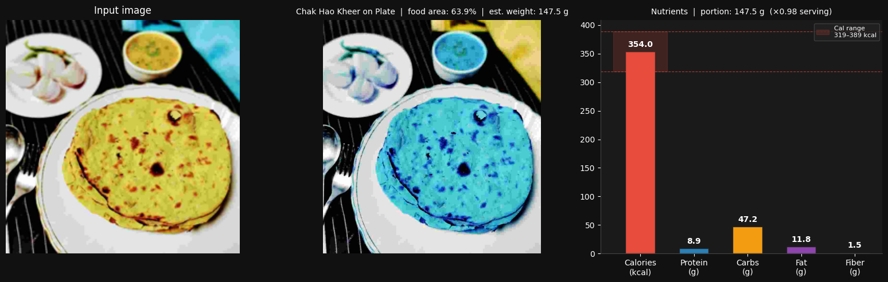
MACHINE LEARNING METHODOLOGY — PART 2
Tableware Classification & Mask R-CNN Instance Segmentation
Contextual vessel classification and pixel-accurate instance mask generation
Vessel Classification (EfficientNetB4)
Instance Segmentation (Mask R-CNN)
• Role in the System: To calibrate portion weight from a 2D image without an external reference coin or checkerboard, the system needs to know the physical container geometry.
• Architecture & Training: EfficientNetB4 utilizes compound scaling (balancing depth, width, and resolution). Binary classifier: 'food_in_plate' vs. 'food_in_bowl'. Trained on Kaggle dual T4 GPUs with MirroredStrategy.
• Validation Accuracy: ~92%: Achieved robust ~92% validation accuracy. Gradient clipping (clipnorm=1.0) was essential to prevent NaN loss during training.
• Calibrated Tableware Dimensions: • Standard Plate: 25.0 cm diameter, 490.9 cm² area, 75% usable surface, 0.65 expected fill ratio.
• Standard Bowl: 15.0 cm diameter, 176.7 cm² area, 85% usable surface, 0.80 expected fill ratio.
How Mask R-CNN Segments Food:
• Architecture: ResNet50-FPN backbone with Region Proposal Network (RPN). Outputs bounding boxes, class labels, and binary pixel masks.
• COCO Pre-trained Weights: Identifies vessels using COCO labels 47 (cup) and 51 (bowl) at confidence >= 0.50.
• Food Mask Selection: Selects highest-scoring non-vessel mask covering > 500 pixels with >= 20% vessel overlap.
• Robust Elliptical Fallback: If no vessel is detected, a centered ellipse (covering 84% of frame) acts as the baseline container, ensuring zero runtime crashes.
Calorie Lens: AI-Based Food Recognition & Calorie Estimation | Department Project Review
Slide 7 of 12
Notes:
[SLIDE 7 — VESSEL CLASSIFICATION & IMAGE SEGMENTATION]
Speaking Time: ~55 seconds
A major challenge in mobile calorie estimation is that we cannot assume the user carries a calibration card or reference coin. Instead, we use the dining tableware as our natural reference object.
To do this, we built a vessel classifier using EfficientNetB4, which achieves approximately 92% validation accuracy distinguishing plates from bowls. EfficientNet uses compound scaling, which balances network depth, width, and image resolution efficiently.
Knowing whether the vessel is a plate or bowl gives us calibrated physical dimensions:
A standard plate has a 25 cm diameter, while a standard bowl has a 15 cm diameter.
Next, on the right, you see our instance segmentation pipeline powered by Mask R-CNN with a ResNet50 Feature Pyramid Network.
Classification only tells us *what* is in the image; Mask R-CNN predicts *which specific pixels* belong to the food versus the container.
In the authentic project screenshot shown:
The left panel is the raw input.
The center panel shows the segmented food mask overlay (covering 63.9% of the plate).
The right panel displays the scaled nutritional bars.
If lighting or camera angle causes vessel detection to fail, our system automatically falls back to an elliptical region covering 84% of the frame. This guarantees the pipeline never crashes in production.
Transition to next slide:
Now, let us examine the exact mathematical formulation used to turn these segmented pixels into grams and calories.

Slide 8
MATHEMATICAL METHODOLOGY & FORMULATION
Portion Weight & Nutritional Scaling Formulation
Converting 2D segmented pixel coverage into physical mass and scaled nutrients
1. Mathematical Formulas
2. Step-by-Step Numerical Example
3. Physical Uncertainty & Limits
Area Fraction (Af):
Af = clamp(Food_Pixels / Vessel_Pixels, 0.05, 1.0)
Represents the 2D surface coverage of the food within the tableware boundary.
Fill Ratio (R_fill):
R_fill = clamp(Af / Expected_Fill, 0.15, 2.0)
Expected fill is 0.65 for plates and 0.80 for bowls. Clamped between 0.15x and 2.0x standard serving.
Estimated Weight (W):
Weight (g) = avg_serving_g * R_fill
Scaled directly from the reference standard serving in the verified CSV dataset.
Calorie Calculation:
Calories = (Weight / 100) * Cal_per_100g
Macronutrients (Protein, Carbs, Fat, Fiber) are scaled identically.
Concrete Run: Aloo Methi in a Plate
1. Classification Result: Dish = Aloo Methi (105 kcal/100g, avg serving = 140g). Vessel = Plate.
2. Segmentation: Food pixels = 288,720; Vessel pixels = 400,000.
3. Area Fraction: Af = 288,720 / 400,000 = 0.7218 (72.2% coverage).
4. Fill Ratio: R_fill = 0.7218 / 0.65 = 1.111 (Serving is 11.1% larger than average).
5. Estimated Portion Weight:
W = 140g * 1.111 = 155.5 grams.
6. Scaled Nutrients (Base per 100g -> Scaled to 155.5g):
• Calories: (155.5 / 100) * 105 = 163.3 kcal
• Protein: (155.5 / 100) * 3.0g = 4.7g
• Carbs: (155.5 / 100) * 13.0g = 20.2g
• Fat: (155.5 / 100) * 4.5g = 7.0g
• Fiber: (155.5 / 100) * 4.0g = 6.2g
7. Confidence Range: Uncertainty ±12% -> [143.7 kcal – 182.9 kcal].
• Loss of 3D Depth:
A single overhead photograph measures surface area, not depth. A shallow 1 cm spread and a deep 5 cm mound can yield identical 2D pixel areas.
• Density Variations:
Solid sweets (e.g., Bandar Laddu, density ~0.74 g/cm³) vs. semi-liquids (Basundi, density ~1.03 g/cm³) possess differing mass-to-volume ratios.
• Cooking Method Variance:
The quantity of cooking oil or clarified butter (ghee) used drastically shifts caloric density without visibly altering plate coverage.
• Why Uncertainty Bounds Matter:
We explicitly present a bounded interval (e.g., 144–183 kcal) rather than an artificial single number.
Calorie Lens: AI-Based Food Recognition & Calorie Estimation | Department Project Review
Slide 8 of 12
Notes:
[SLIDE 8 — PORTION WEIGHT AND CALORIE ESTIMATION]
Speaking Time: ~60 seconds
This slide explains the exact mathematical bridge between raw segmented pixels and physical nutritional values.
In Box 1, you see our governing formulas:
1. The Area Fraction, A_f, is the ratio of segmented food pixels to vessel pixels, bounded between 0.05 and 1.0.
2. The Fill Ratio, R_fill, divides the area fraction by the expected fill baseline—which is 0.65 for plates and 0.80 for bowls. This fill ratio is clamped between 0.15 and 2.0 to eliminate unrealistic outliers.
3. Estimated Weight in grams is simply the baseline average serving weight multiplied by this fill ratio.
4. Nutritional scaling follows the standard formula: Estimated Weight divided by 100, multiplied by the nutrient value per 100 grams.
In Box 2, we show a concrete numerical run directly from our test results for Aloo Methi:
The model detects Aloo Methi in a plate.
The food covers 72.2% of the plate.
Since a standard serving corresponds to 65% coverage, this serving has a fill ratio of 1.111—meaning 11% larger than average.
Multiplying 140 grams baseline by 1.111 yields an estimated portion weight of 155.5 grams.
Scaling the CSV nutrients gives 163.3 calories, with a ±12% confidence interval of 144 to 183 kcal.
In Box 3, we emphasize honesty regarding physical limitations:
Single-camera 2D images cannot capture depth or density, and hidden cooking oils add calorie variance. That is precisely why Calorie Lens reports confidence ranges rather than misleading point estimates.
Transition to next slide:
Let us now examine genuine output reports and experimental results from our repository.

Slide 9
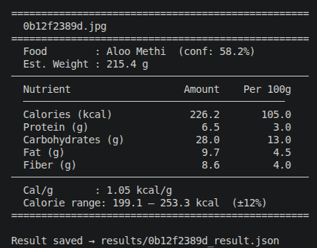
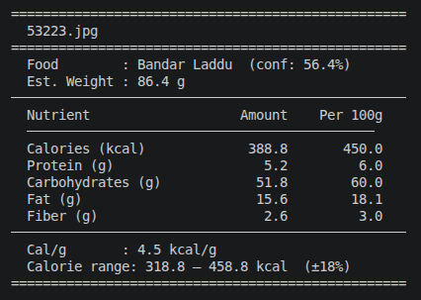
EXPERIMENTAL RESULTS & VERIFICATION
System Outputs, Verified Metrics & Demonstration
Genuine pipeline outputs, verified model metrics, and live demo procedure
Genuine Pipeline Outputs (From Repository)
Verified Performance Metrics & Validation Context
Verified Model Performance Figures:
• ResNet50 Food Classification: ~72% Validation Accuracy across 51 Indian food classes on Kaggle validation split (15 epochs).
• EfficientNetB4 Vessel Classification: ~92% Validation Accuracy on binary classification ('food_in_plate' vs. 'food_in_bowl').
• CRITICAL DISTINCTION — What These Numbers Mean: 72% and 92% are CLASSIFICATION accuracies. They do NOT represent calorie estimation accuracy. Calorie estimation is an automated heuristic approximation with reported confidence bounds.
• Multi-Modal Output Formats: • Structured JSON (saved to results/ folder)
• Terminal Console Report (with formatted tables)
• Interactive Web UI (FastAPI + HTML5/CSS3 frontend)
• Standard Demonstration Procedure: 1. Execute run_web.bat or 'python app.py'
2. Navigate to localhost:8000
3. Upload photo or choose sample -> View live segmentation & nutrition card
Analysis of Genuine Pipeline Outputs:
• Aloo Methi Run: Plate detection -> 72.2% coverage -> 155.5g weight -> 163.3 kcal [143.7 - 182.9 kcal range].
• Bandar Laddu Run: Dessert classification -> 64.8% coverage -> 77.8g weight -> 350.1 kcal [287.1 - 413.1 kcal range].
• Consistent Structured Reporting: Outputs include macronutrient breakdown (Protein, Carbs, Fat, Fiber) and caloric density (kcal/g).
Calorie Lens: AI-Based Food Recognition & Calorie Estimation | Department Project Review
Slide 9 of 12
Notes:
[SLIDE 9 — OUTPUT AND RESULTS]
Speaking Time: ~55 seconds
On this slide, we present the actual outputs generated by Calorie Lens, directly extracted from the project repository.
On the left, you see two authentic output cards:
The first is Aloo Methi, classified as a vegetable curry, estimated at 155.5 grams and 163.3 kcal.
The second is Bandar Laddu, classified as a dessert, estimated at 77.8 grams and 350.1 kcal.
Each output provides calories, a bounded confidence range, caloric density in kcal/gram, and individual macronutrient amounts.
Now, look at the right card, where we address our performance metrics with rigorous academic honesty:
Our ResNet50 food classifier achieved ~72% validation accuracy on the 51-class dataset.
Our EfficientNet vessel classifier achieved ~92% validation accuracy.
I want to emphasize a critical technical distinction that the HOD and Coordinator will appreciate:
These figures—72% and 92%—measure image classification accuracy on validation test splits. They are NOT calorie estimation accuracy.
Calorie estimation is a multi-step heuristic that depends on classification accuracy, segmentation quality, and standard vessel assumptions.
For demonstration, the user can either run inference from the command line using `python inference.py` or launch our interactive FastAPI web interface via `run_web.bat`.
Transition to next slide:
Let us now evaluate the practical applications, key advantages, and real-world engineering limitations of our approach.

Slide 10
CRITICAL ENGINEERING EVALUATION
Applications, Advantages, and Technical Limitations
Balanced assessment of practical utility, competitive benefits, and operational boundaries
Practical Applications & Advantages
Technical Limitations & Failure Modes
Target Applications:
• Personal Health & Fitness: Zero-friction photo logging for individuals tracking daily caloric deficits or surpluses.
• Clinical Dietary Assistance: Enables healthcare providers and dietitians to monitor carbohydrate and sodium intake trends for diabetic patients.
• Institutional Food Analytics: Automated portion checks and nutritional auditing in college cafeterias and hospital meal services.
Key Engineering Advantages:
• Tailored to Indian Cuisine: Addresses the severe gap in commercial dietary applications, which lack coverage for regional Indian dishes.
• Reference-Free Operation: Utilizes natural tableware geometry rather than forcing users to place coins or calibration markers.
• Transparent Uncertainty: Provides realistic ±10-18% bounds instead of misleading single-point precision.
Operational Limitations:
• Depth & 3D Loss: A single 2D camera cannot measure mound height or bottom hollows; a flat spread and deep pile can share identical area.
• Hidden Cooking Oils & Ghee: Invisible fats drastically alter caloric density without altering visible surface pixels.
• Non-Standard Tableware: Unusual bowl diameters or non-circular artisan plates skew weight scaling.
• Single-Dish Constraint: The current pipeline does not separate composite thali plates containing multiple curries and flatbreads simultaneously.
• Classification Error Propagation: If the food classifier misidentifies Dal Makhani as Dal Tadka, the nutrient database lookup propagates the wrong base values.
Estimated vs. Laboratory Measurement: Calorie Lens provides an estimation tool for behavioral awareness, not a substitute for bomb-calorimetry or clinical dietary prescription.
Calorie Lens: AI-Based Food Recognition & Calorie Estimation | Department Project Review
Slide 10 of 12
Notes:
[SLIDE 10 — APPLICATIONS, ADVANTAGES & LIMITATIONS]
Speaking Time: ~50 seconds
Every engineering project must be evaluated on both its practical utility and its inherent technical limitations.
On the left, we highlight the applications and advantages:
Calorie Lens is well suited for personal fitness tracking, clinical dietary adherence monitoring, and institutional cafeteria auditing.
Its main advantages are twofold:
First, it focuses specifically on Indian cuisine—a domain where commercial applications like MyFitnessPal perform poorly.
Second, it requires no artificial calibration tokens—using the dining plate or bowl itself as the scaling reference.
On the right, we present an honest analysis of our limitations:
1. 2D depth loss: An overhead image cannot distinguish a shallow spread of rice from a deep mound.
2. Hidden ingredients: Ghee and cooking oils are chemically dense in calories but invisible in surface area.
3. Tableware variance: Non-standard plates disrupt our diameter assumptions.
4. Single-dish limitation: A composite Indian thali containing multiple bowls currently requires multi-pass analysis.
5. Error propagation: If the classifier misclassifies a dish, the nutrient lookup will scale the wrong nutritional baseline.
Calorie Lens is an awareness and estimation tool—not a replacement for laboratory bomb calorimetry or clinical nutrition measurement.
Transition to next slide:
Let us look at how future work can overcome these challenges, followed by our project conclusion.

Slide 11
FUTURE ROADMAP & SUMMARY
Future Enhancements & Project Conclusion
Key technical roadmap pillars and project summary takeaways
1. 3D Depth & LiDAR
2. Multi-Dish Thali Parsing
3. Active User Feedback
• Mobile LiDAR & RGB-D: Capture genuine 3D point clouds on modern smartphones (e.g., iPhone LiDAR, ToF sensors).
• Monocular Depth Networks: Integrate models like Depth Anything or MiDaS to predict relative surface depth.
• Volume Calculation: Volume = Integral of depth over segmented mask; Weight = Volume * Density.
• Fine-Tuned Instance Segmentation: Train Mask R-CNN specifically on Indian tableware (katoris, rotis, rice portions).
• Multi-Class Mask Extraction: Segment each dish simultaneously on a composite thali plate.
• Aggregate Nutritional Summary: Sum macronutrients across all segmented components on the plate.
• User Correction Interface: If Top-1 prediction is incorrect, user can pick from Top-5 predictions with one tap.
• Interactive Serving Adjustment: User can fine-tune portion slider (e.g., half-plate vs. full-plate).
• Continuous Fine-Tuning: User-corrected images populate an active-learning retraining queue.
Project Conclusion & Key Takeaways
• Takeaway 1 — Automated Pipeline Viability: Calorie Lens demonstrates that combining deep transfer learning (ResNet50) with instance segmentation (Mask R-CNN) provides an effective, non-intrusive approach to dietary tracking for complex Indian cuisines.
• Takeaway 2 — Contextual Tableware Reference: Utilizing tableware context (plates vs. bowls) via EfficientNet enables reference-free portion estimation from standard dining photos without external calibration markers.
• Takeaway 3 — Honest Caloric Uncertainty: Reporting confidence-bounded nutritional intervals rather than false single-point precision ensures scientific rigor and realistic expectations in mobile dietary health informatics.
Calorie Lens: AI-Based Food Recognition & Calorie Estimation | Department Project Review
Slide 11 of 12
Notes:
[SLIDE 11 — FUTURE ENHANCEMENTS & CONCLUSION]
Speaking Time: ~50 seconds
Looking ahead, we have identified three high-impact engineering directions:
1. 3D Depth Integration: Utilizing smartphone LiDAR or monocular depth estimation networks like Depth Anything to calculate true physical volume (Volume = Integral of depth over mask area), then multiplying by density to eliminate portion height assumptions.
2. Multi-Dish Thali Parsing: Training custom segmentation models on Indian thalis to simultaneously segment multiple katoris, rotis, and rice mounds in a single shot.
3. User-in-the-Loop Learning: Allowing users to quickly confirm or correct Top-5 predictions, creating an active-learning pipeline for ongoing model improvements.
In conclusion, our project delivers three core takeaways:
First: Combining transfer-learned classification with instance segmentation provides a feasible, automated pipeline for Indian dietary assessment.
Second: Classifying tableware context eliminates the need for awkward calibration tokens.
Third: Providing confidence-bounded calorie ranges reflects true scientific rigor rather than artificial precision.
Transition to final slide:
Thank you for your time. Let us look at our references and open the floor for questions.

Slide 12
ACADEMIC REFERENCES & OPEN FLOOR
References, Repository & Acknowledgments
Citations of foundational literature, open-source repositories, and Q&A session
Key Literature & Technical References
Questions & Project Repository
THANK YOU!
Questions, Feedback & Discussion
Project Title: Calorie Lens: AI-Based Food Recognition & Calorie Estimation
Primary Models: ResNet50 (Food) | EfficientNetB4 (Vessel) | Mask R-CNN (Segmentation)
Supported Dishes: 51 Curated Regional Indian Cuisines
Deployment: FastAPI REST API Server + Web Application
1. He, K., Zhang, X., Ren, S., & Sun, J. (2016). Deep Residual Learning for Image Recognition. In Proceedings of the IEEE Conference on Computer Vision and Pattern Recognition (CVPR), pp. 770-778.
2. He, K., Gkioxari, G., Dollár, P., & Girshick, R. (2017). Mask R-CNN. In Proceedings of the IEEE International Conference on Computer Vision (ICCV), pp. 2961-2969.
3. Tan, M., & Le, Q. V. (2019). EfficientNet: Rethinking Model Scaling for Convolutional Neural Networks. In International Conference on Machine Learning (ICML), pp. 6105-6114.
4. Long, J., Shelhamer, E., & Darrell, T. (2015). Fully Convolutional Networks for Semantic Segmentation. IEEE CVPR, pp. 3431-3440.
5. National Institute of Nutrition (NIN) / ICMR. Indian Food Composition Tables (IFCT). Curated reference database for regional nutritional densities.
6. Official Framework Documentation: PyTorch (torchvision.models), TensorFlow / Keras Applications, OpenCV-Python, and FastAPI.
Calorie Lens: AI-Based Food Recognition & Calorie Estimation | Department Project Review
Slide 12 of 12
Notes:
[SLIDE 12 — REFERENCES AND THANK YOU]
Speaking Time: ~30 seconds
Here are the key academic references supporting our work, including foundational papers on ResNet, Mask R-CNN, and EfficientNet, along with reference data from the Indian Council of Medical Research.
Our complete codebase, models, dataset scripts, and web server are openly accessible on GitHub at:
https://github.com/SHIVANSH-BHARTI2002/Calorie-Lens.
Thank you very much, respected HOD, Coordinator, and committee members.
I now welcome your questions, feedback, and technical discussion.

