Slide 1
21CSE457T
SERVICE ORIENTED ARCHITECTURE
UNIT-2
Service-Oriented Applications
(SOA-based software applications)
Prepared by
Dr. Lubin Balasubramanian

Slide 2
Service-Oriented Model Considerations
Key factors for designing service-oriented applications
Identify the services exposed and consumed
Determine appropriate service granularity
Select suitable service integration patterns
Align with business process models
Align application data with enterprise data models
Apply security and governance mechanisms

Slide 3
Service-Oriented Model Considerations
1. Services Exposed or Consumed
Identify the services involved in the application
Determine what functionality the application exposes as services
Identify services that the application consumes from other systems
Common service types:
  Activity Services – perform specific business activities
  Business Services – represent reusable business capabilities
  Business Process Services – support end-to-end processes
  Client Services – support interaction with users or client applications
  Data Services – provide controlled access to enterprise data
Example:
An e-commerce application may expose Order Service and consume Payment Service and Inventory Service.

Slide 4
Service-Oriented Model Considerations
2. Granularity of Services Exposed
Choosing the right service size
Service granularity refers to the scope and size of functionality provided by a service.
Services should have an appropriate level of granularity for:
  Reusability , Integration ,Performance,Maintainability, Service orchestration
Too Fine-Grained
More network calls
Higher communication overhead
Difficult orchestration
Too Coarse-Grained
Less reusable
Difficult to modify
May contain excessive functionality

Slide 5
Service-Oriented Model Considerations
3. Integration Model for Services
How services communicate and integrate
Important integration patterns include:
Enterprise Service Bus (ESB)
  Centralized integration infrastructure
  Routing, transformation, mediation and protocol conversion
API Gateway
  Single entry point for APIs
  Authentication, routing, throttling and monitoring
Message Broker
  Enables asynchronous communication
Direct Service Integration
  Services communicate directly using APIs/protocols

Slide 6
Service-Oriented Model Considerations
4. Business Process Model
Align services with business processes
Understand the organization's business processes
Identify activities and tasks within each process
Map services to business process activities
Support service orchestration across multiple services
Ensure services contribute to business objectives
Example: Online Order Process
Place Order → Validate Customer → Check Inventory → Process Payment → Ship Order
Each activity may be supported by one or more reusable services.

Slide 7
Service-Oriented Model Considerations
5. Enterprise Data Model
Align application data with enterprise-wide data definitions
Applications should follow established enterprise data models
Ensure consistent:
  Data definitions , Data formats , Naming conventions , Relationships, Identifiers
Avoid duplicate and conflicting data definitions
Support data interoperability between services
Example:
Customer Service → Customer ID, Name, Address
Order Service → Customer ID, Order ID, Order Date
Both services should use a consistent definition of Customer ID.
Benefit: Improved data consistency, integration and reuse.

Slide 8
Service-Oriented Model Considerations
6. Governance
Controlling and managing services throughout their lifecycle
Governance addresses:
Security
Authentication, Authorization , Identity management , Access control
Design-Time Governance
Service standards , Service contracts
Versioning , Service registry/repository
Design and approval policies
Run-Time Governance
Monitoring , Policy enforcement ,
SLA management , Performance tracking ,
Fault management

Slide 9
Service-Oriented Model Considerations
These 6 considerations grouped under four categories:
service enablement;
service integration;
service orchestration & choreography;
service governance.

Slide 10
Service-Oriented Model Considerations
Service Enablement
Identify services exposed or consumed
Ensure appropriate granularity of services
Choose technologies for service enablement
Service Integration
Identify integration patterns
Select appropriate integration technologies
Goal: Ensure trade-offs are addressed appropriately

Slide 11
Service-Oriented Model Considerations
Service Orchestration & Choreography
Define business process models
Implement workflows (manual or automated)
Align with enterprise data models
- Orchestration: Central coordinator
- Choreography: Distributed decision logic in services
Service Governance
1. Design-time governance (e.g., service registry and repository)
2. Run-time governance (e.g., monitoring, policy enforcement)
Security considerations:
- Authentication and authorization
- Implementation of security products and solutions

Slide 12
SOA Patterns
Patterns for Service Enablement
Patterns for service enablement applied to expose the functionality as a service and also to consume remote services.
1. Services Layer: Encapsulates business logic and coordinates interactions.
2. Service Proxy: Interface for calling remote services.
3. Service Gateway: Hides complexity and provides a unified access point.
Patterns for Service Integration
Service integration patterns constitute the solution for the problem of integrating service providers and service consumers.
1.Enterprise Service Bus: Mediates service communication and transformation.
2.Service Adapter: Enables legacy or non-service systems to participate.
3.API Gateway: Single entry point to route requests to appropriate services.

Slide 13
SOA Patterns
Patterns for Orchestration & Choreography
employed to orchestrate services exposed within an application context or across applications.
1.Orchestration Language: Defines activities of business processes.
2.Orchestration Engine: Coordinates sequence of service invocations.
3.Choreography Language: Specifies global interaction logic across services.
4.Compensating Action: Cancels effects of selected actions when needed.

Slide 14
SOA Patterns
Patterns for Service Governance
Service governance ensures that services are:
Designed according to enterprise standards
Properly registered and managed
Compliant with organizational policies
Monitored during execution
Secure, available, and performant
Two Key Governance Patterns
Validation Pattern – Design-Time Governance
Management Pattern – Run-Time Governance

Slide 15
SOA Patterns
1. Validation Pattern
Design-Time Governance Pattern
The Validation Pattern ensures that services conform to established enterprise guidelines and policies before and during their lifecycle.
Key responsibilities:
Validate newly developed services
Ensure compliance with enterprise standards
Control service modifications
Manage service lifecycle
Ensure proper service documentation
Govern service retirement

Slide 16
SOA Patterns
2. Management Pattern
Run-Time Monitoring & Policy Enforcement Pattern
The Management Pattern addresses governance while services are executing.
Key responsibilities
Monitor service execution
Enforce runtime policies
Monitor security
Track performance
Monitor throughput
Check availability
Detect violations and failures
Ensure service-level requirements are met
The Management Pattern monitors important Quality of Service (QoS) requirements:Security, Performance, Throughput, Availability

Slide 17
PATTERN-BASED Architecture For Service-Oriented Applications
Java EE Architecture – Overview
Presentation Layer: Uses MVC or MVVM (e.g., JSP, HTML, JavaScript)
Business Layer: Uses Session Facade and Business Components
Data Access Layer: Implements persistence with JDBC, ORM (Hibernate), JPA
Integration Layer: Uses ESB (Enterprise Service Bus)
Governance Layer: Validation & Management patterns

Slide 18
PATTERN-BASED Architecture For Service-Oriented Applications
Layered Architecture of a Java EE Application
Key Architectural Layers
A thin-client Java EE application can be organized into three major layers:
-Presentation Layer
-Business Layer
-Data Access Layer
Primary Design Patterns:
MVC / MVVM → Presentation
Session Façade → Business Logic
DAO → Data Access

Slide 19
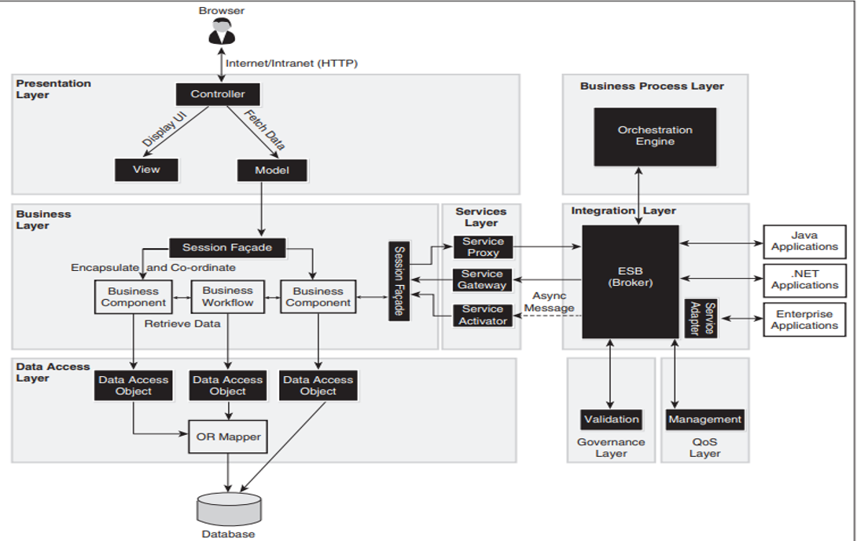
Reference Model Service-Oriented -Java EE Applications

Slide 20
PATTERN-BASED Architecture For Service-Oriented Applications
Presentation Layer: MVC Pattern
Model–View–Controller (MVC)
The MVC pattern separates the presentation responsibilities into:
Model
  Represents application data and business-related operations
View
  Presents information to the user
Controller
  Receives and processes user requests
  Coordinates interaction between View and Model
Typical Java EE technologies:
JSP → View
Servlets → Controller
JavaBeans → Model

Slide 21
PATTERN-BASED Architecture For Service-Oriented Applications
Alternative: MVVM Pattern - Model–View–ViewModel (MVVM)
MVVM is another pattern that can be used for the presentation layer.
Components
Model
  Application data and business logic
View
  User interface
ViewModel
  Provides presentation-specific data and state
  Acts as an intermediary between View and Model
Common technologies:
HTML
CSS
JavaScript
Suitable for: Rich and interactive web interfaces.

Slide 22
PATTERN-BASED Architecture For Service-Oriented Applications
Business Layer: Session Façade Pattern
Session Façade Pattern
The Session Façade is retained to encapsulate business logic and decouple it from the presentation layer.
Responsibilities
Provides a simplified interface to business operations
Encapsulates complex business logic
Coordinates multiple business components
Reduces coupling between presentation and business layers
Helps optimize application performance
Business Layer Implementation
The business layer implements business processes through business components.
Possible implementation technologies:
Java Objects
Enterprise JavaBeans (EJBs)
Workflow Engines
Rule Engines

Slide 23
PATTERN-BASED Architecture For Service-Oriented Applications
Data Access Layer
Purpose:
The Data Access Layer provides controlled access to the database.
Key Responsibilities
Connect to databases
Execute data operations
Manage persistence
Isolate database-specific implementation
Provide reusable data access operations
Data Access Object (DAO)
The DAO pattern wraps access to persistence objects.

Slide 24
PATTERN-BASED Architecture For Service-Oriented Applications
Data Access Layer
Data Access Technology Options
Three major technology options can be used:
1. JDBC - Java Database Connectivity
Direct database connectivity
SQL-based operations
Provides fine-grained control and Requires more manual database interaction
2. ORM
Object-Relational Mapping , Example: Hibernate
Maps Java objects to relational database tables
Reduces manual SQL coding
Supports object-oriented data access
3. JPA - Java Persistence API
Standard Java persistence specification
Provides object-relational persistence
Can work with different persistence providers

Slide 25
Java EE Architecture - Services Layer
Service Proxy: Interface to external services
Service Gateway: Entry point to exposed services
Service Activator: For asynchronous service processing
Session Beans & Workflow Engine used in Business Layer

Slide 26
Java EE Reference Diagram
Explains layered architecture using controller, service gateway, session facade
Uses ESB for integration and BPEL for orchestration
Includes Governance for validation and QoS

Slide 27
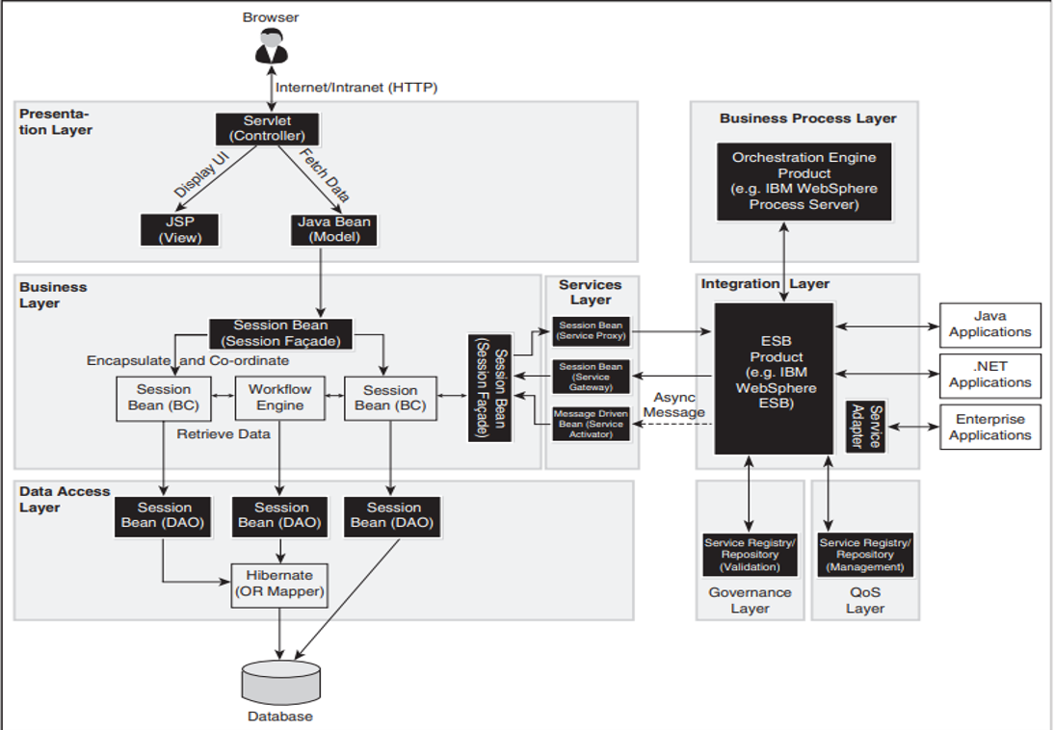
Logical Architecture - Service-Oriented -Java EE Applications

Slide 28
Logical Architecture for Java EE
Uses tools like IBM WebSphere ESB, Hibernate, JavaBeans
Supports UI with JSP/Servlets and backend with Session Beans
Workflow Engine integrated for rule-based execution

Slide 29
.NET Architecture Overview
Presentation Layer: MVC or MVP using ASP.NET, WCF, WF
Business Layer: Uses Service Interface pattern
Data Access: Implements ADO.NET, LINQ, Entity Framework
Integration via Microsoft BizTalk ESB Toolkit

Slide 30
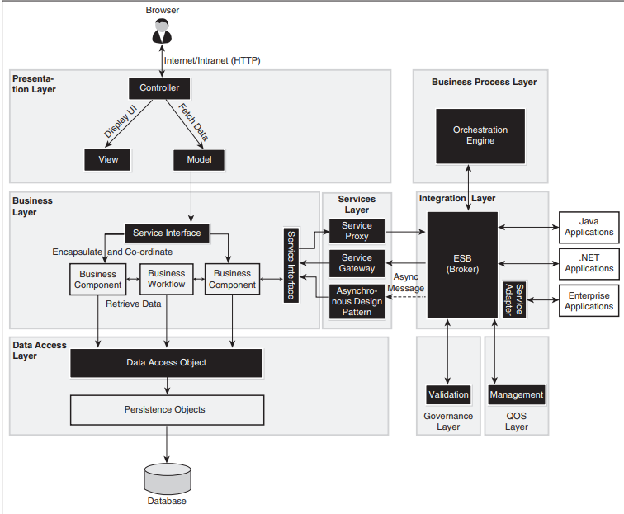
Reference Model Service-Oriented -Microsoft .Net Applications

Slide 31
.NET Architecture - Services Layer
Service Proxy & Gateway handle external interactions
Async Design pattern used for messaging with ESB
Orchestration with BizTalk + BPEL for long-running workflows

Slide 32
.NET Logical Architecture
Layers: Presentation → Business → Service → Integration → Governance
Supports various client applications
Security, transformation, protocol mediation managed at integration layer

Slide 33
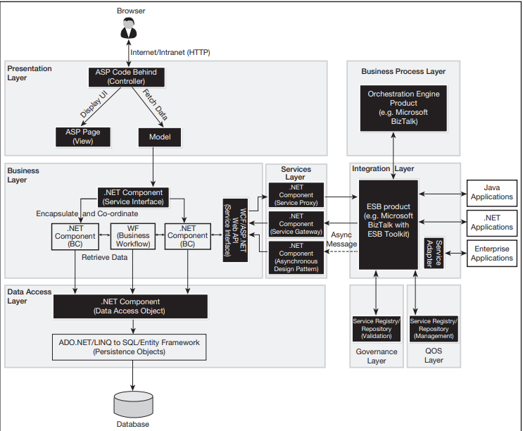
Logical Architecture for Service-Oriented .Net Applications

Slide 34
Composite Applications
Combine multiple services into one application
Use orchestration or aggregation of services
Examples: Travel apps, workflow managers
Built using mashups or business process automation tools

Slide 35
Composite Application Requirements
Right granularity of services
Configurable service combinations
Reusable metadata repository
Support for dynamic service composition

Slide 36
Composite Application Programming Model
Configuration: Achieved through declarative programming techniques
Composition: Combine services using aggregation/orchestration
3. Customization: Enhance service capabilities without changing interface

Slide 37
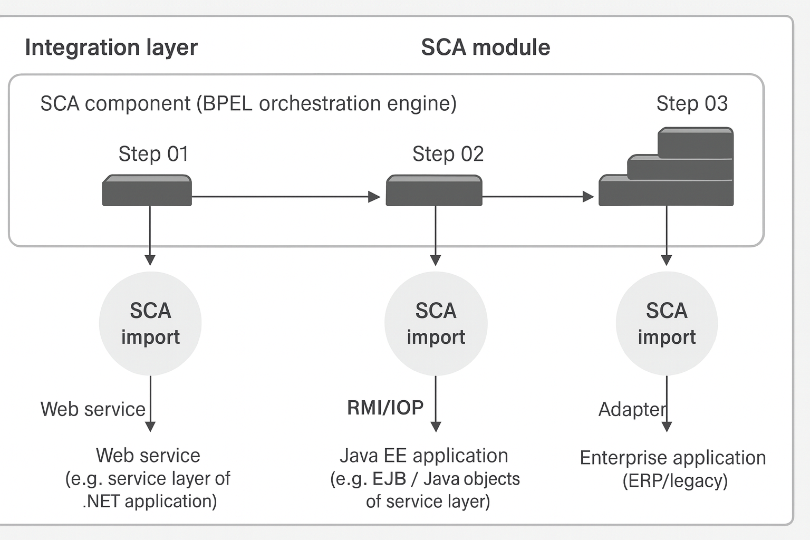
SCA(Service Component Architecture) Programming Model

Slide 38
Service Component Architecture (SCA)
• SCA is a model for assembling services without tight coupling
• Uses Service Data Object (SDO) for uniform business data access
• Core unit: Module deployed in SCA runtime (e.g., Apache Tuscany)
• Supports BPEL, service registry, references, and imports/exports

Slide 39
SCA Runtime Characteristics
• Modules define services and support async/sync invocation
• Can use BPEL, Spring Beans, EJBs, Adapters, etc.
• Components can be imported/exported declaratively
• Enables implementation of composite applications

Slide 40
Objectives of SOAD
Provide systematic methodology to identify and design services.
Ensure business–IT alignment by mapping business capabilities to services.
Deliver contracts, schemas, and policies that form the foundation for implementation.
Support governance, reuse, interoperability, and non-functional requirements.

Slide 41
The Need for Models
Software application design involves identifying and defining many elements, such as:
-Classes , Objects
-Components , Interfaces
-Activities , Services
-Interactions , Deployment elements
A model provides a visual representation of these elements and makes the overall design easier to understand.

Slide 42
The Need for Models
A model is a pictorial representation of a specific kind of elements based on an established notation.
-A model helps designers to:
-Visualize the software structure
-Represent system behavior
-Understand relationships between elements
-Communicate design decisions
-Identify design problems early
-0Document the software architecture
Example:
A class diagram represents classes and their relationships in a software system.

Slide 43
The Need for Models
Design Model
When a model represents the relationships among design elements
A design model provides a visual view of:
System structure
System behavior
Component relationships
Object interactions
Dependencies between elements
Purpose:
Transform complex design information into an understandable visual representation.

Slide 44
The Need for Models
UML: Unified Modeling Language
Unified Modeling Language (UML) is a widely accepted modeling notation for software design.
Developed and standardized through the Object Management Group (OMG)
Supported by many software modeling tools
Provides standardized graphical notation
Used to represent structure, behavior and interactions
UML helps developers, architects and stakeholders communicate software design using a common visual language.

Slide 45
The Need for Models
The UML 2.0 specification, describes thirteen types of diagrams under three categories:
Structure diagrams: class diagram, object diagram, component diagram, composite structure diagram, package diagram and deployment diagram.
Behavior diagrams: use case diagram, activity diagram and state machine diagram.
Interaction diagrams: sequence diagram, communication diagram, timing diagram and interaction overview diagram.

Slide 46
The Need for Models
Commonly Used Design Diagrams
Although UML provides 13 diagram types, some are particularly useful for software application design:
1. Class Diagram
Represents:
Classes , Attributes , Operations, Relationships
2. Activity Diagram
Represents:
Workflow ,Activities , Decisions , Parallel processes
3. Sequence Diagram
Represents:
Objects , Messages , Message sequence ,Time ordering
4. Communication Diagram
Represents:
Objects , Relationships , Messages exchanged between objects

Slide 47
The Need for Models
UML Profiles for Software Services
Two noteworthy profiles for service modeling are:
1. UML 2 Profile for Software Services
Extends UML concepts for software service modeling
Helps represent service-oriented application designs
2. SoaML Profile
Service-Oriented Architecture Modeling Language (SoaML)
Developed by the Object Management Group (OMG)
Provides modeling concepts specifically for SOA
Supports representation of services and service interactions

Slide 48
PRINCIPLES OF SERVICE DESIGN
Service Design Principles
Service design principles provide guidelines for designing effective, reusable, flexible and loosely coupled services.
These principles are derived from the business transformation dimensions of SOA.
Three Major Categories
Reuse
Integration
Agility

Slide 49
PRINCIPLES OF SERVICE DESIGN
Reuse
Reuse is one of the key objectives of the Service-Oriented Model.
Services should be designed as reusable business capabilities that can be consumed by multiple applications or services.
1. Well-Chosen Granularity
Service functionality should be defined at the right level of granularity.
A reusable service should ideally have potential for use by three or more services/applications in an enterprise.
Avoid services that are too fine-grained or too coarse-grained.
2. Abstraction
Service interfaces hide the underlying implementation.
Consumers interact only through:
  Service Contract
  Data Contract
  Associated Policies

Slide 50
PRINCIPLES OF SERVICE DESIGN
3. High Cohesion
A service should focus on a closely related set of functionalities.
Operations belonging to the same business capability should be grouped together.
Improves:
  Reusability
  Maintainability
  Clarity
  Service effectiveness
Example:
Customer Service → Create Customer, Update Customer, Validate Customer, Retrieve Customer
4. Autonomy
Defines the degree of control a service has over its:
  Environment
  Resources
  Internal processing
Service boundaries should be explicit and well-defined.
Services communicate through explicit message passing across defined boundaries.

Slide 51
PRINCIPLES OF SERVICE DESIGN
Integration: Loose Coupling
Loose coupling is a key service design principle that minimizes dependencies between service providers and service consumers.
Key Principles
Define services with minimum dependency on other services.
All interactions must occur through well-defined service interfaces.
Service providers should not depend on the consumer's:
  Internal implementation
  Technology
  Data structures
  Processing logic
Service consumers should depend only on the published service interface.
Changes to the internal implementation of a service should have minimal impact on consumers.

Slide 52
PRINCIPLES OF SERVICE DESIGN
Agility in SOA
Agility is one of the key business benefits of Service-Oriented Architecture (SOA).
Service design should enable organizations to adapt quickly to changing business requirements.
Three Principles for Agility
Statelessness
Composability
Discoverability
1. Statelessness
Services do not maintain conversational state related to individual service invocations.
Each service request can be processed independently.
Business process state can be maintained externally.
Enables business processes to be implemented using orchestrated or choreographed stateless services.
Benefit: Improved scalability and flexibility.

Slide 53
PRINCIPLES OF SERVICE DESIGN
2. Composability
Multiple services can be combined to create new services or business solutions.
Autonomous services act as reusable building blocks.
Services can be combined through:
  Aggregation & Orchestration
Example:
Customer Service + Order Service + Payment Service → Order Processing Service
3. Discoverability
Service consumers should be able to find relevant services using service metadata.
Service Metadata Describes:
Service capabilities
Operations provided
Data requirements
Policies
Limitations
Service interface information
Service Registry
A Service Registry typically stores service metadata and enables consumers to dynamically discover available services.

Slide 54
Non-Functional Requirements (NFRs)
Defined by stakeholders as solution-level requirements.
Crucial for SOA design beyond functional use cases.
Applied at service-level (reusable components), not just at application-level.
Enable reliability, reuse, governance, and scalability in enterprise context.

Slide 55
Key Non-Functional Properties
Response Time – Elapsed time for execution of a service.
Availability – Ability to perform a function when required.
Reliability – Consistently perform without degradation or failure.
Usability – Service is understandable, learnable, and usable under conditions.
Failure Modes – Ways in which failures occur and how they are handled.
Security – Authentication, authorization, audit trails for service invocations.
Service Versioning – Managing changes via documented versions.
Scalability – Ability to perform under increasing workload/service invocations.

Slide 56
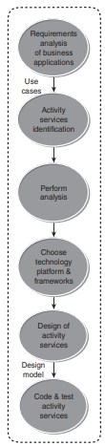
Design of Activity Services
Encapsulate and expose functionality in
business applications.
Represent reusable business-level
services.
Candidates for orchestration in business
processes.
Design of Activity Services:
Based on SOAD process
Can be implemented through:
Bottom-up: Enhancing existing applications.
Top-down: Developing new service-oriented applications.

Slide 57
Design of Activity Services
Requirements & Contracts
Functional and non-functional requirements analyzed via use cases.
Services exposed/consumed documented in:
  Service Contracts – define services, operations, policies.
  Data Contracts – define data exchange formats
  Forward Engineering Approach:
Analysis classes identified → mapped to design classes.
Consider:
  Use cases
  Platform technology strategy
  Available frameworks (e.g., Spring, Apache Axis2, Enterprise Library).

Slide 58
Design of Activity Services
Design Tools & Models
Use of round-trip engineering tools (e.g., IBM Rational Software Architect).
Represented with:
  Class diagrams
  Sequence diagrams
  Communication diagrams
Ensures design consistency and developer communication.

Slide 59
Design of Activity Services
Design Tools & Models
Use of round-trip engineering tools (e.g., IBM Rational Software Architect).
Represented with:
  Class diagrams
  Sequence diagrams
  Communication diagrams
Ensures design consistency and developer communication.

Slide 60
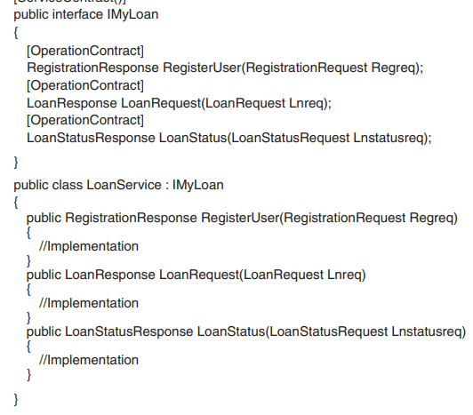
Example - Loan Management System
Use cases
Register User;
2. Request Loan;
3. View Loan Status.
Service – LoanService
service contract –
IMyLoan
Service contract specification.

Slide 61
Example: LoanService
A service called LoanService is defined.
Service contract: IMyLoan.
Operation contracts: Define methods of LoanService.
Implements service interface using WSDL (Web Services Definition Language).

Slide 62
Service Contract
Defines the service interface.
Specifies methods (operations) and input/output parameters.
Described in WSDL as:
  Abstract Description – Technology-independent, defines service interface.
  Concrete Description – Communication binding, endpoint (port), and address.

Slide 63
Abstract Part
- <wsdI:operation name="LoanRequest">
<wsdl:input wsaw:Action="http://tempuri.org/IMyLoan/LoanRequest"
message="tns:IMyLoan_LoanRequest_lnputMessage"/>
<wsdl:output wsaw:Action="http://tempuri.org/IMyLoan/LoanRequestResponse"
message="tns:IMyLoan_LoanRequest_OutputMessage" />
</wsdl:operation>

Slide 64
Concrete Part
- <wsdl:operation name="LoanRequest">
<soap12:operation soapAction="http://tempuri.org/IMyLoan/LoanRequest" style="document" />
- <wsdl:input>
<wsp:PolicyReference URI="#WSHttpBinding_IMyLoan_LoanRequest_lnput_policy" />
<soap12:body use="literal" />
</wsdl:input>
- <wsdl:output>
<wsp:PolicyReference URI="#WSHttpBinding_IMyLoan_LoanRequest_output_policy" />
<soap12:body use="literal" />
</wsdl:output>
</wsdl:operation>

Slide 65
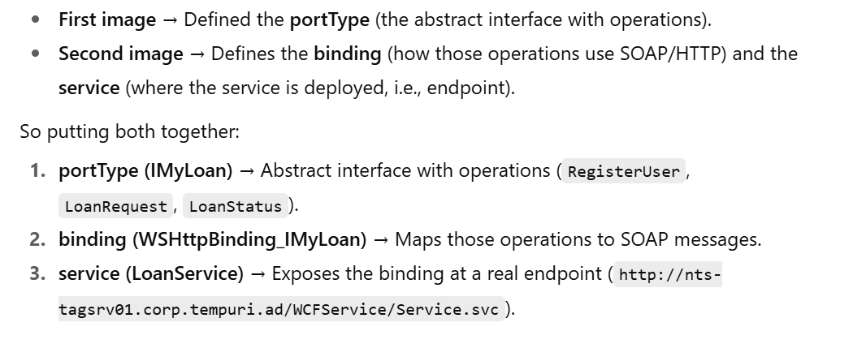

Slide 66
Service Specification
Collection of endpoints for communication.
Each endpoint = Address + Binding Protocol + Contract.
Example: URI (Uniform Resource Identifier) specifies service location.

Slide 67
Data Contract
In WCF (Windows Communication Foundation), a Data Contract is a formal agreement between a service and a client that defines the structure of the data to be exchanged.
A Data Contract specifies:
What data is sent (fields/properties).
How the data is serialized (converted to XML/JSON for transmission).
What the structure of the message looks like.
It is declared in C# using attributes:
[DataContract] → marks the class as serializable for WCF.
[DataMember] → marks individual fields/properties that should be included in the serialized data.
Defines data exchanged between service and consumer.
Example: LoanRequest operation in LoanService.
Implemented using Microsoft WCF.
Stored as XSD files in WSDL → used for input/output messages.

Slide 68
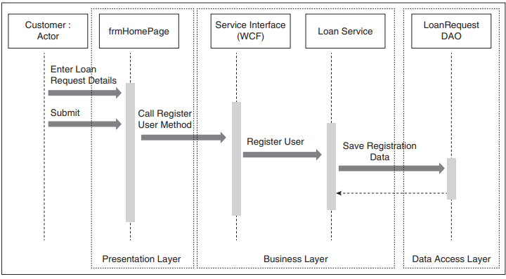
Sequence Diagram for RegisterUser usecase

Slide 69
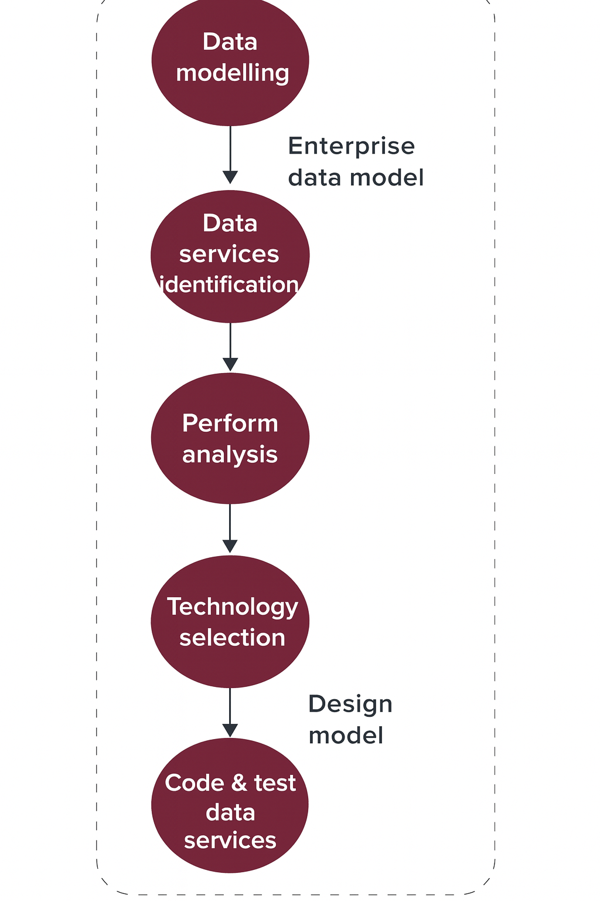
Design of Data Services
Introduction
Data services are the backbone of SOA.
They decouple consumers from data stores
and provide a consistent enterprise-wide view.
Key Benefits:
- Fine-grained and reusable
- Promote consistency, flexibility
- Enable integration across business processes

Slide 70
Types of Data Services
1. Services that encapsulate enterprise data access
2. Services that enable interaction with external data sources
Features:
- CRUD operations with security policies
- Bulk data delivery and streaming
- Unified access across applications

Slide 71
Design Process of Data Services
Steps:
1. Data Modelling → Enterprise data model
2. Data Services Identification
3. Perform Analysis
4. Technology Selection
5. Design Data Services → Design model
6. Code & Test Data Services

Slide 72
Example: Loan Management System
- Loan data acts as Master Data Service
- Customer subscribes to Loan + Credit Card → Master Data reused
- Avoids duplication and ensures synchronization

Slide 73
Information Layer
Integrates multiple sources:
- Relational Databases
- Spreadsheets
- Warehouses
- External Data
Mapping & Transformation ensures unified access
via integrated data objects exposed as services.

Slide 74
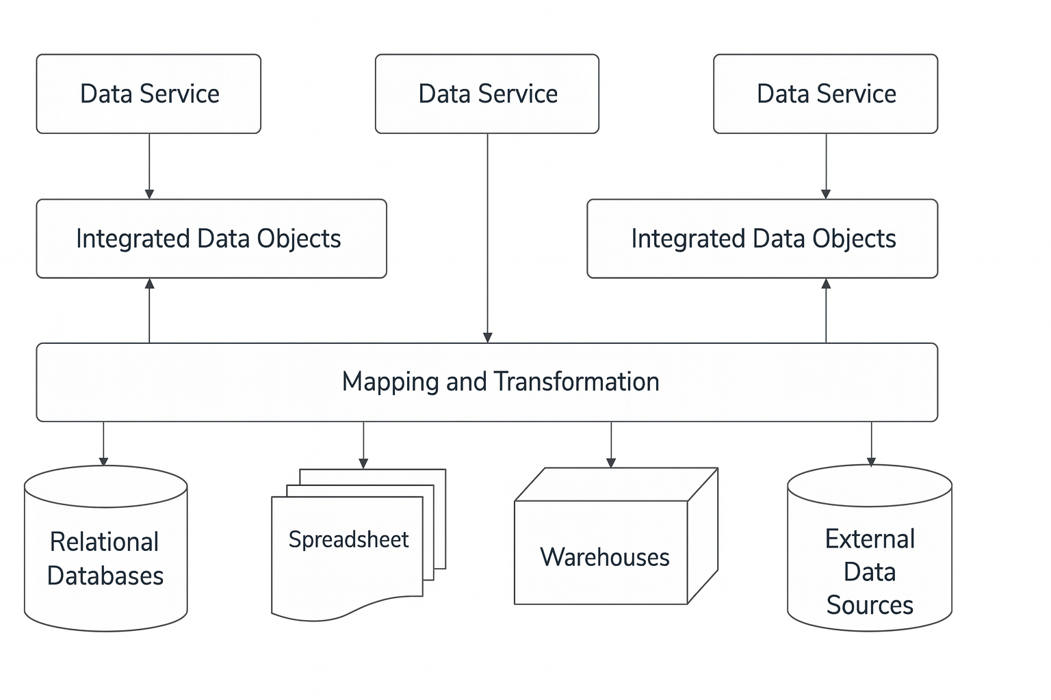
Information Layer

Slide 75
Design of Client Services
Client services deliver content to front-end applications.
They are of two types:
1. Fine-grained business data (e.g., order information)
2. Coarse-grained aggregated data (e.g., dashboards)
Content is provided to users in enterprise,clients and partners.

Slide 76
Role of Client Services
- Content must be aggregated, filtered, and presented for end users.
- Presentation tools include web/mobile user interfaces, dashboards, and portals.
- Technologies: Web 2.0, Mashup, AJAX, REST.
- Mashup aggregators combine data from multiple services for richer views.

Slide 77
Steps in Client Services Design
1. Identify aggregation of fine-grained business data and aggregated data.
2. Represent requirements as use cases.
3. Identify interaction and presentation components.
4. Define business process logic across services.
5. Select interaction styles, protocols, and tools.
6. Specify client services in terms of service contracts and data contracts.

Slide 78
Example: Loan Management System
- Functions: registration, loan request, enquiry for status.
- Enterprise users approve loans through dashboards.
- Mobile and portal integration ensures accessibility.
- Architecture integrates ESB and API Gateway for internal/external apps.

Slide 79
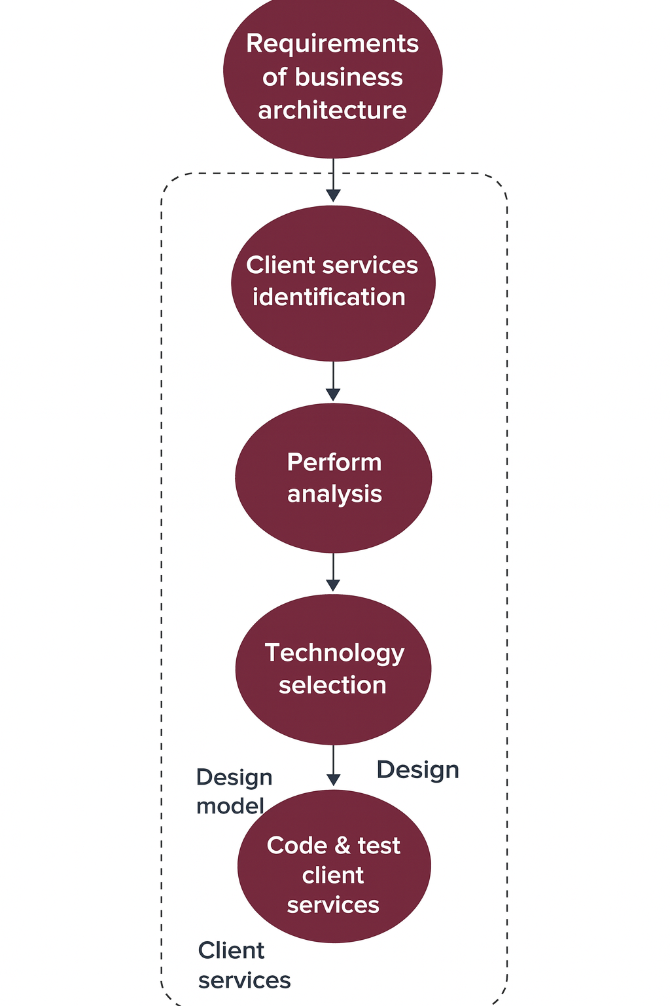
Design of Cient Services

Slide 80
Design of Business Process Services
Business process services externalize processes for enterprise-wide reuse.
They model workflows and tasks as services.
Key technology: WS-BPEL (Web Services Business Process Execution Language)
• XML-based standard
• Supports orchestration of web services
• Models business processes as flows of service interactions

Slide 81
Steps in Business Process Services
1. Identify business processes that can be externalized.
2. Break down processes into a sequence of service interactions.
3. Define orchestration steps across multiple services.
4. Specify execution using WS-BPEL.
5. Integrate with enterprise systems via service contracts.

Slide 82
WS-BPEL in Action
BPEL combines strengths of XML and scripting languages.
Enables defining workflows declaratively.
Example: LMS orchestrates services for loan approval, credit check, and payment.
Provides control structures: sequence, flow, switch, fault handling, compensation.

Slide 83
Example: Loan Management System (LMS)
Loan request initiated through client services.
Business process service orchestrates interactions:
* Customer registration
* Loan request submission
* Approval workflow
* Disbursement and monitoring
Supports dashboards for managers and loan officers.

Slide 84
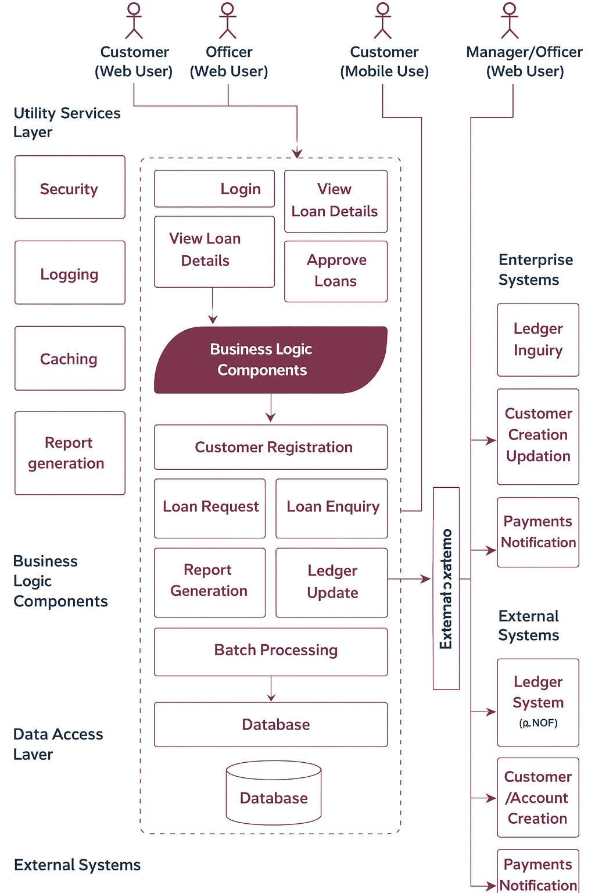
Example: Loan Management System (LMS)

Slide 85
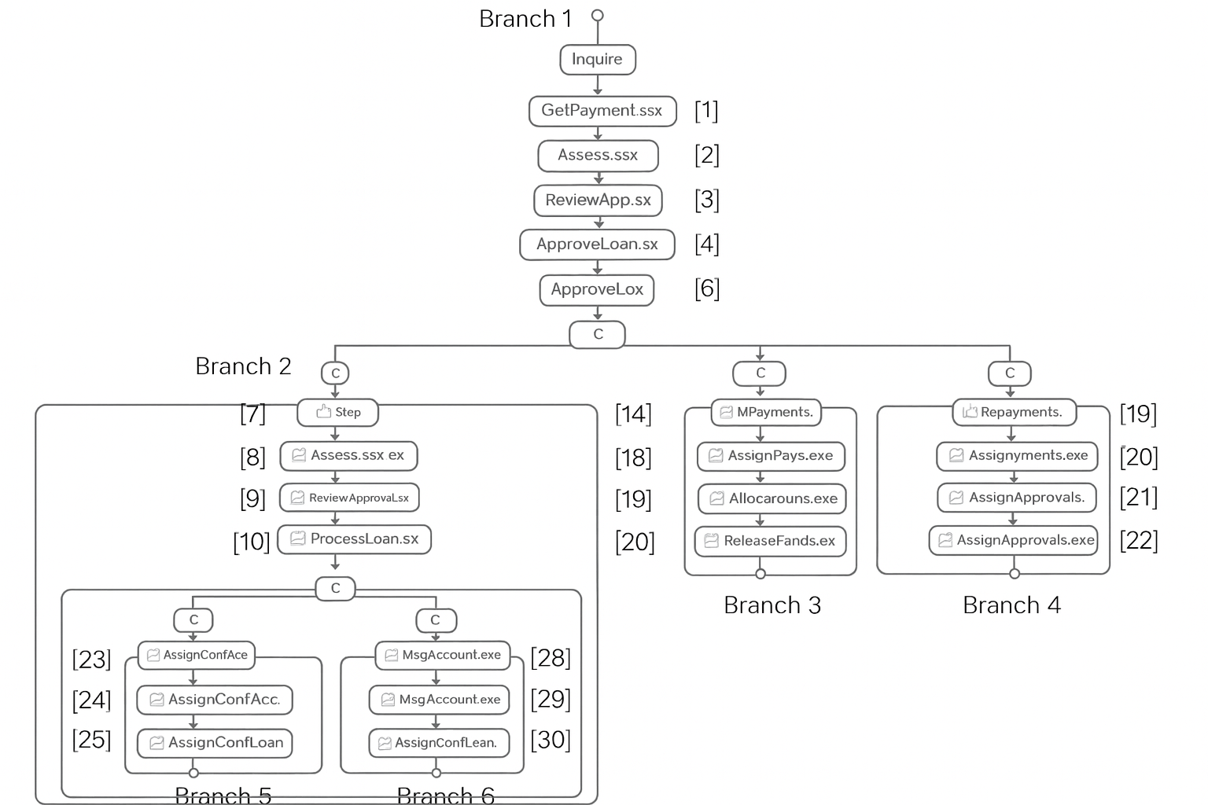
Example: Loan Management System (LMS)

Slide 86
Example: (LMS) - Loan Approval Business Process
Loan approval process illustrated using BPEL execution.
Bank customer initiates the process by requesting a loan.
Process execution involves multiple branches with decision points.
Loan Request Decision
Loan Officer can either approve or reject the request.
If rejected → process ends.
If approved → system checks loan amount.

Slide 87
Example: (LMS) - Loan Approval Business Process
System Check – Loan Amount
If Loan < $10,000 → system directly approves the request.
If Loan > $10,000 → requires confirmation from a manager.
Manager’s Role
For higher loan amounts, manager’s approval is mandatory.
Manager makes the final decision on loan approval.
Notifications are sent accordingly.
Importance of Business Process Design
Business process design often uses visual tools.
Understanding BPEL structure is essential.
Helps gain insights into process orchestration and workflow execution.

Slide 88
Example: (LMS) - Loan Approval Business Process
Loan Approval Process & BPEL Activities
Loan approval is a long-running transaction.
Triggered when user requests a loan.
Process ends when approval cycle is complete.
Execution order depends on activities within BPEL process.
Importance of BPEL in Loan Approval
Provides standardized orchestration of loan approval steps.
Supports both basic (atomic) and structured (composite) activities.
Enhances automation, flexibility, and error handling in processes.

Slide 89
Example: (LMS) - Loan Approval Business Process
Loan Approval Process & BPEL Activities
Basic Activities in BPEL
Receive – Starts process, receives input message.
Invoke – Calls web service operation from partner.
Assign – Data manipulation and variable assignment.
Reply – Sends response back to client.
Terminate – Ends the process immediately.
Wait – Pauses process for a specified time.
Throw – Throws an error in the process.
Compensate – Compensation for successfully completed set of activities.

Slide 90
Example: (LMS) - Loan Approval Business Process
Loan Approval Process & BPEL Activities
Structured Activities in BPEL
While – Implements loops.
Switch – Conditional branching (if-else logic).
Pick – Event-based branching (first event that occurs is executed).
Sequence – Executes activities sequentially.
Flow – Executes activities in parallel.
Scope – Defines nested activities, event handlers, fault handlers.

Slide 91
Branch 1 – Customer Request Customer initiates process by requesting a loan. Steps executed: ReceiveLoanRequest AssignLogLoan InvokeLogLoan AssignLogLoanOutput ReplyLoan ReceiveApproveLoan Process triggers loan officer intervention. | Branch 2 – Loan Officer (Amount ≤ $10,000) Officer reviews and approves. Steps executed: 7. Transition Condition (Approved) 8. AssignApproveLoan 9. InvokeApproveLoan 10. AssignApproveLoanOutput 11. ReplyApproveLoan Process instance ends here.
Branch 3 – Loan Officer (Amount > $10,000) Requires Manager’s Approval. Steps executed: 13. Transition Condition (Approved) 14. AssignApproveLoan 15. InvokeApproveLoan 16. AssignApproveLoanOutput 17. ReplyApproveLoan Escalated to Manager. | Branch 4 – Loan Officer (Rejects Loan) Steps executed: 19. Transition Condition (Rejected) 20. AssignRejectLoan 21. InvokeRejectLoan 22. AssignRejectLoanOutput 23. ReplyRejectLoan Process ends with rejection notification.
Its continuous for Branch 5 – Manager Approves Loan(> $10,000), Branch 6 – Manager Rejects Loan (> $10,000)

Slide 92
Example: (LMS) - Loan Approval Business Process
BPEL Implementation – Example 1 - Receive LogLoan
<bpel:receive name="ReceiveLogLoan" partnerLink="client“ portType="tns:LoanProcess" operation="logLoan" createInstance="yes“ variable="PLLogLoanRequest">
<bpel:correlations>
<bpel:correlation set="CorrelationSet" initiate="yes"/>
<bpel:correlation
</bpel:correlations>
</bpel:receive>

Slide 93
Example: (LMS) - Loan Approval Business Process
BPEL Implementation – Receive LogLoan Example
Explanation –
Captures loan logging request from client.
partnerLink="client": Defines client as the communication partner.
portType="tns:LoanProcess": Specifies the loan process service.
operation="logLoan": Identifies invoked operation.
createInstance="yes": Starts a new process instance.
variable: Holds the loan request payload.
Correlation Handling
CorrelationSet: Ensures continuity across multiple messages.
initiate="yes": Begins tracking a unique loan approval transaction.
Maintains message consistency during process execution.

Slide 94
Example: (LMS) - Loan Approval Business Process
BPEL Implementation – Example 2 - Invoke Loan Logging
<bpel:invoke name="InvokeLogLoan"
partnerLink="LoanProxyPL"
operation="logLoan"
portType="ns1:LoanProxyServicePortType"
inputVariable="LogLoanRequest">
</bpel:invoke>
Explanation of Attributes
name: Activity identifier → InvokeLogLoan.
partnerLink: Communication partner → LoanProxyPL.
operation: Service operation → logLoan.
portType: Interface of web service → LoanProxyServicePortType.
inputVariable: Input data for request → LogLoanRequest.

Slide 95
THANK YOU

