Slide 1
Network Intrusion Detection System (NIDS)
Website
Build
Real-Time Attack Detection, Hybrid Intrusion Analysis, and Intelligent Security Monitoring
S3
[Presenter name]
[Department], [Institution]
[Date]
Proxy
Monitoring
Notes:
Introduce the project as one platform. A website is built and hosted, and monitoring protects it once it is live. Replace the bracketed placeholders with the presenter, department, institution and date.

Slide 2
The problem and motivation
1
2
3
Deployment needs infrastructure
Live sites face hostile traffic
Operators need visibility
Build environments, artifact storage and request routing must all work together.
Flooding, scanning and brute-force login attempts reach the application once it is public.
Security alerts, request history and a single place to understand suspicious behaviour.
The unified platform treats these as connected problems, not separate ones.
Notes:
These three problems come up in sequence. Deploying a site needs build and hosting. Once it is live it faces attacks. Operators then need one view of what is happening. The platform addresses all three.

Slide 3
Network Intrusion Detection System overview
Deployment engine
Runtime security engine
Hybrid log analysis
Accepts a Git URL, builds the site in an isolated container, and stores output in S3 behind a reverse proxy.
Inspects each HTTP request, applies rate limits and detection rules, and raises incidents in real time.
Reads access logs, combines explicit rules with an Isolation Forest, and produces severity-ranked alerts.
Deployment provides the hosted target. Runtime security protects it at request level. Log analysis looks for patterns across traffic over time.
Notes:
Walk through the three modules as components of one platform. The deployment engine hosts the site. The runtime security engine works per request. The hybrid log analysis looks at patterns across traffic over a time window.

Slide 4
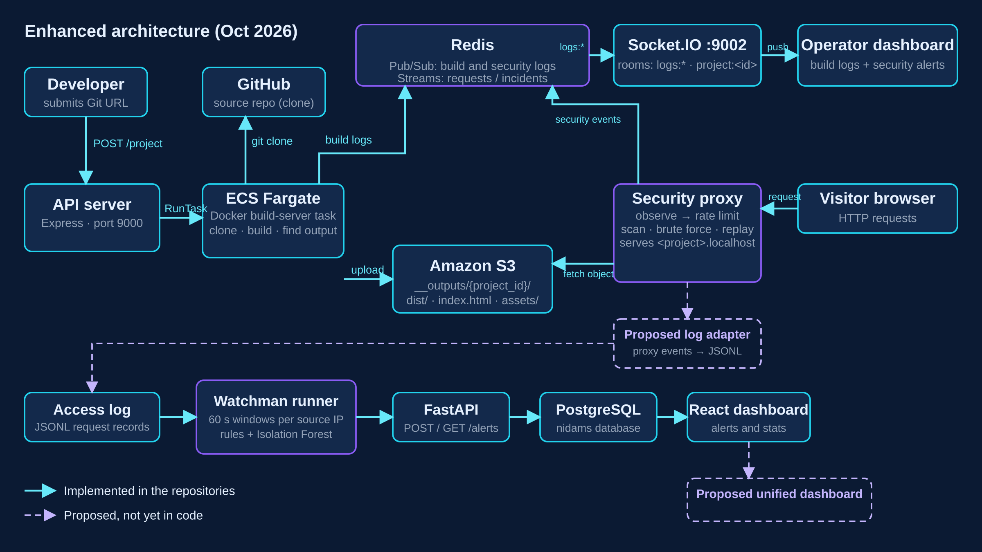
End-to-end architecture
Notes:
Read the diagram in three passes. The top half is the deployment path: API server, ECS build task, S3 and the reverse proxy. The middle band is runtime security, with Redis carrying security events to the Socket.IO dashboard. The bottom row is the log-analysis pipeline. Solid arrows exist in the code. Dashed arrows are proposed.

Slide 5
Cloud deployment lifecycle
1
2
3
4
Submit a Git repository URL
Generate or accept a project slug
Launch an ECS Fargate task
Clone the source and inspect the build config
5
6
7
8
Install dependencies and run the build, or handle a static site
Locate the generated build output
Upload files to an S3 project prefix
Route browser requests to the stored site
Key technologies: Docker · Node.js · Express · AWS SDK · ECS · S3
Notes:
Explain the eight steps in order. The API server launches an ECS Fargate task that clones the repository, builds it inside a Docker container, finds the output directory and uploads it to an S3 prefix named after the project. The reverse proxy then routes browser requests to that prefix.

Slide 6
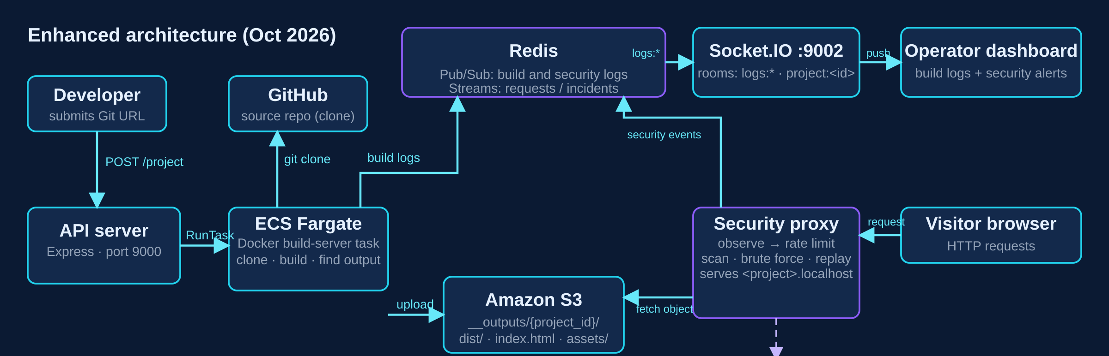
Deployment infrastructure and live logs
ECS Fargate
Docker
Amazon S3
Redis Pub/Sub
Socket.IO
Reverse proxy
isolated build tasks
build environment
generated site files
log transport
live log delivery
routes to projects
Notes:
The solid path is deployment: the API server starts the ECS task, the task builds and uploads to S3, and the proxy serves it. The log path runs separately: build output is published to Redis and streamed to the browser over Socket.IO.

Slide 7
Why runtime security is needed
Deploying is only the first step. The site must be watched after it goes live.
Visitor
A request-level monitoring layer sits in front of every deployed site. It observes traffic, applies configurable rules, and records what it sees.
Security proxy
Deployed site
Notes:
Frame this as the bridge from deployment to protection. Once the site is live, the proxy sits between visitors and the site, observing every request. It is a request-level layer, not an ML model.

Slide 8
Rule-based attack detection
Detector | Signal | Default setting
HTTP flood | Requests per source IP | 100 requests per 10 s window
Path scanning | Unique paths and 404 ratio | 30 unique paths, 60% 404s, 10 s window
Brute force | Failed demo-login attempts | 10 failures within 60 s
Replay protection | Signed webhook: timestamp and nonce | 300 s tolerance, nonce reuse rejected
Request
Rate-limit check
Observe
Rule evaluation
Incident
Redis
Dashboard
Replay protection checks signed webhooks only. It is not a general detector for every kind of replay.
Notes:
The rate limit is a fixed window. Path scanning uses a sliding window with a 404 ratio check. Brute force counts failed attempts on the demo login route. Replay protection is limited to signed webhooks, using timestamps and nonce reuse. Incidents are deduplicated for 60 seconds per source and project.

Slide 9
HYBRID LOG ANALYSIS
Hybrid log analysis: rules and machine learning
Rule-based detection can miss low-rate, slow attacks. Looking at traffic over a time window helps catch them.
Read logs
Window per IP
Extract features
Detect
Alert
Access log records as JSONL
Group requests into 60 s windows
Rate, unique paths, failed logins, 4xx ratio, gaps, bytes, response time
Explicit rules plus Isolation Forest (300 trees, trained on normal traffic)
Severity-classified alerts stored via FastAPI and PostgreSQL
Hybrid recall on simulated data rose from 0.68 (rules only) to 0.91, with no false positives in the test set.
Notes:
This pipeline reads access logs, groups them into 60-second windows per IP, extracts features, and runs explicit rules plus an Isolation Forest trained on normal windows. The model threshold is set near the 97th percentile of normal windows. Results come from simulated traffic and should be presented as such.

Slide 10
Two security approaches, one platform
Runtime security engine
Hybrid log analysis
Evaluates live reverse-proxy request events
Applies configurable rules and rate limits
Memory-backed or Redis-backed state
Generates incidents and streams logs
Analyses grouped access-log records
Uses explicit rules and Isolation Forest
Produces structured intrusion alerts
Persists alerts through FastAPI and PostgreSQL
Proposed: immediate request-level protection feeding broader log-based analysis. No such link exists in the current code.
Notes:
Two lenses on the same traffic. The runtime engine acts on each request as it happens. The log analysis looks for patterns across many requests. Combining them is a proposal and is not implemented yet.

Slide 11
Unified monitoring dashboard (concept)
Proposed layout. Not a screenshot of the existing system.
Deployment status
Request activity
Incidents
Anomaly score
Build logs and state
Incoming traffic over time
Type, source IP, severity
From log analysis
Incident status and history: open · acknowledged · resolved, with evidence and timestamps
Notes:
This is a concept for how one interface could show deployment and security together. None of this is built as a single interface today. Be clear about that when presenting.

Slide 12
Technology stack
Deployment
Real-time messaging
Node.js · Express · Docker · Git · AWS SDK · ECS Fargate · S3
Redis Pub/Sub · Redis Streams · Socket.IO
Runtime security
Log analysis
Node.js · HTTP reverse proxy · rule engine · Redis-backed state
Python · pandas · NumPy · scikit-learn (Isolation Forest)
Monitoring backend
Frontend
FastAPI · SQLAlchemy · PostgreSQL
React · Vite · Recharts
Notes:
Each row is a role, not a list of packages. The deployment and security modules are Node.js. The log analysis and its backend are Python with a React dashboard. Verify exact versions against each repository before the viva.

Slide 13
Incident lifecycle
Request arrives
Rules evaluated
Incident created
Logs published
A visitor hits a deployed site
The proxy checks rate limits and detectors
Suspicious behaviour is deduplicated and stored
Redis carries events to Socket.IO
Log analysis
Adapter (proposed)
Unified view (proposed)
Rules and the Isolation Forest scan access logs
Normalises alerts to one schema
Source, severity, evidence, time, status
Solid: implemented in code. Dashed: proposed.
Notes:
Walk the incident from request to dashboard. The first four steps are implemented. The last two are proposed. Point out that the log analysis reads its own access logs.

Slide 14
Evaluation and testing
Method | Precision | Recall | F1 | FPR
Rules only | 1.00 | 0.68 | 0.81 | 0.00
Isolation Forest only | 1.00 | 0.61 | 0.75 | 0.00
Hybrid detection | 1.00 | 0.91 | 0.96 | 0.00
Runtime security test coverage
Rate-limit boundary and incident creation
Path-scan boundary and deduplication
Brute-force boundary
Replay nonce reservation and stale timestamps
Query redaction, Redis outages, proxy 502s
Reported on simulated data: 61 normal and 81 attack windows. Results may vary and do not establish production performance.
Deployment is described by its code paths: build execution, output detection, artifact upload and log streaming. No success rate is claimed.
Notes:
The metrics come from the NIDAMS evaluation file on simulated data. The security test cases exist in the repository; they are listed here, not claimed as passing. Do not present these numbers as production accuracy.

Slide 15
Limitations, integration plan and future scope
Current limitations
Proposed roadmap
Evaluation uses simulated traffic and a small dataset
Detection pipelines and alert formats differ
Incidents are kept in a bounded Redis stream; no durable store yet
No shared alert store, normalised schema or unified dashboard
Define a common event and incident schema
Add a log adapter that feeds access logs to log analysis
Normalise rule and ML alerts
Add shared alert storage and project mapping
Build one dashboard with deployment and security views
Add integration tests, authentication and production hardening
Notes:
Be direct about the limits. The modules are not yet joined. The roadmap lists the steps to combine them, all of which are proposals. Production readiness is not claimed.

Slide 16
“Automated deployment provides the foundation, runtime security provides immediate request-level protection, and hybrid intrusion detection adds log-based anomaly analysis.”
Contributions: cloud infrastructure · deployment automation · cybersecurity · machine learning · API development · real-time messaging · observability
Hybrid log analysis source: https://github.com/ShashankSharma-hash/NIDAMS
Questions & Answers
Notes:
Close on the unified vision. Summarise the engineering areas covered. Then open for questions.

