Slide 1

IILM UNIVERSITY GREATER NOIDA, UTTAR PRADESH
ACADEMIC CREDENTIALS
Shivendra Shrivastav
B.Tech CSE (AI & ML) • Batch 2026-27
CODEC TECHNOLOGIES · AICTE NATIONAL INTERNSHIP PORTAL
Artificial Intelligence
Roll Number 25SCS1003004154 Designation Artificial Intelligence Intern
Internship Presentation Report
Codec Technologies • Internship Completed
INTERNSHIP DURATION 02 July 2026 – 02 August 2026 (1 Month)
An Internship Report submitted in partial fulfilment of the requirement for the degree of B.Tech CSE (Artificial Intelligence and Machine Learning)

Slide 2


Candidate & Program Overview
Candidate Details
Internship Profile
STUDENT NAME Shivendra Shrivastav
PROGRAM Codec Technologies – AICTE National Internship Portal
ROLL NUMBER 25SCS1003004154
DESIGNATION Artificial Intelligence Intern
DEGREE B.Tech CSE (Artificial Intelligence and Machine Learning)
DURATION 1 Month (02 Jul 2026 – 02 Aug 2026)
ACADEMIC BATCH 2026 – 2027
LOCATION & MODE Pan India, Hybrid
UNIVERSITY IILM University, Greater Noida, U.P.
NCS ID / AICTE ID E19E86-0116588288923

Slide 3



Organization Profile: Codec Technologies
Codec Technologies is a global platform empowering learners and connecting diverse talent to meaningful career opportunities. It is an ISO 9001:2015 certified organization delivering IT and business consultancy services across 27+ countries, and is recognized as a Google for Education partner.
AICTE Collaboration
Operates internship programmes under the AICTE National Internship Portal (NIP) framework, empowering engineering talent across India.
Industry Alignment
Delivers dedicated IT and business consultancy services across 27+ countries, bridging academia and industry practice.
Core Focus Domains
Artificial Intelligence, IT Consultancy, Business Automation, and Enterprise Strategy for global clients.

Slide 4


Problem Statement & Project Context
The Industry Challenge
The Project Scope
While academic curriculum extensively covers building Machine Learning and AI models, students often lack hands-on exposure to applying such models within a structured, professional, industry environment.
A well-built model or idea in isolation provides limited value until it is scoped, developed, tested, and reviewed the way a real business project demands.
This internship addressed the practical Artificial Intelligence project lifecycle: requirement analysis, solution/model development, API-based integration, and structured review under an assigned Project Head.
The goal was mastering industry practice — turning an AI concept into a reviewed, documented, and demo-ready solution.

Slide 5




Core Project Objectives
AI Solution Development
API & Integration
Develop and test an AI/ML based solution addressing the assigned project's requirements.
Expose solution functionality through FastAPI/REST endpoints for consumption by demo applications.
Automation & Agent Workflows
Review & Quality Assurance
Explore AI agents and automation pipelines using frameworks such as LangChain and LlamaIndex.
Incorporate feedback from weekly performance reviews conducted by the assigned Project Head.

Slide 6




Technologies & Tooling
Languages & APIs
Containers & Ops
GenAI & Agents
Apps & Reporting
Python
Docker basics
LangChain, LlamaIndex
Streamlit / Gradio
FastAPI (REST Services)
Environment setup
Vector Databases, RAG
Weekly review reports

Slide 7

AI Solution Architecture
Model Layer
AI/ML model forming the core intelligence of the solution.
API Layer
FastAPI wrapper exposing the model logic via REST endpoints.
Containerization Layer
Application packaged with its dependencies for portability.
Application / Agent Layer
LangChain agents and Streamlit/Gradio front-ends consuming the AI logic.
Review Layer
Assigned Project Head reviews progress via weekly performance reviews.

Slide 8
Internship Timeline (Week 1 to 4)
Week 1
Week 3
Onboarding & AI Foundations
Testing, Automation & Review
Onboarding with Codec Technologies, AI/ML lifecycle concepts, and requirement analysis.
Testing the solution, exploring automation workflows, and incorporating review feedback.
Week 2
Week 4
Solution Development & API Integration
Documentation & Final Submission
Hands-on development of the AI/ML solution, exposed via APIs for a demo application.
Final testing, project documentation, and submission of tasks to the Project Head.

Slide 9

Key Skills & Demonstrated Outcomes
AI/ML Solution Contribution
Contributed to the development of an AI/ML based solution as part of an industry team.
API & Basic Containerization
Practical exposure to exposing AI logic through APIs and basic containerization practices.
Agent & Automation Workflows
Hands-on exposure to AI agent and automation workflow concepts used in business applications.
Security & Quality Awareness
Understanding of AI security, privacy, and quality considerations while integrating AI into apps.
Hybrid Team Collaboration
Experience working in a hybrid, Pan-India project team with structured weekly performance reviews.

Slide 10
Certification & Official Verification
Verification Metric | Official Record / Credential Details
Internship Title | Artificial Intelligence Internship (Project Intern)
Issuing Organization | Codec Technologies Pvt. Ltd. (ISO 9001:2015 Certified)
Academic Patronage | AICTE National Internship Portal
NCS ID | E19E86-0116588288923
AICTE ID | CORPORATE6759d549ce59e1733940553
Duration | 02 July 2026 – 02 August 2026 (Date of Issue: 02 Jul 2026)

Slide 11
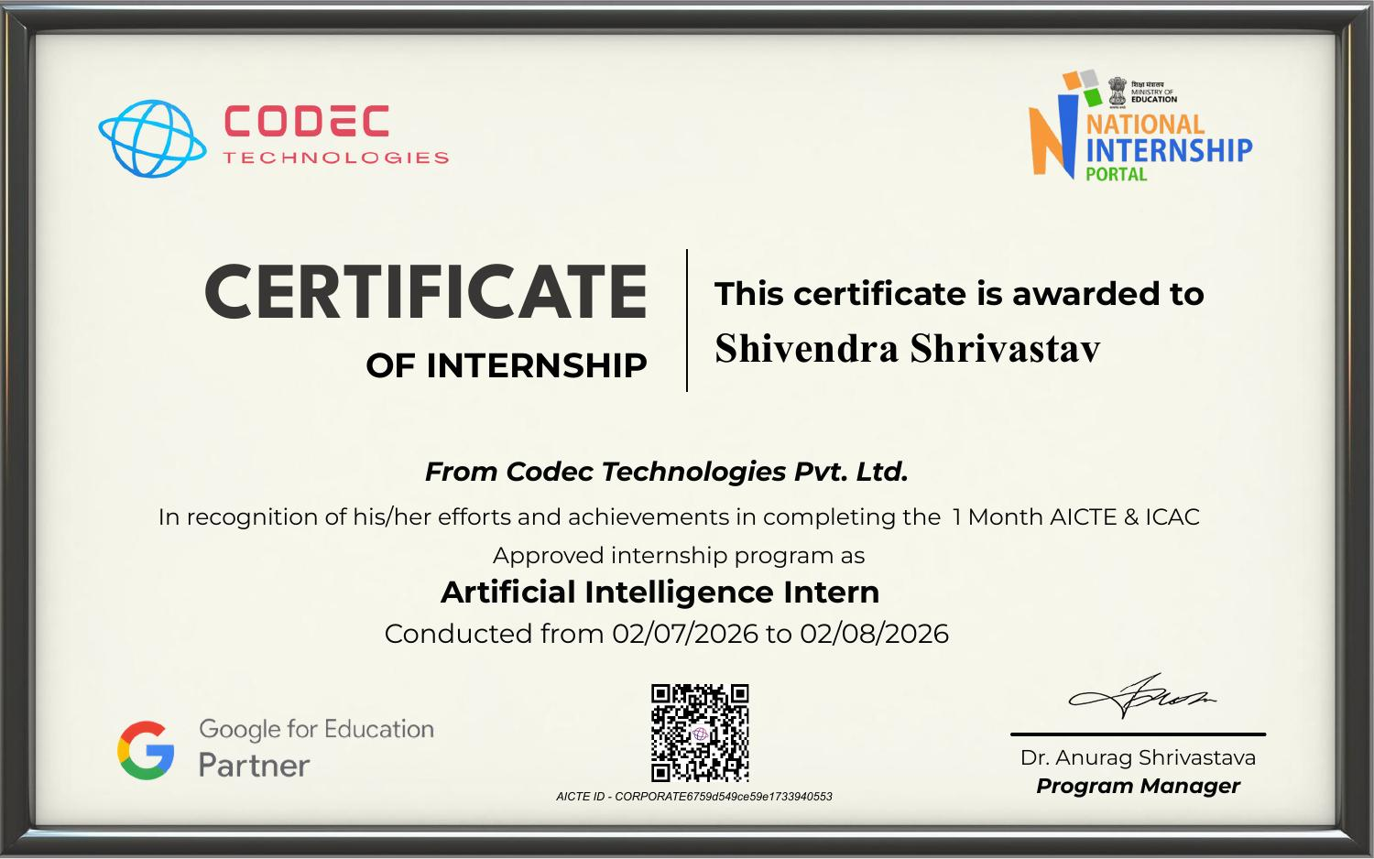
Certificate of Internship

Slide 12
Thank You!
Shivendra Shrivastav Roll No: 25SCS1003004154
School of Computer Science & Engineering IILM University, Greater Noida, U.P.

