Slide 1
a_good_movie_review
Abhishek Seth
P.Malla Reddy
Mradul Dubey
Vikas Upadhyay
Shivendra Pratap Singh

Slide 2
Project Overview
This projects is a proper fusion of the ImDb and Wikipedia models.
ImDb maintains online database of information related to films, television programs and video games, including cast, production crew, biographies etc.
Wikipedia is a free online encyclopedia that, by default, allows its users to edit any article.
This project amalgamates both the models by letting any registered user add any movie to the database, edit and review it.
The current status of the project will serve as a basic model to expand to an aggrandized service where user can receive recommendations based on his preferences and editor’s selected lists.

Slide 3
Technologies Used: Rails
Ruby On Rails
Rails is a model–view–controller (MVC) framework, providing default structures for a database, a web service, and web pages.
Rails emphasizes the use of other well-known software engineering patterns and paradigms, including convention over configuration (CoC), don't repeat yourself (DRY), and the active record pattern.
Rails is a web application framework running on the Ruby programming language.
Ruby on Rails includes tools that make common development tasks easier "out-of-the-box", such as scaffolding that can automatically construct some of the models and views needed for a basic website.
Also included are WEBrick, a simple Ruby web server that is distributed with Ruby, and Rake, a build system, distributed as a gem. Together with Ruby on Rails, these tools provide a basic development environment.
It has been used widely in the IT industry with services like Twitter, GitHub, Airbnb, Heroku, Soundcloud based on Ruby On Rails.

Slide 4
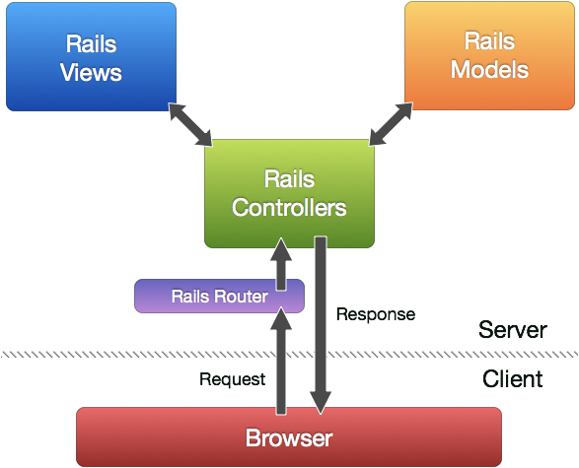
Technologies Used: Rails MVC
Model – Views - Controller
A Model maps to a table in a database and to a Ruby file. For example, a model class User will usually be defined in the file 'user.rb' in the app/models directory, and linked to the table 'users' in the database.
A controller is a server-side component that responds to external requests from the web server to the application, by determining which view file to render. The controller may also have to query one or more models directly for information and pass these on to the view.
A view in the default configuration of Rails is an erb file, which is evaluated and converted to HTML at run-time. Alternatively, many other templating systems can be used for views.

Slide 5
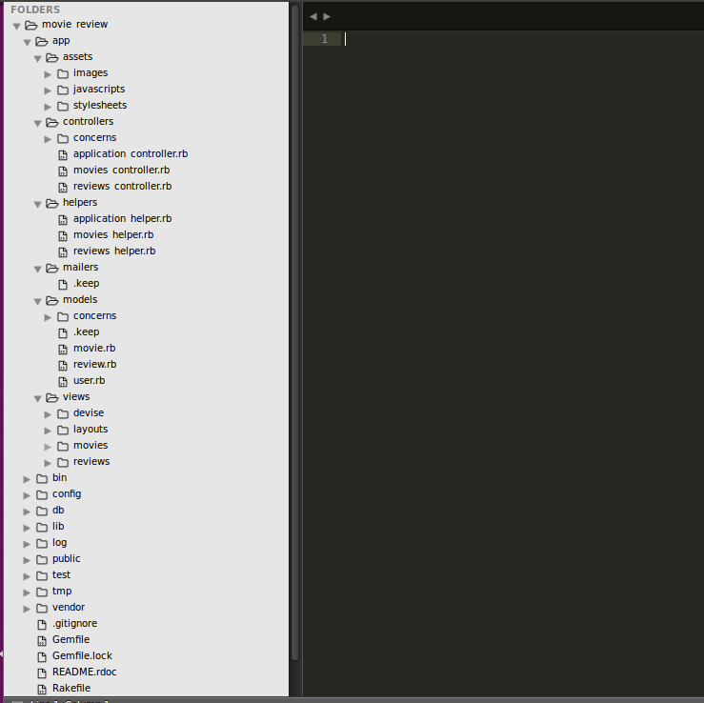
Getting Started with a Project
.
.
.

Slide 6
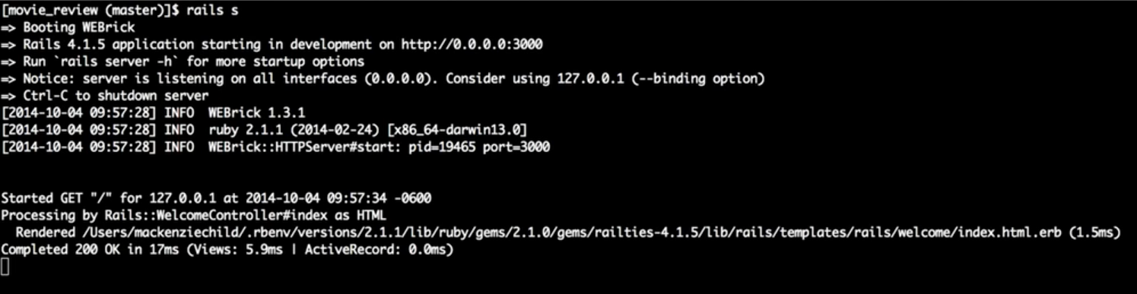
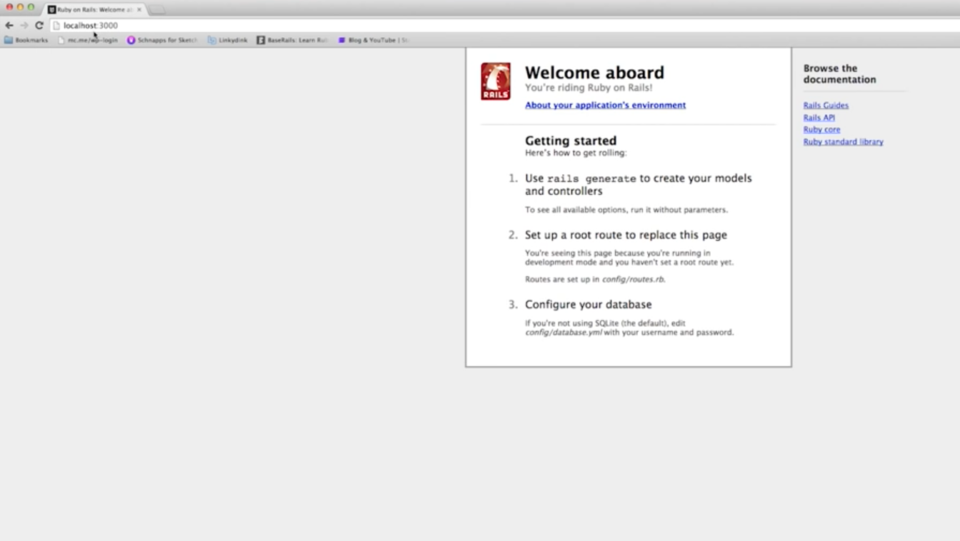
Getting Started: Server Up

Slide 7
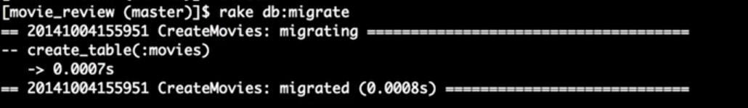
Getting Started: Migrations

Slide 8
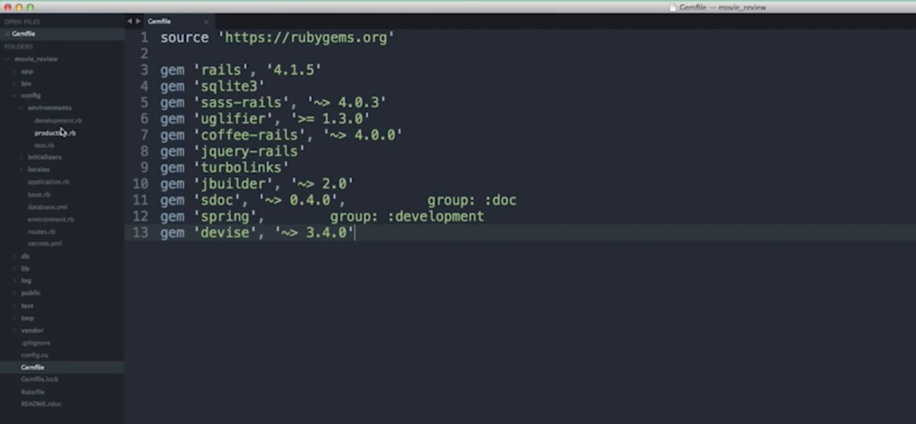

Getting Started: Gem Files`

Slide 9
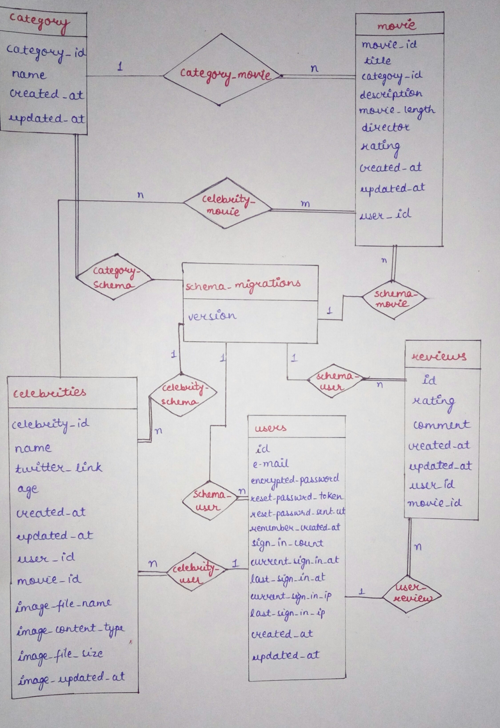
Entity Relationship Diagram

Slide 10
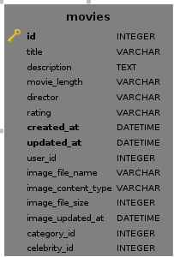
Relational Schema: movies
Candidate Keys={id}
For each Functional Dependency:
A → B
A is always candidate key(id).
So, this table is in BCNF.

Slide 11
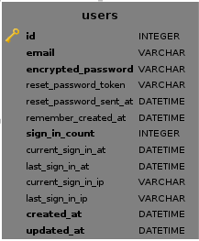
Relational Schema: users
Candidate Keys={id},{email}
This table has following types of functional depnendency:
Every attribute is f.d. on each candidate key i.e. primary attr → non-primary
Id → email and email →id i.e. primary attr → primary attribute
So, users is in BCNF.

Slide 12
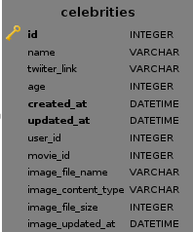
Relational Schema: celebrities
Candidate Keys={id},{twitter_link}
This table has following types of functional depnendency:
Every attribute is f.d. on each candidate key i.e. primary attr → non-primary
Id → twitter_link and twitter_link →id i.e. primary attr → primary attribute
So, celebrities is in BCNF.

Slide 13

Relational Schema: categories
Candidate Keys={id}
This table has following types of functional depnendency:
Every attribute is f.d. on candidate key i.e. primary attr → non-primary
So, celebrities is in BCNF.

Slide 14
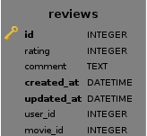
Relational Schema: reviews
Candidate Keys={id},{created_at,user_id}
This table has following types of functional depnendency:
Every attribute is f.d. on candidate key i.e. primary attr → non-primary
Primary attribute → Primary attribute functional dpendency present
So it is in BCNF.

