Slide 1

Compilers-II Project Lumiere
A brief overview of the Physics DSL

Slide 2
Table of Contents
Language Overview
Lexer
Parser
Semantic Analysis
Transpilation

Slide 3
Team Member's
Bikraj Shreshta(System Architect)
Nigam Niraula(System Integrator)
Shashwot Paudel(Tester)
Gaurav Choudekar(System Architect)
Medoju Srimannarayana(Language Guru)
Dheeraj D.(Tester)
Shaik Armaan(Language Guru)
Gadekar S.B.(Project Manager)

Slide 4
Aim of Lumiere DSL
Abstract complexity with high-level interfaces.
Integrate familiar mathematical notations.
Provide real-time feedback for dynamic behavior observation.

Slide 5
Language Overview
Simulations are crucial in engineering and physics education.
Traditional programming languages lack abstractions for mechanical systems.
Solution: Lumiere simplifies modeling and simulation of physical systems using Newtonian mechanics principles.
Lumiere is a DSL for extensive physics computations, especially for mass interactions.

Slide 6
Language Overview
Language Supports Various Types of Arithmetic and boolean operations.
Lumiere also supports compound operators such as +=,-= and many more..
Lumiere uses in-build functions to calculate values of various physics quantities such as positions, velocity and displacement.

Slide 7

HOW?

Slide 8
Data Types Used in the DSL
mass
init_vel
final_vel
final_pos
init_pos
init_time and so on..

Slide 9
Lexical Format
Comments are given as : /*… */
Basic operations : +, -, *,/
Compound Operators: +=, -=, *=,/=
Boolean Operators: &&, || , != ,==

Slide 10
Lexical Analysis- Reserved Words
mass
init_vel
final_vel
accl
init_pos
final_pos
init_time
final_time
body
if
else if
else
check_until
return
connectTo
Variable
library
include
int
function
console

Slide 11
Input-output Format for Lex
In order to see the output From lexer, Go to 'test' directory and give your input code in the 'inp.txt' then run makefile commands to execute the file
Output for the given input file will be given as 'out.txt' in the same directory

Slide 12
Parse Tree Construction
CMPD_STATEMENTS
|
STATEMENT
|
MAIN_FUNCTION_STATEMENT
|
FUNCTION
IDENTIFIER (main)
CMPD_STATEMENTS

Slide 13
Parsing Phase
Converting a stream of token into parse tree
Ensure the code follows proper grammar as given by the set of rules
Use of tokens from the lexical phase to then define the grammar for the parsing phase

Slide 14
Components of parser
Rules:
To Specify the structure of the language.
Defines how tokens can combine to form valid statements.
Actions:
Code executes when a production rule matches to given statement.
Updates the parser state or builds parts of the syntax tree.
Precedence and Associativity:
Ensures correct parsing of operators (e.g., +, *).
Defined using %left, %right.

Slide 15
Grammar Rules - Overview
STATEMENT: Can be a function declaration, comment, or assignment.
CMPD_STATEMENTS: Sequence of statements.
EXPRESSION: Arithmetic or boolean expressions.

Slide 16
Grammar Rule - STATEMENT
The rule defines a STATEMENT as any one of several types of constructs in the language.
This rule groups all the various types of statements that could exist in the language. A single statement in the source code could correspond to any of these types.
INCLUDE_TYPE_STATEMENT,MAIN_FUNCTION_STATEMENT,COMMENTS,RESERVED_TYPE_DECLARATION,CONDITIONAL_STATEMENT are the next variables where it next propagates.

Slide 17
Grammar Rule – CMPD_STATEMENTS
The rule defines CMPD_STATEMENTS as a sequence of one or more statements, using recursion. This allows a program to consist of multiple statements.
This recursion causes the tree to grow downwards, with each level of recursion representing a new statement in the program.

Slide 18
Parsing Expressions
Arithmetic Expressions: Parses expressions involving operators like +, -, *, /, ^. Supports operator precedence and associativity with levels as in C.
Boolean Expressions: Parses Boolean expressions with relational and logical operators.

Slide 19
Handling Expressions
Allows complex expressions to be parsed correctly
ARITHMETIC_EXPRESSION handles addition and subtraction by recursively combining expressions.
MUL_EXP represents multiplication/division operations.

Slide 20
Conditional Statements
This handles if, else, and else-if statements.
Supports nested conditionals, allowing the parser to handle complex branching logic.

Slide 21
Handling Complex Assignments
Handles assignments where variables are assigned the result of expressions.
CMPD_OPERATOR: Represents assignment operators like =, +=, -=.
Rule for Handling Complex Assignments:
COMPLEX_ASSIGNMENT : IDENTIFIER CMPD_OPERATOR EXPRESSION;

Slide 22
Using connect to statement
The CONNECT_TO statement is used for connecting two entities, represented as identifiers, within the code.
This involves an identifier (variable or object) on the left side, a join operator, and another identifier being connected using the CONNECT_TO keyword within parentheses.

Slide 23
● Variable Declarations:
Declares variables with or without initialization.
● Array Declarations:
Declares arrays and allows initializing them with values.
● If-Else Statements:
Supports simple if, else if, and else conditions.
Can nest and chain multiple conditions.
● Else-If Handling:
Allows complex decision-making with multiple else if conditions.
● Custom Loop Parsing (CHECK_UNTIL):
Implements a loop construct similar to a for loop.
Initial condition, condition checking, and loop body are parsed.
● Initial Conditions in Loops:
Can have multiple conditions or an empty loop body.

Slide 24
In-built Functions
Lumiere uses inbuilt functions to calculate values for various physics quantities such as velocities of multiple objects, their positions,trajectories
Lumiere can provide support for various types of equations depending on the libraries provided by the systems.

Slide 25
Semantic Analysis Phase
Ensures that the program follows the language's semantic rules beyond syntax.
Key Objectives:
Detect semantic errors (e.g., type mismatches, undeclared variables).
Validate scope and binding rules.
Enforce language-specific rules (e.g., function argument types and return types).

Slide 26
Semantic Analysis (Contd..)
Key Tasks:
Type Checking: Ensures data types in expressions and assignments are compatible.
Symbol Table Management: Tracks variables, functions, and their scopes.
Scope Resolution: Verifies variable usage aligns with its declaration scope.
Control Flow Validation: Ensures proper return statements and reachable code.

Slide 27
In Lumiere we have implemented the semantic analysis by using AST and Symbol Table.
AST:
Hierarchical representation of program constructs.
Guides type checking and scope resolution.
Validates expressions, function calls, and control flow.
Symbol Table:
Tracks variables, functions, and constants.
Supports nested scopes with stack-based management.
Verifies declarations and prevents redeclarations.

Slide 28
Steps for Integration:
AST Construction:
Parse source code into AST.
Symbol Table Population:
Add identifiers during declaration traversal.
Semantic Validation:
Type checking and scope resolution.
Match function calls with their definitions.
Error Reporting:
Identify and report semantic errors.

Slide 29
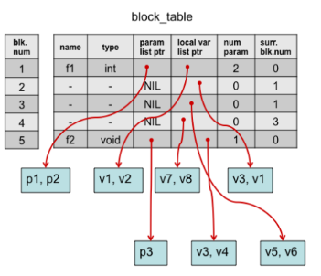
Implementation
Symbol Table:

Slide 30
Implementation Continued
Program has been divided into blocks to implement symbol table.
The functionalities in the symbol table include adding variables, adding variables list and looking up variables based on scope.
Scope resolution happens by first scanning the current scope's symbol table and recursively searches all the surr_scope after which an error is thrown.

Slide 31
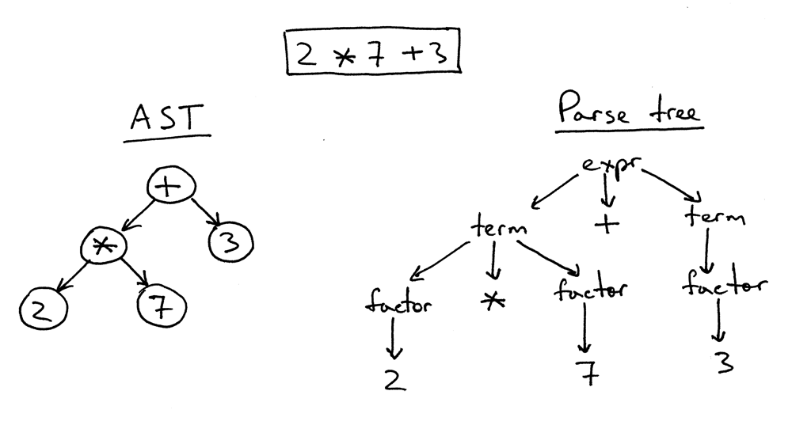
Implementaion
AST:

Slide 32
Implementation Continued
AST has been implemented using class structure in CPP.
Each statement type has its own node that can point to other nodes.
Operations for semantic check and lookup can be implemented as methods in the class.

Slide 33
Planned transpilation
Converting code from one language to another is transpilation
This can be done easily with parser
We can print each line of code while we complete expanding grammar and come up after it

Slide 34
Planned Optimisations
Constant folding
Loop invariant code motion
Common subexpression elimination

Slide 35
Implementing constant folding
Replace expressions involving only constants with their computed values
Identify operations on constant operands
Replace the operation with the result
This could be done with small modifications in parser,we just need to identify part which includes only constants

Slide 36
Implementing loop invariant code motion
Identify loops,using struct for basic blocks and using predecessor and successor with it
Identify loop invariant part of every loop in code
Add basic block before current loop and change edges accordingly.

Slide 37
Common subexpression elimination
For expressions in code,store them in hash map
This can be used again when we encounter same expression and directly replace result
This will reduce repeated calculation and improve efficiency

