Slide 1
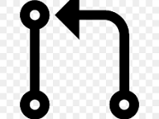
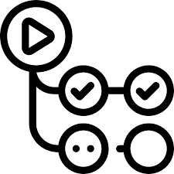
workflow Graph
Developer opens/updates a PR
1
Summary of the Workflow:
1. Developer opens/updates a PR.
2. GitHub Workrflow triggers the code review action.
3. Action sets up Python env, and runs the review script.
4. The script sends code (Only added) changes to OpenAI for review and receives feedback.
5. Feedback is posted as a comment on the PR.
Workflow triggers the code review Action
2
Action sets up Python env, and runs the review script
3
The script sends code changes to OpenAI for review
| and receives feedback
4
Feedback is posted as a comment on the PR
5

