Slide 1

Transformer-Based Emotion Recognition Using Multimodal Data Fusion
Submitted By:
Shivendu Mishra (206124031)
Guide:
Dr. R. Bala Krishnan
DEPARTMENT OF COMPUTER SCIENCE AND ENGINEERING NATIONAL INSTITUTE OF TECHNOLOGY, TIRUCHIRAPPALLI
206124031
CS677 : Transformer-Based Emotion Recognition Using Multimodal Data Fusion

Slide 2
1. PROBLEM STATEMENT, OBJECTIVES & MOTIVATION
Problem Statement
  To develop robust multimodal emotion recognition system using Transformer-based architecture that effectively models cross-modal dependencies and temporal dynamics across physiological signals.
Objectives
  To design Transformer-based multimodal system.
  To fuse ECG, EDA and acceleration features to predict emotions.
  To reduce the artifacts in the signals.
  To improve accuracy.
Motivation
  To enhance human-computer interaction.
  To bridge gap between laboratory validations and real-world deployment.
  To support affective computing.
206124031
CS677 : Transformer-Based Emotion Recognition Using Multimodal Data Fusion

Slide 3
2-A. LITERATURE SURVEY
S.No | Paper Details | Techniques Used | Gaps Identified
1. | Title: "UAED: Unsupervised Abnormal Emotion Detection Network Based on Wearable Mobile Device" Author: J. Zhu et al. Year: 2023 | • Gaussian Mixture VAE • 2D-CNN with stacking • Whitening distance anomaly scoring • Unsupervised training | • Unimodal approach - Uses only ECG signals. • No cross-modal attention – Cannot leverage multiple physiological signals. • Limited emotion granularity - Only binary anomaly detection. • Fixed window processing - No adaptive temporal modeling.
2. | Title: "Self-supervised ECG Representation Learning for Emotion Recognition" Author: P. Sarkar et al. Year: 2022 | • Self-supervised learning • Contrastive pre-training • CNN-LSTM architecture • Transfer learning fine-tuning | • Single modality dependency - ECG-only approach. • No multimodal fusion - Misses complementary signal information. • Supervised requirement - Needs labeled data for fine-tuning. • Short-term focus - Limited long-range temporal context.
206124031
CS677 : Transformer-Based Emotion Recognition Using Multimodal Data Fusion

Slide 4
2-B. LITERATURE SURVEY CONTD.
S.No. | Paper Details | Techniques Used | Gaps Identified
3. | Title: "Behavioral and Physiological Signals-Based Deep Multimodal Approach for Mobile Emotion Recognition" Author: K. Yang et al. Year: 2023 | • LSTM with attention • Multimodal fusion • Mobile deployment optimization • Behavioral + physiological signals | • Limited temporal context - LSTM struggles with long sequences. • Sequential processing - Inherent RNN limitations. • Shallow fusion - Basic attention on temporal dimension only. • Limited physiological coverage - Focuses more on behavioral sensors.
4. | Title: "EmotionSense: An Adaptive Emotion Recognition System" Author: Z. Wang et al. Year: 2020 | • Random Forest classifiers • Wearable sensor integration • Context-aware recognition • Personalization approach | • Shallow models - Limited feature learning capacity. • Traditional ML limitations - Poor scalability with complex data. • Feature engineering dependency - Manual feature extraction required. • No deep temporal modeling - Cannot capture complex temporal patterns.
206124031
CS677 : Transformer-Based Emotion Recognition Using Multimodal Data Fusion

Slide 5
2-C. LITERATURE SURVEY CONTD.
S.No. | Paper Details | Techniques Used | Gaps Identified
5. | Title: "Attention Is All You Need" Author: A. Vaswani et al. Year: 2017 | • Transformer Architecture • Scaled Dot-Product Attention • Multi-Head Attention • Positional Encoding • Encoder-Decoder Structure | • High Computational Complexity (O(n²) with sequence length). • No Native Multimodal Support - Designed for NLP. • Large Data Requirements for effective training. • No Domain Adaptation for physiological signals.
206124031
CS677 : Transformer-Based Emotion Recognition Using Multimodal Data Fusion

Slide 6
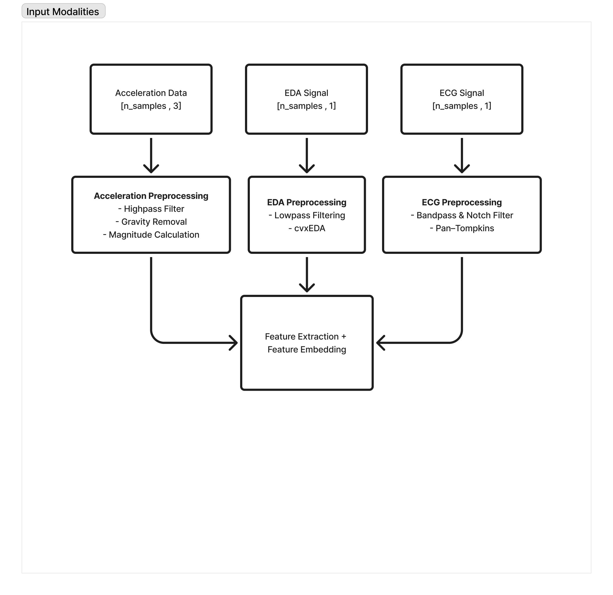
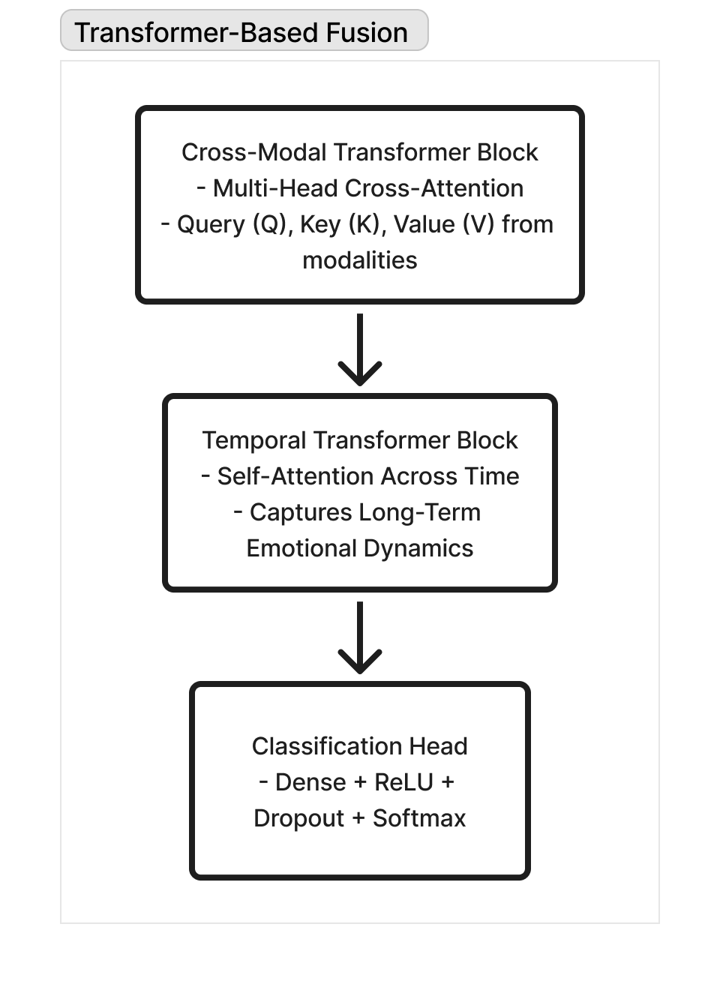
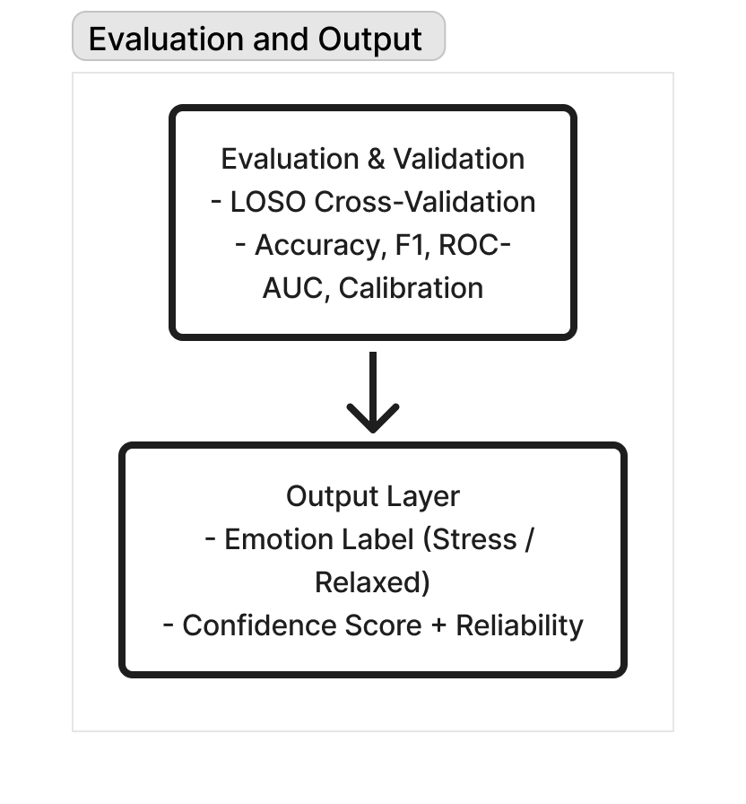
3-A. BLOCK SCHEMATIC
206124031
CS677 : Transformer-Based Emotion Recognition Using Multimodal Data Fusion

Slide 7
4-A. ALGORITHMS
ALGORITHM: Pan-Tompkins + Heart Rate Variability (HRV) Feature Extraction
INPUT
  Raw ECG signal x(t) sampled at 700 Hz.
PROCESS
  Step 1: Apply a bandpass filter to remove baseline wander and high-frequency noise.
  Step 2: Use the Pan-Tompkins algorithm to detect R-peaks:
    Differentiate → Square → Moving window integration → Threshold.
    Output is a list of detected R-peak indices.
  Step 3: Compute R–R intervals to estimate beat-to-beat timing.
  Step 4: Derive Heart Rate Variability (HRV) features, such as mean RR, SDNN, RMSSD, etc.
OUTPUT
  Clean ECG signal with noise removed
206124031
CS677 : Transformer-Based Emotion Recognition Using Multimodal Data Fusion

Slide 8
4-B. ALGORITHMS CONT.
ALGORITHM: : Convex Optimization (cvxEDA Decomposition)
INPUT
  Raw EDA signal 𝑦(𝑡)y(t) collected from wrist sensor.
PROCESS
  Step 1: Apply a low-pass filter (cutoff = 2 Hz) to remove high-frequency fluctuations.
  Step 2: Use cvxEDA (Convex Optimization-based Decomposition) to split the signal
  into:
    Tonic component (T): slow baseline skin conductance.
    Phasic component (P): fast changes linked to emotional arousal.
  Step 3: Detect Skin Conductance Response (SCR) peaks from the phasic component 𝑟.
  Step 4: Extract statistical features — mean, standard deviation, and number of SCR peaks.
OUTPUT
  Clean ECG signal with noise removed
206124031
CS677 : Transformer-Based Emotion Recognition Using Multimodal Data Fusion

Slide 9
4-C. ALGORITHMS CONT.
ALGORITHM: Convex Optimization (cvxEDA Decomposition)
INPUT
  3-axis acceleration signal 𝑎_{𝑥}(𝑡) , 𝑎_{𝑦}(𝑡) , 𝑎_{𝑧}(𝑡).
PROCESS
  Step 1: Apply a high-pass filter (cutoff = 0.5 Hz) to remove gravitational components.
  Step 2: Compute the magnitude of the resultant acceleration.
  Step 3: Segment the signal into small time windows (e.g., 4–6 s).
  Step 4: Extract activity-level features such as mean, variance, energy, and entropy.
OUTPUT
  Clean ECG signal with noise removed
206124031
CS677 : Transformer-Based Emotion Recognition Using Multimodal Data Fusion

Slide 10
4-D. ALGORITHMS CONTD..
ALGORITHM: Cross-Modal Transformer with Multi-Head Attention (Fusion Stage)
INPUT
  Embedded feature sequences for each modality:𝑒_{𝐸𝐶𝐺}, 𝑒_{𝐸𝐷𝐴}, 𝑒_{𝐴𝐶𝐶} obtained from CNN encoders or preprocessing.
PROCESS
  Step 1: Prepare attention inputs:
    For each modality 𝑚m, create:
    Query (Qm) , Key (Km) , Value (Vm)
  Step 2: Compute attention weights:
    Use scaled dot-product attention to decide how strongly one signal should focus on another.
  Step 3: Use multiple attention heads:
    Several parallel “heads” learn different kinds of relationships
  Step 4: All heads are concatenated and linearly combined.
OUTPUT
  The model outputs a single fused vector 𝐹_{𝑓𝑢𝑠𝑖𝑜n}
206124031
CS677 : Transformer-Based Emotion Recognition Using Multimodal Data Fusion

Slide 11
4-E. ALGORITHMS CONTD..
ALGORITHM: Temporal Transformer Block (Sequential Modeling)
INPUT
  Sequence of fused embeddings 𝐹_{𝑓𝑢𝑠𝑖𝑜𝑛,𝑡} obtained from the Cross-Modal Transformer.
PROCESS
  Step 1: Add positional information:
    Since Transformers don’t know time order naturally, add positional encodings
  Step 2: Compute self-attention across time:
    For every time window, compute attention.
  Step 3: Residual + Layer Normalization.
    Maintains stable gradients and keeps temporal context consistent.
  Step 4: A small network refines each time-step’s contextual embedding, strengthening temporal coherence.
OUTPUT
  Final time-dependent emotional embedding 𝐹_{𝑡𝑒𝑚𝑝𝑜𝑟𝑎l}
206124031
CS677 : Transformer-Based Emotion Recognition Using Multimodal Data Fusion

Slide 12
5. EXPERIMENTS & PERFORMANCE METRICS
Experimental Setup
  Dataset: WESAD (primary) and AffectiveROAD (supplementary)
  Training:
    ECG/EDA CNN: 100 epochs × 32 batch size
    Acceleration CNN: 50 epochs × 64 batch size
    Optimizer: AdamW (weight decay=0.01, β₁=0.9, β₂=0.999, ε=1e-8)
    Validation: LOSO Cross Validation
Performance Metrics
  Core Metrics: Accuracy, ROC-AUC, PR-AUC.
  Calibration Metric: Expected Calibration Error (ECE) – assesses reliability of predictions.
  Subject-Level Metric: Inter Subject Variability (ISV) – measures generalization.
Model Setup
  Modality specific CNN encoders for ECG, EDA and Acceleration.
  Cross-Modal Transformer Fusion + Temporal Transformer for sequence modeling.
206124031
CS677 : Transformer-Based Emotion Recognition Using Multimodal Data Fusion

Slide 13
6. IMPLEMENTATION ENVIRONMENT
Hardware
  Processor: Intel i7 / AMD Ryzen 7 (8-core, 3.0GHz+)
  RAM: 16 GB minimum
  Storage: 500 GB NVMe SSD
  GPU: NVIDIA RTX 4060 (12 GB VRAM) or equivalent CUDA-enabled GPU
  Operating System: Windows 11 (64-bit)
Software & Libraries
  Language: Python 3.10.x
  IDE: Visual Studio Code
  Core Framework: PyTorch (with CUDA support)
  Deep Learning Models:
    NeuroKit2/SciPy Essential for robust ECG R-peak detection, cvxEDA decomposition, and HRV analysis.
    Transformers (for implementing attention mechanisms)
  Data Handling & Processing: NumPy, Pandas, OpenCV, Open3D
  Visualization Tools: Matplotlib, TensorBoard, Seaborn
206124031
CS677 : Transformer-Based Emotion Recognition Using Multimodal Data Fusion

Slide 14
7. EXPECTED MILESTONE / WORK PLAN
Milestones | Period | Work to be completed
MS0 | 14 Aug 2025 – 26 Oct 2025 | Literature survey, tool & language selection, dataset setup (WESAD/AffectiveROAD), sensor level study, bio-signal study, algorithm selection, and project planning.
MS1 | 29 Oct 2025 – 23 Nov 2025 | Implement preprocessing for ECG, EDA, and acceleration (filtering, HRV, SCR, activity features) and begin 1D-CNN feature extraction.
MS2 | 26 Nov 2025 – 21 Dec 2025 | Integrate feature embeddings and Transformer-based fusion, temporal modeling, and perform preliminary training and validation.
MS3 | 24 Dec 2025 – 31 Dec 2025 | Conduct full LOSO evaluation, performance analysis and finalize document.
206124031
CS677 : Transformer-Based Emotion Recognition Using Multimodal Data Fusion

Slide 15
8. REFERENCES
^{[1]} J. Zhu, J. Jiang, and X. Zhao, “UAED: Unsupervised Abnormal Emotion Detection Network Based on Wearable Mobile Device,” IEEE Transactions on Affective Computing, vol. PP, no. 99, pp. 1–12, 2023.
^{[2]} K. Yang, X. Huang, and Y. Liu, “Behavioral and Physiological Signals-Based Deep Multimodal Approach for Mobile Emotion Recognition,” IEEE Transactions on Mobile Computing, vol. PP, no. 99, pp. 1–10, 2023.
^{[3]} P. Sarkar, S. Dey, and A. Dutta, “Self-Supervised ECG Representation Learning for Emotion Recognition,” IEEE Sensors Journal, vol. 22, no. 18, pp. 17456–17464, 2022.
^{[4]} Z. Wang, X. Chen, and Y. Zhang, “EmotionSense: An Adaptive Emotion Recognition System,” IEEE Internet of Things Journal, vol. 7, no. 9, pp. 8550–8563, 2020.
^{[5]} D. Pollreisz and N. TaheriNejad, “Detection and Removal of Motion Artifacts in PPG Signals,” Mobile Networks and Applications, vol. 27, pp. 728–738, Aug. 2019.
^{[6]} A. Vaswani, N. Shazeer, N. Parmar, J. Uszkoreit, L. Jones, A. N. Gomez, Ł. Kaiser, and I. Polosukhin, “Attention Is All You Need,” Advances in Neural Information Processing Systems (NeurIPS), pp. 5998–6008, 2017.
^{[7]} A. Greco, G. Valenza, M. Nardelli, M. Bianchi, L. Citi, and E. P. Scilingo, “Force–Velocity Assessment of Caress-Like Stimuli Through the Electrodermal Activity Processing: Advantages of a Convex Optimization Approach,” IEEE Transactions on Human-Machine Systems, vol. 47, no. 1, pp. 91–100, Feb. 2017.
206124031
CS677 : Transformer-Based Emotion Recognition Using Multimodal Data Fusion

Slide 16
THANK YOU…

