Slide 1


PeakForm Technologies Reverse Logistics
October 24th, 2026
Notes:
Rohan

Slide 2
Agenda
PeakForm Technologies
1
Introduction & Problem
2
NFF & Data Problem
AI Platform & Tech Training
3
Disposition Problem
3rd Party Refurb & & Buildout
4
Budget & Implementation
Notes:
Anish

Slide 3






Meet the Team
Shiven P.
Supply Chain Management
Anish Y.
Supply Chain Management
Rohan A.
Econ & Comp Sci.
Notes:
Everyone

Slide 4
PeakForm Tech. Overview & Problem
PeakForm now handles 36,000 annual returns across all five product lines through a depot designed for just 12,000; three times its intended capacity. Growth has outpaced its returns infrastructure, creating costly bottlenecks and missed recovery opportunities. The challenge is to connect customer support and product recovery: keeping more products in customers’ homes and recovering more value from those that come back, while preserving the service customers expect.
Notes:
Shiven

Slide 5
Approach
Section 1 - Reduce Avoidable Returns
Slow intake data and incentives favoring quick return authorizations send working equipment back to the depot.
Goal
Reduce physical pickups, particularly NFF returns, while preserving satisfaction and ease of service.
Section 2 - Recover Value from Returns
Flat-rate liquidation treats equipment with very different recovery potential the same.
Goal
Increase net recovery value captured from each return without uninformed or risky capex.
Notes:
Rohan

Slide 6
1
The NFF & Data Problem
Notes:
Anish

Slide 7
Problem 1: Misaligned Incentives Drive Returns
Customer Support owns satisfaction. Operations absorbs the return cost. Neither team owns the full resolution outcome.
29%
NFF rate at the depot (benchmark 8–12%)
10,440
working units shipped back in 2025
$4.57M
spent on NFF returns (10,440 × $438)
Structural Issue
Operating Model Fix
Siloed KPIs
Fast approvals protect Support's CSAT, while downstream costs sit with Operations.
Shared scorecard
Marcus and Jordan jointly own CSAT, NFF return rate and cost per resolved case.
Broken feedback loop
Depot findings do not consistently improve frontline decisions.
Closed-loop learning
Confirmed diagnoses feed support playbooks, technician training and Engineering fixes.
Success means resolving more issues on the first contact while protecting the customer experience.
Source: Exhibit 2 (NFF-path cost $438 per return); Exhibit 5 (NFF rate benchmark).
Notes:
Start with the cost. 29 percent of returns, 10,440 units, had nothing wrong with them. Each one cost 438 dollars in pickup, freight, testing and handling, so PeakForm spent 4.57 million dollars in 2025 picking up working equipment. The cause is structural: Support is measured on handle time and CSAT, so approving a return in 3.4 minutes is the rational choice, and the cost lands on Operations. Our fix is a shared scorecard for Marcus and Jordan covering CSAT, NFF return rate and cost per resolved case, plus a feedback loop so depot findings improve frontline decisions.

Slide 8
Problem 2: Data Usage Issue
Current Challenges
Existing telemetry lacks alerts and Customer Support integration
Customer Support does not have data about a customer need, and does not record customer interactions
Faults are only diagnosed after the unit reaches the depot
41%
Returns with complete, actionable reason codes
62%
Warranty returns with pre-return telemetry anomalies
23 days
Average advance warning from telemetry
Notes:
Shiven

Slide 9



Solution: Internal AI Company Brain
Two Data Inputs
Peakform Company Brain
One shared view of the device and the customer
Live Device Telemetry
Error Codes and Firmware
—
Connectivity and Usage
—
Model and Serial Number
Existing Data
AI is both a tool & proactive agentic
Diagnostic Intake
On-device help or Support Entry
—
What is wrong? When did it start?
—
What have you already tried?
Customers speak only with real people
Staff own the service decision
Completed before agent connection
Notes:
Rohan

Slide 10
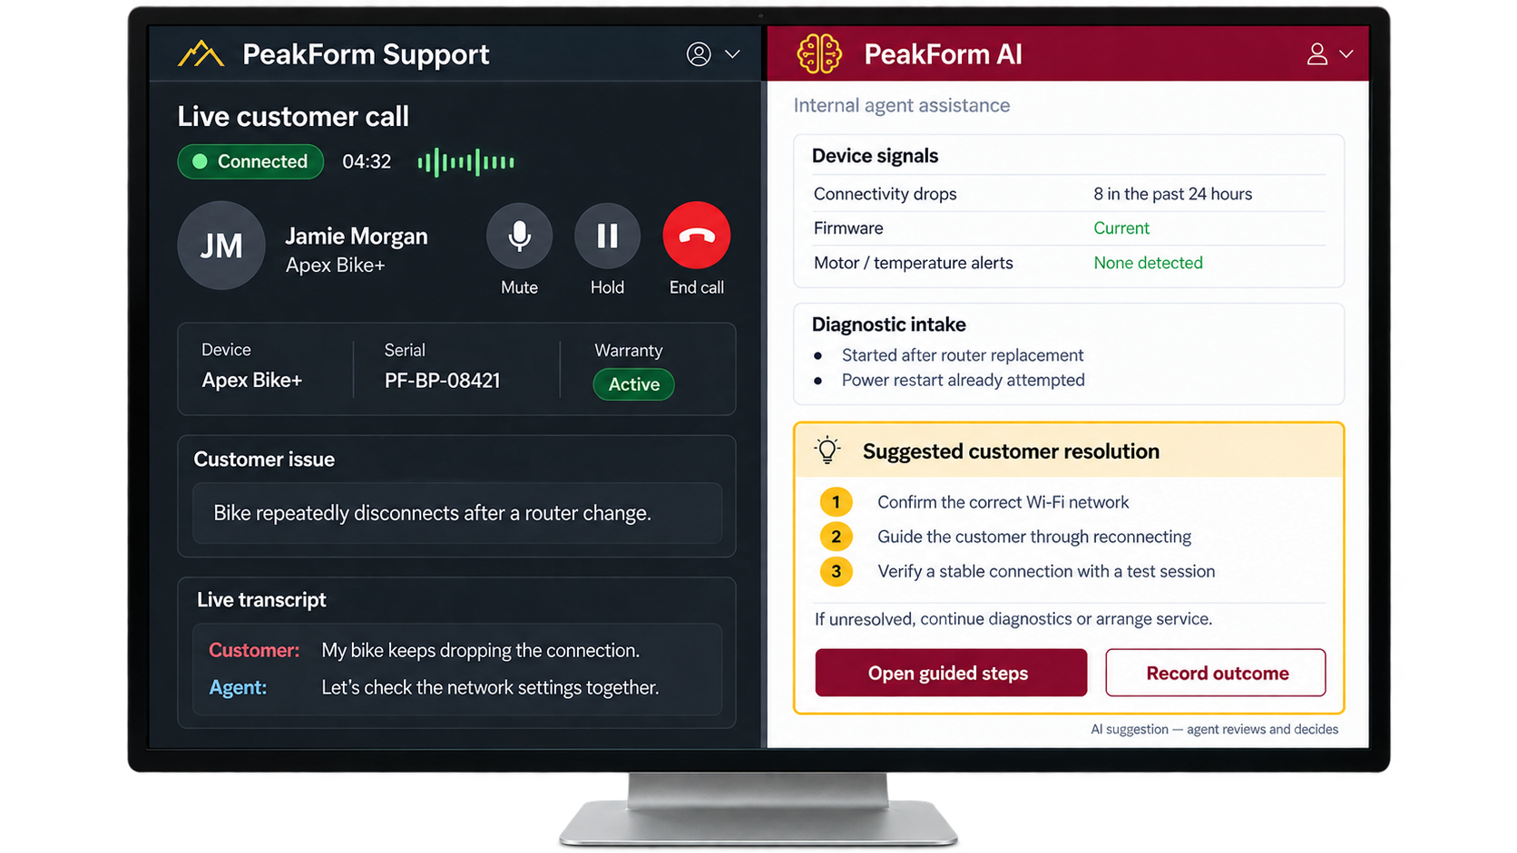
Main Use Case: Live Call Assistance
An active agent listens to calls, using past data & intelligence to provide quick, informed troubleshooting recommendations to the Agent.
Troubleshooting Time
Current: 14.2 Minutes
Proposed: 8 Minutes
Source: https://www.telusdigital.com/insights/customer-experience/resource/agent-assist-automation
Notes:
Shiven

Slide 11











Additional Company Brain Use Cases
Proactive Outreach
Actionable Company Insights
Engineering
Prioritize firmware and product fixes
Detect
Signal (23 Days Avg.)
Prioritize
Risk
Human
Outreach
Quality & Suppliers
Investigate recurring component failures
Kaplan-Meier analysis estimates return risk over time.
Support contacts customers with a relevant next step.
Customer Support
Improve troubleshooting and training
Operations
Plan parts and service capacity
Illustrative example
Firmware error signals prompt an offer of guided troubleshooting.
Commercial
Refine refurbished pricing and channels
Use each issue to improve the next customer outcome.
Source: PeakForm case, Exhibit 7. Applications are proposed; savings not separately modeled. *Requires linked 3PL repair and resale reports.
Notes:
Anish

Slide 12



Solution 2: Certified Technician Training
Train
Equip and Resolve
Record and Improve
Read diagnostics and service tickets
Resolve common setup issues
Replace approved components
Share telemetry and customer history
Bring the right parts and guidance
Verify the equipment works
Log the fault, action and outcome
Identify recurring NFF patterns
Update AI guidance and training
Selected pickup crews, defined repair scopes
AI-informed service, delivered by people
Every visit improves the next
~4,050
fewer returns per year
Cost per Case (Exhibit 2)
$773
$1.2M
net annual savings
$438
$158
Same day
fix vs 18–27 days waiting
Full return
NFF return
On-site fix (est.)
Notes:
Anish
Showcases 4,00 and 1.7M for just technician program, next slide shows full thing
3,227 × $438 = $1.41M
823 × $773 = $0.64M
Minus visits: 6,750 × $120 = –$0.81M
= $1.24M ≈ $1.2M

Slide 13
Estimated Decrease in Return
Unit condition | Old Units | Projected Units
Return to Stock | 2520 | 2520
Grade A | 7200 | 2823
Grade B | 5040 | 2195
Repair | 7920 | 7098
Parts Harvest | 13320 | 13320
Total | 36000 | 27956
NFF | 10440 | 3219
Estimated annual cost savings: $2.92 million from reducing returns from 36,000 to 27,956.
Source: Financial Model; Return Projections
Notes:
Shiven
As you can see here: column 2 represents our original return quantities, and after careful modeling with conservative assumptions here are our new numbers. With an estimated reduction of 8k returns, we hope to save over 2.9 million dollars.
ROHAN
7,221 fewer NFF returns × $438 = $3.16M
823 fewer defect returns × $773 = $0.64M
Minus technician visits (–$0.81M) and longer calls (–$0.12M)
= ~$2.9M a year
Here is why mew number^^^

Slide 14
2
The Disposition System

Slide 15
The Problem: Every Imperfect Unit Sells for $82
93%
$82
~$12M
of returns liquidated (33,480 units)
flat rate, Grade A bike or broken
recovery left on the table each year
Unit condition | Units | Recovery today ($82) | Benchmark recovery | Value lost
Grade A (minor cosmetic) | 7,200 | $0.59M | $6.77M | $6.18M
Grade B (visible wear) | 5,040 | $0.41M | $3.43M | $3.01M
Repairable defect | 7,920 | $0.65M | $4.59M | $3.94M
All returns (Exhibits 3 vs 4) | 36,000 | $7.40M | $19.42M | $12.02M
Source: Exhibits 3 and 4. Benchmark values are industry estimates for a tiered certified refurbishment program; row figures exclude parts revenue.
Notes:
Shiven

Slide 16
Why Not Build Our Own Refurb Line Yet?
The in-house program in Exhibit 8 pays off on paper, but Year 1 is the wrong time to build it
1 It eats the budget
84%
3 No sales channels
Every non-perfect unit goes to one liquidator today. There's no resale channel for 12,000 certified units a year.
$1.685M in-house refurb
$315K
$1.005M one-time build + $680K staff, leaving $315K of $2M for the NFF and data fixes
4 No grading expertise or data
Reason codes are complete only 41% of the time, so we can't yet sort Grade A from parts-only.
2 Nothing at full speed until Month 7
5 True value is unproven
1
2
3
4
5
6
7
8
9
10
11
12
Exhibit 4 values ($940 Grade A, $680 Grade B) are industry estimates, not PeakForm's real mix.
Ramp (Months 1–6)
Full throughput
Our call: prove the value with a partner first, then build with real data at the Month 6 gate.
Source: Exhibit 8 cost and ramp estimates; Exhibit 3 (single liquidation partner); Exhibit 4 benchmarks; Exhibit 5 intake data.
Notes:
Rohan

Slide 17
Disposition Solution: 3rd Party Refurbishment
Regional 3PL refurb partner
Grade A, Grade B, repairable defects
Ships direct, never touches Indianapolis
Customer
home
return approved
Pre-graded at pickup
telemetry + certified tech check
Indianapolis depot
NFF units → return to stock
Units beyond economic repair
Disposition Path | Units | Partner Rev. Share | Expected Addtl. Rev. | New Recoup
Grade A (minor cosmetic) | 7,200 | 19% | $679.40 | $4,891,680
Grade B (visible wear) | 5,040 | 32% | $380.40 | $1,917,216
Repairable defect | 7,920 | 46% | $231.20 | $1,831,104
Additional returns (Exhibits 3 vs 4) | 36,000 | - | - | $8,640,000
Additional Recoup Opportunity
$10.29m (3rd Party Refurb) - $1.65m (Flat Rate Liquidation) = $8.64 Million
Notes:
Anish

Slide 18
Data Play
Partners refurbish and sell returned units → PeakForm shares the proceeds and gets unit-level repair and resale data
1 Understand what sells
2 Identify the strongest markets
3 Build around proven demand
Demand by product, age and condition grade
Realized selling price, time to sale and unsold inventory
Net recovery after repair, freight and selling costs
Sales and margins by region and channel
Product and grade preferences across markets
Post-sale activation, usage and reliability from telemetry
Prioritize products with the strongest recovery economics
Size refurb capacity to actual sales velocity
Develop channels where demand is proven
Shared across Engineering, Operations and Commercial: capital goes where demand and recovery economics are proven.
Requires a data-sharing clause in every partner contract (Day 1–45).
Notes:
Rohan

Slide 19
3PL Refurbishment Pilot: 12-Month Timeline
Start small, scale with proof, decide on in-house refurb with real data
Day 1–45
Months 2–3
Months 4–6
Month 7
Months 8–12
Contract & Set Up
Route to 3PL
Full-Scale Data
Build
Ramp Refurbs.
Select a refurb partner
Sign rev share, grade checks and data sharing
Define the A / B / repairable standard
Pre-grading at pickup goes live
Pilot home-to-partner routing in 1–2 regions
Partner verifies grade on arrival
Track real grade mix and resale prices
Measure sell-through by region
Count refurb buyers joining PeakForm Live
Start In house Build
Find Build contractors
Mobilize required other business units
Full Scale In - House Refurb
Optimize Shipping
Get first real feedback to improve Ops
In Short: Use 3rd Party Refurbishers to capture crucial information about refurb, then approach the buildout in an informed, strategic manner
Proposed sequence; phase lengths are team estimates.
Notes:
Shiven

Slide 20
3
Implementation & Budget

Slide 21
45 Day Plan
Data+AI
Tech Training
3PL Partnerships
1
2
3
Work with PeakForm Technologies Data Team to create a data pipeline into an AI tool
Engage Experts in the Depot to upskill employees to work with customers/fix products
Run a search and find a reputable/established refurbishment vendor

Slide 22
Deferred Plans
2 Expand Tech Program via Contractors
1 Defer the In-House Refurb Build
■ Contract regional field techs rather than hiring full-time crews
■ Certify them through online training + AI playbooks
■ More $158 on-site fixes in place of $773 full returns
■ Hold the build until Month 6
■ Let 3PL partner data size capacity, grade mix and channels
■ Build in Months 8–12 only if resale economics are proven
3 Launch a DIY Repair Option
■ Ship OEM replacement parts straight to the customer's home
■ Pair each part with step-by-step video tutorials
■ Telemetry + support confirm the failed part before shipping
Proven model: Peloton self-service part replacement
Source: Exhibit 8 cost and ramp estimates; Exhibit 2 cost per case; team estimates for contractor and DIY programs.

Slide 23
Costs & Payback Period
Each solution's Year 1 commitment against the savings it returns every year
Solution | Commitment | Payback period | Annual savings
AI Company Brain Data pipeline, live call assist, on-device Get Help | $500K ceiling; build + integration | ~4 months | $1.6M 3,994 fewer NFF returns
Certified Technician Training Pickup crews fix at the door | $150K course; visits at $120 | ~2 months | $1.2M 4,050 fixed on-site
3PL Refurbishment Pilot Partners refurbish and resell | $185K grading software + setup | < 1 month | $4.4M vs $82 liquidation
Direct-to-Partner Routing Units skip Indianapolis | $0 included in 3PL setup | Immediate | $5.5M 12,116 units × $450
Total | $835K | < 1 month | ~$12.7M
Year 1 budget
$835K committed
$1.165M reserve funds most of the Month 7 build
$835K of the $2M budget returns ~$12.7M a year (~$7.3M in Year 1 with ramp-up). Full model and assumptions available in Q&A.
Payback measured from go-live at full run-rate. Technician visits, partner rev share and longer calls are netted out of savings. Commitments are team estimates; savings use Exhibit 2 costs and Exhibit 4 values.

Slide 24
Questions?

