Slide 1


Predicting Solar Flare Peak to End Time Utilizing Machine Learning & Deep Learning Techniques
By:– Shivesh Raj Sahu
Student ID:- U28571764

Slide 2
Introduction
Objective:- Predict the "peak to end" time for solar flares.
Data:-The Dataset is containing solar flare data with features such as flare class, start time, peak time, and end time.
Approach:- Data preprocessing, feature engineering, model training, and evaluation.

Slide 3
Data Preparation & Feature Engineering
Dataset:- `/Users/shiveshrajsahu/Desktop/CS677/SHIVESH_RAJ_SAHU_Project Proposal/Viewing Solar Flares.CSV`.
Feature Engineering:-
1. Calculate time to peak.
2. Calculate difference in peak time between current flare and the last flare.

Slide 4
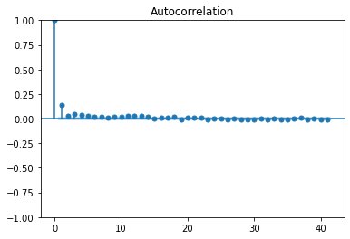
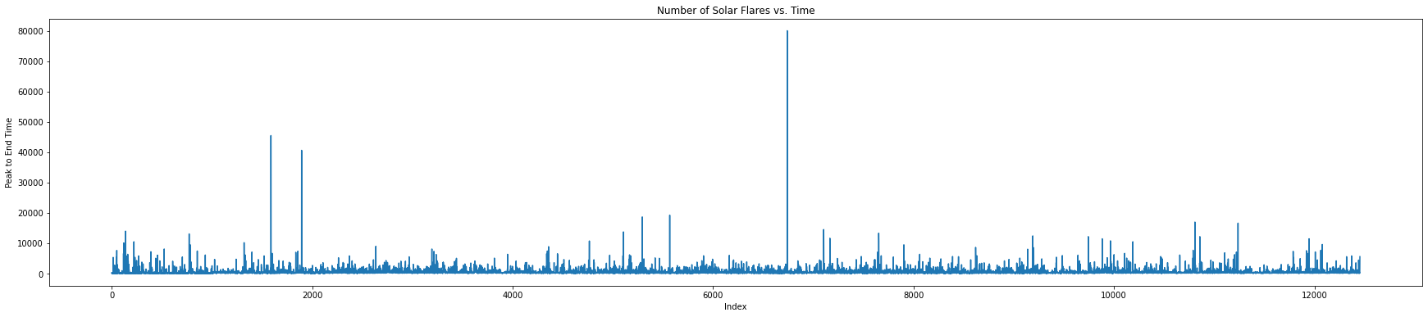
Data Visualization
Plot 1:- Autocorrelation function to determine how many past days are correlated with the prediction for the current day.
Plot 2:-Number of solar flares vs. Time.

Slide 5
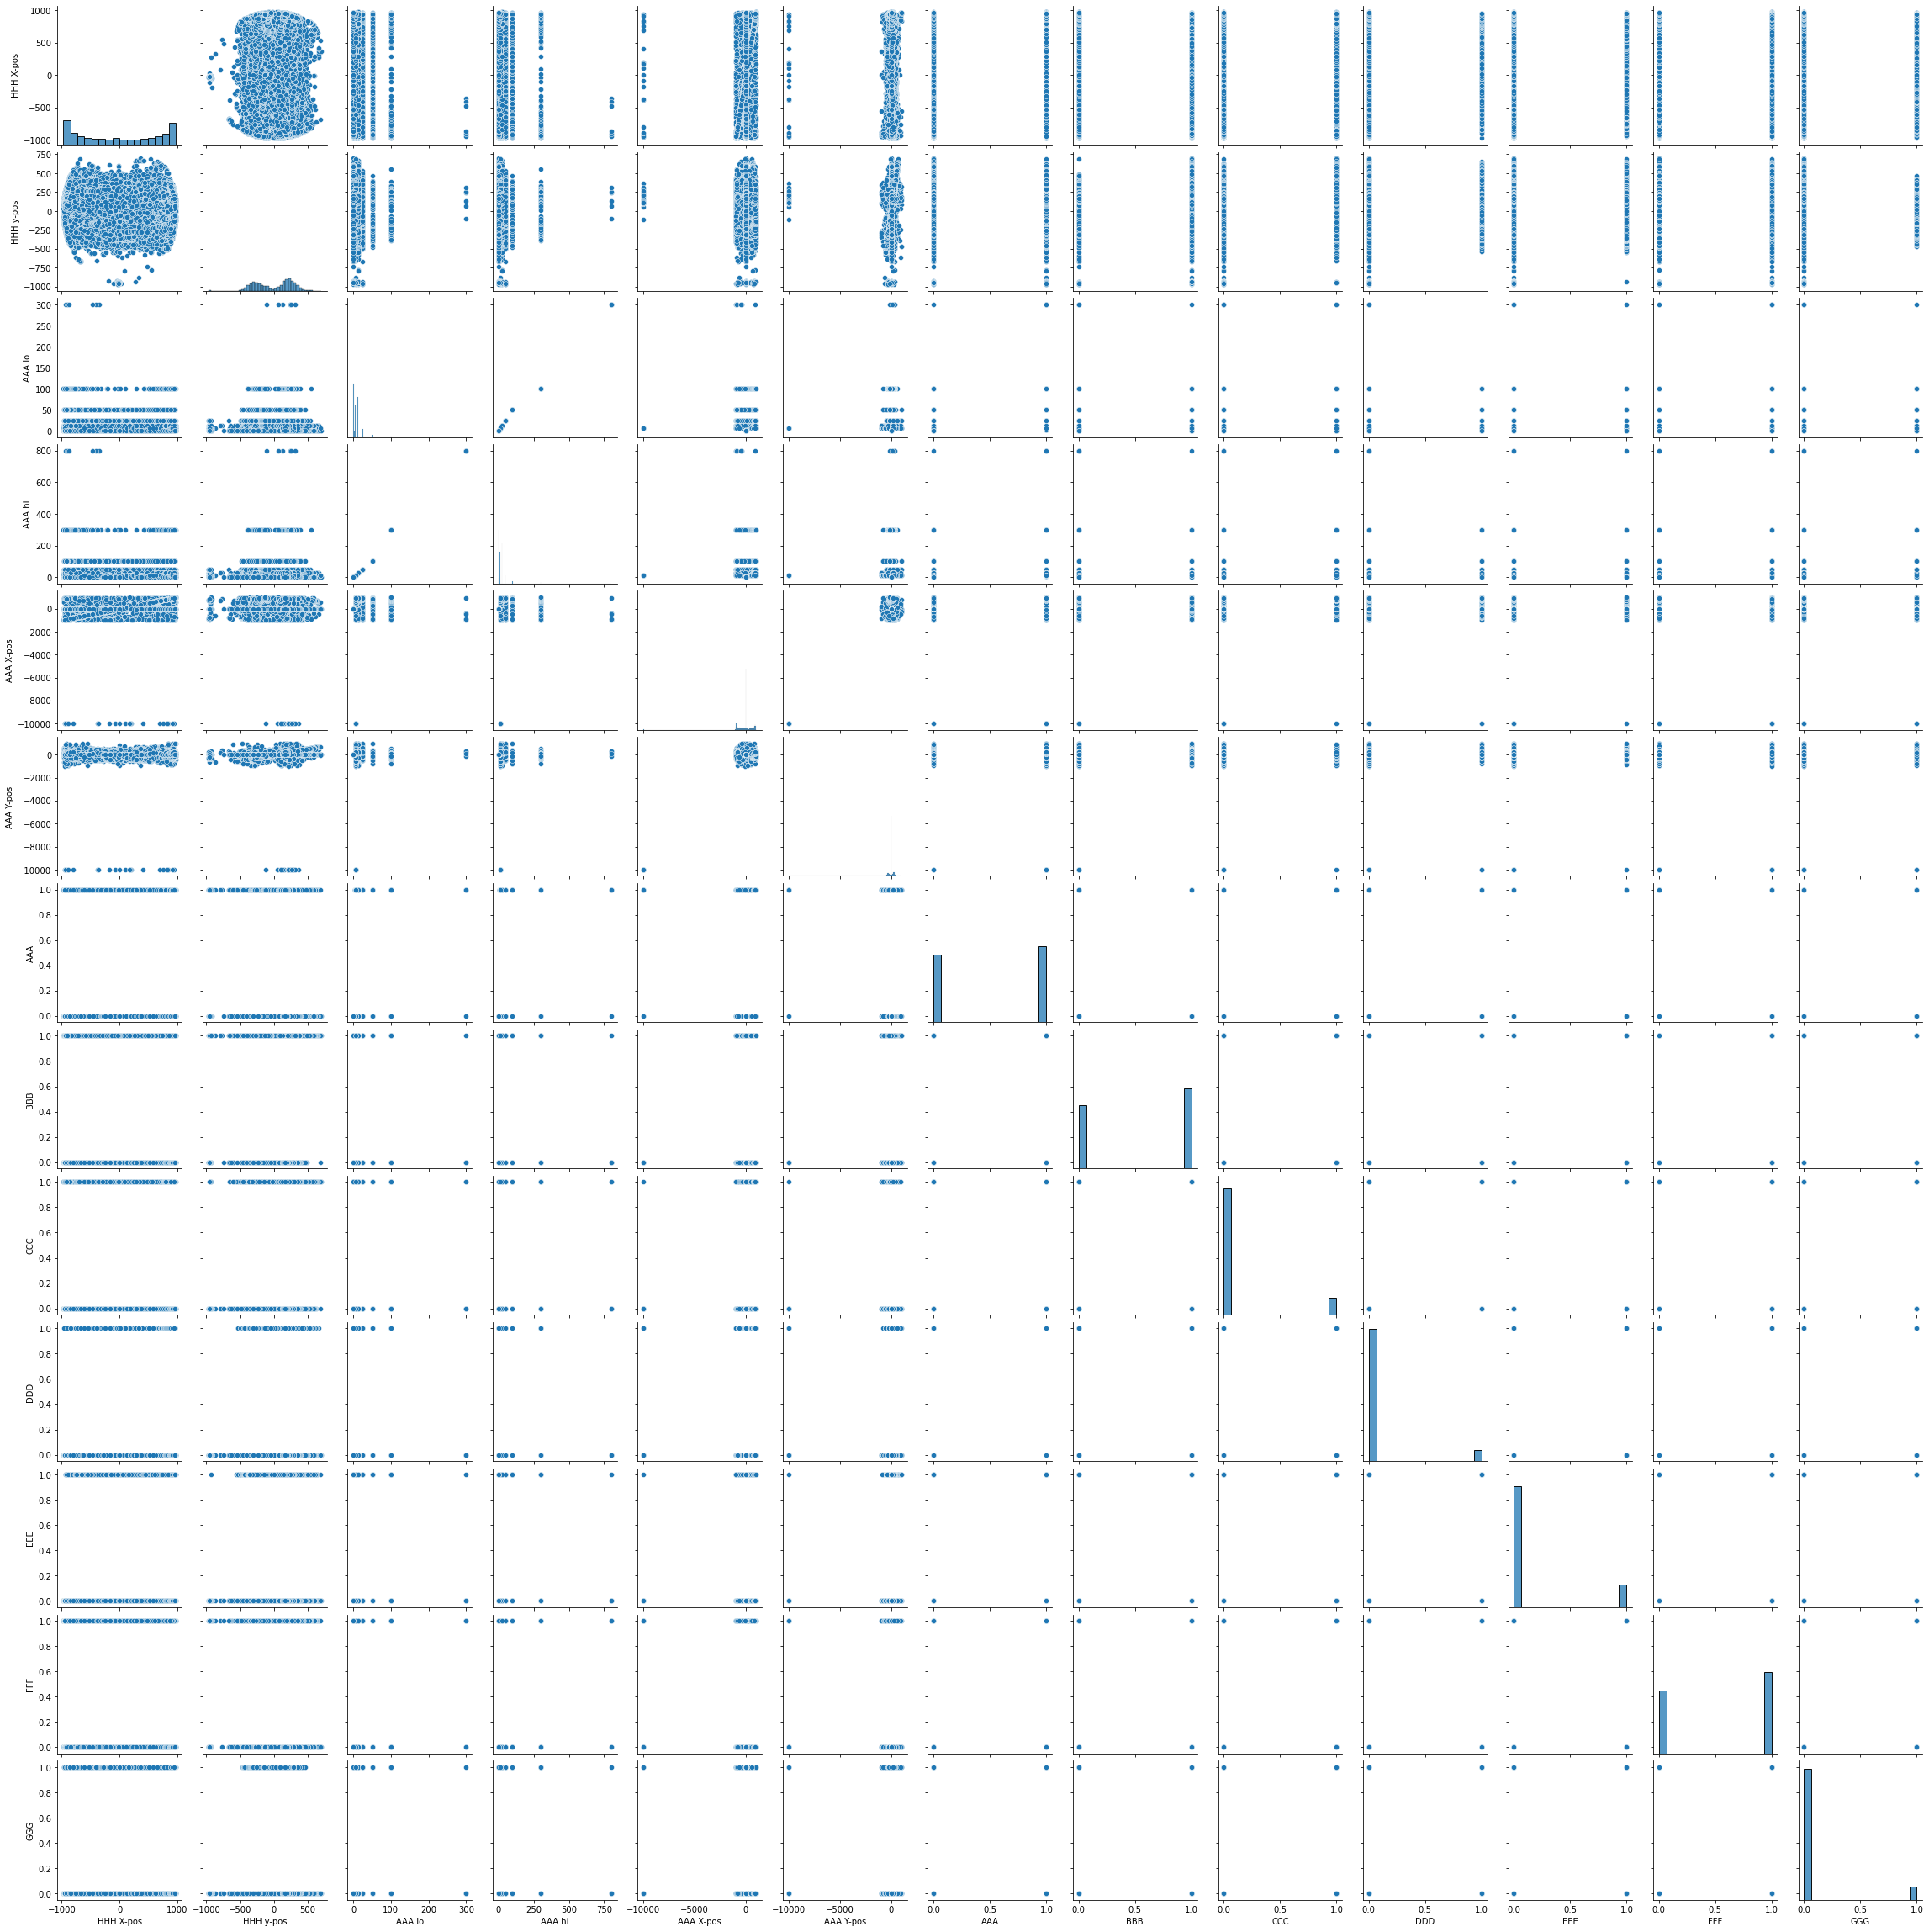
Data Exploration

Slide 6
Model Training
1. Data Splitting:- 80% training, 20% testing.
2. Random Forest Regressor:-Tree-based model.
3. Neural Networks:-Feed-forward neural network using TensorFlow/Keras.
4. SVM (Support Vector Machine)

Slide 7
Model Evaluation
1. Random Forest –
MSE: 0.7370801325494979,
R2: 0.2753424966959027
2. SVM –
MSE: 1.0900863291123262,
R2: -0.07171419056993678
3. Neural Network –
MSE: 342620905199.68726,
R2: -336846427921.3019

Slide 8


Conclusions
6. Results:
The first 5 rows of the dataset.
The summary of the dataset (data types and non-null counts).
Performance metrics (MSE and R2) for the three regression models on the test data.
My results show:
Random Forest: Has the best R2 score of ~0.28.
SVM: Performs slightly worse with a negative R2, indicating it might be performing no better than a horizontal straight line.
Neural Network: Shows an incredibly high MSE and a massively negative R2.

Slide 9
Thank you

