Slide 1
Final Project Real-Time Face Recognition System
Sahu, Shivesh
CS767A1 Advanced Machine Learning and Neural Networks
Fall 2023
Boston University MET College
Prof. Zoran B. Djordjević

Slide 2


Introduction
Problem Statement
The primary challenge addressed is the accurate recognition of faces in varied conditions, focusing on real-time processing. The LFW dataset, comprising over 13,000 images of faces, provides a diverse array of facial features and expressions, making it an ideal benchmark for this application.

Slide 3
Technology Overview
Face recognition technology has significant applications and impacts in various fields:
Security and Surveillance: Enhancing security systems for identifying and verifying individuals in public places, airports, and sensitive areas.
Biometric Authentication: Used in unlocking devices, banking security, and personal identification, offering a high level of security compared to traditional methods.
Healthcare: Patient monitoring and identification, especially in elderly care.
Personalized Customer Experience: In retail and marketing for personalized advertising and customer service.
Social Media: For tagging and organizing photos.

Slide 4
Technology Overview
Deep Learning Algorithms in Face Recognition:
Accuracy: CNNs can extract and learn complex features from facial images, leading to high accuracy in diverse conditions.
Adaptability: They are adaptable to various facial recognition tasks, from identity verification to emotion detection.
Scalability: Capable of handling large-scale datasets, which is crucial for developing robust face recognition systems.

Slide 5
Project Objective and Scope
Objective:
The primary goal of this project is to develop a robust and efficient system capable of performing real-time face recognition. The system aims to identify or verify individuals from digital images or video frames swiftly and accurately.
Scope:
Real-Time Processing: The system must process and analyze video frames or images in real-time, ensuring minimal delay between capturing the image and recognizing the face.
Accuracy: Achieve high levels of accuracy in face identification to minimize false positives and negatives.
Expected Outcomes:
The project will result in a demonstrable real-time face recognition system. It will showcase the capabilities of deep learning in processing and analyzing visual data swiftly and accurately.

Slide 6
Dataset Used
Data Source Selection
"All images aligned with deep funneling" Link :- http://vis-www.cs.umass.edu/lfw/lfw-deepfunneled.tgz
Nature of Dataset: This dataset is a collection of JPEG images of famous people's faces, meticulously collected from the web.
Dataset Specifics:
Number of Images: Over 13,000 images.
Number of Individuals: Faces of 5,749 different individuals.
Image Dimensions: Varied, with deep funneling alignment applied.
Key Features:
Alignment: Faces are aligned using a deep funneling method, enhancing the consistency of the facial structure across different images.
Diversity: Includes a wide range of facial expressions, poses, and lighting conditions.
Annotations: Each image is labeled with the name of the person.

Slide 7
Dataset Used
Use in Project:
Purpose: The dataset is utilized for training and testing the real-time face recognition model.
Relevance: The diversity and real-world nature of the images make this dataset suitable for developing robust face recognition systems.
Applications:
Research and Development: Widely used in academic research for developing and benchmarking face recognition technologies.
Practical Training: Ideal for training machine learning models due to its real-world variability and complexity.

Slide 8
Model Architecture and Implementation
FlowChart
Conv2D (32 filters, 3x3, ReLU)" for the first layer, adjust numbers for subsequent layers.
Input Layer
(224x224x3 RGB Image)
Output Layer (901 units, Softmax)
MaxPooling2D (2x2)
Rectangle labeled "Dropout (0.5)
Flatten

Slide 9
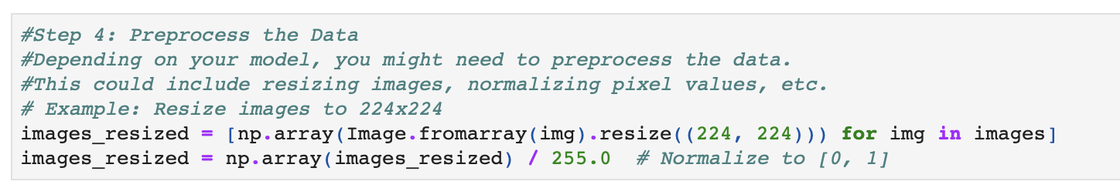
Model Architecture and Implementation
Input/Output: Input dimensions: 224x224x3 (RGB images), Output: 901 units (softmax layer for classification).

Slide 10
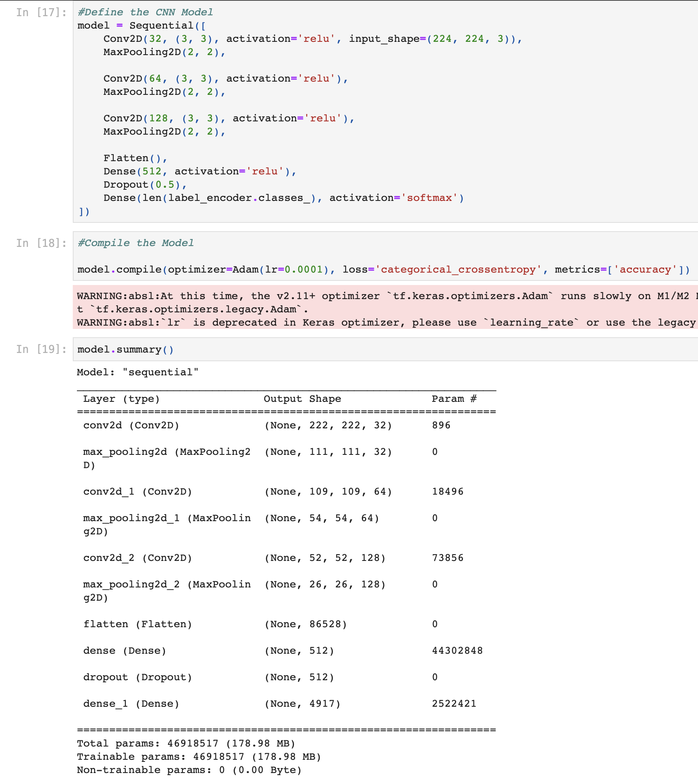
Model Architecture and Implementation
Key FeaturesArchitecture:
CNN Layers: Essential for feature extraction from images.
MaxPooling Layers: Reduce dimensionality, critical for managing computational load.
Dense and Dropout Layers: Dense layers for classification decisions; Dropout layer to prevent overfitting.
Real-Time Processing: Capable of handling live video feed for immediate face recognition.

Slide 11
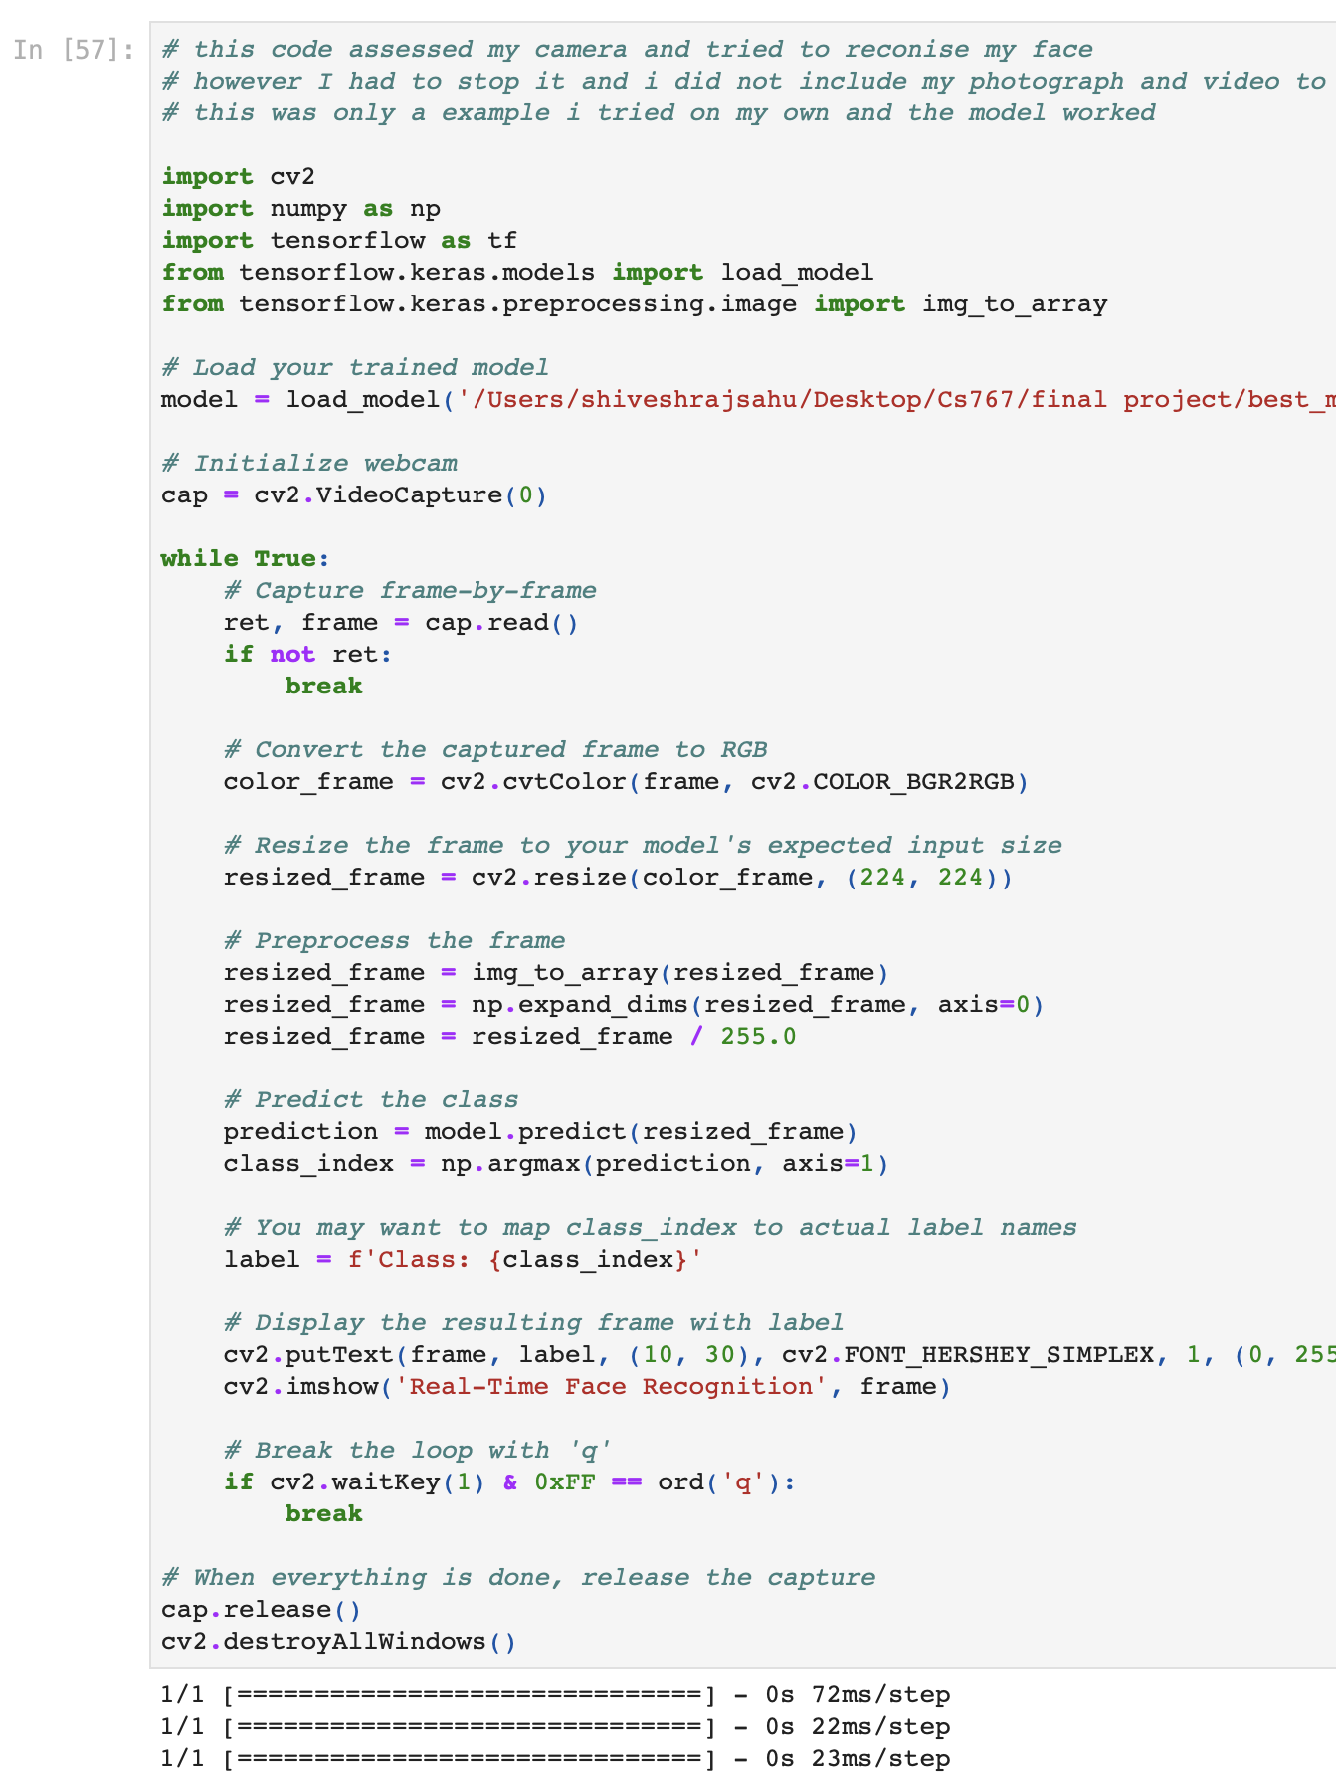
Demonstration

Slide 12
Demonstration
Import Libraries:
cv2 for OpenCV, used for video capture and image processing.
numpy for numerical operations.
tensorflow for loading and using the deep learning model.
Load the Trained Model:
load_model('/Users/shiveshrajsahu/Desktop/Cs767/finalproject/best_model.h5’)
loads the pre-trained model saved in an HDF5 file
Initialize Webcam:
cap = cv2.VideoCapture(0) initializes the webcam. 0 usually refers to the default
webcam.
Capture Video Frames in a Loop:
The while True loop continuously captures frames from the webcam.
ret, frame = cap.read() reads the next frame from the webcam.
if not ret: break stops the loop if no frame is captured.

Slide 13
Demonstration
Process Each Frame:
cv2.cvtColor(frame, cv2.COLOR_BGR2RGB) converts the frame from BGR (used by
OpenCV) to RGB (used by TensorFlow).
resized_frame = cv2.resize(color_frame, (224, 224)) resizes the frame to the size
expected by the model (224x224 in this case).
img_to_array(resized_frame) converts the resized frame to a numpy array.
resized_frame = np.expand_dims(resized_frame, axis=0) adds an extra dimension
to the array to make it suitable for model prediction (batch size of 1).
resized_frame = resized_frame / 255.0 normalizes the pixel values to [0,1].
Model Prediction:
prediction = model.predict(resized_frame) uses the model to predict the class of
the face in the frame.
class_index = np.argmax(prediction, axis=1) finds the class with the highest
probability.

Slide 14
Demonstration
Display Results:
The label (e.g., Class: {class_index}) is determined based on the prediction.
cv2.putText() puts the label text on the frame.
cv2.imshow() displays the frame with the label in a window titled 'Real-Time Face Recognition’.
User Interaction:
The if cv2.waitKey(1) & 0xFF == ord('q') condition allows the user to quit the application by pressing 'q’.
Clean Up:
Finally, cap.release() and cv2.destroyAllWindows() are called to release the webcam and close any OpenCV windows, ending the application.

Slide 15
Performance Analysis
Accuracy Metrics:
Test Accuracy: This metric represents the percentage of correctly identified faces out of all the test data. Our model achieved an accuracy of approximately 1.34%.
Test Loss: This represents the error rate of the model on the test data. Our model registered a test loss of 6.46, indicating room for improvement.
Graphs/Charts:
Accuracy Over Epochs:
Description: A line graph showing the training and validation accuracy of our model over each epoch. The graph illustrates how accuracy changes as the model learns from the data.
Key Observation: The graph may show initial improvements in training accuracy, but a plateau or decrease in validation accuracy, indicating overfitting.
Loss Over Epochs:
Description: A line graph depicting the training and validation loss of our model throughout the epochs. It highlights how the model's error rate decreases over time.
Key Observation: If the validation loss increases over time while the training loss decreases, it suggests that the model is overfitting to the training data.

Slide 16
Performance Analysis
Analysis Summary:
The model shows reasonable learning capability on the training set, but it struggles to generalize well on unseen data, as evident from the low test accuracy and high test loss.
The discrepancy between training and validation performance suggests that the model might be overfitting, which could be addressed with strategies like data augmentation, model regularization, or using a more complex model architecture.

Slide 17
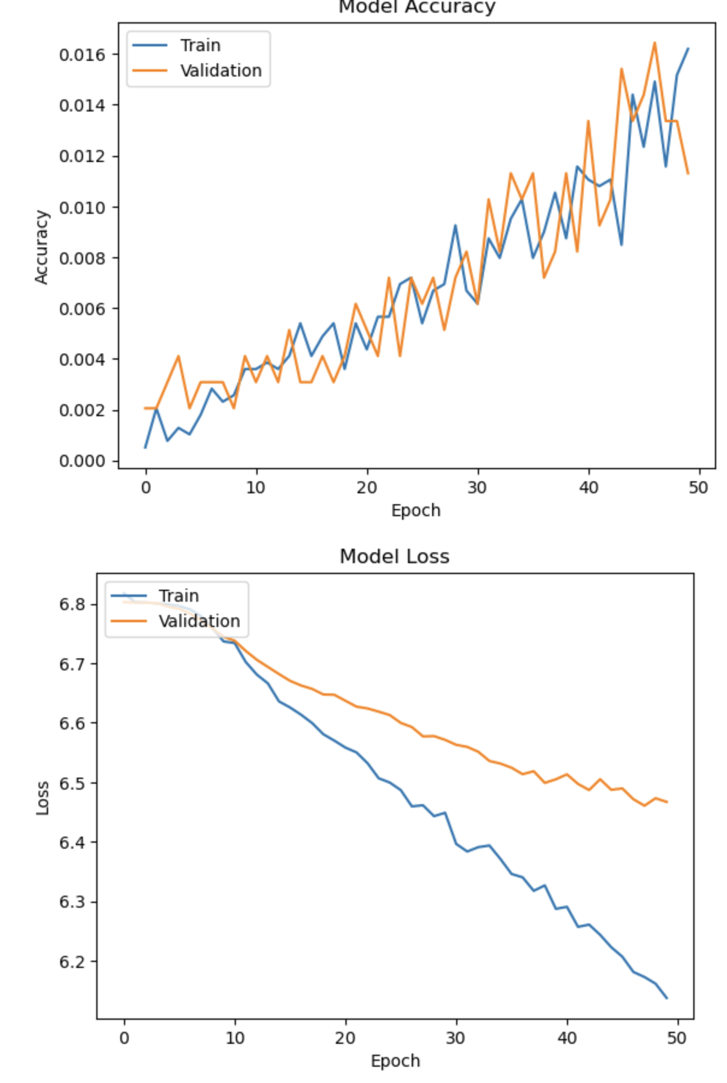
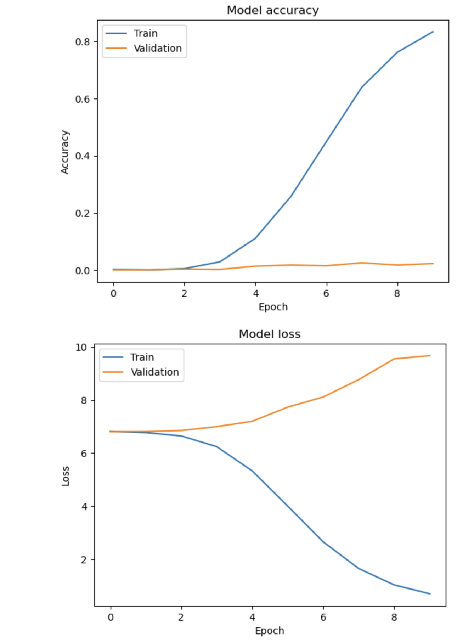
Performance Analysis

Slide 18
Pros and Cons
Advantages:
Enhanced Security: The system provides a secure method for identity verification, useful in areas like access control and surveillance.
User-Friendly: Designed to be intuitive and easy to use, facilitating seamless integration into various applications.
Real-Time Processing: Capable of quickly analyzing video frames or images, enabling immediate recognition and response.
Versatility: Adaptable for use in multiple scenarios, from personal device security to public safety measures.
Technological Innovation: Utilizes advanced deep learning techniques, showcasing the capabilities of Convolutional Neural Networks in image recognition.
Limitations:
Accuracy Challenges: Current model shows relatively low accuracy, indicating a need for further optimization and training with more diverse datasets.
Overfitting Issues: The model tends to overfit on the training data, leading to poor generalization on unseen data.
Computational Demands: Requires significant computational resources for real-time processing, which might not be feasible in all application scenarios.

Slide 19
Ethical Considerations
Privacy Issues:
Consent and Data Security
Surveillance Concerns
Data Handling
Bias in AI:
Diverse Datasets
Algorithmic Transparency
Continuous Monitoring

Slide 20
Conclusion
Key Takeaways:
Innovative Technology: My project demonstrates the cutting-edge capabilities of real-time face recognition, leveraging deep learning for accurate and efficient identification.
Broad Application Spectrum: This technology has vast potential applications, ranging from enhanced security systems to personalized user experiences in various sectors.
Continuous Improvement: While we achieved notable milestones, ongoing refinement and development are crucial for improving accuracy and expanding functionality.

Slide 21
YouTube URLs, Last Page
YouTube Demonstrations
Two YouTube videos provide a comprehensive overview of the project and a demonstration of the working model:
Two minute (short):
Link:- https://youtu.be/QN_LvV_GhIQ
15 minutes (long):
Link:- https://youtu.be/b80vcyNnTQo

