Slide 1
St. Joseph Academy
TOPIC-COMPUTER AND IT’S WORKING
Subbmitted by:- Aarav Gautam Shivansh Singh
Shivesh Ku. Dwivedi
Subbmitted to:- Nitesh sir

Slide 2
Computer
Computer is a digital electronic digital device, that takes input from the user, process it and give the proccessed output to the user.
We use computer to make our daily life easier. For eg. using computer to do maths, intead of calculating 324*43+3 by ourself we can use a computer, this makes it easier and faster.
We use computer for entertainment. We watch movies,play games etc.
It has the ability to store, retrieve, and process data.

Slide 3
Input Devices
Devices used to give input to the computer are input devices.
For example:-
Keyboard
Microphone
Webcam
Scanner
Mouse etc.

Slide 4
Output Devices
Devices used to give processed output to the user are called output devices.
For example:-
Monitor
Speaker
Printer etc.

Slide 5
CPU
A central processing unit (CPU) also known as brain of the computer is a device of computer that connects input devices and output devices and is composed of the memory, control unit, and arithmetic-logic unit.
As all the inputs from the devices comes to it and it processes the information and sends the output to the device and stores data. Hence, it is also known as brain of the computer

Slide 6
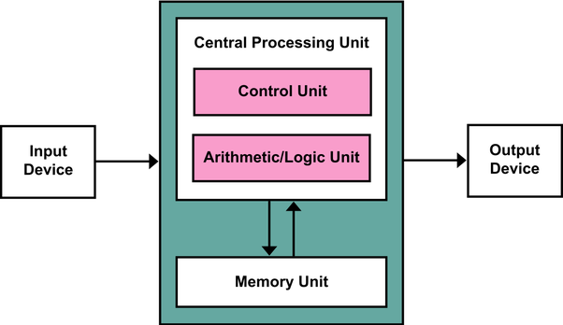
Working of CPU

Slide 7
Control Unit and Arithmetic/Logic Unit
Arithmetic/Logic Unit (ALU) performs all the task of al and arithmetic operations.ALU performs Arithmetic functions like Addition, subtraction, division, etc.
Control Unit(CU) performs the task of controlling functions of the computer. It monitors and gives proper instructions to all parts of the computer.

Slide 8
Memory
Memory is a device that is used to store information
Memory can be classified into two types:-
Primary memory
Secendory memory

Slide 9
Primary Memory
Primary memory is the main memory of computer, and is required to turn the compueter on.
There are mainly two primary memories in a computer:-
RAM: Random Access Memory is a volatile memory (it’s data get erased when computer turns off) device where the operating system (OS), application programs and data in current use are kept.
ROM: Read Only Memory, is a memory device or storage medium that stores information permanently, we can only read the programs and data stored on it but cannot modify or delete it.The data in it is stored during it’s manufacturing.

Slide 10
Secondary Memory
Secondary memory is a physical device for the permanent storage of programs and data.
Secondar memory could be fixed or portable.
They are not necessary for the computer but are very usefull as they store all our data.
Some examples of secondary memory are:-
Hard disk drive, solid state drive, pen drive,DVD,CD etc.

