Slide 1
DESIGN AND ASSEMBLY OF A KNUCKLE JOINT USING SOLIDWORKS
Internship Final Task | Real-World Mechanical CAD Project
SOLIDWORKS

Slide 2
1. Project Overview
Application-oriented CAD project based on a real mechanical knuckle joint.
Three principal components were modelled: fork/double-eye member, single-eye member and knuckle pin.
Individual parts were created first and then integrated into a functional assembly.
The final model was checked using standard and trimetric views.
The project demonstrates a complete mechanical CAD workflow from part creation to assembly inspection.

Slide 3
2. Project Objectives
Understand the construction and working principle of a knuckle joint.
Create accurate 3D component models in SOLIDWORKS.
Use sketches and feature-based modelling operations effectively.
Build the complete assembly using appropriate mates.
Verify component alignment and overall assembly geometry.
Develop practical skills applicable to mechanical design and manufacturing.

Slide 4
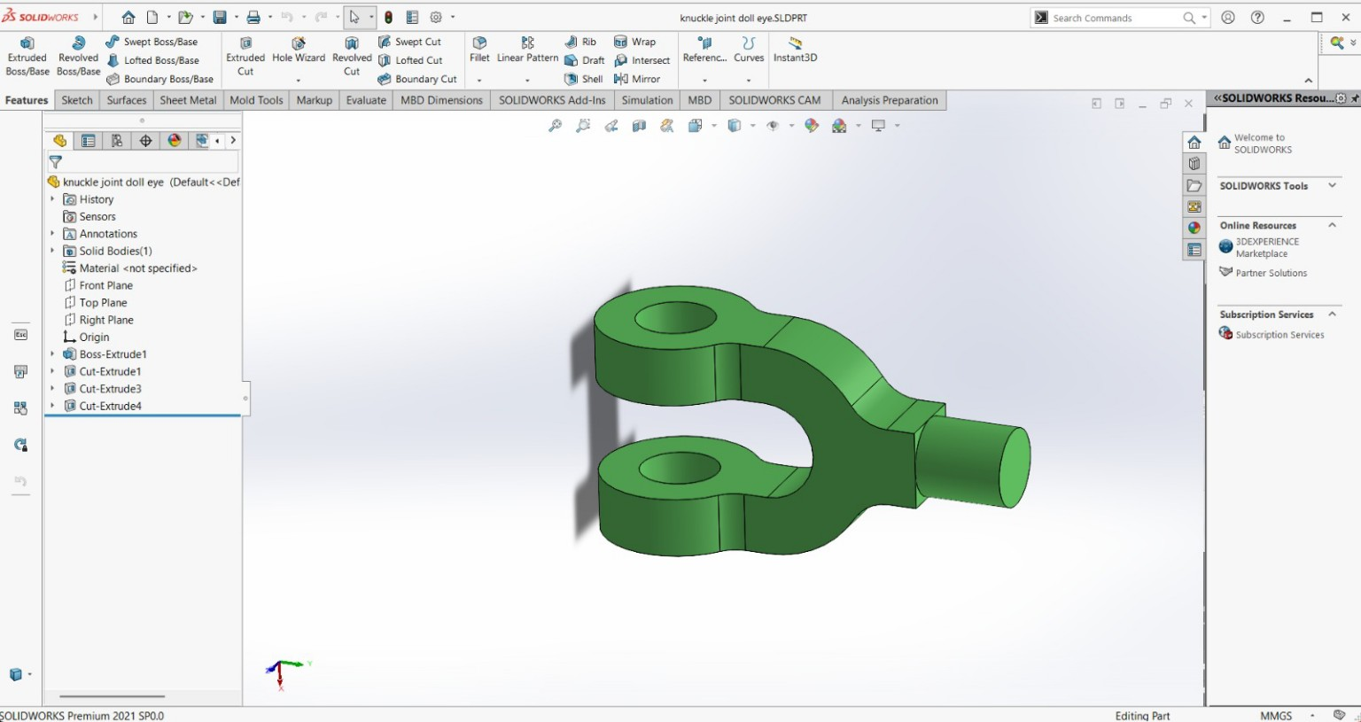
3. Fork / Double-Eye Member
Main supporting component of the joint.
Contains two aligned lugs with circular holes.
Central opening accommodates the single-eye member.
Created as a separate SOLIDWORKS part using feature-based modelling.

Slide 5
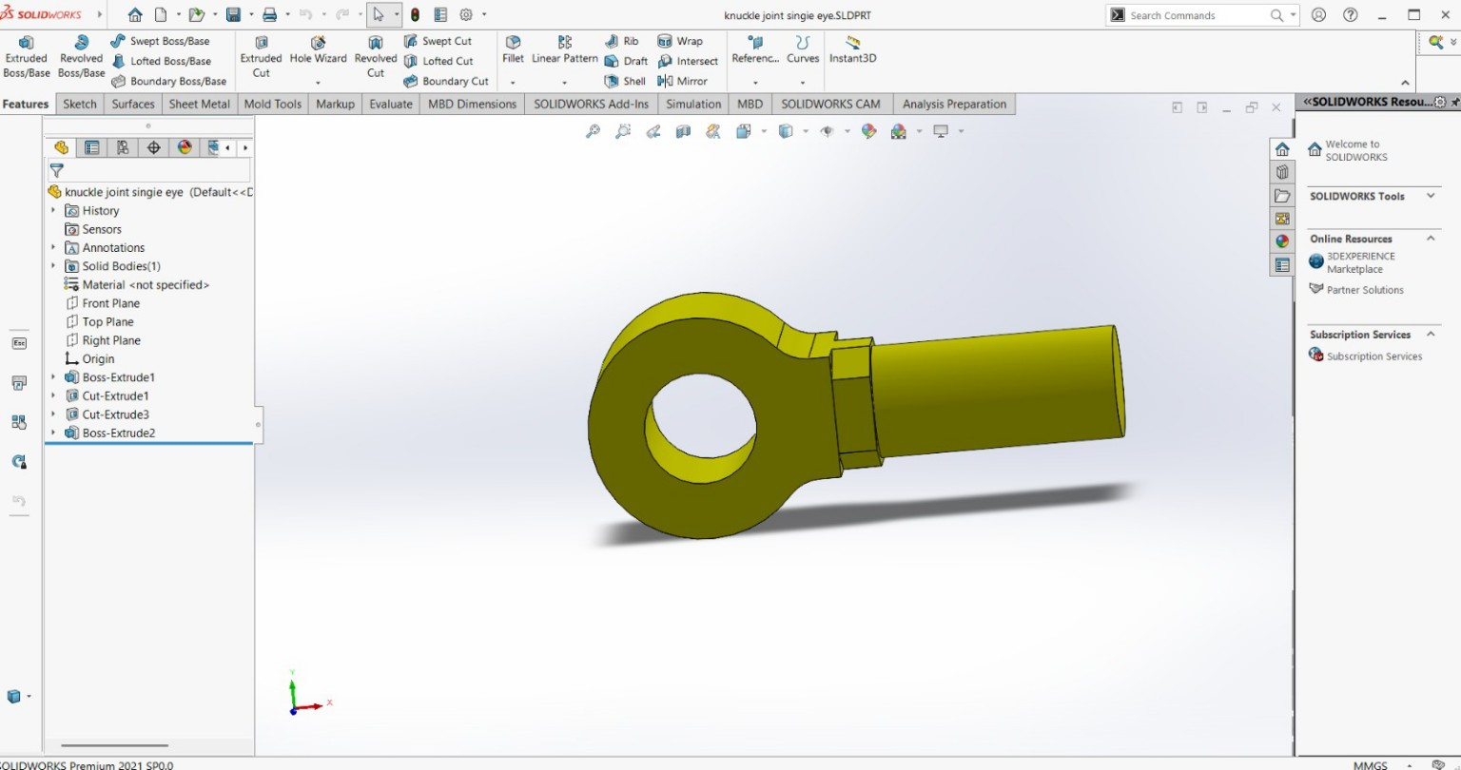
4. Single-Eye Member
Fits between the two lugs of the fork.
Contains a circular eye and through-hole for the joint pin.
The opposite side forms the connected shank.
Geometry is designed to align with the fork during assembly.

Slide 6
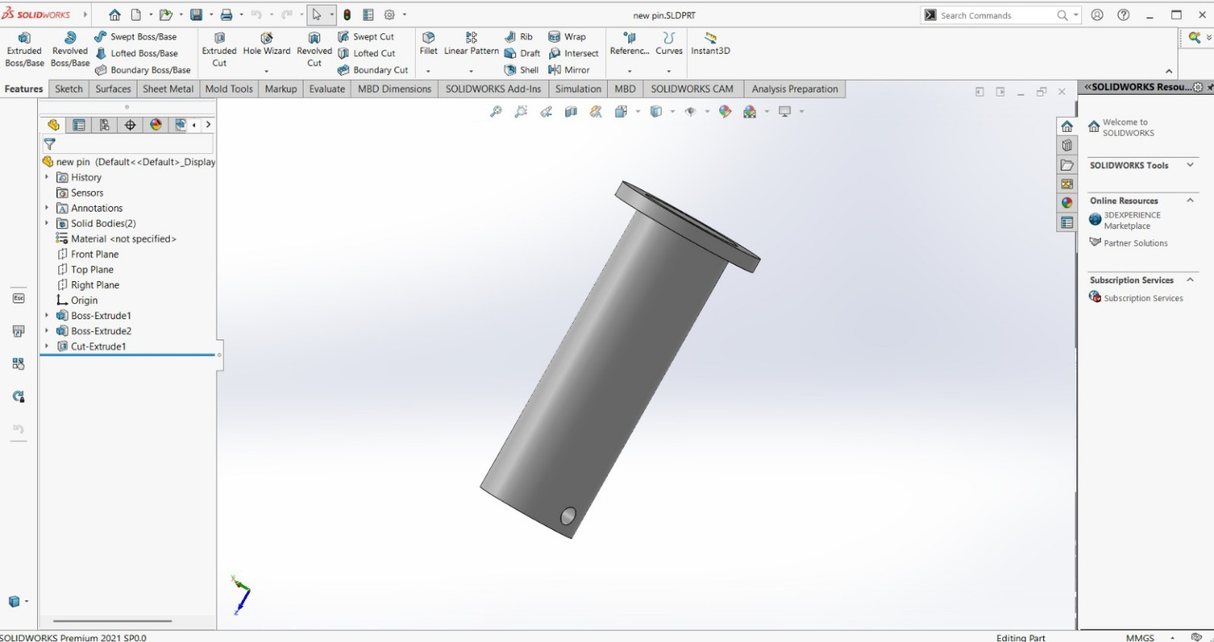
5. Knuckle Pin
Cylindrical connecting element and pivot axis of the joint.
Passes through the aligned holes of the fork and single-eye member.
Includes a head/flange and a transverse retaining-hole feature.
Acts as the primary removable connecting element.

Slide 7
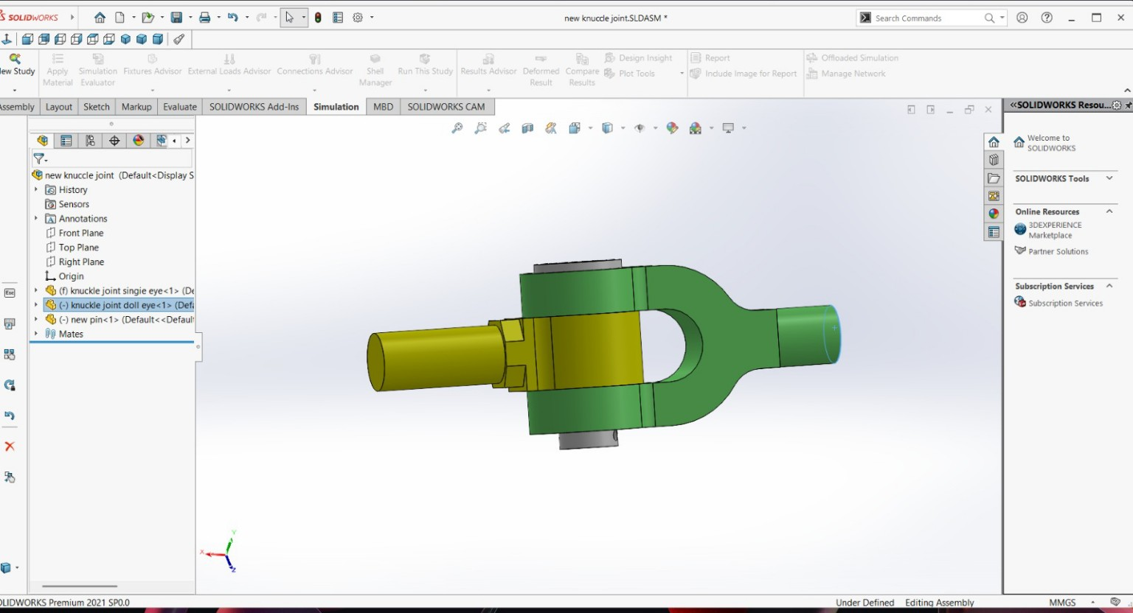
6. Assembly Procedure
Insert the fork as the reference component.
Place the single-eye member between the fork lugs.
Insert the pin through the aligned holes.
Apply concentric/coincident-type assembly mates.
Check orientation, alignment and relative positioning.
Inspect the finished assembly from multiple views.

Slide 8
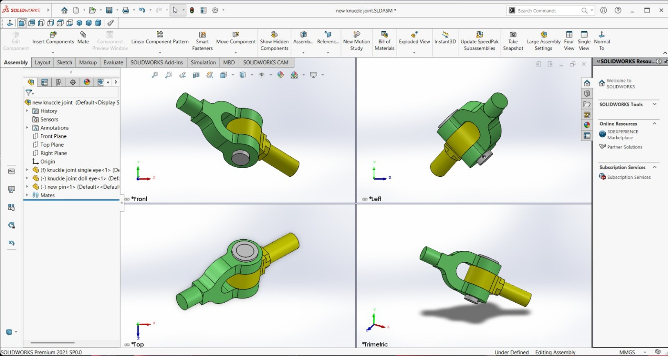
7. Multi-View Inspection
Front view verifies the overall longitudinal arrangement.
Left view helps inspect the pin and lug relationship.
Top view verifies the eye, pin and fork alignment.
Trimetric view provides a quick overall 3D inspection.
Multi-view checking helps identify orientation and assembly errors.

Slide 9
8. Working Principle
The fork surrounds the single-eye member.
The pin passes through the aligned holes and establishes a common axis.
The connection permits controlled angular movement between the connected members.
The joint is suitable for mechanical linkages where articulation is required.
Actual load capacity depends on dimensions, material, loading and safety factors.

Slide 10
9. Skills and Learning Outcomes
3D part modelling and sketch interpretation.
Feature-tree management and design intent.
Mechanical assembly creation and mates.
Understanding of real-world joint geometry.
Multi-view model inspection.
Technical documentation and engineering presentation.

Slide 11
10. Result and Future Scope
Completed CAD assembly of a three-component knuckle joint.
Verified the component relationship through multiple views.
Future work: engineering drawings, GD&T, material selection and tolerance design.
Future work: interference checking and SOLIDWORKS Simulation.
Future work: manufacturing planning and design optimization.

Slide 12
11. Conclusion
The project successfully connected mechanical engineering theory with practical CAD modelling.
Separate part models were developed and assembled into a complete knuckle joint.
The task improved understanding of component compatibility, assembly constraints and design visualization.
The completed model provides a foundation for further analysis, detailing and manufacturing documentation.

Slide 13
Thank You
Questions & Discussion

