Slide 1

Employee retention

Slide 2

Introduction
Employee retention is basically every organization's goal to keep productive and talented employees and reduce turnover by creating and maintaining positive work environment.
HR Analytics enables organizations to make smarter, more informed decisions about their employees.
By using data, HR professionals can gain valuable insights that drive productivity, enhance workplace culture, and improve overall business outcomes.
Today, we’ll mainly look at employee attrition against different employee parameters and also some other parameter comparisons.
We used different tools for this project such as MySQL, Power Bi, Tableau and Microsoft Excel.

Slide 3

Data overview
The dataset we used for analysis has mainly two tables in excel format.
This data shows details of over 50000 employees in total which include both current and ex-employees.
Both these tables show numerous employee parameters. So, including these parameters and two tables with 50K records each, we had large amount of data in our hand.
However, we mainly used the following parameters for our analysis:
Attrition
Monthly Income
Job Role
Work-life balance
Working years
Year since last promotion
Department
Above parameters are based on objectives we’ll see further.

Slide 4

Objectives
Average Attrition rate for all Departments
Average Hourly rate of Male Research Scientist
Attrition rate Vs Monthly income stats
Average working years for each Department
Job Role Vs Work life balance
Attrition rate Vs Year since last promotion relation

Slide 5
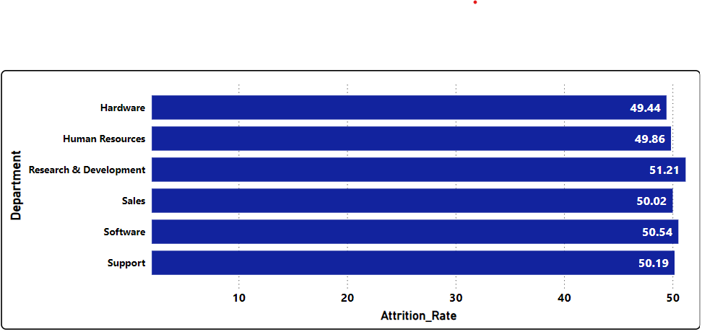
KPI’s
1) Average Attrition rate for all Departments
*Research & Development has
the highest attrition rate
Hardware has the
lowest attrition rate
Overall
consistency

Slide 6
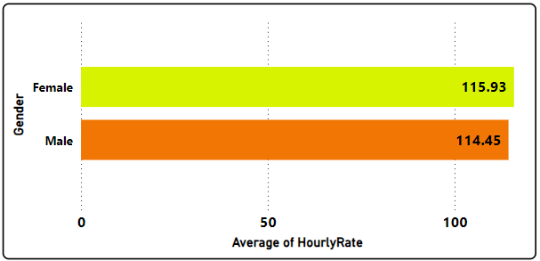
KPI’s
2) Average Hourly rate of Male Research Scientist
Slight difference
in hourly rates
Gender pay gap
is minimal
Equal opportunity
indication

Slide 7
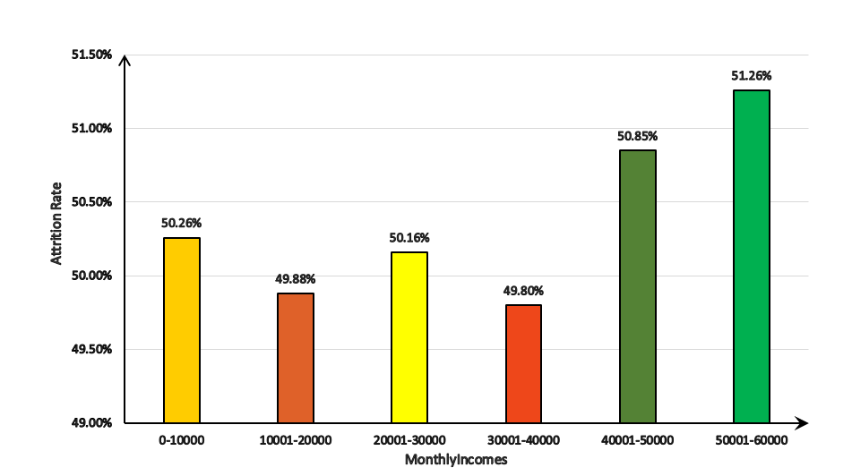
KPI’s
3) Attrition Rate vs MonthlyIncome
High attrition in top earners:
Steady attrition
across
incomes
Slight stability at mid-level incomes

Slide 8
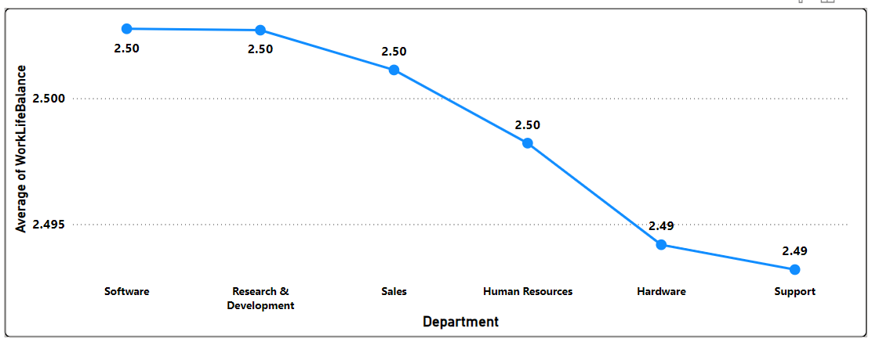
KPI’s
4) Average working years for each Department
Software has the most experienced employees
Support has the
least average experience
Consistent experience across departments

Slide 9
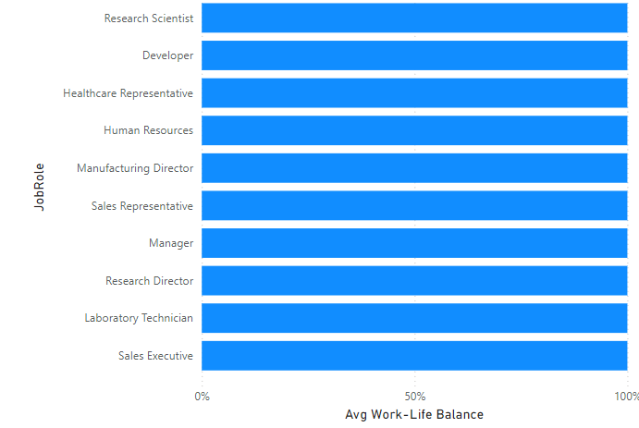
KPI’s
5)Job role vs Work life balance
1.Uniformity in balance:
The chart shows that average work life balance are relatively consistent across the all job roles, with no extreme outliers.
The horizontal bar chart depicts the average work life balance scores for various job roles .
with the x-axis shows the average work life balance and y axis shows the various job role.
Even though the balance is consistent certain roles have unique challenges.
All job roles are looking to similar to each other then work life balance should be balances in all job roles.

Slide 10
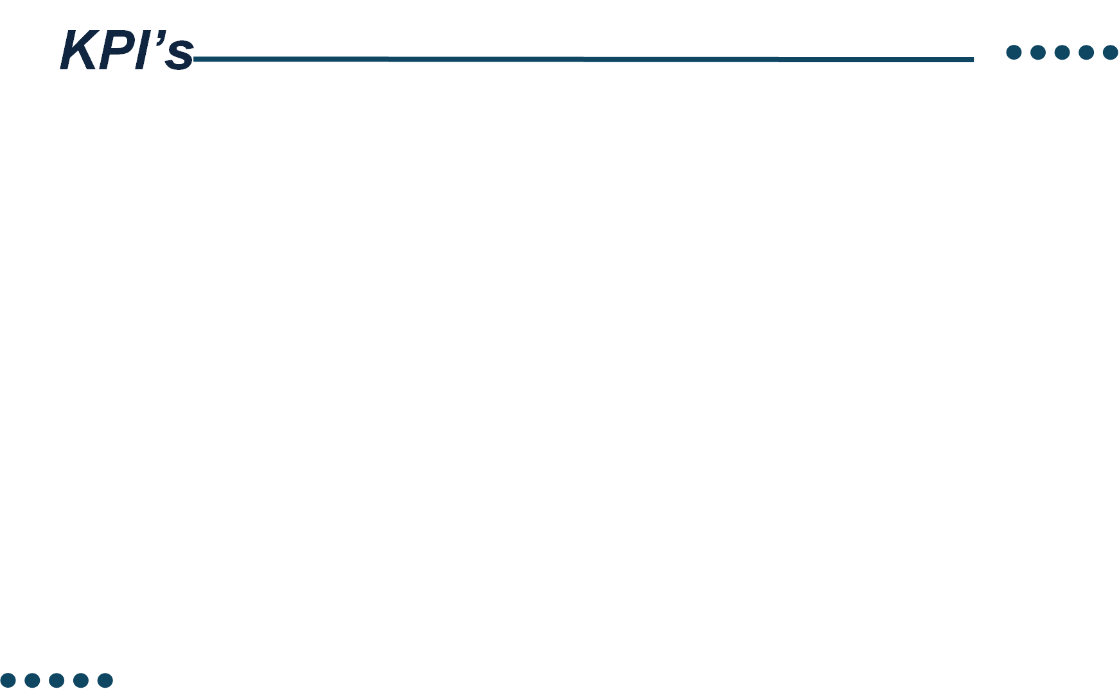
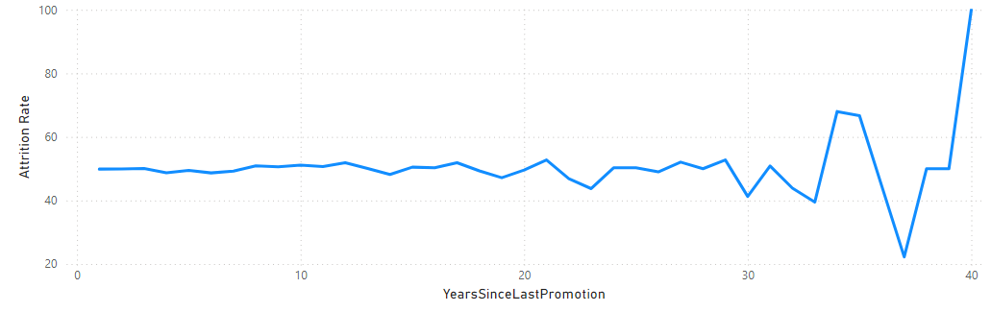
6)Attrition rate vs year since last promotion relation
This line graph plots attrition rate against the years since last promotion. It shows a relatively stable attrition rate initially, followed by notable spikes, especially after extended periods without a promotion (30+ years).
Employees who haven’t received a promotion in many years are far more likely to leave, with attrition peaking dramatically after 40 years since the last promotion.

Slide 11
Recommendations
Department-Specific Retention Strategies: Develop targeted retention programs for the Research and Development and Software departments to address the high attrition rates.
Competitive Compensation for Male Research Scientists: Review and adjust the compensation package for male research scientists to ensure fairness and equity, as their average hourly rate is lower than that of female research scientists.
Training and Development Programs: Provide training and development opportunities to employees in departments with lower average working years, such as Research and Development, to enhance their skills and job satisfaction.
Promotion and Growth Opportunities: Develop a clear promotion and growth framework to provide employees with opportunities for advancement and professional development, particularly for those who have not received a promotion in the last 5 years or more.

Slide 12
Recommendations
Work-Life Balance Initiatives: Launch initiatives to improve work-life balance for Sales executives, who report a poor work-life balance, and consider flexible work arrangements, employee wellness programs, or mental health support.
Income-Based Retention Strategies: Implement retention strategies for employees with monthly incomes below 10,000, as they have a higher attrition rate compared to those with higher incomes.

Slide 13
Conclusion
In conclusion, our analysis has identified key trends and insights that can inform strategic decisions to improve employee retention, job satisfaction, and overall well-being. The high attrition rates in the Research and Development and Software departments, as well as the disparities in compensation and work-life balance, highlight the need for targeted retention strategies and initiatives.
By implementing the recommended strategies, we can:- Reduce attrition rates in high-risk departments- Improve work-life balance and job satisfaction- Enhance diversity and inclusion- Provide opportunities for growth and development- Recognize and reward employees for their contributions
Our ultimate goal is to build a workplace culture that supports positivity, support, and growth, allowing us to attract and retain the best talent and drive business success.

Slide 14
Thank you

