Slide 1
Superstore Sales Analysis – Business Analyst Project
SQL + Excel Dashboard + Insights
Prepared by: Bhupendra shivhare

Slide 2
Business Problem & Objectives
Business Problem: The company wants to increase profitability and understand customer buying patterns across different regions, segments, and product categories.
Objectives:
1. Analyze sales, profit, and discount trends.
2. Identify top-performing regions, categories, and sub-categories.
3. Highlight underperforming states/cities with losses.
4. Compare shipping modes and segment contributions.
5. Provide data-driven recommendations to improve business decisions

Slide 3
Requirement Gathering
Stakeholders:
Sales Managers: want to track revenue & top products.
Marketing Team: need insights on discount impact & promotions.
Finance Team: focused on profit/loss trends.
Customers: benefit indirectly from improved pricing & service.
Deliverables:
Business Requirement Document (BRD): Increase profitability by analyzing sales patterns.
Functional Requirement Document (FRD): Create dashboards for region, category, discount, and shipping analysis.
User Story Example:
As a Sales Manager, I want to see top categories by profit so that I can plan promotions effectively.
Acceptance Criteria: Dashboard shows top 10 categories with filters for region.

Slide 4
Dataset Overview
Dataset Source:
Sample Superstore Dataset (Kaggle)
Size:
9000+ records
13 columns
Key Columns:
Order Details: Ship Mode, Segment, Region, Country, State, City, Postal Code
Product Info: Category, Sub-Category
Sales Metrics: Sales, Quantity, Discount, Profit

Slide 5
SQL Analysis Approach
Queries Performed:
Total Sales, Profit, Quantity (overall performance)
Top 10 Most Profitable Sub-Categories
Region-wise Sales & Profit
State with Highest Loss
Discount vs Profit Analysis
Segment-wise Revenue (Consumer, Corporate, Home Office)
Top 5 Cities by Revenue
Orders with Negative Profit
Sales vs Profit by Shipping Mode
Approach:
Wrote SQL queries to answer specific business questions.
Exported dataset & used Excel Dashboard (charts, visuals) to present results.
Combined SQL + Excel to generate insights for decision-making.

Slide 6
Dashboard Overview
Dashboards Created in Excel:
Sales & Profit by Region → Bar Chart
Top Sub-Categories by Profit → Bar Chart
Discount vs Profit Analysis → Scatter Plot
Segment-wise Contribution (Consumer, Corporate, Home Office) → Pie/Donut Chart
Purpose of Dashboard:
Simplify complex SQL results into visual insights.
Allow stakeholders to quickly understand sales, profit, discount, and category performance.

Slide 7
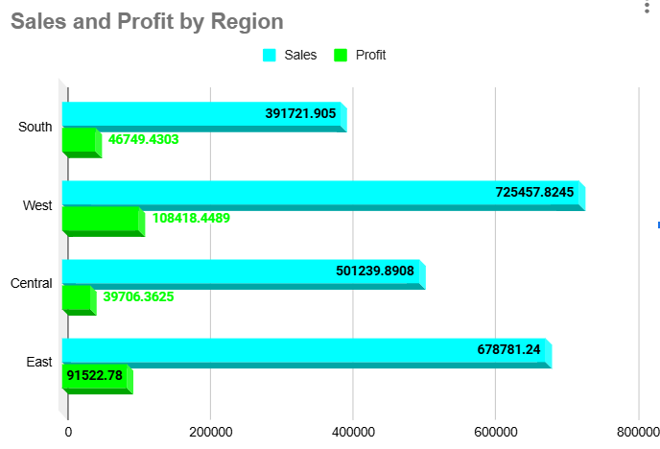
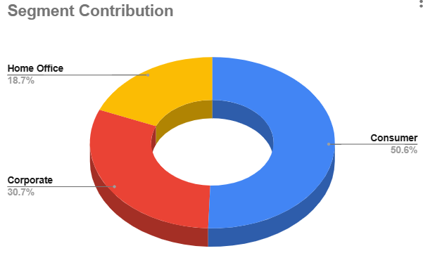
Charts

Slide 8
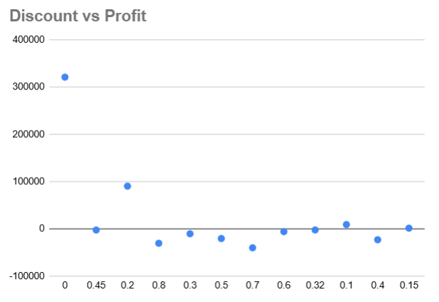
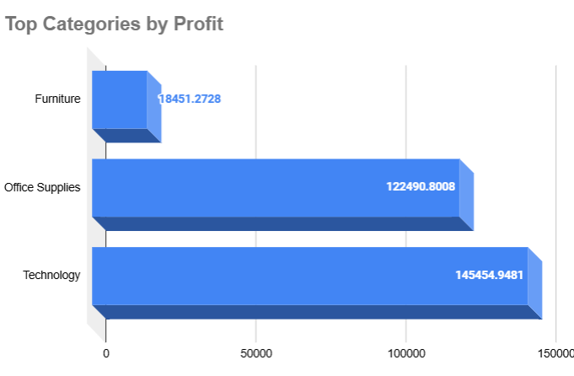
Charts

Slide 9
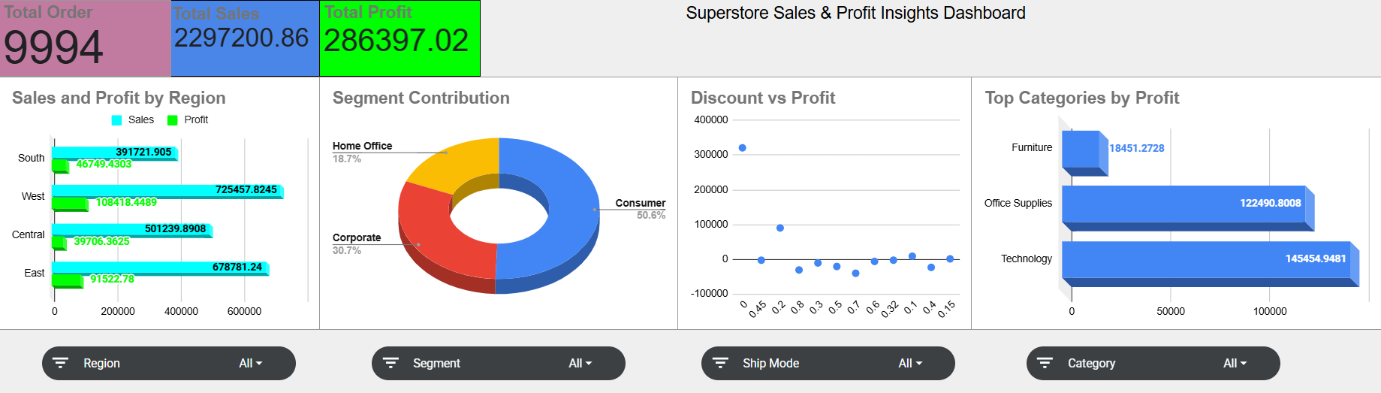
Dashboard

Slide 10
Key Insights
From SQL Queries + Excel Dashboard:
West Region is the strongest performer (725K profit), followed by East Region (~678K).
South Region (46K) performs slightly better in profit than Central Region (39K), but both lag far behind West & East.
Consumer Segment dominates revenue (50.6% share), with Corporate (30.7%) and Home Office (18.7%) behind.
Technology is the most profitable category (~145K), while Furniture contributes very little (~18K).
High discounts (>40%) lead to negative profit, whereas low–moderate discounts (0–20%) are profitable.

Slide 11
Recommendations
Focus on West & East Regions to maintain and expand profitability; replicate successful strategies in South & Central.
Promote Technology & Office Supplies (high profit) while reviewing or repositioning Furniture due to low returns.
Revise discounting strategy → Limit discounts >40% as they cause losses; encourage small to moderate discounts (0–20%).
Leverage Consumer Segment (50%+ share) with loyalty programs, while designing targeted offers for Corporate & Home Office to boost their share.
Optimize shipping modes by balancing Standard Class (high sales) with more profitable alternatives.

Slide 12
BA Deliverables
Documents Prepared
Business Requirement Document (BRD): High-level goal → improve profitability through sales & discount analysis.
Functional Requirement Document (FRD): Detailed KPIs → region-wise profit, discount vs profit, category performance, shipping analysis.
User Stories
As a Sales Manager, I want to see the top 10 profitable sub-categories so that I can plan promotions effectively.
As a Marketing Analyst, I want to compare discounts vs profit so that I can design profitable campaigns.
As a Finance Manager, I want to track states with negative profit so that I can recommend corrective actions.
Acceptance Criteria Example
Dashboard must display Top 10 Sub-Categories by Profit with filters for Region and Segment.

Slide 13
Conclusion
The analysis of ~10,000 Superstore orders revealed clear profit patterns across regions, segments, and categories.
West & East Regions drive most of the profit, while Central & South underperform.
Technology & Office Supplies are profitable, whereas Furniture contributes minimal profit.
Discounts above 40% consistently reduce profitability, requiring an immediate strategy revision.
Final Recommendation: Leverage strengths (Technology, West/East regions, Consumer segment), while optimizing discounts, shipping, and underperforming categories.
Next Steps: Perform predictive analysis (sales forecasting, what-if discount scenarios) for long-term decision-making.

Slide 14
Thank You

