Slide 1

Acropolis Institute of Technology & Research, Indore
www.acropolis.in

Slide 2
Auto Valuator : Car Price Prediction Model.
Submitted to: Department of Computer Science and Engineering

Slide 3

Team Members 1. PRANAY JAIN (Leader)
2. RAHUL SHARMA PRIYANSHI GOYAL RACHIT SHIVHARE
Supervised by:
Prof. KRUPI SARAF
3.
4.

Slide 4
Project Presentation Outline
Introduction
Problem Statement
Survey of Existing Systems
Project Objectives
Requirement Analysis
System architecture
System Designs/UML Diagrams
Solution Proposed
The Outcome Discussion
Conclusions and Limitations

Slide 5
Introduction
Auto Valuator is a smart and user-friendly website that predicts the price of a car.
It uses car details like brand, model, year, fuel type, and kilometers driven to estimate the value
Many people are confused about the correct price when buying or selling a car—this tool solves that problem.
It uses machine learning to quickly give an accurate price estimate in just a few seconds.
The goal is to make car buying and selling easier, faster, and more trustworthy for everyone.

Slide 6
The Problem Statement
The Problem:
Used car price estimation lacks standardization, leading to wide variation and subjectivity.
Buyers fear overpaying and sellers fear underselling, causing trust issues and market inefficiency.
The Solution:
Predict car resale value using machine learning.
Help users make smart and fair pricing decisions.
Reduce time, confusion, and negotiation in deals.

Slide 7
Scope of the Project
The AutoValuator project focuses on predicting the prices of used cars based on specific input features like brand, year, fuel type, transmission, kilometres driven, and more. It is designed for users including individual buyers, sellers, and car dealers who want accurate price estimations.
The scope includes:
Collecting and preprocessing a relevant car dataset.
Training a machine learning model to predict car prices.
Evaluating the model for accuracy and reliability.
Deploying the model through a simple user interface.

Slide 8
Objectives
Predict the resale value of a car using machine learning.
Help users make data-driven pricing decisions.
Ensure fair and accurate pricing for both buyers and sellers.
Reduce time spent on price negotiations.
Improve transparency in the car buying and selling process.
Provide a user-friendly interface for easy input and results.
Support better decision-making for car dealerships and individuals.
Reduce human error in price estimation.
Adapt pricing based on real-time data trends (if implemented).
Promote digital transformation in the used car market.
:

Slide 9
Requirement Analysis
Functional Specifications:
Data Collection and Preprocessing
Model Development
Frontend Interface
Backend Integration

Slide 10
Non-Functional Specifications: 1. Performance 2. Scalability 3. Usability 4. Security 5. Accuracy
Requirement Analysis

Slide 11




System Architecture
The system architecture of this project is made up of three main parts that work together to make the platform run smoothly:
Frontend (User Interface):- HTML ,CSS ,JAVASCRIPT ,REACTJS

Slide 12


System Architecture
2. Backend (Processing Engine): Python
3. Machine Learning Algorithms:

Slide 13
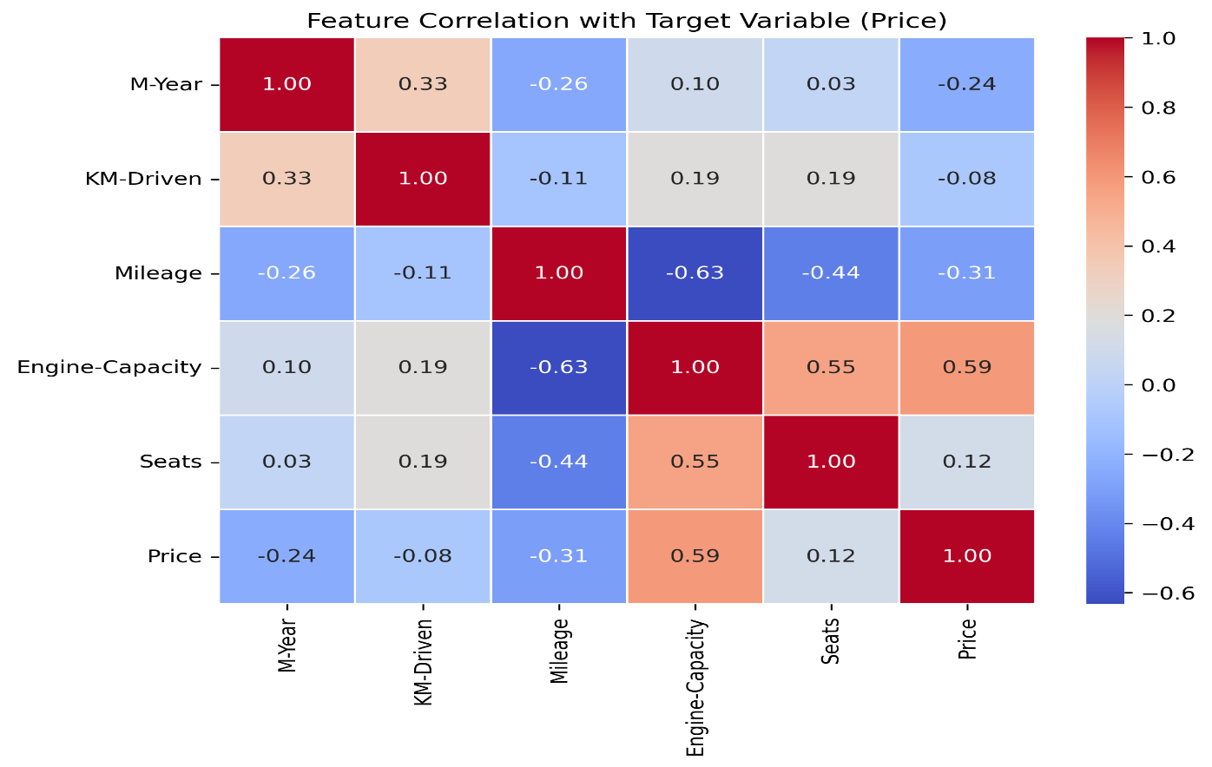
Feature Selection

Slide 14
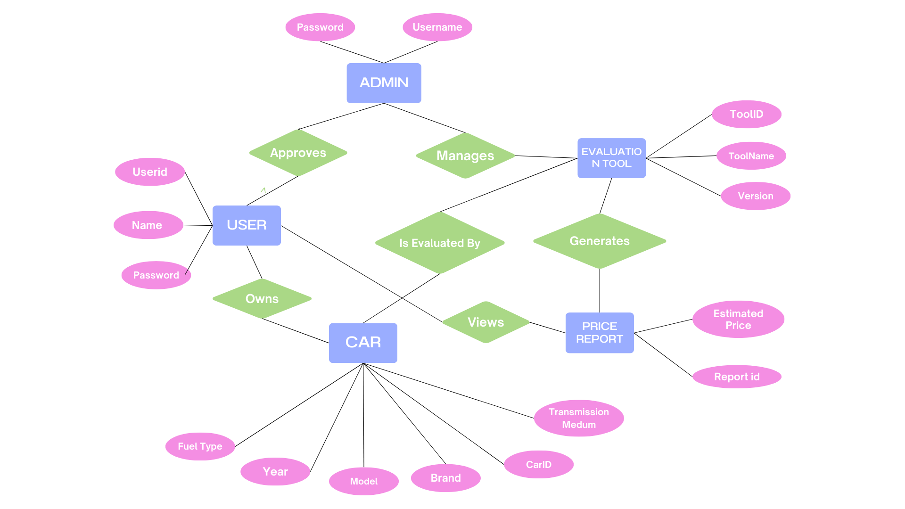
System Designs/UML Diagrams
Entity Relationship Diagram

Slide 15
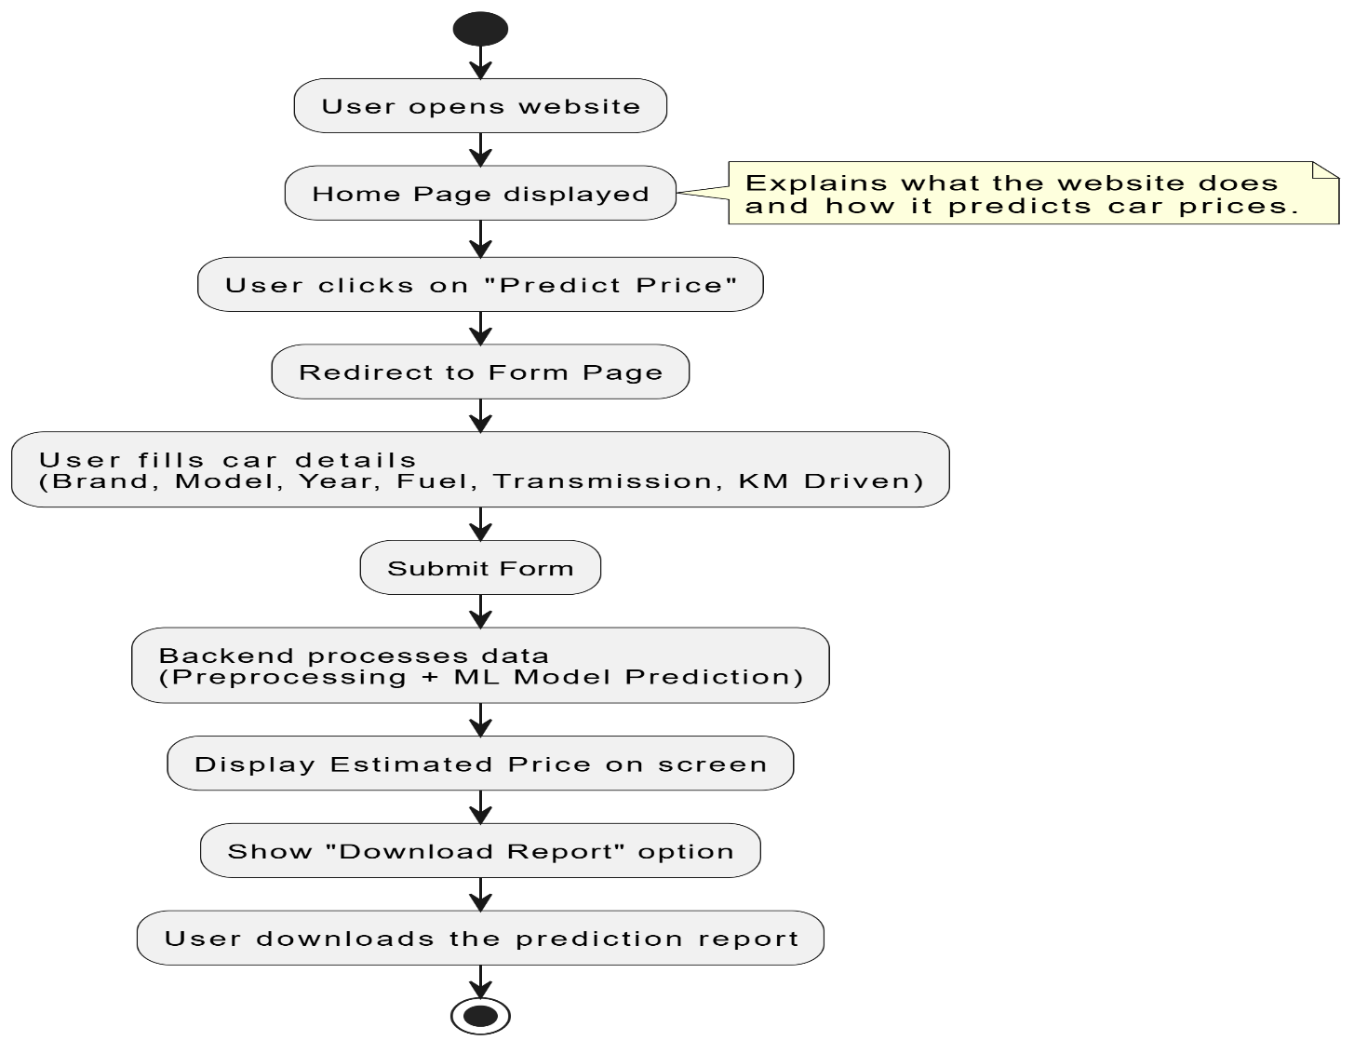
System Designs/UML Diagrams
Flow Chart

Slide 16
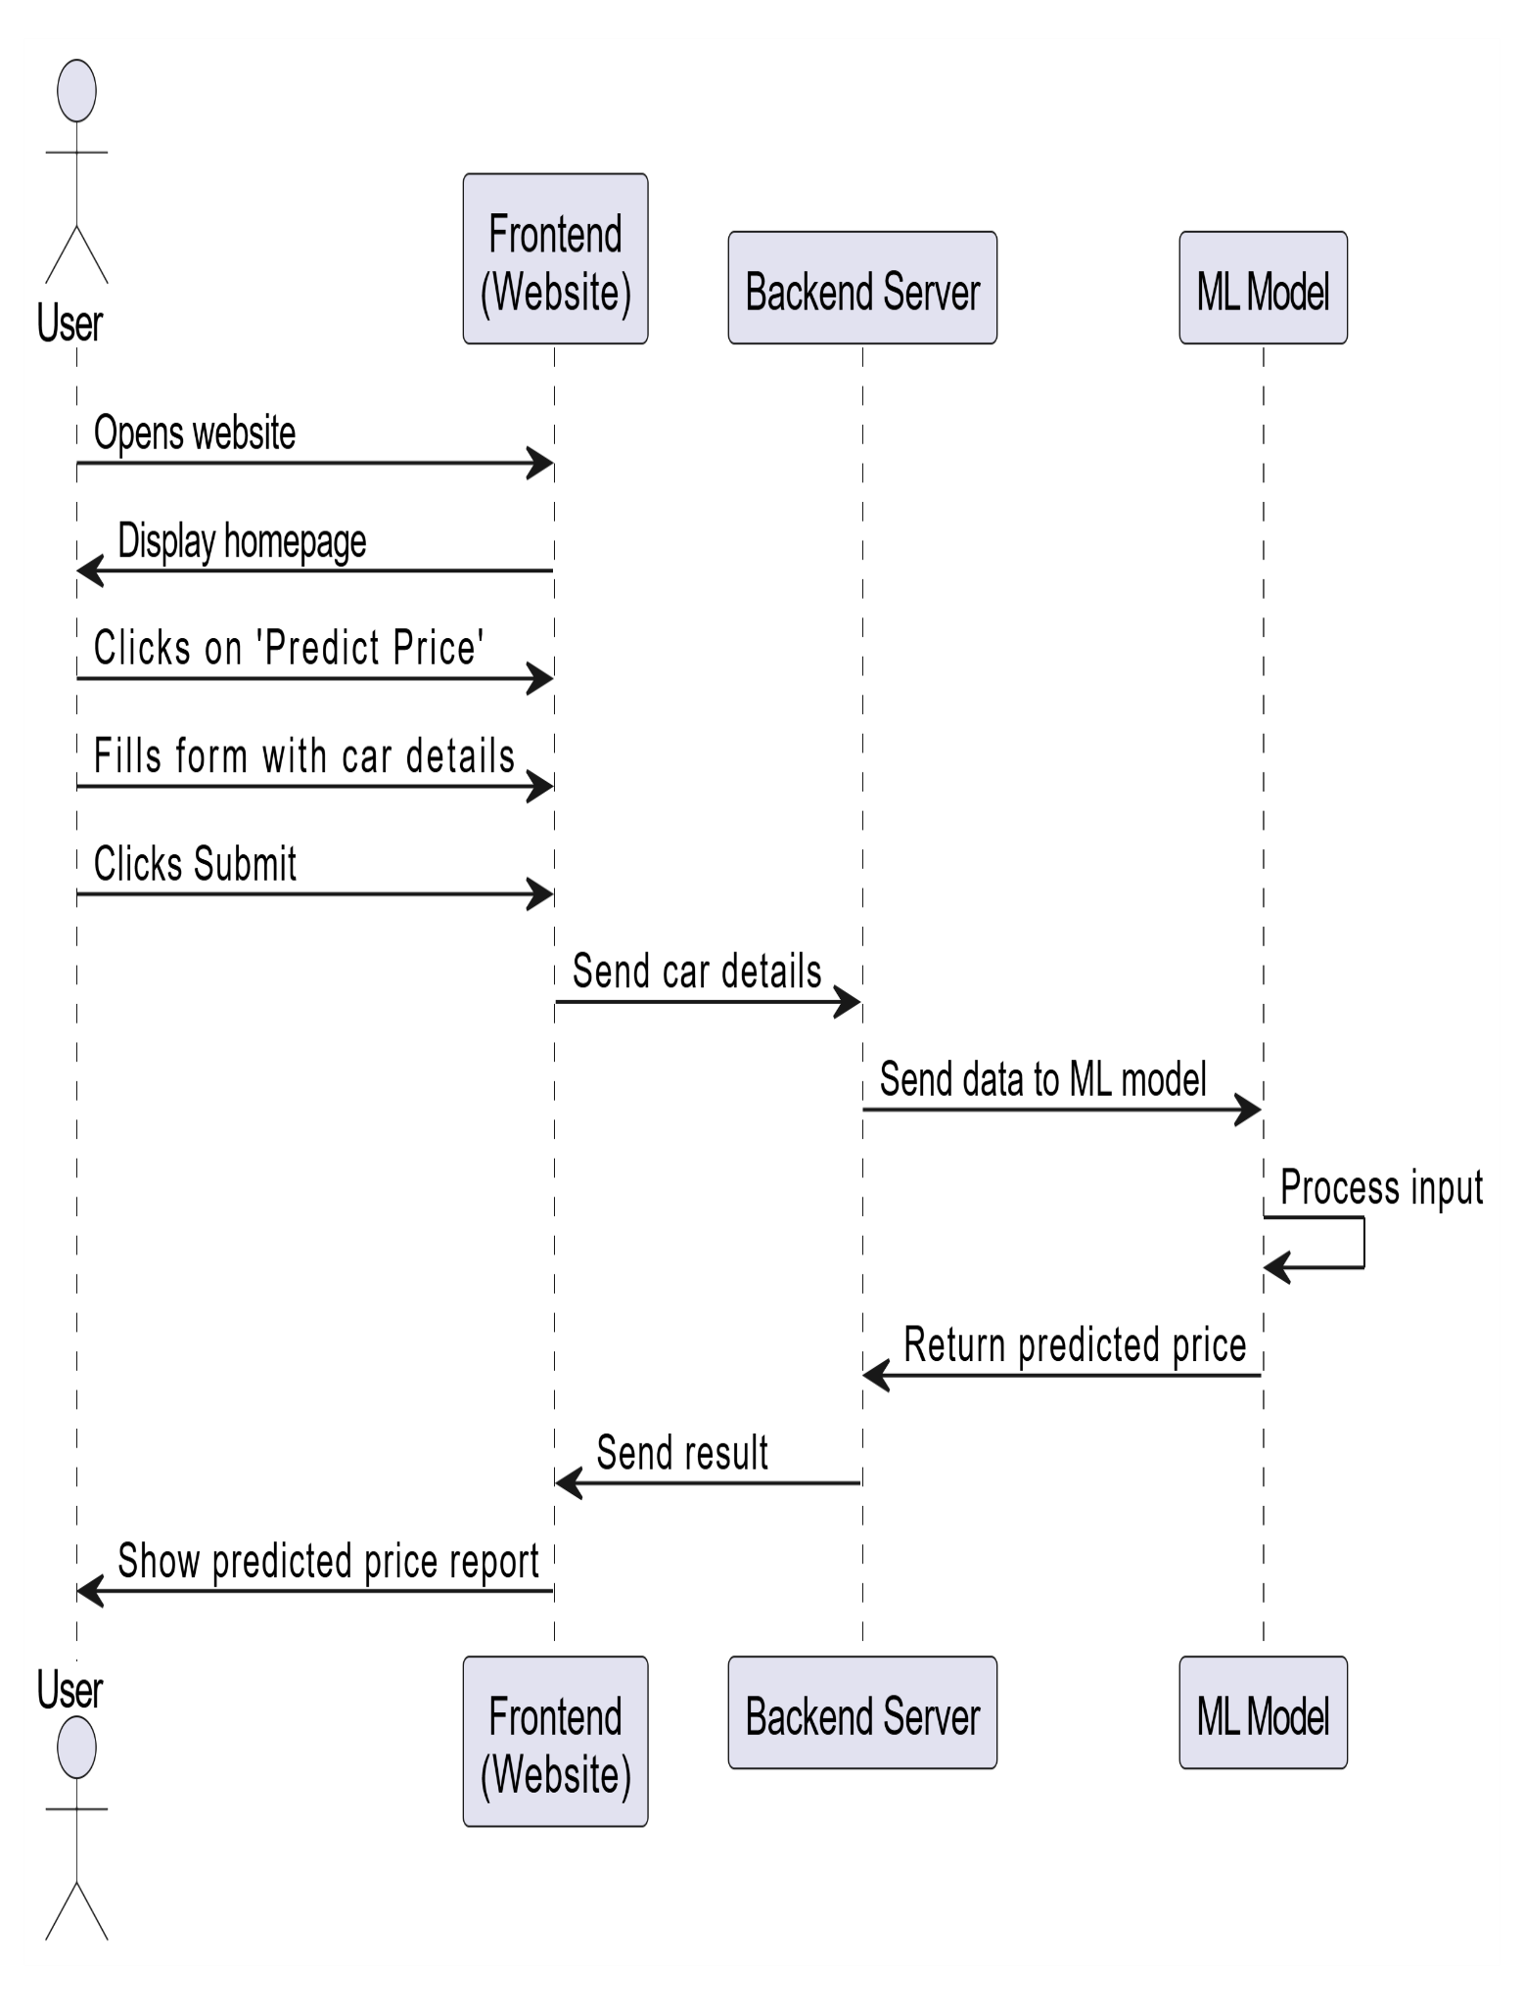
System Designs/UML Diagrams
Sequence Diagram

Slide 17
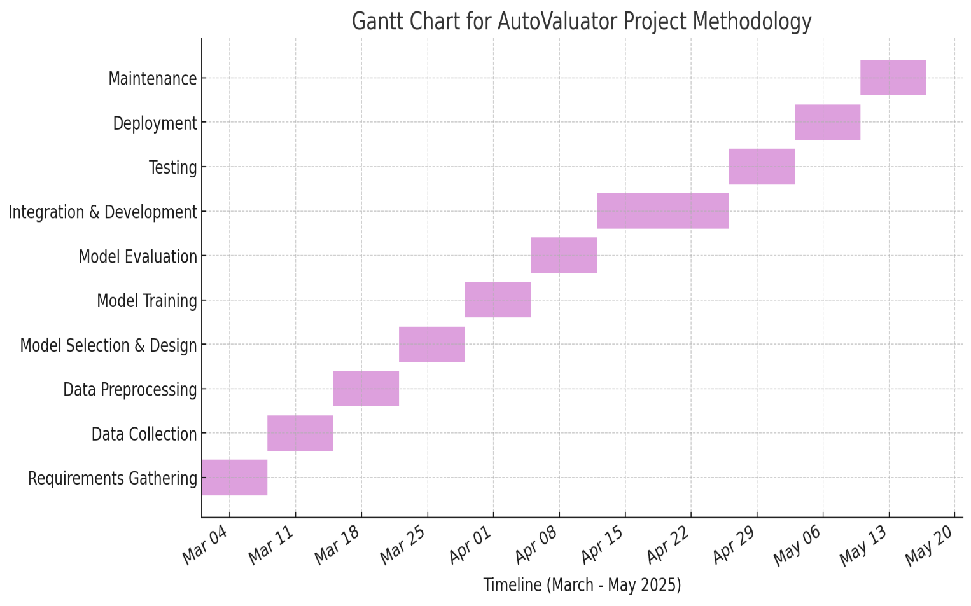
Solution Proposed
AutoValutoer is a web tool that predicts car resale value using machine learning. It ensures fast, fair, and accurate price estimation for users:
Introduction :- A smart web-based tool designed to predict car resale prices using machine learning
Key Features :- Predicts car price using brand, year, fuel type, transmission, etc.
Login to Get Started :- Users can log in securely to access the to
Access Your Dashboard :- Central hub to manage all tools.
Input Car Details:Users fill car info to get the resale value.
Efficiency at Your Fingertips :- Fast and reliable results using ML.

Slide 18
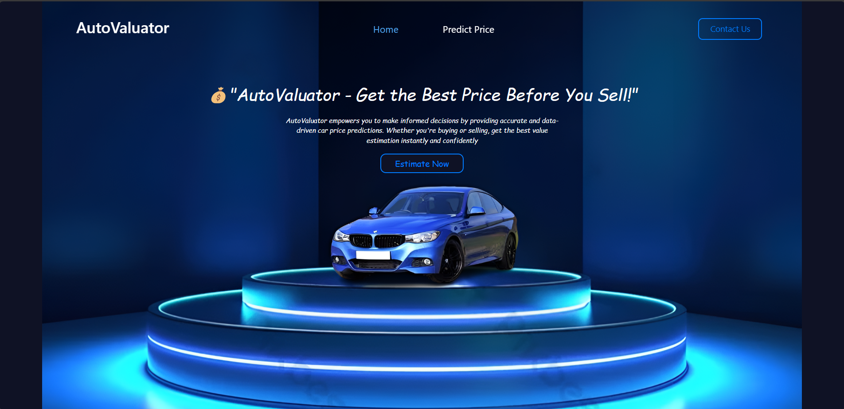
Solution Proposed

Slide 19
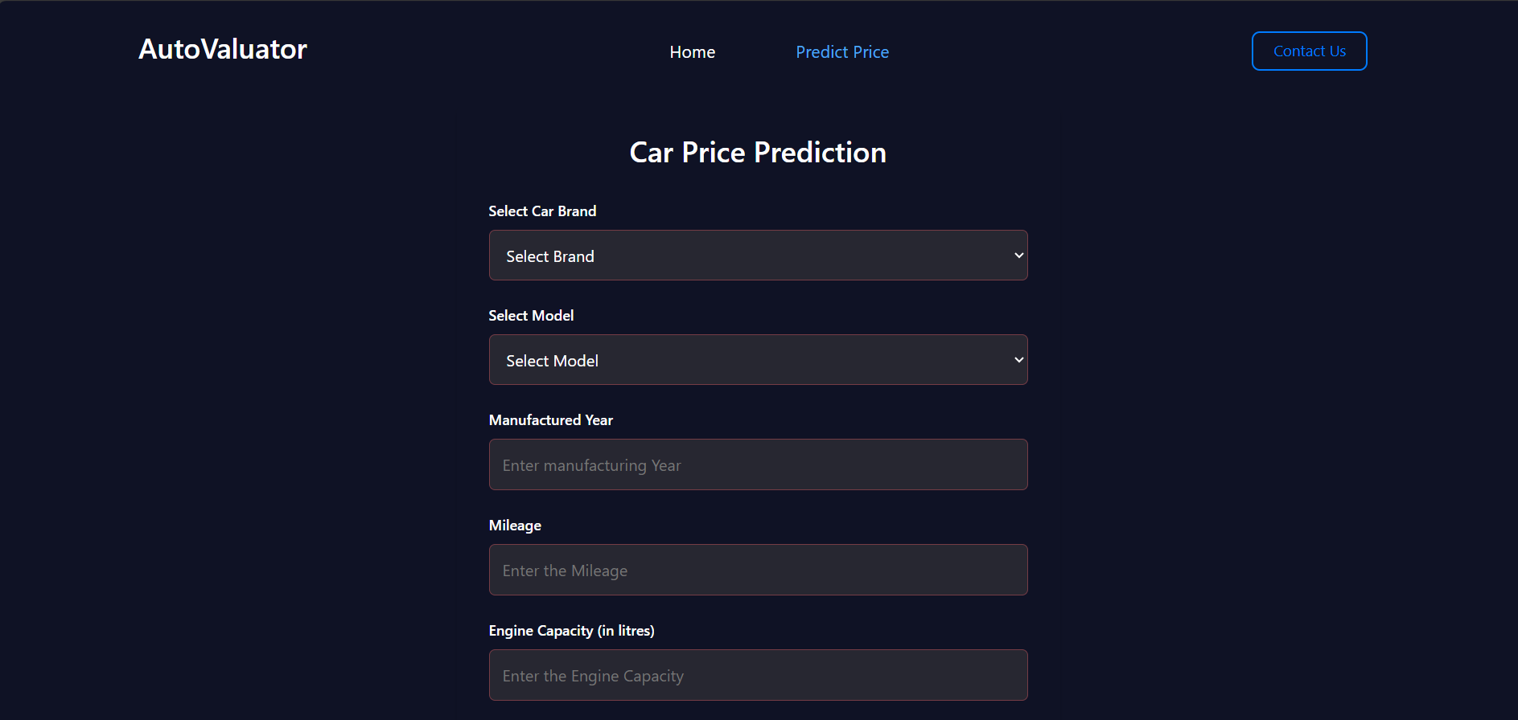
Solution Proposed

Slide 20
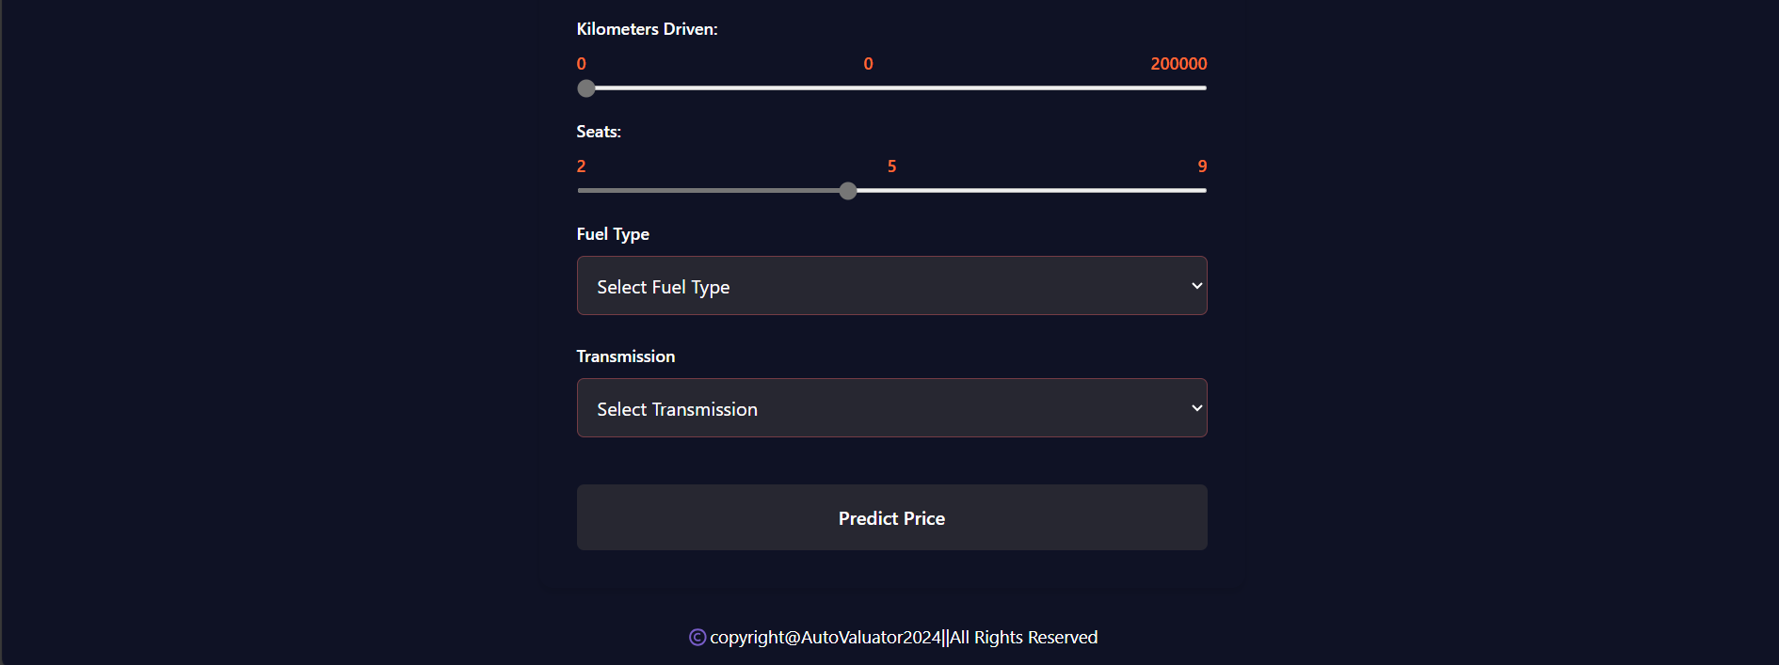
Solution Proposed

Slide 21
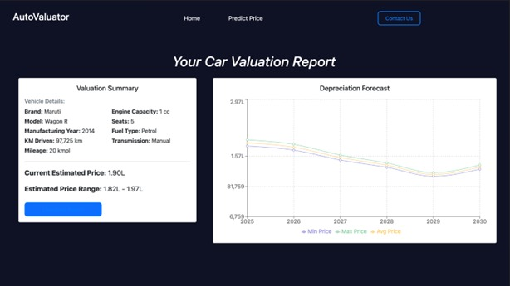
Solution Proposed

Slide 22
The Outcome Discussion
Unified Platform
Hassle-Free Experience
Workflow Efficiency
User-Friendly Design
Cost Reduction
Empowering Users
Valuable Resource

Slide 23
Testing
Testing Approach :-
To ensure that the AutoValuator platform performs accurately and smoothly for users, we’ll follow a structured testing approach. Here's the plan.
Unit Testing.
Integration Testing
User Testing
Performance Testing
Security Testing
Bug Fixing and Retesting

Slide 24
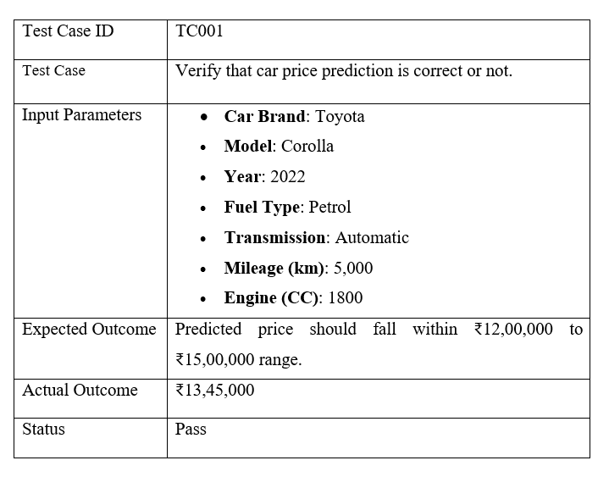
Testing
Test Case 1: Toyoto Car Price Prediction:
.

Slide 25
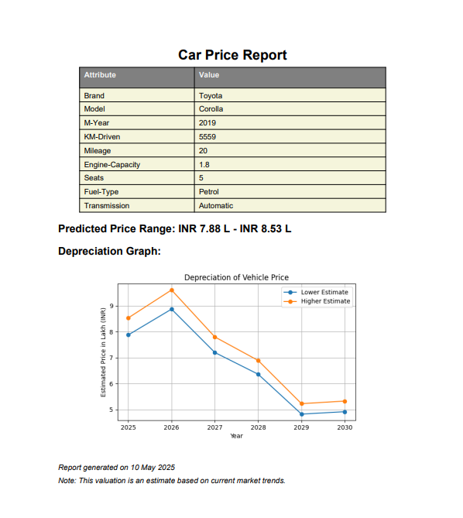
Testing
Test Case Output 1: Toyoto Car Price Prediction

Slide 26
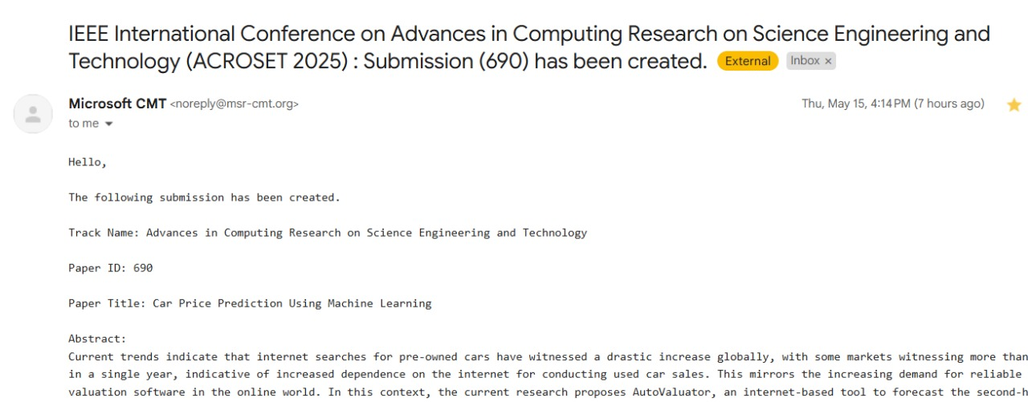
Research Paper
We have published our research paper on this website
https:/………?

Slide 27
Conclusion
Limited Dataset.
Omission of Certain Factors.
Incorporating More Features.
User-Friendly Design.
Easy Navigation.
Advanced Machine Learning Models.
Real-Time Price Prediction.
Improved Quality of Work.

Slide 28
Q&A

Slide 29
THANKS

